Slide 1
Understanding systems: Is it important for energy reasoning?
Eugenia Etkina, Lane Seeley and Stamatis Vokos
Rutgers University, Seattle Pacific University, and CalPoly University
APS Denver 2019

Slide 2
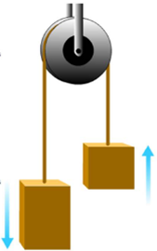
Ms. Santucci’s class is discussing the energy associated with an Atwood’s machine which consists of two blocks connected by a string that runs over a smooth, lightweight pulley as shown in figure 1. The students are discussing the energy related to the larger block as it moves downward and speeds up. Taylor says: “I was thinking about the work done on the larger block. I think both gravity and the string could be doing work on that block, but doesn’t the work by gravity come from the gravitational energy of the block and the Earth?”

Slide 3
What does the teacher need to know if order to help?

Slide 4
Content Knowledge for Teaching…
… is a set of knowledge that teachers have that enable them to carry out everyday tasks of teaching in the classroom with the goal of helping their students learn.
Ball, Thames, and Phelps (2008)

Slide 5
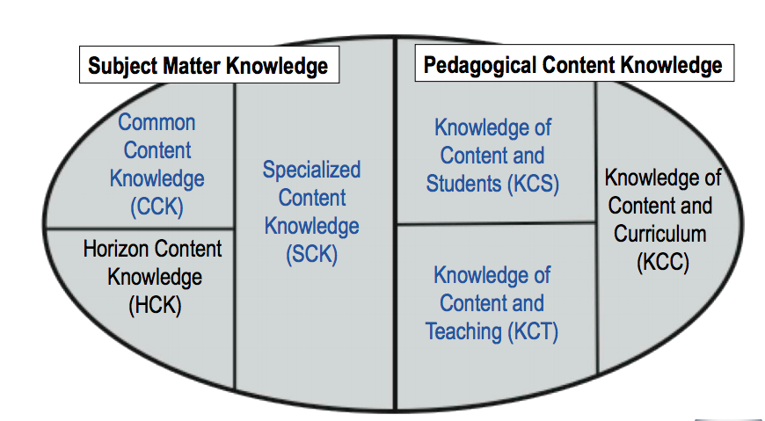
Model of content knowledge for teaching a specific subject
Ball, Thames, and Phelps (2008)
Notes:
Common content knowledge: Energy is a conserved quantity, can be constant in an isolated system but change in an non-isolated system, however we can always find a system in which energy is constant, Horizon content knowledge – energy conservation is the consequence of the homogeneity of time; special content knowledge: when it is useful to choose a system in which energy is constant and when it is useful to choose a system on which the environment does work; knowledge of students: for the students it is difficult to choose a system and be consistent with it (double counting), to decide on initial and final states and realize that mechanical energy is converted to internal and the latter is imperceptible; knowledge of content and teaching: there are ways of experimentally detecting and measuring conversion of mechanical energy to internal; energy bar charts are an effective tool to help students write mathematical models of energy conservation; Knowledge of content and curriculum: system is a cross cutting concept in the NGSS, a consistent approach to energy should be used in all physics topics

Slide 6
CKT energy – examples of 5 elements
Common content knowledge: Energy is a conserved quantity,
always constant in an isolated system but can change in
an non-isolated system, however we can always find a system in which total energy is
constant
Horizon content knowledge: The role of friction in rolling – static friction force makes an object roll; so we cannot disregard it but it is not the for reason for slowing down of a rolling object, it is conversion of kinetic energy into internal energy;
Special content knowledge: when it is useful to choose a system in which energy is constant and when it is useful to choose a system on which the environment does work;
Knowledge of students: for the students it is difficult to choose a system and be consistent with it (double counting), to decide on initial and final states and realize that mechanical energy is converted to internal and the latter is imperceptible;
Knowledge of content and teaching: there are ways of experimentally detecting and measuring conversion of mechanical energy to internal; energy bar charts are an effective tool to help students write mathematical models of energy conservation;
Knowledge of content and curriculum: system is a cross cutting concept in the NGSS, a consistent approach to energy should be used in all physics topics.

Slide 7
Theoretical framework for studying Content Knowledge for Teaching in the domain of energy (CKT-E)
Horizon knowledge
Tasks of Teaching
CKT-E
Student Energy targets
Etkina, Phelps, Iconageloa, Seeley, Vokos, and Gitomer, 2018

Slide 8
Tasks of Teaching (ToTs)
Anticipating student thinking around science ideas;
Designing, selecting, and sequencing learning experiences and activities;
Monitoring, interpreting, and acting on student thinking;
Scaffolding meaningful engagement in a science learning community;
Explaining and using examples, models, representations, and arguments to support students’ scientific understanding; and
Using experiments to construct, test, and apply concepts.

Slide 9
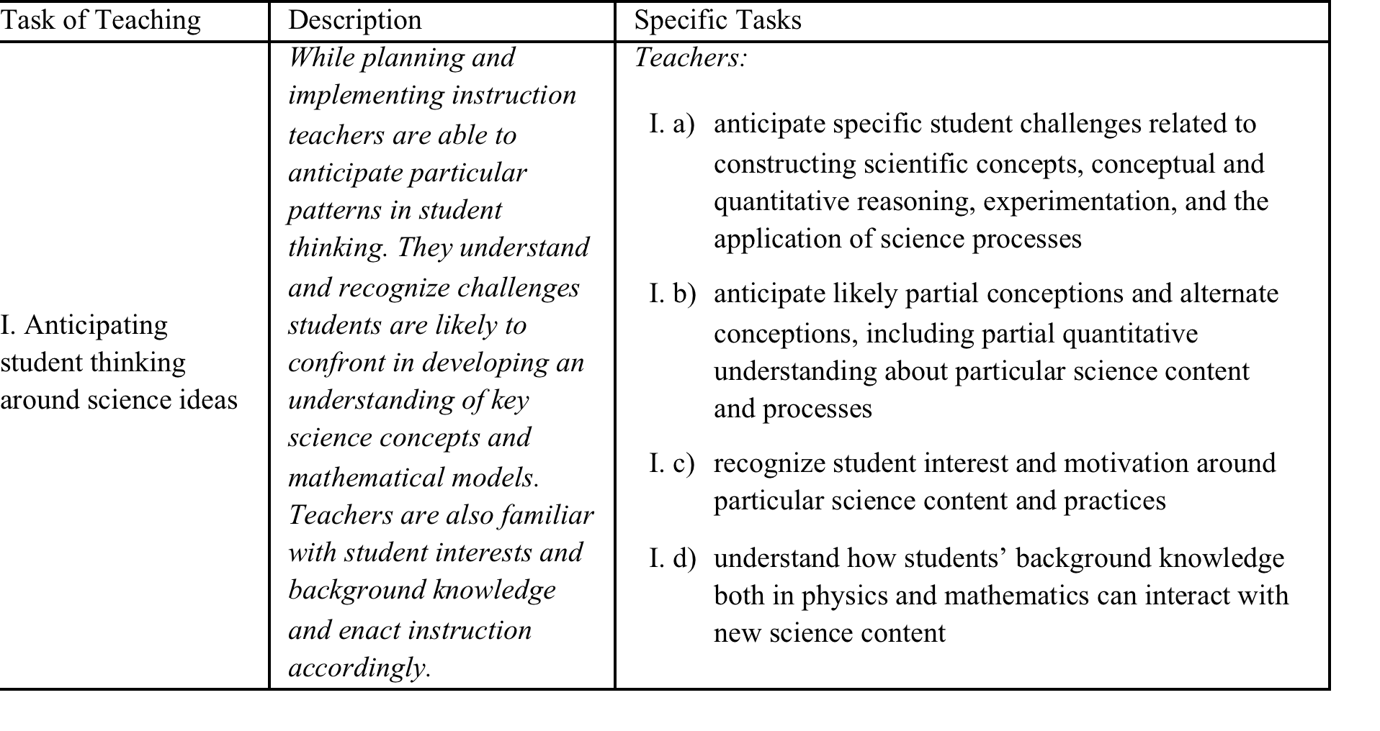
I. Anticipating student thinking around science ideas

Slide 10

Student learning energy targets (ETs)
connection of energy to everyday experiences;
choice of system;
C) identification of and differentiation between energy and other physics concepts;
D) transfer of energy;
E) use of mathematics;
F) use of representations; and
G) use of other science practices.

Slide 11
B. Choice of system
The student:
1) recognizes that the energy accounting in a phenomenon depends on the choice of system
2) explains the relative advantage of a given system choice (i.e., relative ease of analysis)
3) recognizes that the choice of system determines whether springs or Earth do work (i.e., if the spring or Earth are in the system they do not do any work on the system, but the system can possess elastic or gravitational potential energy)
4) identifies and differentiates between forms of energy and other physics concepts
Notes:
Despite our language, a single object does not posses GPE – a system does;
Imagine an motor and a cable elevator lifting an elevator cabin – do we include the motor in the system or let is do work? You are pulling and object across a floor at constant speed

Slide 12
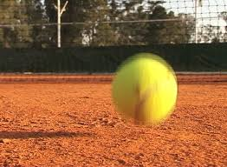
Conserved or constant?
I want to stop here and discuss our language:
Conserved vs constant

Slide 13
B. Choice of system
The student:
1) recognizes that the energy accounting in a phenomenon depends on the choice of system
2) explains the relative advantage of a given system choice (i.e., relative ease of analysis)
3) recognizes that the choice of system determines whether springs or Earth do work (i.e., if the spring or Earth are in the system they do not do any work on the system, but the system can possess elastic or gravitational potential energy)
4) identifies and differentiates between forms of energy and other physics concepts
Notes:
Despite our language, a single object does not posses GPE – a system does;
Imagine an motor and a cable elevator lifting an elevator cabin – do we include the motor in the system or let is do work? You are pulling and object across a floor at constant speed

Slide 14
Development of the CKT-E Assessment
Initial Item Development
Energy Learning Targets
Pilot Study
N = 220 high school physics teachers
Field Test
N = 362
Tasks of Teaching
Web-based administration system
Included both Selected and Constructed Response Items
Reviewed by Teacher Experts
50 distinct questions
Pilot study items were refined and/or removed based on statistical analysis and
constructed response answers
And then we gave the test to 200 senior physics majors
Notes:
Static CKT-E adopts the theoretical perspective of knowledge as a possession of the teacher
Enacted CKT-E adopts the theoretical perspective of knowledge as manifested through a teacher’s words, actions and decisions.
We believe that these are complimentary perspectives which are both useful.

Slide 15
Trampoline item
In a situation with a number of interacting objects, one can select any subset of them as the system of interest. The objects that have not been selected as a part of the system are therefore external to the system.
A bowling ball is dropped from a height of 1 m above a small trampoline. It lands and stretches the trampoline downward. Describe the energy changes in this process from the time the ball is dropped to the time it reaches the lowest point in its motion.
For each of the student responses select the system for which the response is correct.

Slide 16
Student response | Ball and Earth | Ball and Trampoline | Ball, Earth and Trampoline | None of these systems is consistent with the response
First there is GPE. Then Earth does work and the ball gains KE. The trampoline does negative work on it and we have elastic energy. |  |  |  | PT 30% PM 13%
The GPE is converted gradually to KE as the ball falls and ends up as elastic energy. |  |  | PT 60% PM 39%
First there is GPE. Some of this energy is converted to KE as the ball falls until all GPE becomes KE. Finally the trampoline does negative work and there is no more ME. | PT 42% PM 23%
There is no ME at the beginning and then Earth does positive work on it and the ball gains KE. Then the trampoline does negative work on it and KE decreases to zero. |  |  |  | PT 52% PM 31%
There is no ME at the beginning, then Earth does positive work on the ball and it gains KE. Finally all KE goes to elastic energy. |  | PT 41% PM 22%

Slide 17
Trampoline is difficult
On average, teachers scored better than physics majors on our CKT-E assessment as a whole. But the difference was especially pronounced on this item.
The percentage of teachers answering each question correctly was higher than the percentage among physics majors by an average margin of 20%.

Slide 18
We found that both teachers and physics majors have real difficulties with systems. We decided to investigate why.

Slide 19



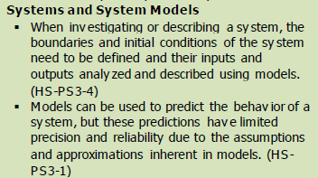
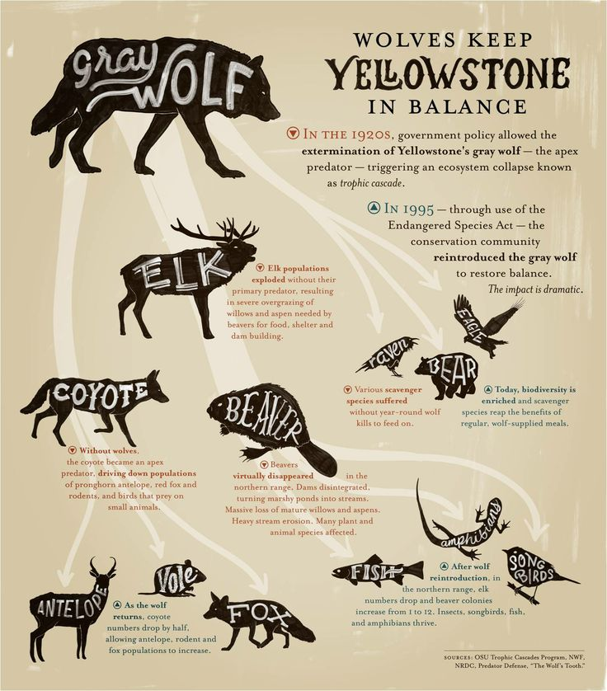

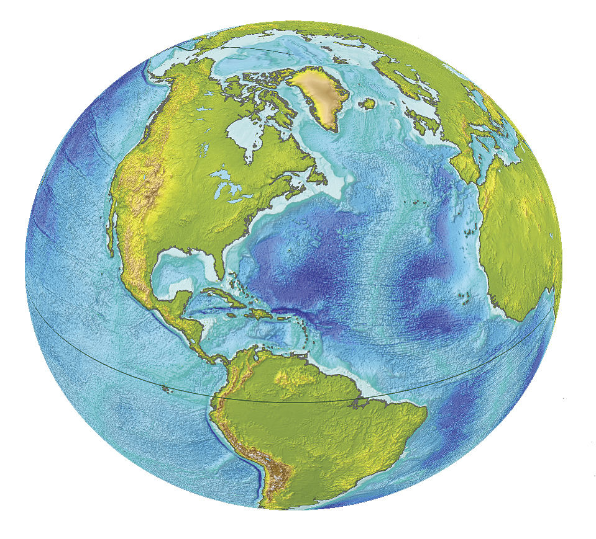
What is a “system”?
5th Grade Earth Systems
High School Energy
System - A group of related natural objects or forces within a defined zone, a regularly interacting or interdependent group of items forming a unified whole.
(www.biology-online.org/dictionary/System)
We will often consider a particular system, by which we mean a particular object or set of objects; everything else in the universe is called the “environment.”
Giancoli, Physics for Scientists and Engineers, 3rd Edition, pg 445.
Notes:
One broad sub-category of our CKT-E items which were particularly challenging for teachers was understanding of systems reasoning. This may, in part, result from two distinctly different approaches to systems reasoning in biology and physics.

Slide 20
Systems
Physics Textbooks
“The law of conservation of energy states that in a closed, isolated system, energy can neither be created or destroyed; rather, energy is conserved. Under these conditions, energy can change form but the system’s total energy in all of its forms remains constant.”
“A closed system of interacting particles has another remarkable property. Each system is characterized by a certain number, and no matter how complex the interactions, the value of this number never changes. This number is called the energy of the system, and the fact that it never changes is called the law of conservation of energy. It is, perhaps, the single most important physical law ever discovered.”

Slide 21
How does this confusion affect teachers and students?

Slide 22
Two types of items
Assessing teachers’ knowledge of energy (common CK and horizon)
Disciplinary CKT-E(D)
Assessing teachers’ knowledge of student learning (specialized CK and PCK)
Pedagogical CKT-E(P)

Slide 23
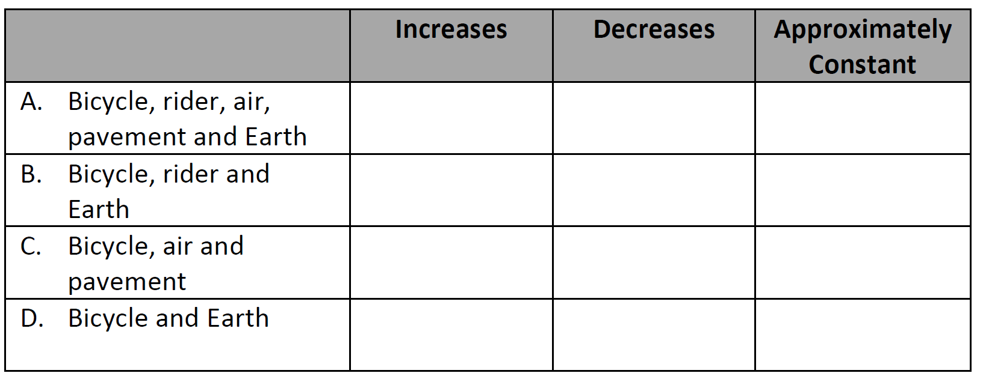


Measuring CKT-D of Systems
In a situation with a number of interacting objects, one may select any subset of them as the system of interest. The objects that have not been selected as belonging to the chosen system are therefore external to the system.
Ms. Inez wants to help her students recognize that energy is a conserved quantity but that the energy of a particular system may not be constant, depending on the specific scenario and the choice of system for analysis. She decides to have them focus on the scenario of a cyclist riding up a hill at constant speed.
For each of the following systems indicate whether the energy associated with that system increases, decreases, or remains approximately constant.
Notes:
As a result of teacher comments on our pilot assessment we added a brief explanation of physics systems reasoning on each of the systems related questions for our field test. This is an example of an item which challenges a teacher to adopt a physics approach to systems reasoning.

Slide 24
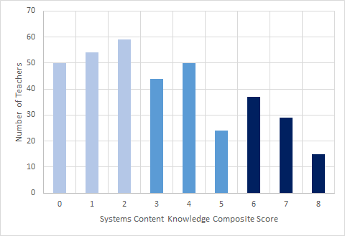
Teacher’s CKT-D of Systems
Composite score based on several CKT-D systems items
In general these CKT-D items assessing knowledge of energy reasoning for systems were challenging for teachers.
Low Systems CKT-D
N = 163
High Systems CKT-D
N = 81
Notes:
For example, on the uphill cycling item teachers were awarded 0, 1 or 2 points depending on whether they got 3 or 4 correct answers out of 4.

Slide 25
Measuring CKT-P of Systems Attending productively to learner systems reasoning
A student, Taylor, shares the following idea,
“I was thinking about the work done on the larger block. I think both gravity and the string could be doing work on that block but doesn’t the work by gravity come from the gravitational energy of the block and the Earth?”
What specific inconsistency does Taylor need to resolve in her analysis in order to make progress?
What question would you ask Taylor to help her resolve this inconsistency?
How might that question help her resolve this inconsistency

Slide 26
Rubric to score responses (90% IRR)
Teacher correctly identifies the inconsistency in Taylor’s analysis – 1 point
Teacher poses a question that can be answered and would likely lead to increased understanding – 1 point
Teacher explains how their question could lead to a facet of understanding that would be helpful for Taylor – 1 point

Slide 27

Attending Productively to Learner Systems Reasoning
A student, Taylor, shares the following idea,
“I was thinking about the work done on the larger block. I think both gravity and the string could be doing work on that block but doesn’t the work by gravity come from the gravitational energy of the block and the Earth?”
What specific inconsistency does Taylor need to resolve in her analysis in order to make progress?
What question would you ask Taylor to help her resolve this inconsistency?
How might that question help her resolve this inconsistency
“Taylor needs to understand that work is only done by external forces. I would ask Taylor to reiterate what makes up the system. If she answers that it is the larger block and the earth, I would ask her to remember what kinds of forces are necessary to do work on the system. If she answers that the system is only the large block, then I'd ask her how any gravitational energy could be stored in a system not including the earth.”
“a. Taylor's inconsistency is that she is not thinking of work as a force multiplied by a distance. The work done by gravity comes from the force of gravity (the weight) acting on the box, not on the "gravitational energy" of the block and the Earth. b. I would ask Taylor to define work and describe how it can be calculated. c. If she is able to see that work is the product of a force and a displacement, she would be able to understand that both gravity and the string are doing work, but acting in opposite directions.”

Slide 28
Contingency of Systems CKT-P on Systems CKT-D
Teachers with low systems CKT-D were very unlikely to respond productively to this pedagogical challenge.

Slide 29
Explanations of the result
2. Systems subject-matter knowledge is a separate aspect of energy knowledge and teachers who know a great deal about energy, but lack an understanding of systems, cannot respond productively to student difficulties of this sort.
1. Teachers who responded correctly to the Atwood’s, CKT-P, CR item just know physics better in general and thus do better on systems-based items.

Slide 30
Testing of the hypotheses
To test these two possible explanations, we selected a subgroup of teachers (N = 95) based on high scores on non-systems-related items.
The selection criteria for these teachers were entirely independent of their performance on the items assessing systems content knowledge. We identify them as non-systems items, high-performing teachers.
These teachers represented a more select group than the group of teachers scoring a 4 or 5 on the Trampoline item. The number of teachers in this group was somewhat smaller and they had a higher average CKT-D score.

Slide 31
Predictions
If the second explanation were correct, then the performance of non-systems items high-performing teachers should have been significantly lower.
If the first explanation were correct, then non-systems high performing teachers would do as well or better on Atwood’s, CKT-P, CR as the teachers with a high score on the Trampoline item.

Slide 32
Contingency of Systems CKT-P on Systems CKT-D
Teacher’s with low systems CKT-D were very unlikely to respond productively to this pedagogical challenge.

Slide 33
Outcome
Non-systems items high-performing teachers - 49% were able to respond productively to some portion of the constructed-response items.
Teachers who scored 4 and 5 on the Trampoline item - 84% (p= 0.01)

Slide 34
Judgment
These results suggest that understanding the concept of a system is indeed a special, separate aspect of energy knowledge.
Even if a teacher has a high level of content knowledge for teaching energy when they lack specific knowledge for teaching a canonical physics approach to systems, they will be unable to respond productively to student difficulties related to a broad spectrum of energy issues.

Slide 35
And some more
We also found an interesting difference in performance on the Atwood’s, CKT-P, CR among the teachers and senior physics majors who provided 4 or 5 correct responses on the Trampoline, CKT-D, SR item.
Of the 116 teachers who scored 4 or 5 on the Trampoline question only 16% scored a 0 on the Atwood’s question. Of the 37 senior physics majors who scored a 4 or 5 on the Trampoline question, 46% scored a 0 on the Atwood’s question.
This finding provides supporting evidence for our claim that disciplinary knowledge of systems is an important but not sufficient condition for effective facilitation of student systems reasoning.
Among teachers and physics majors with similar disciplinary knowledge of systems, the teachers were much more likely to be able to leverage this knowledge to support productive student reasoning.

Slide 36
And some more

Slide 37
Summary on systems
The canonical approach to systems in physics is distinctly different from both the popular connotation of the word “system” and the approach to systems that is common in other scientific disciplines.
Physics curricular materials often introduce the concept of a system approach to energy in inconsistent ways, which likely make it difficult for students to differentiate the meaning of the terms “constant” and “conserved.”

Slide 38
Summary on teaching systems
Senior physics majors and high school teachers of physics have difficulties in applying a consistent systems approach to energy analysis.
Teachers with a strong understanding of a systems approach to energy analysis are also better equipped to respond productively to student reasoning about a system approach to energy.
Teachers with a strong understanding of a systems approach to energy analysis are also significantly better equipped to respond productively to student reasoning than senior physics majors who demonstrate a similarly strong understanding.

Slide 39
Implications
The difference between physicists’ approach to the concept of a system and other disciplinary approaches needs to be discussed.
Physics instructors and textbook authors need to pay special attention to distinguishing energy constancy (which depends on the system and the physical process) from energy conservation (which is valid for all system choices and all processes).
Neither advanced study nor teaching experience appear to significantly develop the foundational knowledge of systems.
Knowing “physics” and “general, non-content specific, pedagogical strategies” is often not sufficient for effective teaching.

Slide 40
Thank you!
Eugenia.etkina@gse.rutgers.edu

