Slide 1
Advanced Quarto Article
UC Davis Seroepidemiology Research Group (UCD-SERG)

Slide 2
Overview
This article demonstrates advanced features of Quarto for pkgdown articles. Unlike vignettes, articles are only available on the pkgdown website and are not included in the package bundle.

Slide 3
When to Use Articles vs Vignettes
Vignettes should be used for:
Core package documentation
Essential usage examples
Content that users need offline
Articles are better for:
Extended tutorials
Case studies and detailed examples
Content with large datasets or external dependencies
Supplementary material

Slide 4
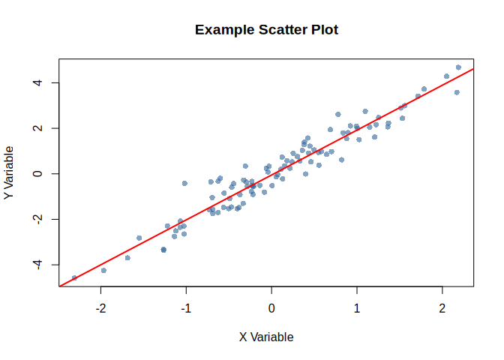
Advanced Quarto Features
Cross-References
Quarto makes it easy to create cross-references. For example, see Figure 1 for a scatter plot and Table 1 for a summary table.
# Generate sample data set.seed(123) x <- rnorm(100) y <- 2 * x + rnorm(100, 0, 0.5) # Create scatter plot plot(x, y, main = "Example Scatter Plot", xlab = "X Variable", ylab = "Y Variable", pch = 16, col = rgb(0.2, 0.4, 0.6, 0.6)) abline(lm(y ~ x), col = "red", lwd = 2)
Figure 1: Scatter plot demonstrating cross-referencing

Slide 5
Summary Tables
As shown in Table 1, the variables have similar distributions.
Code Folding
You can make code chunks foldable:
#> group value1.mean value1.sd value2.mean value2.sd #> 1 A 101.61247 14.63952 51.727220 10.047051 #> 2 B 98.13191 13.84514 53.261796 8.934998
Tabsets
Plot View
Summary View
#> id group value1 value2 #> Min. : 1.00 Length:50 Min. : 79.60 Min. :32.43 #> 1st Qu.:13.25 Class :character 1st Qu.: 89.29 1st Qu.:46.76 #> Median :25.50 Mode :character Median : 96.64 Median :51.04 #> Mean :25.50 Mean : 99.87 Mean :52.49 #> 3rd Qu.:37.75 3rd Qu.:107.93 3rd Qu.:59.34 #> Max. :50.00 Max. :132.98 Max. :72.93
Raw Data
#> id group value1 value2 #> 1 1 A 132.98216 46.24397 #> 2 2 A 119.68619 44.38124 #> 3 3 A 96.02282 46.56083 #> 4 4 A 108.14791 50.90497 #> 5 5 A 93.78490 65.98509 #> 6 6 A 92.85630 49.11435 #> 7 7 A 88.17096 60.80799 #> 8 8 A 91.08074 56.30754 #> 9 9 A 124.76361 48.86360 #> 10 10 A 99.18958 34.67098
Advanced Callouts
Important Considerations
When using this package in production:
Always validate input data
Check for missing values
Consider computational complexity
Performance Warning
Large datasets may require additional memory and processing time.
Columns Layout

Slide 6
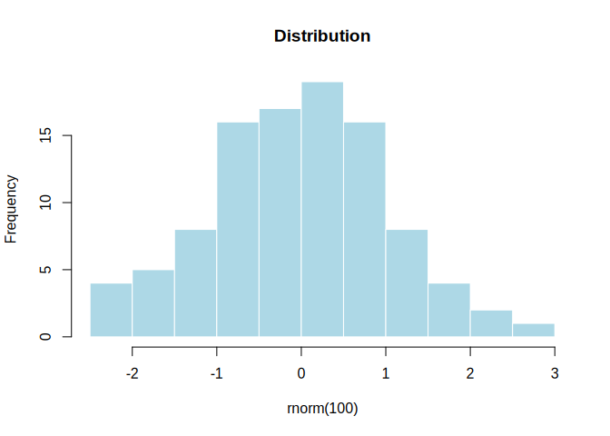
Left Column
This demonstrates a two-column layout in Quarto.
Feature 1
Feature 2
Feature 3
Right Column
You can place different content in each column.

Slide 7
Working with Package Functions
Here’s how to use the package’s example function with different inputs:
#> [1] 15 #> [1] 47.42519

Slide 8
Code Annotations
Quarto supports code annotations for detailed explanations:
#> [1] 3
Load sample data
Create a simple numeric vector
Apply the example function from the package
Display the results

Slide 9
Diagrams with Mermaid

Slide 10
Package workflow diagram

Slide 11
Mathematical Notation
Quarto excels at mathematical notation. Here’s an example of a statistical formula:
The standard error of the mean is calculated as:
$$SE=\frac{s}{\sqrt{n}}$$
where $s$ is the sample standard deviation and $n$ is the sample size.
For a confidence interval:
$$CI=\overset{‾}{x}±t_{α/2,n−1}⋅SE$$

Slide 12
Tips and Best Practices
Expanding tip section
Click to expand this section for additional tips:
Use descriptive chunk labels for better organization
Set global chunk options at the beginning
Use cross-references to link related content
Leverage callouts for important information
Consider code folding for long code blocks

Slide 13
Conclusion
This article demonstrates the advanced capabilities of Quarto for creating rich, interactive documentation for R packages. The integration with pkgdown makes it easy to create professional package websites.

Slide 14
Learn More
Visit the package website
Check out the GitHub repository
Read the Quarto documentation

Slide 15
References

