Slide 1
Quarto Vignette Example

Slide 2
Introduction
This vignette demonstrates how to use Quarto (.qmd) files as vignettes in R packages. Quarto is the next-generation version of R Markdown, offering enhanced features and better integration with multiple programming languages.

Slide 3
Why Use Quarto?
Quarto offers several advantages over traditional R Markdown:
Enhanced features: Better support for cross-references, callouts, and other advanced formatting
Multiple engines: Works with R, Python, Julia, and Observable
Modern syntax: Cleaner YAML and chunk options using #| syntax
Better publishing: Improved website and book publishing capabilities

Slide 4
Basic Example
Here’s a basic example using the package:
#> [1] 4.5

Slide 5
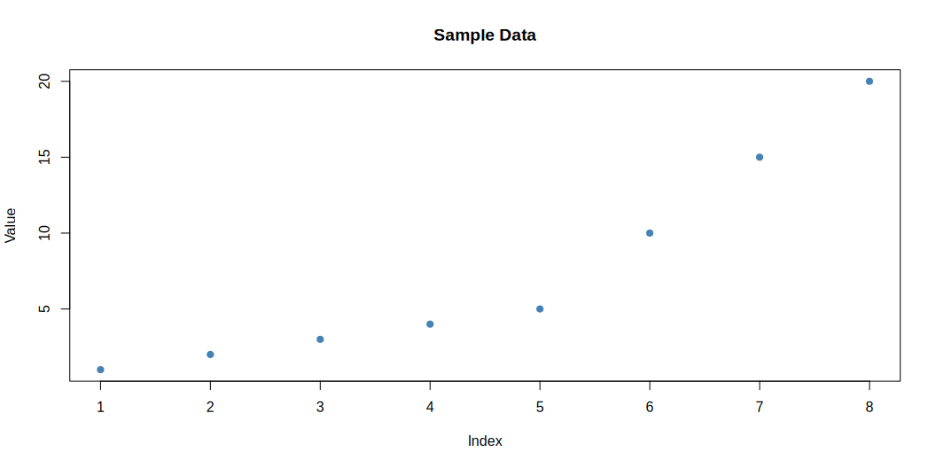
Quarto Features
Callouts
Note
This is a callout block that highlights important information.
Tip
Quarto supports multiple types of callouts: note, tip, warning, important, and caution.
Code Chunks with Modern Syntax
You can use the modern #| syntax for chunk options:
# Create a simple plot plot(sample_data, main = "Sample Data", xlab = "Index", ylab = "Value", pch = 19, col = "steelblue")
Figure 1: Example plot showing data distribution

Slide 6
Equations
Quarto has excellent support for mathematical equations using LaTeX syntax:
Inline equation: $E=mc^{2}$
Display equation:
$$\overset{‾}{x}=\frac{1}{n}\sum_{i=1}^{n}{x_{i}}$$

Slide 7
Tables

Slide 8
Summary
Quarto vignettes provide a modern, feature-rich way to document R packages. They integrate seamlessly with pkgdown and offer enhanced capabilities for technical documentation.

Slide 9
References
For more information, see:
Quarto Documentation
Using Quarto with R
R Core Team (2024)
UCD-SERG (2024)
R Core Team. 2024. R: A Language and Environment for Statistical Computing. Vienna, Austria: R Foundation for Statistical Computing. https://www.R-project.org/.
UCD-SERG. 2024. Rpt: R Package Template. https://github.com/UCD-SERG/rpt.

