Slide 1
Untitled

Slide 2
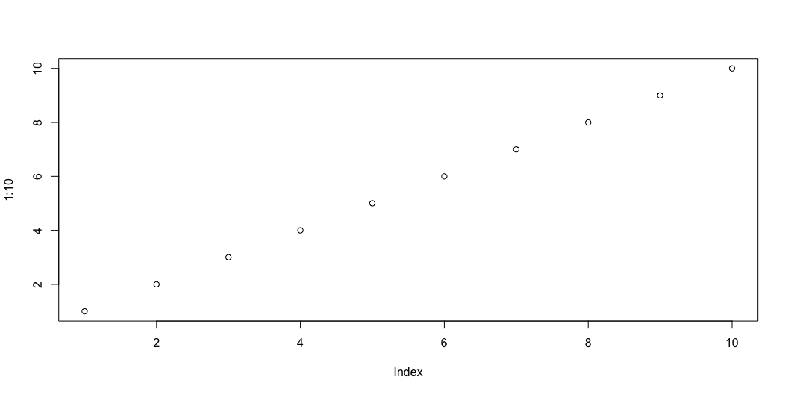
slide with fig div
Figure 1: A graph

