Slide 1
Untitled

Slide 2
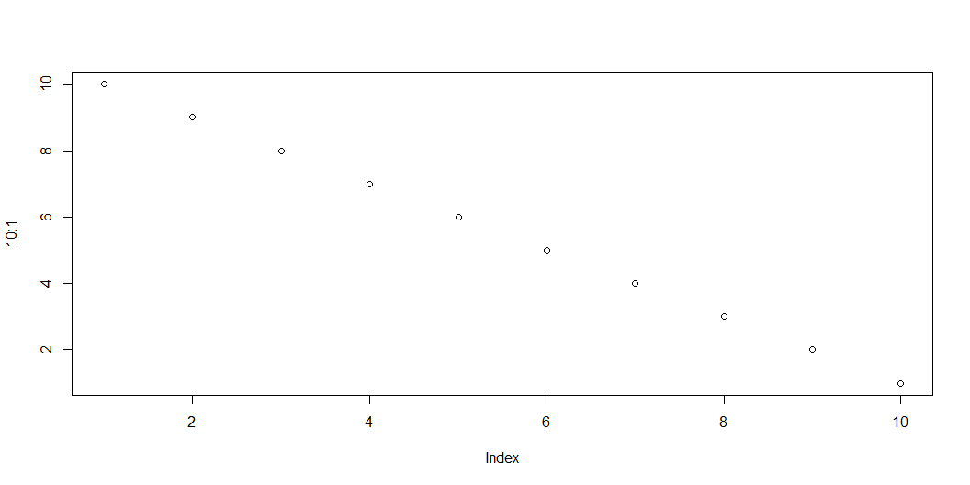
slide with fig chunk
Figure 1: Another graph

