Slide 1
TABLE OF CONTENTS
Introduction
Objective
Motivation
Problem definition
Literature Survey
System Design
System Specification
Implementation details
System Testing
Results & Analysis
Conclusion
Future Scope
References

Slide 2
Introduction
This project aims to develop an archiving system by implementing advanced compression techniques for optimizing data and image storage. With a primary focus on Huffman Coding and Luminance Optimization in Chroma Subsampling, the project seeks to address diverse data types and storage constraints effectively.​

Slide 3
Objective
The objective of this project is to develop a web application called "TinyHuff" that provides functionality for compressing and decompressing text and images using the Huffman coding algorithm and Chroma Subsampling.

Slide 4
Motivation
The motivation behind developing TinyHuff is to showcase the power of Huffman coding in data compression and encryption. Huffman coding is known for its efficiency in reducing file sizes, especially for files with repetitive patterns or symbols. By implementing this algorithm in a web application, users can experience firsthand how compression techniques can optimize storage and transmission of data.​

Slide 5
Problem Definition
Our project focuses on developing better techniques for data compression and encryption. We aim to make files and images smaller without losing quality or taking too much time.
Current methods often compromise between speed, quality, and file size. Some compress quickly but reduce quality, while others keep quality but are slow. We aim to overcome these issues with advanced algorithms that optimize both compression and encryption.
Our approach also ensures that compressed data is secure, protecting it from unauthorized access. By enhancing both compression and encryption, we improve storage management and data privacy.
Join us as we revolutionize data compression and encryption, making it faster, more efficient, and more secure.

Slide 6
Literature Survey
S.NO | Authors name(s) | Full title of the paper with Year | Inference from the paper (based on methodology, technology) | Open Problem (for your proposed work)
1 | Sourya Basu, Shivam Chaturvedi, Rajesh M. Hegde | Text Compression using Lexicographic Permutation of Binary Strings (2016) | Discusses text compression through lexicographic permutation of binary strings, offering a novel approach for reducing file sizes. | Explore further applications of lexicographic permutations in other forms of data compression.

Slide 7
Literature Survey
S.NO | Authors name(s) | Full title of the paper with Year | Inference from the paper (based on methodology, technology) | Open Problem (for your proposed work)
2 | Teddy Mantoro, Media A. Ayu, Yayuk Anggraini | The Performance of Text File Compression Using Shannon-Fano and Huffman on Small Mobile Devices (2017) | Compares Shannon-Fano and Huffman coding for text file compression on small mobile devices, highlighting performance differences. | Investigate hybrid techniques combining Shannon-Fano and Huffman coding to optimize performance on mobile devices.

Slide 8
Literature Survey
S.NO | Authors name(s) | Full title of the paper with Year | Inference from the paper (based on methodology, technology) | Open Problem (for your proposed work)
3 | Md. Atiqur Rahman, Jungpil Shin, Aloke Kumar Saha, Md. Rashedul Islam | A Novel Lossless Coding Technique for Image Compression (2018) | Proposes a new lossless coding technique for image compression, focusing on maintaining data integrity. | Enhance the proposed technique for higher efficiency and applicability to larger datasets.

Slide 9
Literature Survey
S.NO | Authors name(s) | Full title of the paper with Year | Inference from the paper (based on methodology, technology) | Open Problem (for your proposed work)
4 | A.H.M. Zadidul Karim | Image Compression using Huffman Coding Scheme with Partial/Piecewise Color Selection (2021) | Introduces a Huffman coding scheme with partial/piecewise color selection for image compression, improving efficiency. | Develop additional methods to optimize partial/piecewise color selection for better compression ratios.

Slide 10
Literature Survey
S.NO | Authors name(s) | Full title of the paper with Year | Inference from the paper (based on methodology, technology) | Open Problem (for your proposed work)
5 | Qusay Kanaan Kadhim | Image Compression Using Discrete Cosine Transform Method (2016) | Explores image compression using the Discrete Cosine Transform method, emphasizing efficiency and quality. | Investigate further enhancements to the DCT method for better performance in various image types.

Slide 11
Literature Survey
S.NO | Authors name(s) | Full title of the paper with Year | Inference from the paper (based on methodology, technology) | Open Problem (for your proposed work)
6 | Keyur D. Joshi | Reducing Image Compression Time using Improvised Discrete Cosine Transform Algorithm (2022) | Proposes an improvised DCT algorithm to reduce image compression time while maintaining quality. | Further reduce compression time and enhance visual quality with new algorithmic techniques.

Slide 12
Literature Survey
S.NO | Authors name(s) | Full title of the paper with Year | Inference from the paper (based on methodology, technology) | Open Problem (for your proposed work)
7 | A. H. M. Jaffar Iqbal Barbhuiya, Tahera Akhtar Laskar, K. Hemachandran | An Approach for Color Image Compression of JPEG and PNG Images Using DCT and DWT. 2014 International Conference on Computational Intelligence and Communication Networks. | Proposes a method for color image compression using DCT and DWT on JPEG and PNG images, enhancing compression performance. | Explore integration of other compression techniques to further improve performance and efficiency.

Slide 13
Literature Survey
S.NO | Authors name(s) | Full title of the paper with Year | Inference from the paper (based on methodology, technology) | Open Problem (for your proposed work)
8 | S. Benchikh, M. Corinthios | A Hybrid Image Compression Technique Based on DWT and DCT Transforms. International Conference on Advanced Infocomm Technology 2011 (ICAIT 2011). | Introduces a hybrid compression technique combining DWT and DCT transforms to improve image compression efficiency. | Investigate additional hybrid approaches and their impact on various types of images.

Slide 14
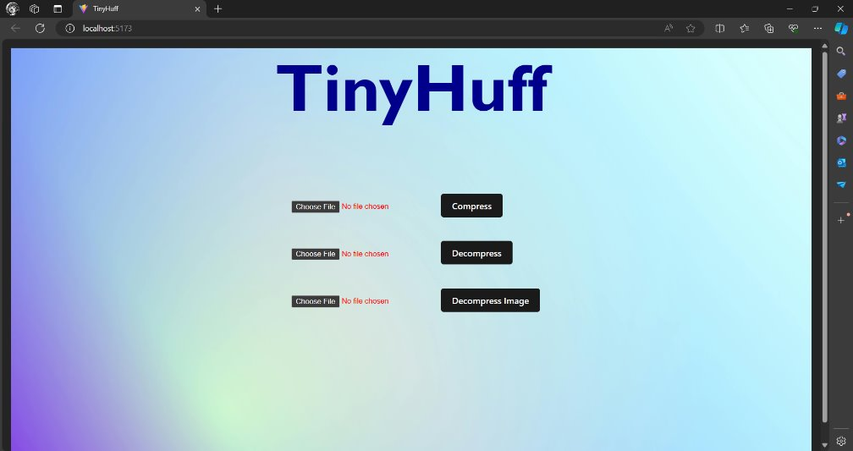
System Implementation

Slide 15
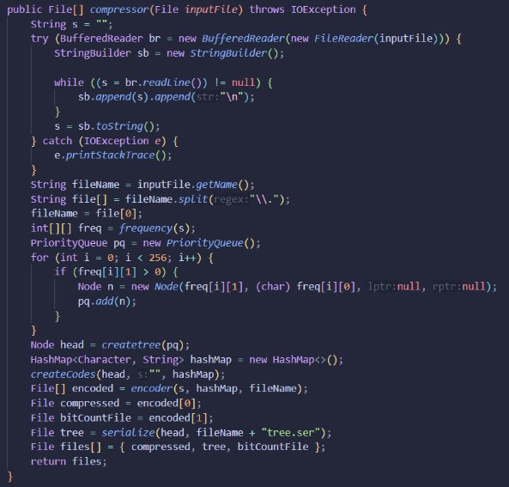
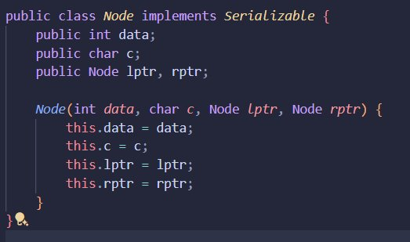
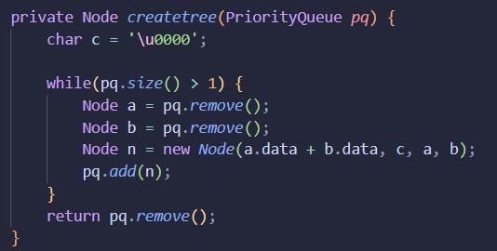
Encoding

Slide 16
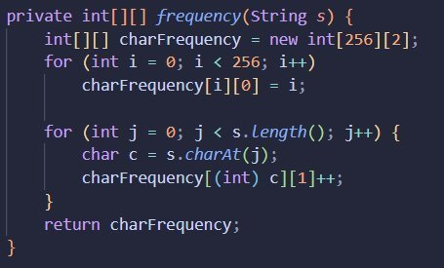
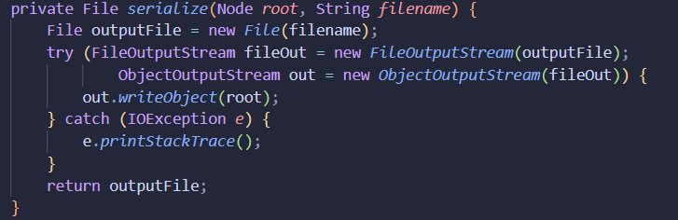
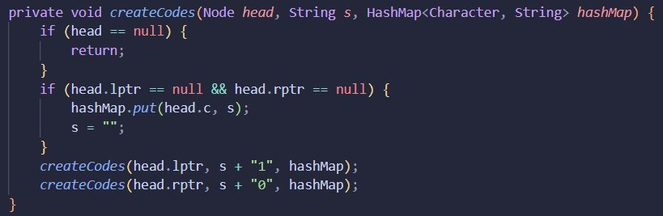
Encoding

Slide 17
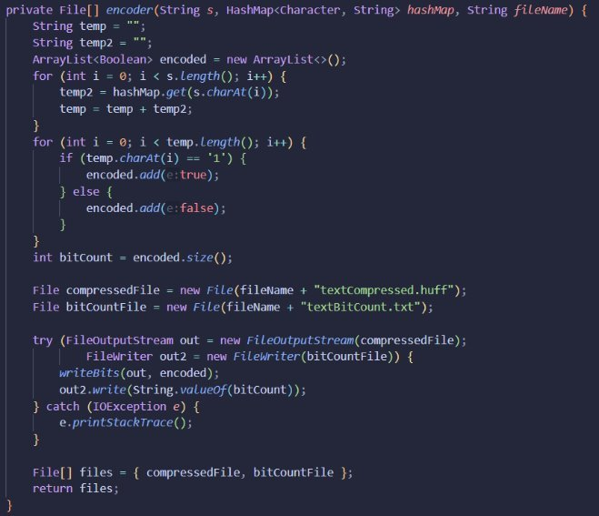
Encoding

Slide 18
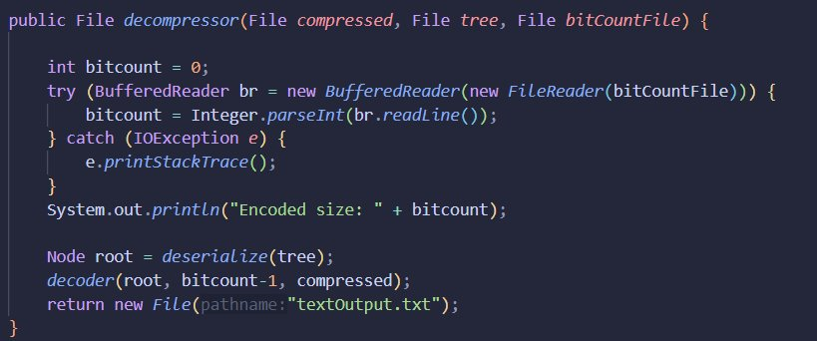
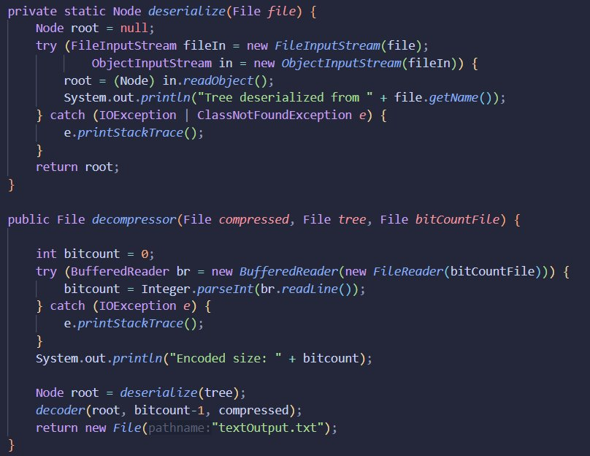
Decoding

Slide 19
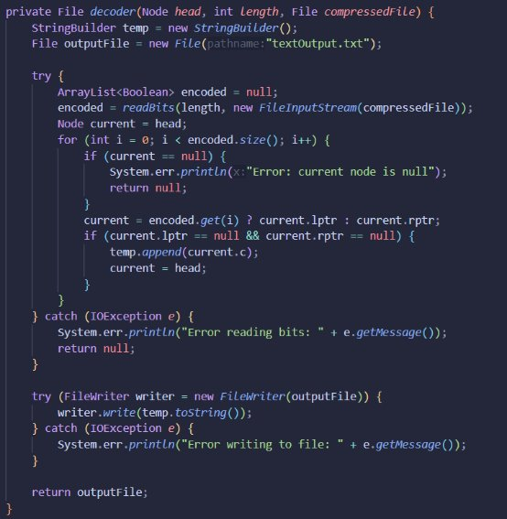
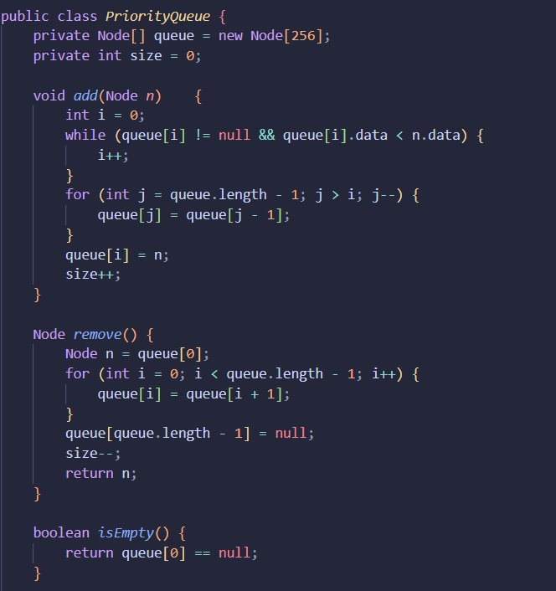
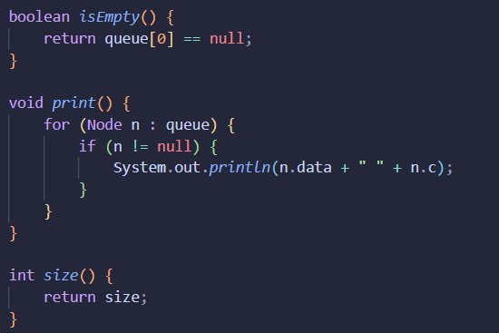
Decoding

Slide 20
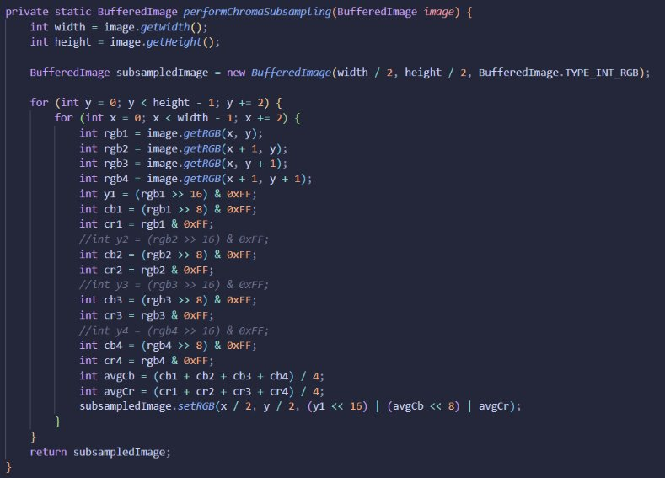
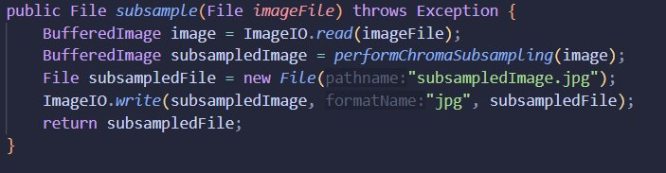
Subsampling

Slide 21
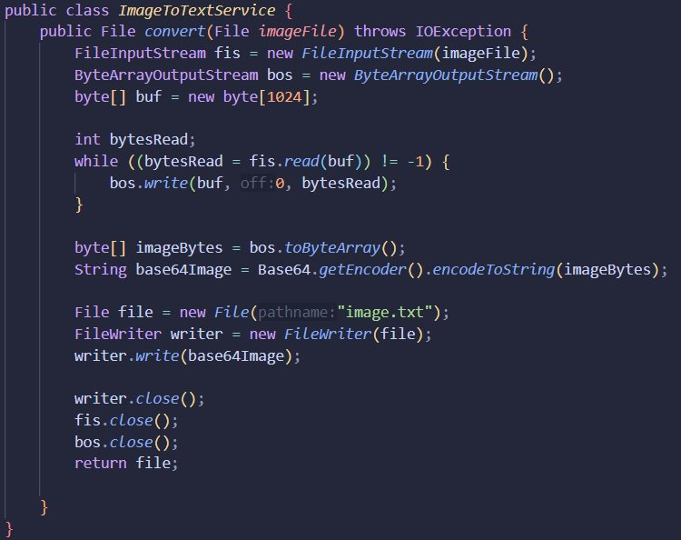
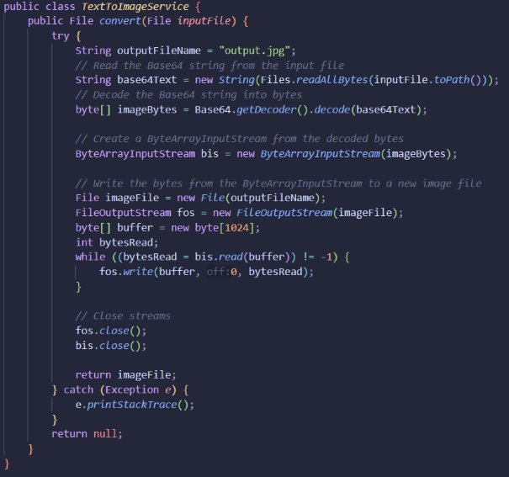
Subsampling

Slide 22
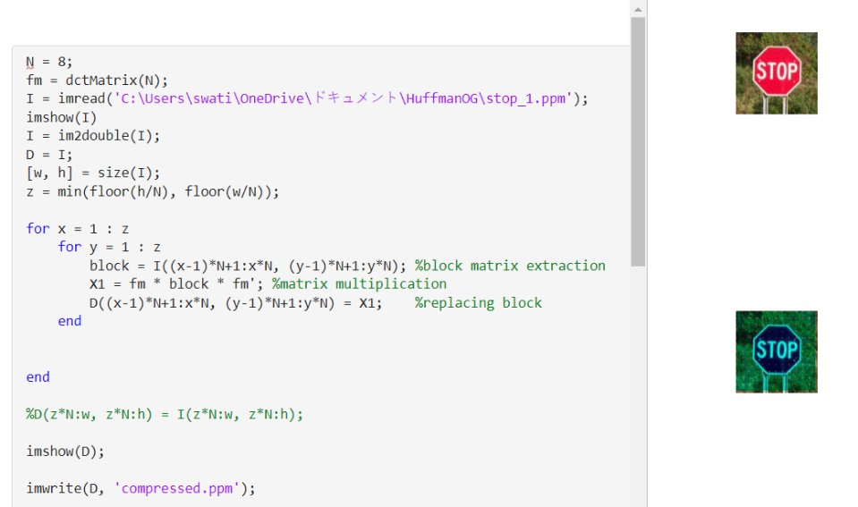
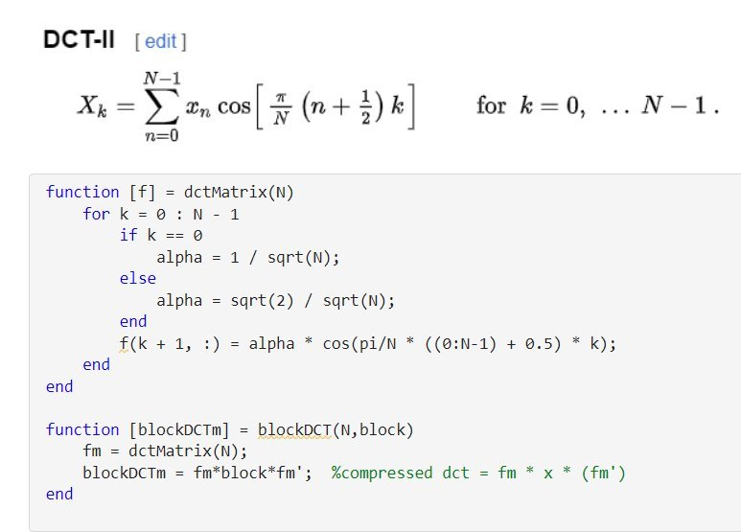
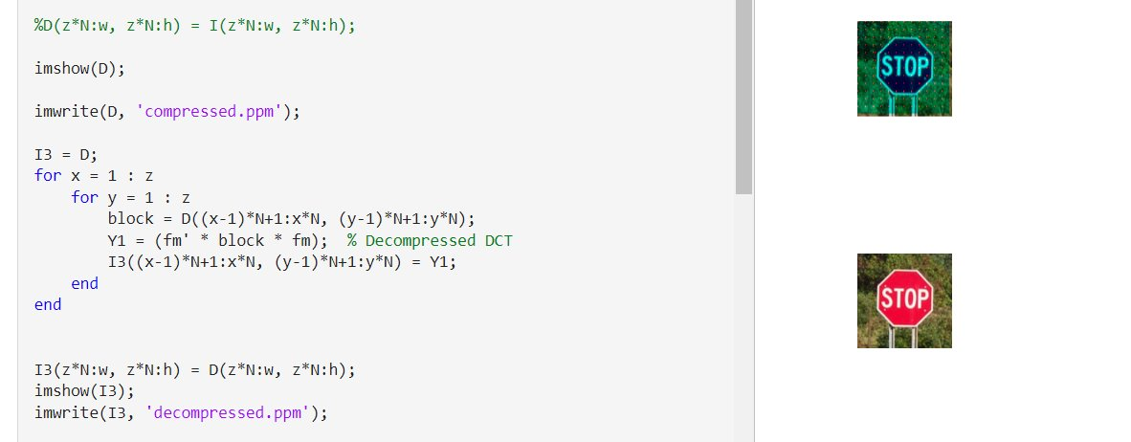
DCT

Slide 23
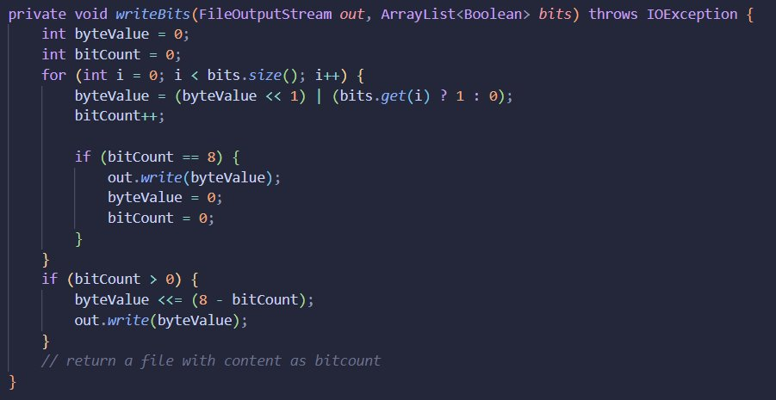
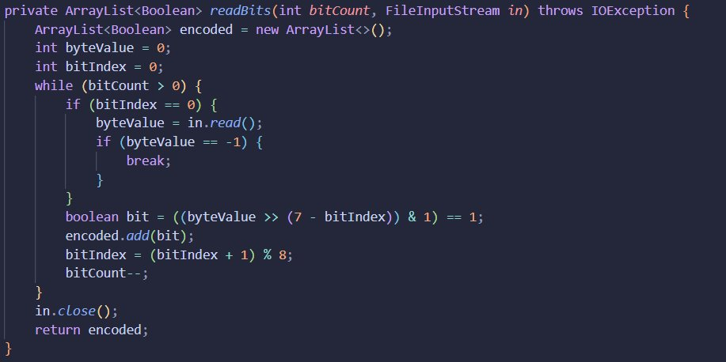
Binary Files

Slide 24
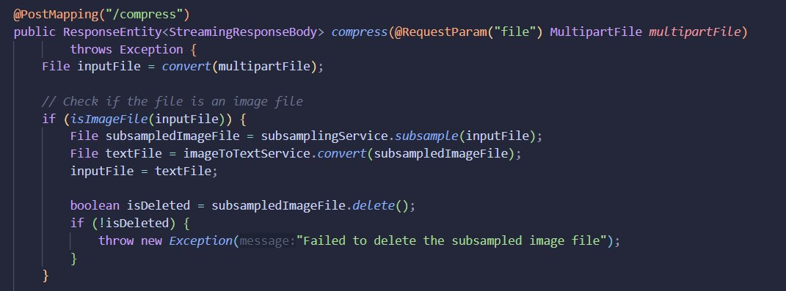
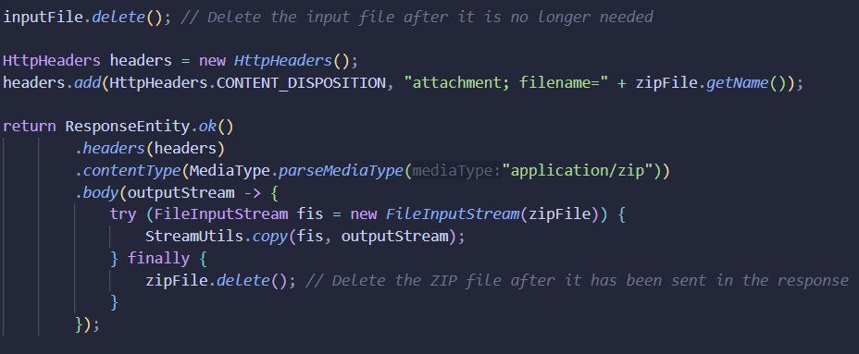
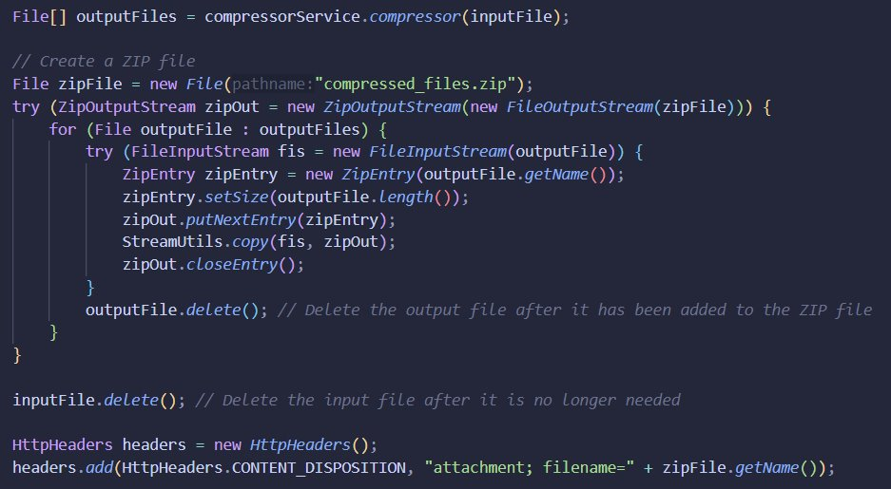
Spring

Slide 25
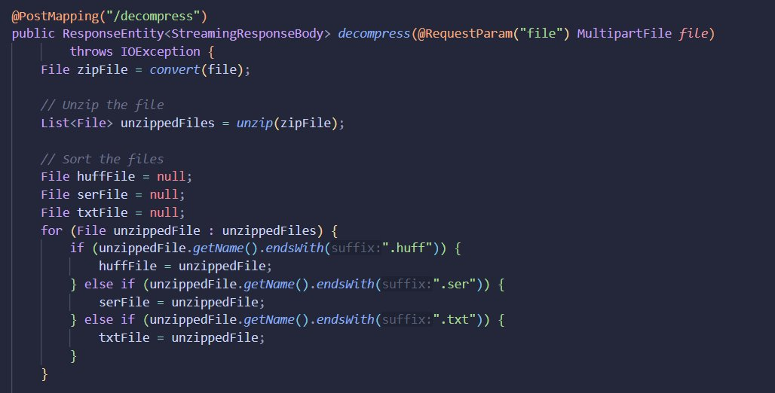
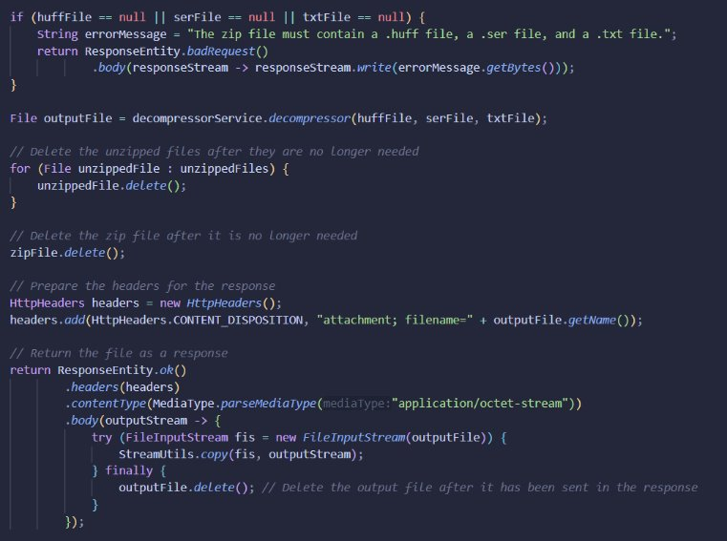
Spring

Slide 26
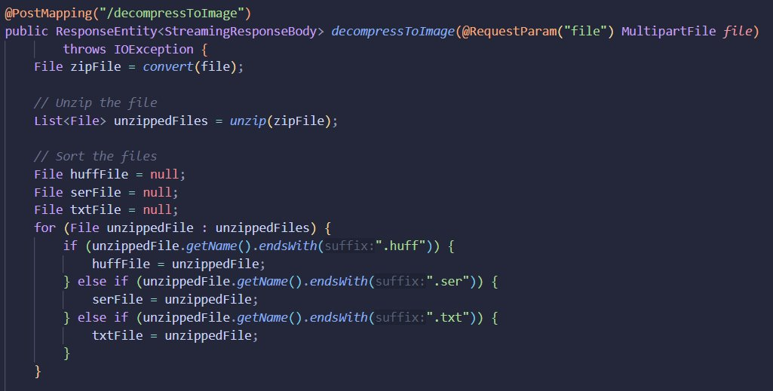
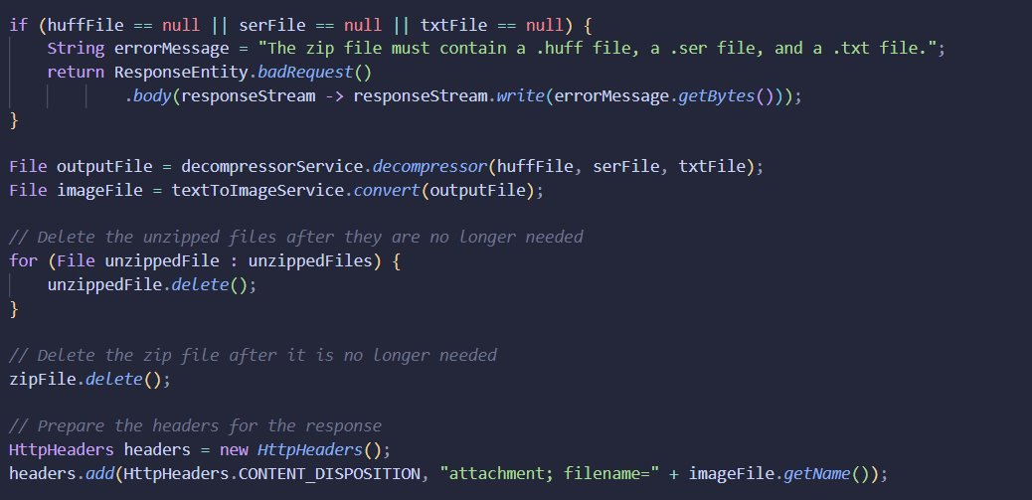
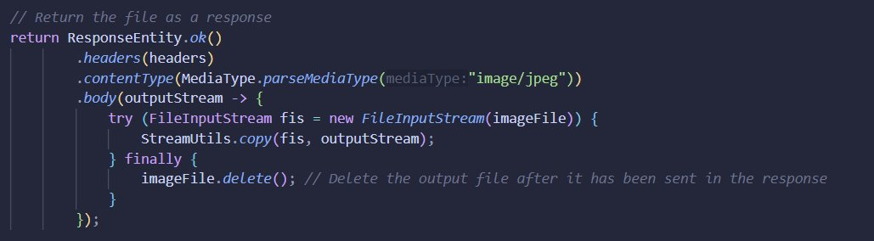
Spring

Slide 27

System Testing

Slide 28
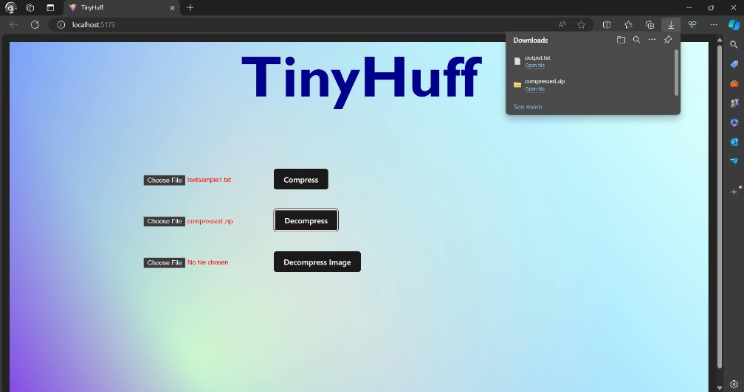
System Testing

Slide 29
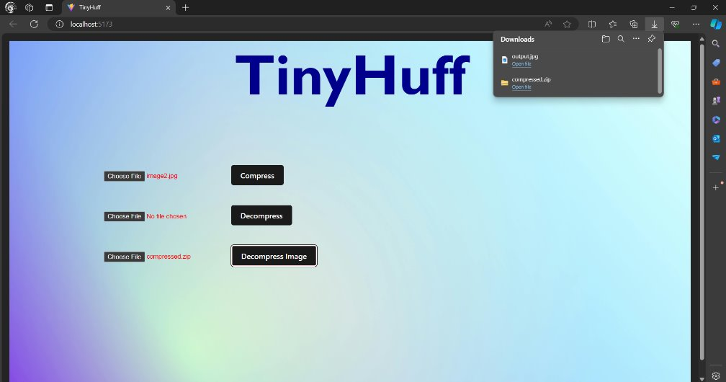
System Testing

Slide 30
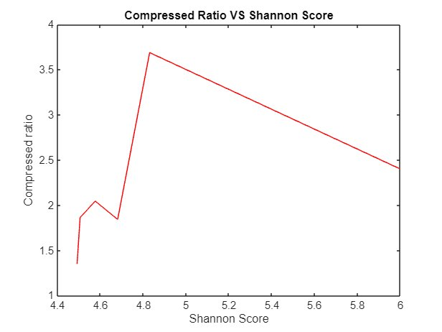
Results and Analysis
The graph illustrates the relationship between the Shannon score and compressed ratio, and shows that beyond a certain entropy level, increased randomness in the data makes compression less effective. Up to a Shannon score of 6, the compressed ratio continues to decrease gradually, showing diminishing returns for compression as entropy grows. Overall, the graph highlights that compression efficiency improves with entropy to a point, after which it flattens due to data complexity.
Fig. 1 Compressed ratio vs Shannon score ​

Slide 31
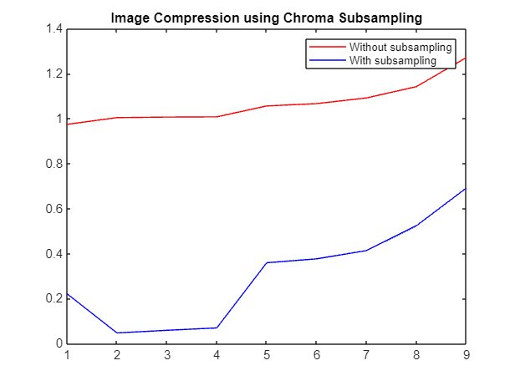
Results and Analysis
The x-axis represents input size, and the y-axis represents output size. Chroma subsampling reduces color information to achieve smaller data volumes without significant quality loss. The graph indicates that chroma subsampling consistently results in smaller output sizes compared to no-subsample compression across all input sizes. This demonstrates the significant advantage of chroma subsampling in reducing file sizes while maintaining image quality, making it beneficial for video streaming and image storage.
Fig. 2 Image compression with subsampling and without subsampling​

Slide 32
Conclusion
Image and text compression are pivotal technologies in the digital age, enabling efficient storage and transmission of data. Formats such as JPEG have become industry standards, each serving distinct purposes based on the requirements of image fidelity and file size reduction.​
Similarly, text compression algorithms like Huffman coding play crucial roles in minimizing the storage and bandwidth needed for text data. These methods ensure that large volumes of text can be transmitted swiftly and stored economically, which is vital for web applications, data storage solutions, and communication systems.​

Slide 33
Future Scope
TinyHuff could explore avenues for enhancing its compression algorithms, though the exact approaches are yet to be defined. Potential improvements in user interface design and broader compatibility with various file formats could also be considered for future iterations.

Slide 34
References
[1] Text Compression using Lexicographic Permutation of Binary Strings Sourya Basu, Shivam Chaturvediand Rajesh M. Hegde Indian InstituteofTechnologyKanpur Kanpur 208016India {souryab, shivamch,rhegde}@iitk.ac.in
[2] The Performance of Text File Compression Using Shannon- Fano and Huffman on Small Mobile Devices Teddy Mantoro1, Media A. Ayu1, Yayuk Anggraini2 1Faculty of Engineering and Technology, Sampoerna University, Jakarta.
[3] A Novel Lossless Coding Technique for Image Compression Md.Atiqur Rahman1, Jungpil Shin2, Aloke Kumar Saha3, Md. Rashedul Islam4,* 1Department of Computer Science and Engineering Bangladesh University of Business and Technology, Dhaka, Bangladesh
[4] Image Compression using Huffman Coding Scheme with Partial/Piecewise Color Selection, A.H.M. Zadidul Karim

Slide 35
References
[5] Image Compression Using Discrete Cosine Transform Method Qusay Kanaan Kadhim Al-Yarmook University College / Computer Science Department, Iraq .qusaykanaan@gmail.com
[6] Reducing Image Compression Time using Improvised Discrete Cosine Transform Algorithm Keyur D. Joshi School of Engineering and Applied Sciences Ahmedabad University, Ahmedabad, India keyur.joshi@ahduni.edu.in
[10] Barbhuiya, A. H. M. Jaffar Iqbal, A. H. Jaffar Iqbal Barbhuiya,
Tahera Akhtar Laskar, and K. Hemachandran. 2014. “An Approach for Color Image Compression of JPEG and PNG Images Using DCT and DWT.” 2014 International Conference on Computational Intelligence and Communication Networks. https://doi.org/10.1109/cicn.2014.40.
[11] Benchikh, S., and M. Corinthios. 2011. “A Hybrid Image Compression Technique Based on DWT and DCT Transforms.” International Conference on Advanced Infocomm Technology 2011 (ICAIT 2011). https://doi.org/10.1049/cp.2011.1065.

Slide 36
THANK YOU

