Slide 1
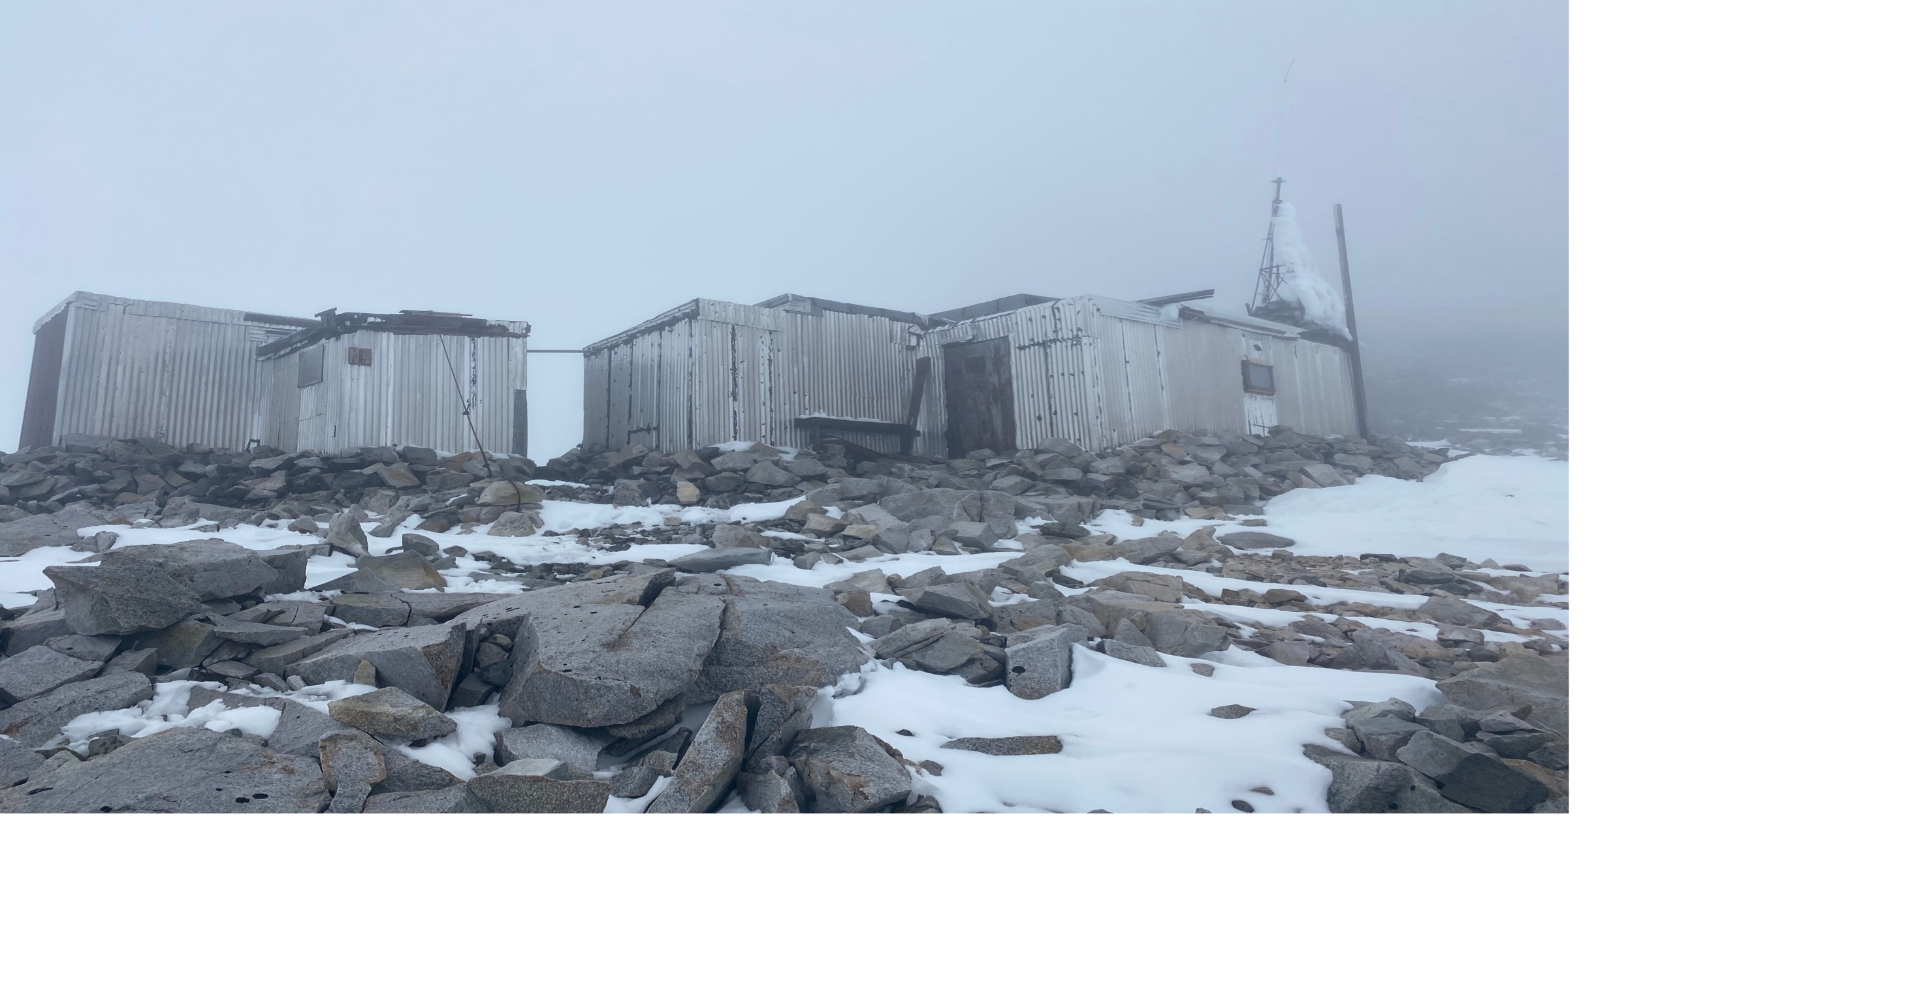
JIF Vulnerability and Lapse Rates
By jonny, tory, emma, ali, xander, and lili
Advised by Jess and isaac

Slide 2
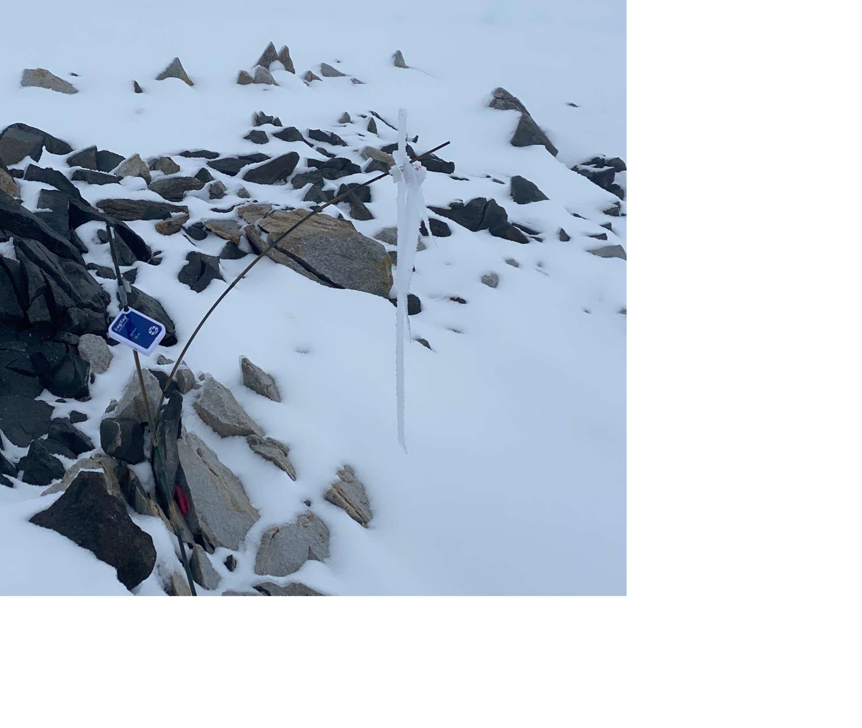
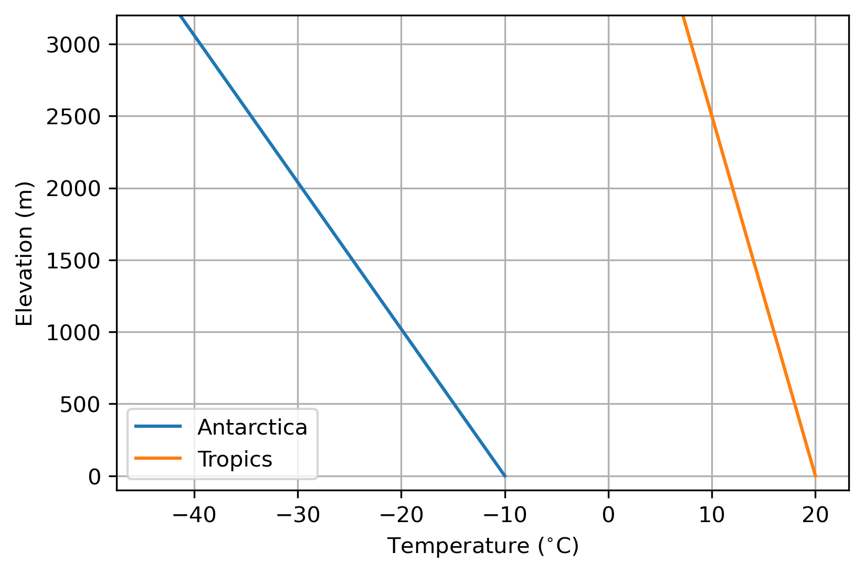

What’s a Lapse Rate?
Large Lapse Rate (9.8 °C/km)
Small Lapse Rate (4 ° C/km)
$$lapse rate=\frac{∆ temperature}{∆ elevation}$$

Slide 3
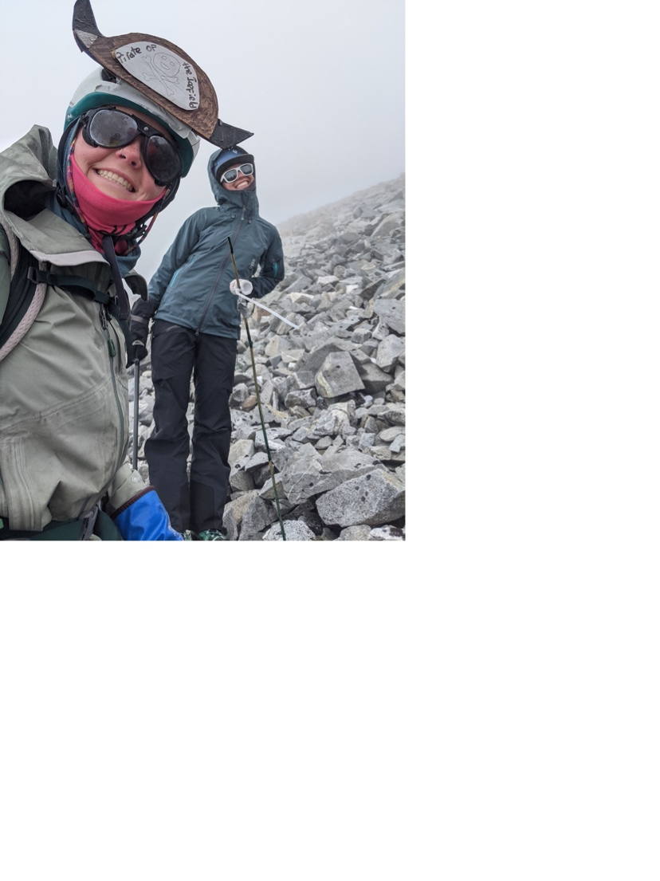
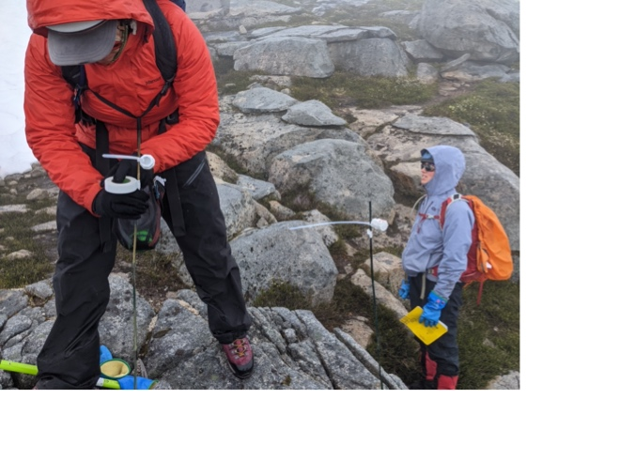
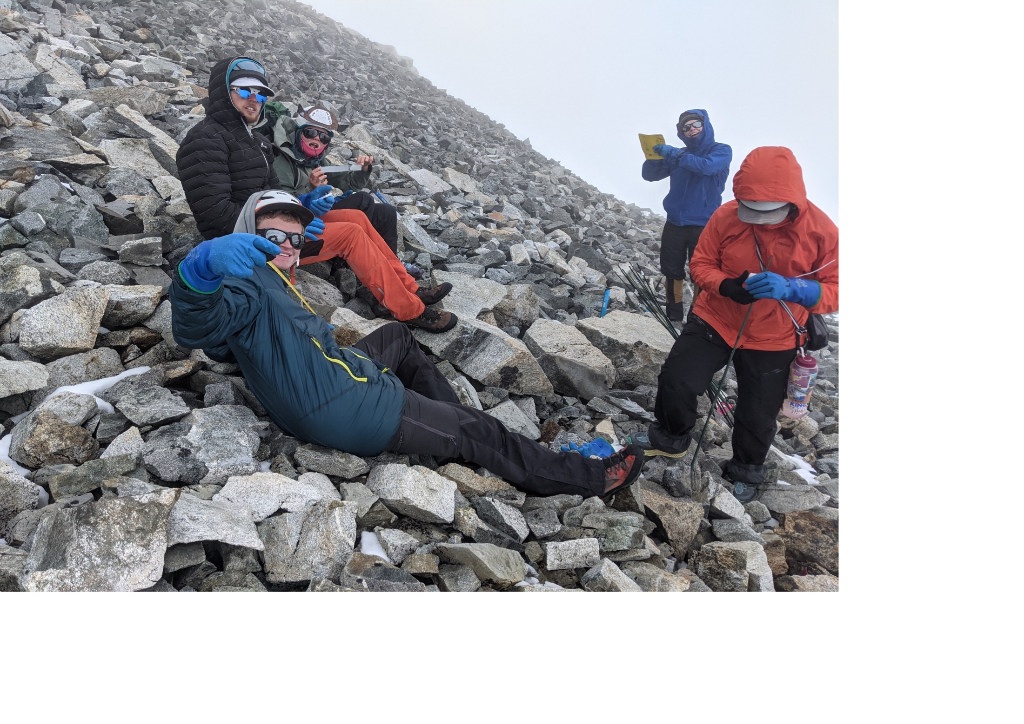
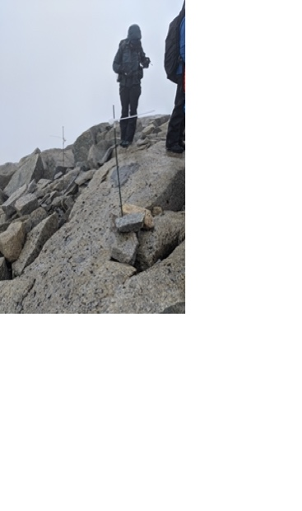
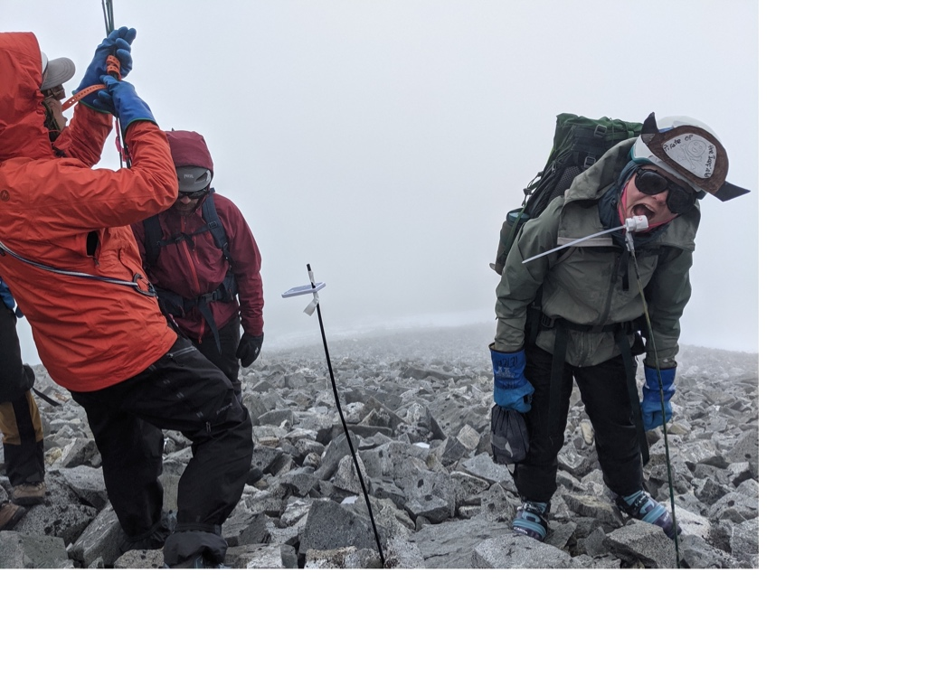
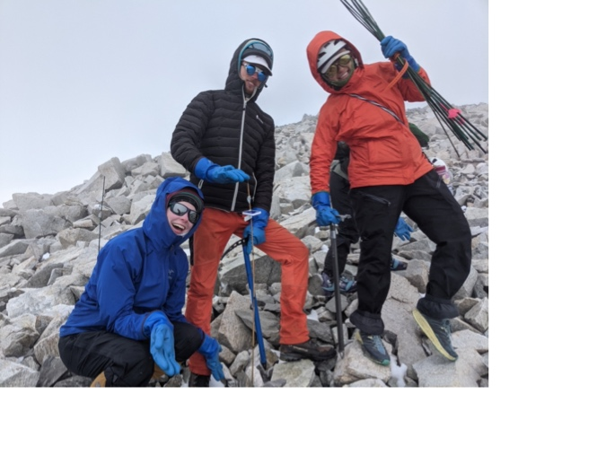
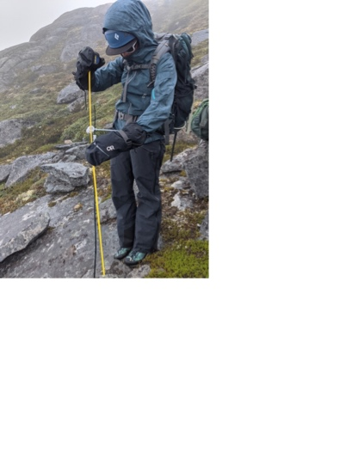
Data Collection:

Slide 4
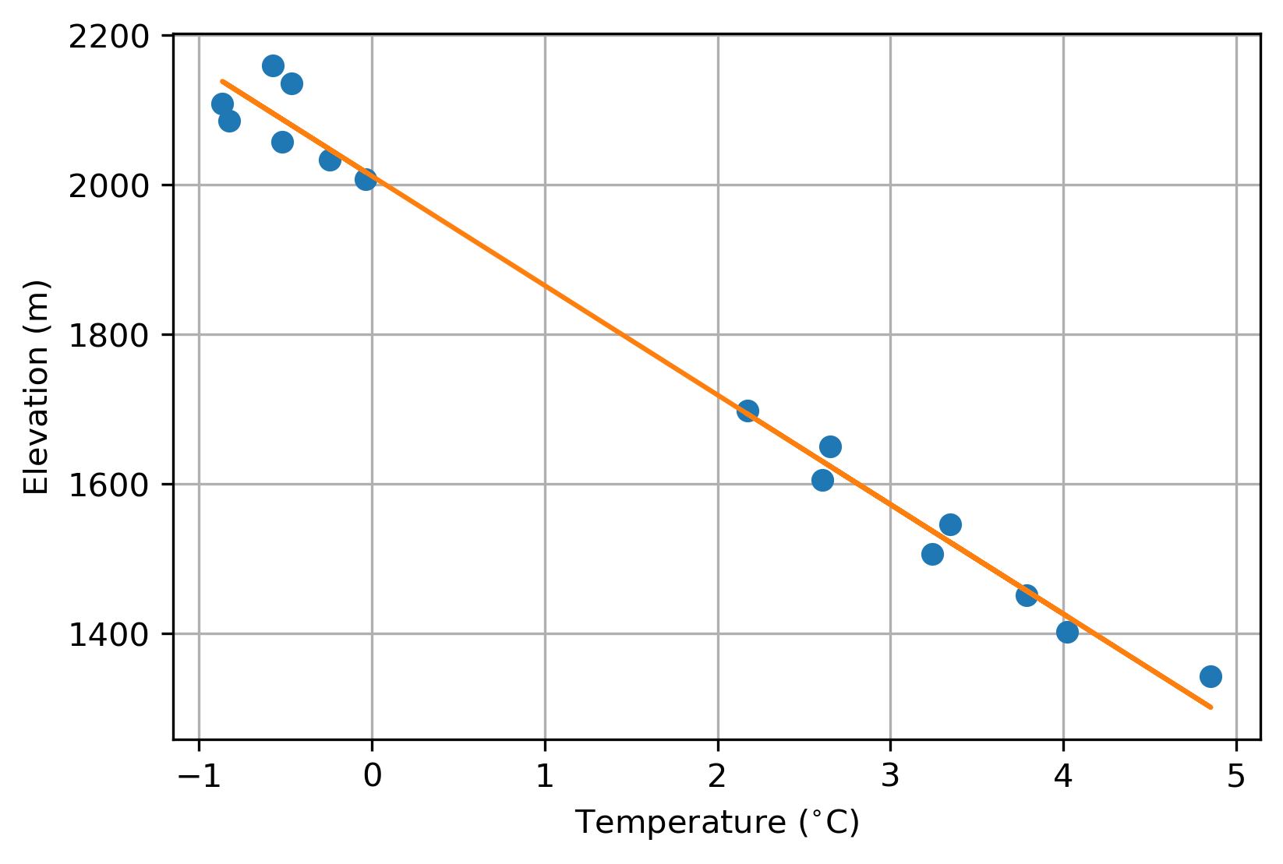
Our Findings:
All sensors active from July 21st-July 23rd
Measured local Lapse Rate: 6.8 °C/km
Icefield wide average (for July): 5.2 °C/km
What does this mean for the Matthes-Vaughn Lewis region?
Heather Camp
C8

Slide 5
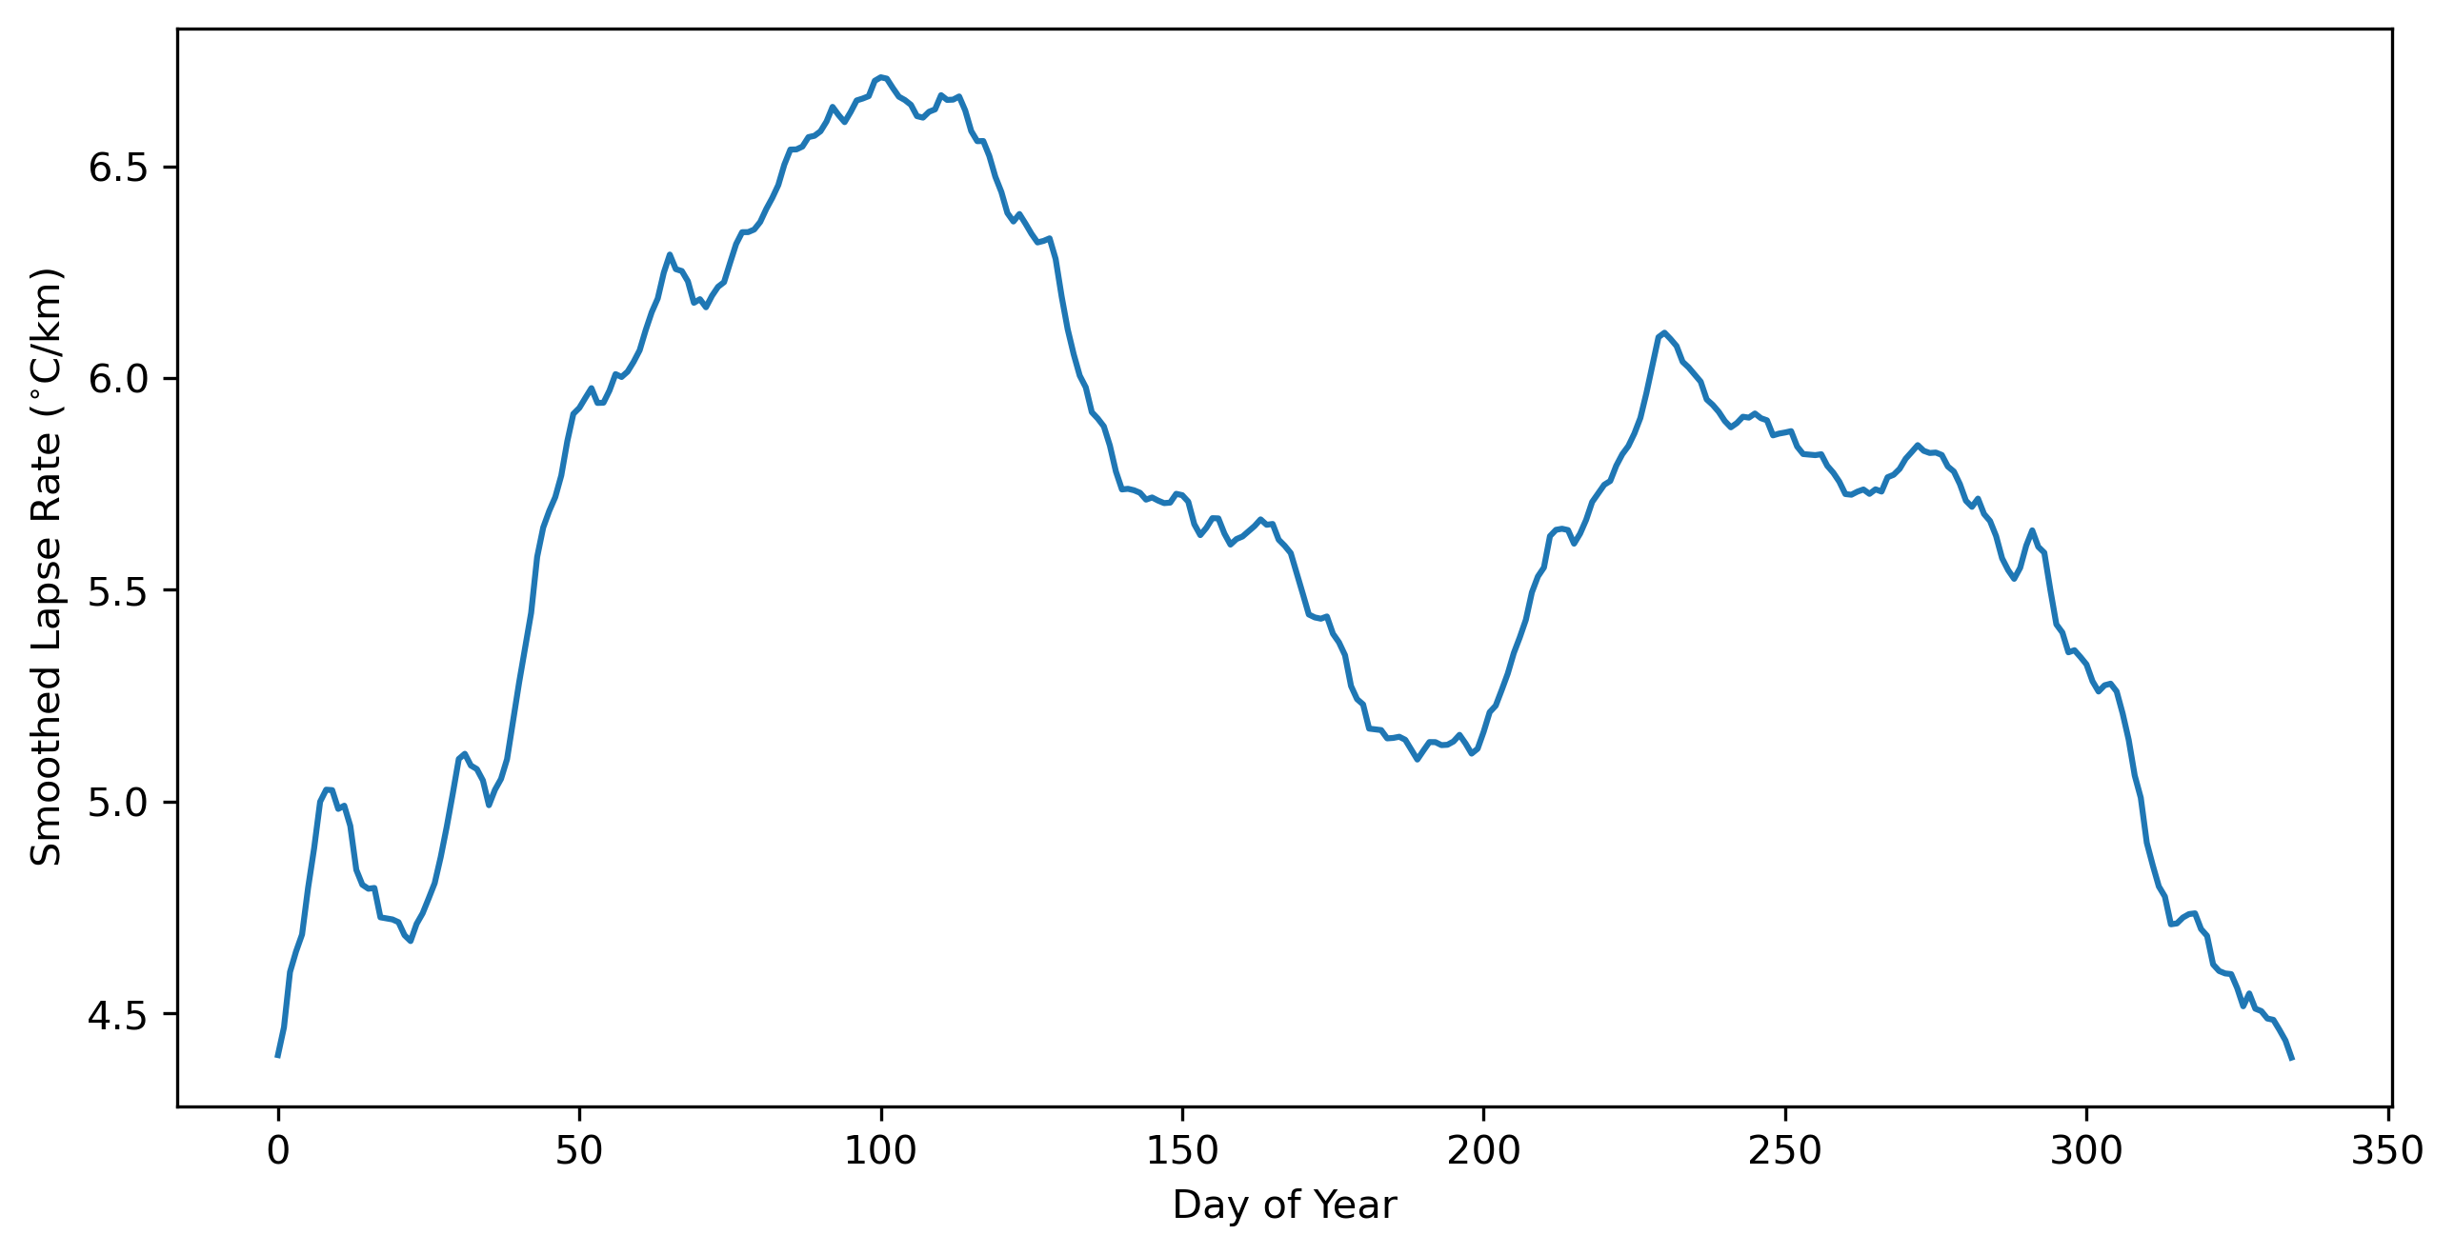
Icefield Findings: Lapse Rate over Year

Slide 6
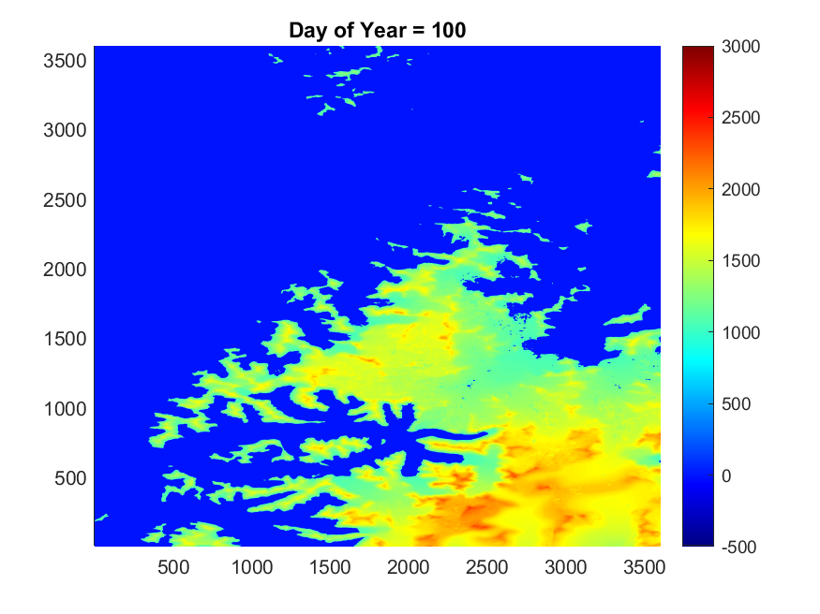
Icefield Findings: 0°C-Isotherm over Year
Elevation (m)

Slide 7
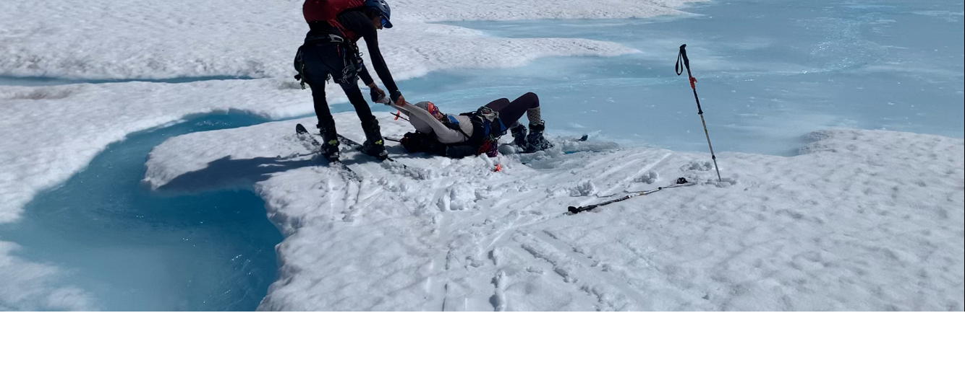
Why care? What next?

Slide 8
Why care? What next?
Plateau Icefield
Downstream Impacts: watersheds, fisheries, and wildlife
Future Study/Improvements: higher resolution data, mass balance data, positive degree days, sensor limitations

Slide 9
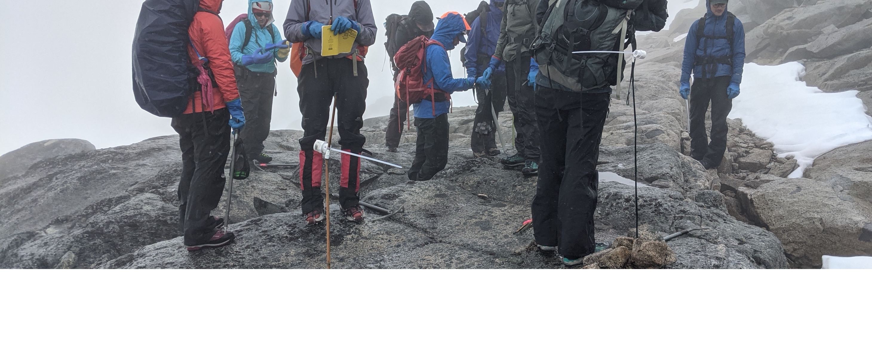
Acknowledgements
We thank Eric Steig and the Ben Rabinowitz Endowment for purchasing the iButton sensors.
Also Isaac and Jess for their support and waffles!

