Slide 1
Bamboo ablation stake 2x 3 m poles, jointed
1 or 2 sensors per pole
Wood 4x4, 1ft long
with thru-holes
2 m
Sun cups
for scale
1.5 – 2 m
Bamboo

Slide 2
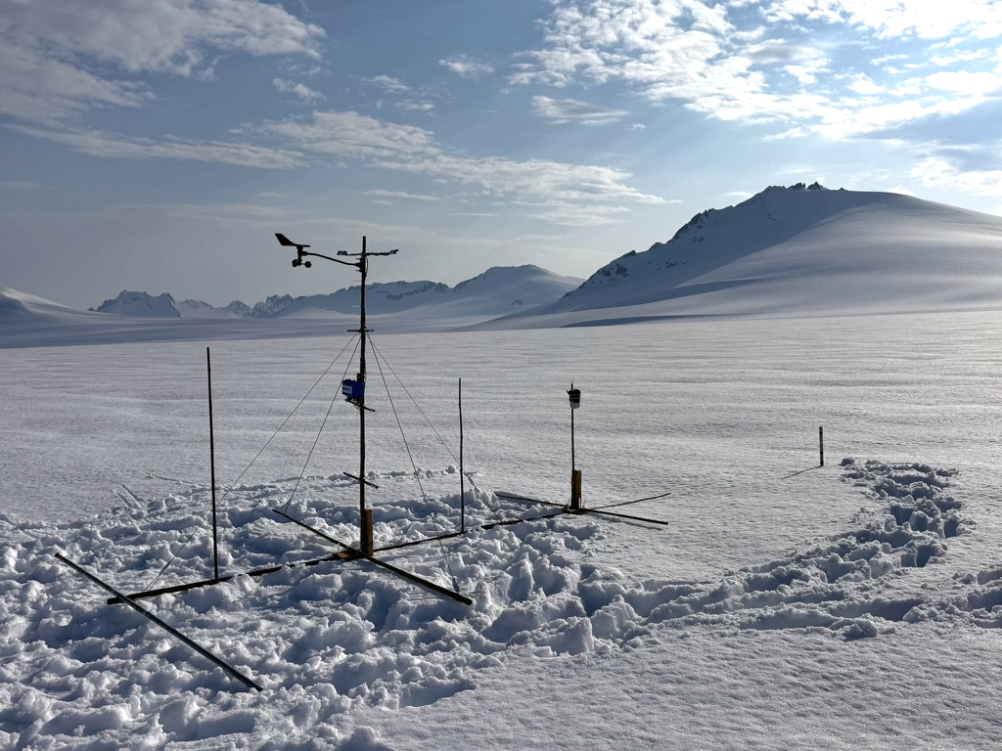

Slide 3
Bamboo ablation stake 2x 3 m poles, jointed
1 or 2 sensors per pole
Wood 4x4, 1ft long
with thru-holes
2 m
Sun cups
for scale
1.5 – 2 m
Bamboo

Slide 4
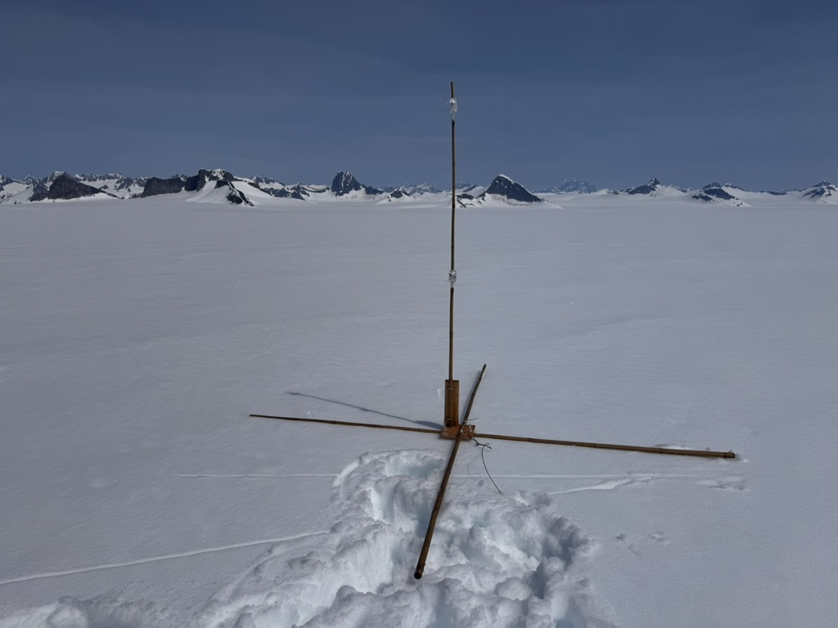

Slide 6
Measure compass direction towards bracket

