Slide 1
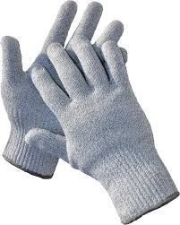
Home
Shop
Cart
Pay
Card Number
Month / Year
Rag & Bone CA$386.51
Slant Gloves
Size: S M L XL
Tax: $30
Total: $416.51
Security Code
Pay

Slide 2
Cart
Pay
Home
Shop
Shopping Cart
Rag & Bone CA$386.51
Slant Gloves
Size: S M L XL
3 left in stock
Not Returnable
Shop
Remove

Slide 3
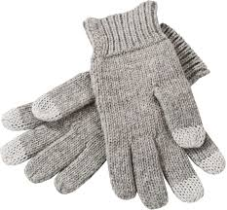
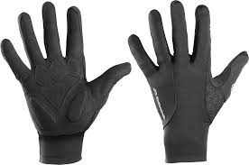
Shop
Cart
Pay
Home
Shop
Women Gloves
Rag & Bone
Slant Gloves
CA$386.51
Adidas
Gym & Fitness Gloves
CA$300
Rag & Bone
Slant Gloves
CA$315

Slide 4
Home
Shop
Cart
Pay
Women Gloves
Rag & Bone
Slant Gloves
CA$386.51
Adidas
Gym & Fitness Gloves
CA$300
Rag & Bone
Slant Gloves
CA$314

