Slide 1

Control of a chain of mass-spring-dumper systems
UNIVERSITA’ DEGLI STUDI DI PAVIA
Babic Enrico mat. 548672
Cogni Elia mat. 546331
Cabri Lorenzo mat. 549158
Romeo Daniele mat. 546469
Academic Year 2023/2024

Slide 2
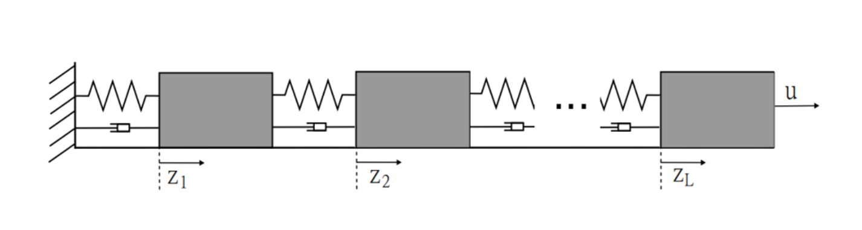


INTRODUCTION
Each subsystem has mass M = 1, spring constant k = 10 and damping constant h = 2. The state of the system is given by x = [z1, z ̇1, ..., zL, z ̇L]′. The system output is the position of the first mass z1
The system can be described by differential equations. The equations in odd position
(i = 2j − 1,with j = 1, ..., 6), that are referred to the positions of the masses, are
Notes:
ENRICO

Slide 3
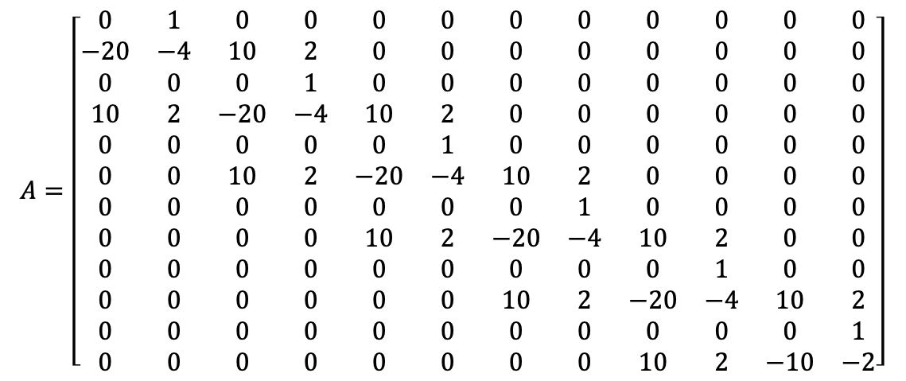
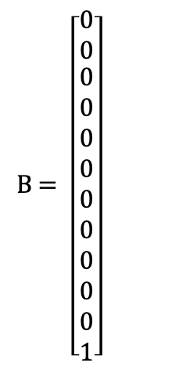

The equations of the velocities (equations in positions i = 2j, with j = 2, ..., 5) are
From these equations, we have derived the system matrices.
Notes:
ENRICO

Slide 4









By the final value theorem:
CONTINUOUS
DISCRETE
T_{s} = 0,1 s
Notes:
ENRICO

Slide 5
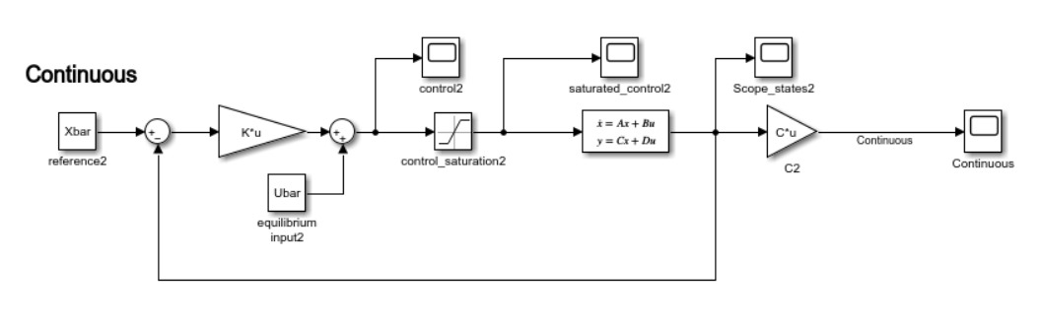
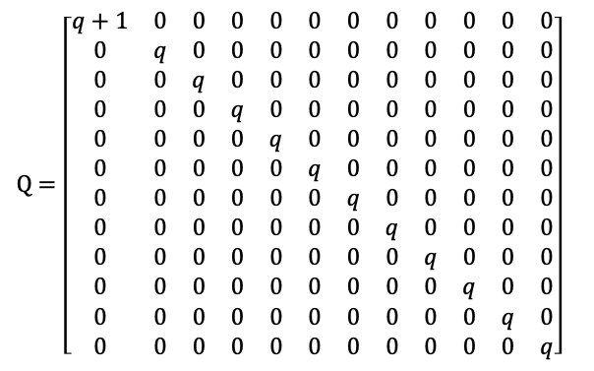
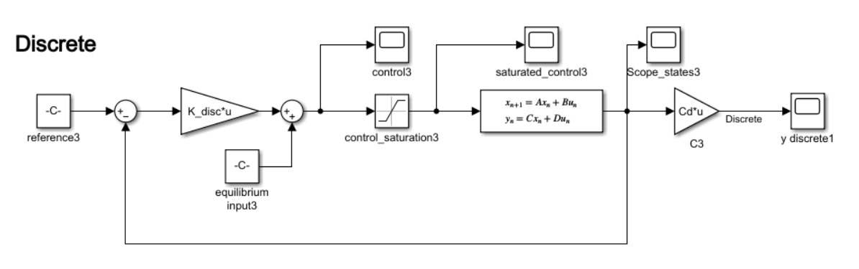



LQ CONTROLLER
Notes:
ENRICO: PUNTO 1

Slide 6
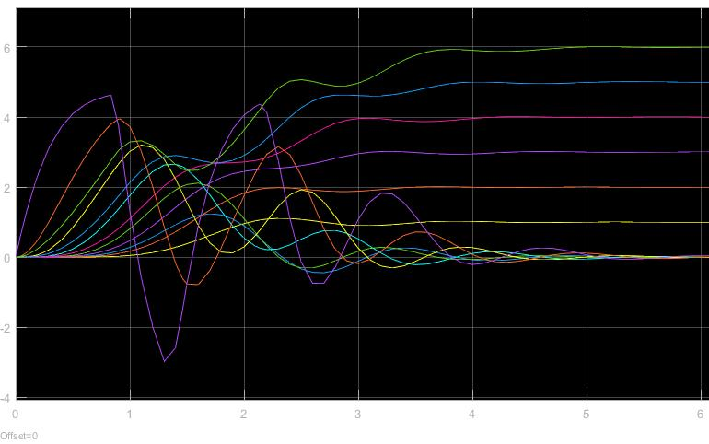
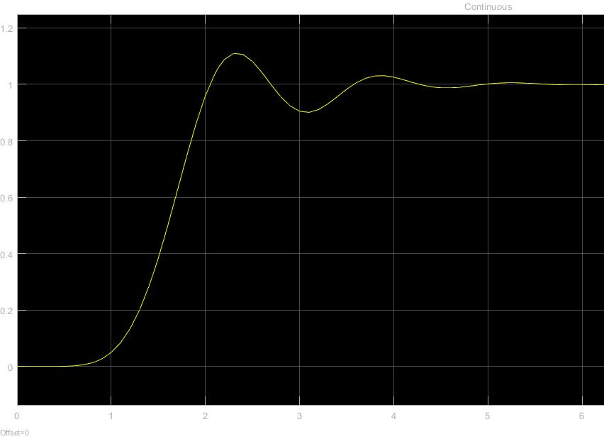
Continuous-Time LQ
States evolution
Output
Notes:
ENRICO

Slide 7
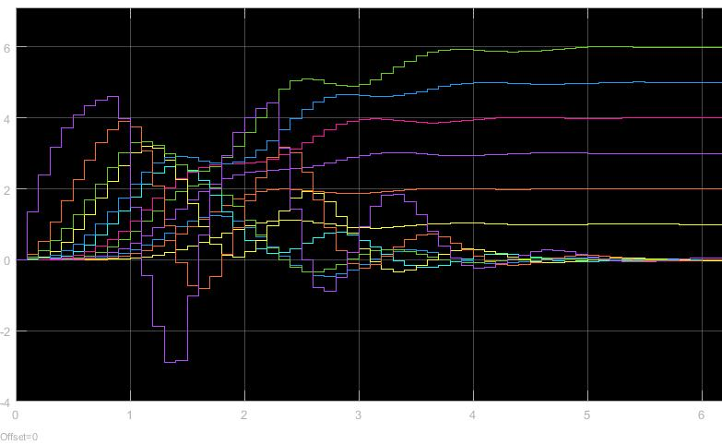
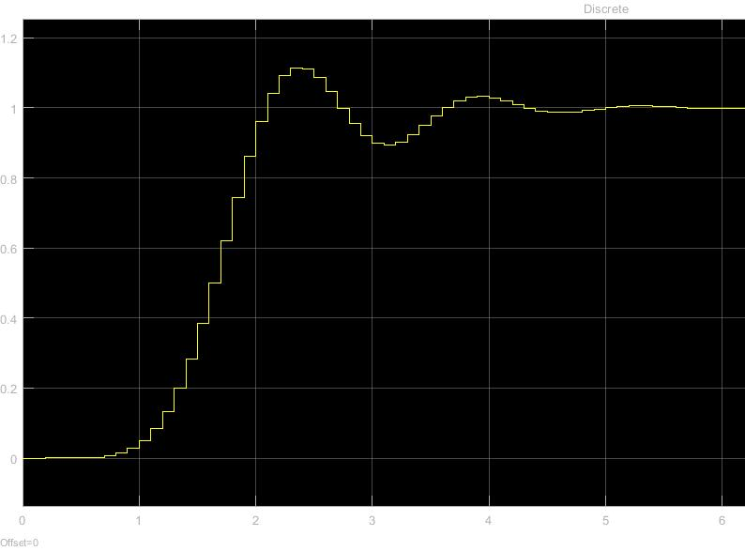
Discrete-Time LQ
States evolution
Output
Notes:
ENRICO

Slide 8
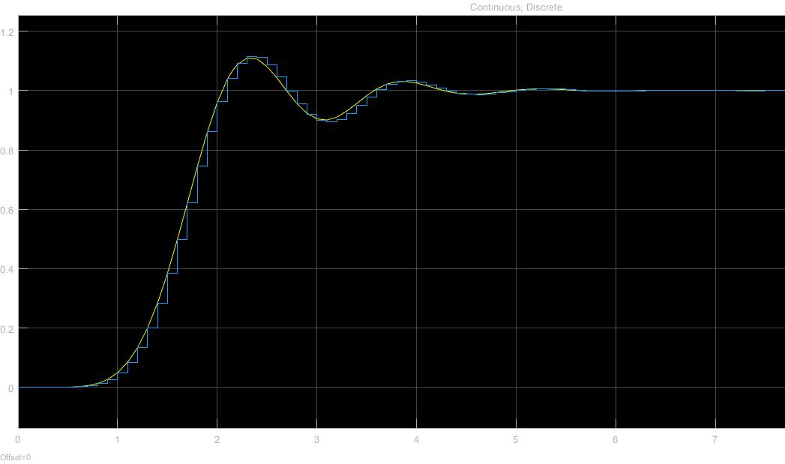
Comparison of y in Discrete-Time and Continuous-Time LQ Systems
Notes:
ENRICO punto 1

Slide 9
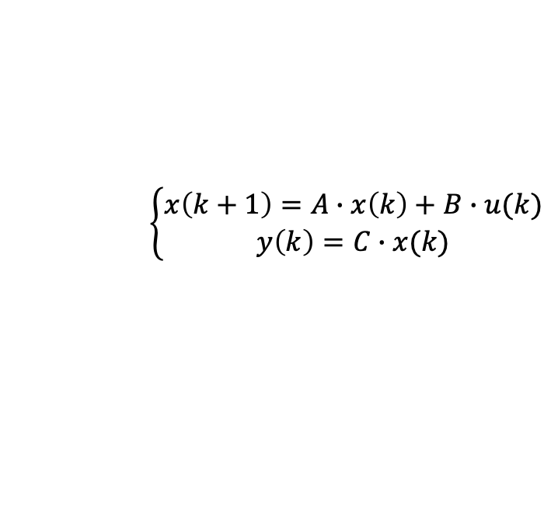

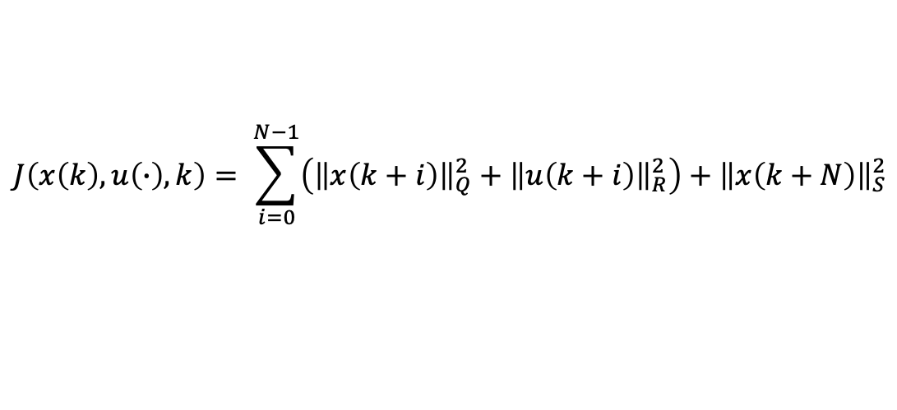



MPC
Control sequence:
Cost function:
N: prediction horizon
Notes:
ELIA: PUNTO 2

Slide 10
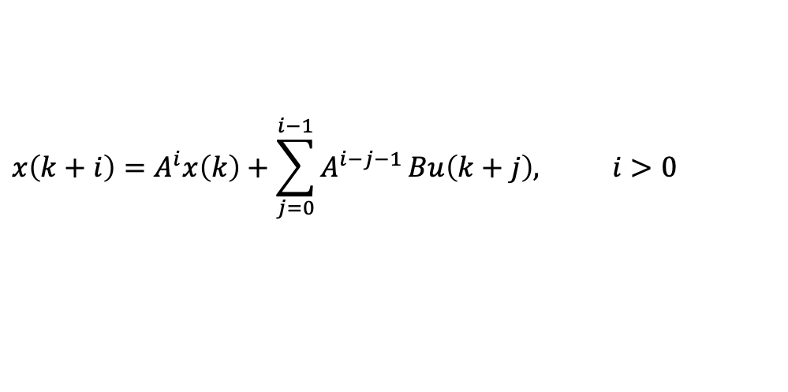
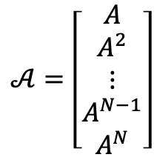
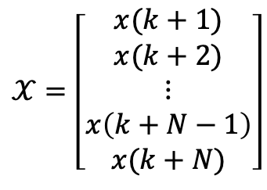
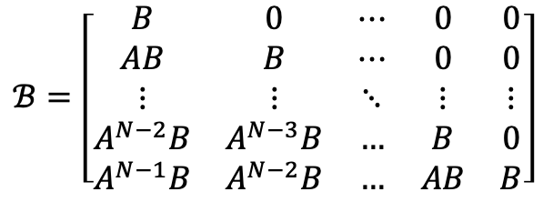
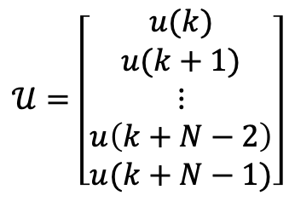
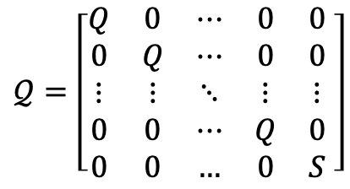
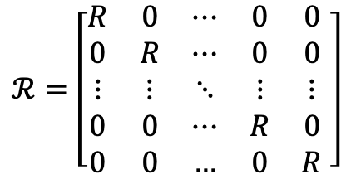
The solution to the optimal problem can also be derived recalling that, in view of the Lagrange equation
Notes:
ELIA

Slide 11
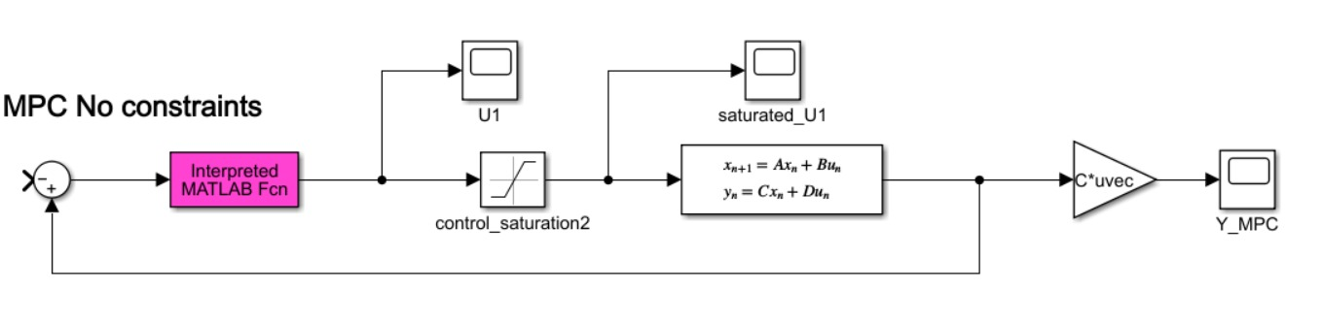
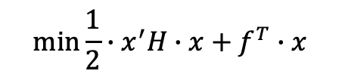
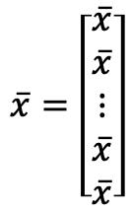
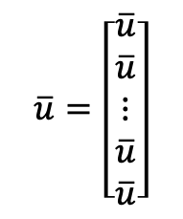


MPC CONTROLLER _{(no constraints)}
U = quadprog(H, f, [ ], [ ], [ ], [ ], [ ], [ ], [ ], options);
Notes:
ELIA:

Slide 12
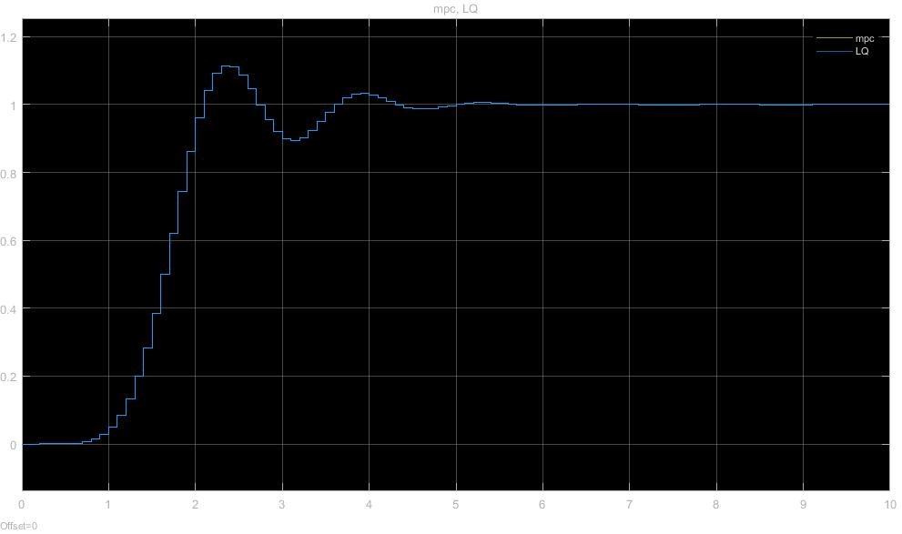
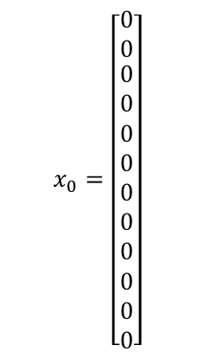
Comparison of System Outputs: MPC vs LQ
$$x_{0}=\left[\begin{matrix}0 \\ 0 \\ \begin{aligned}0 \\ 0 \\ 0 \\ 0 \\ 0 \\ 0 \\ 0 \\ 0 \\ 0 \\ 0\end{aligned}\end{matrix}\right]$$
S = P_{r}
N = 10
Notes:
ELIA

Slide 13
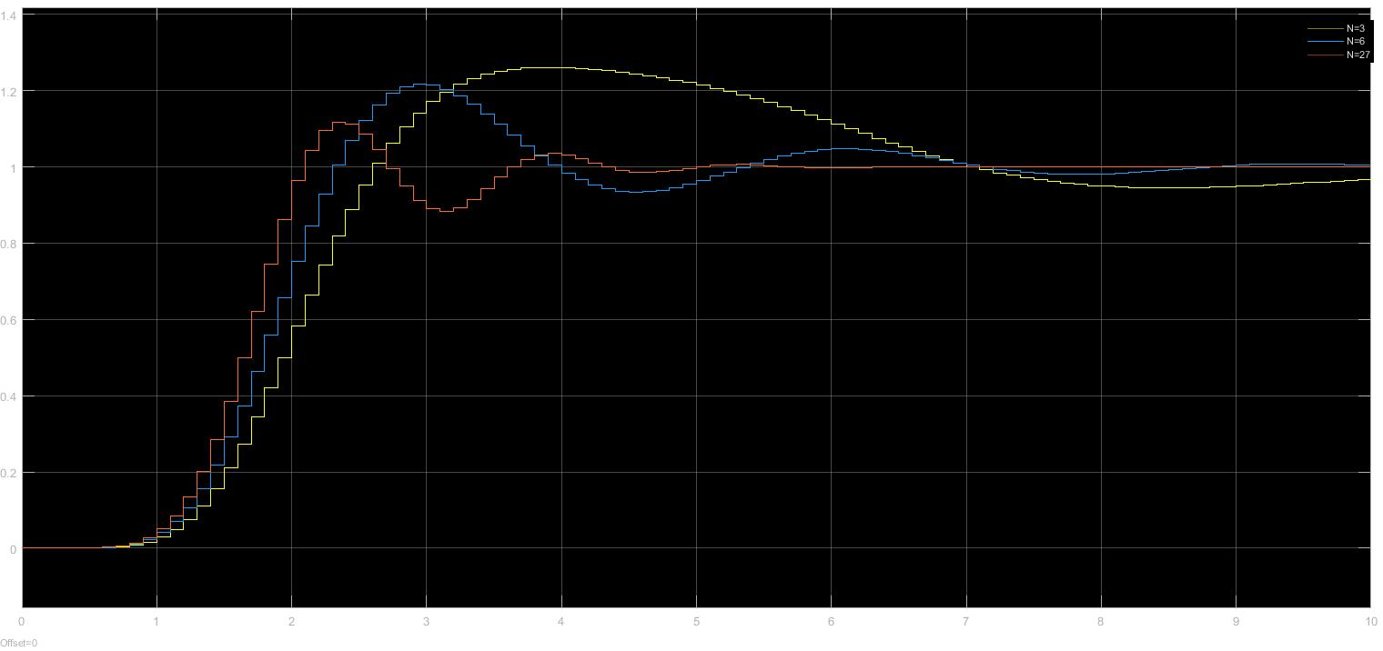
Considering the terminal cost matrix S = 0
Notes:
ELIA: PUNTO 3

Slide 14
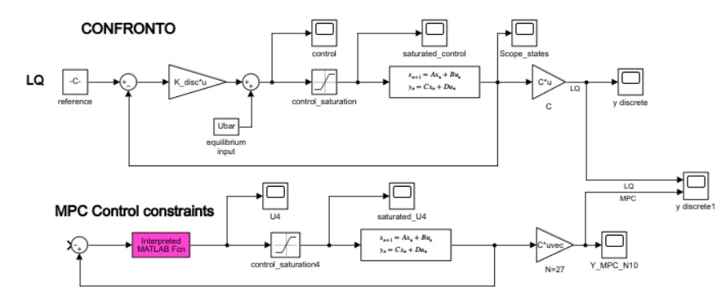



MPC _{(control constraints)}
U = quadprog(H , f, [ ], [ ], [ ], [ ], lb , ub, [ ], options);
Notes:
PUNTO 4

Slide 15
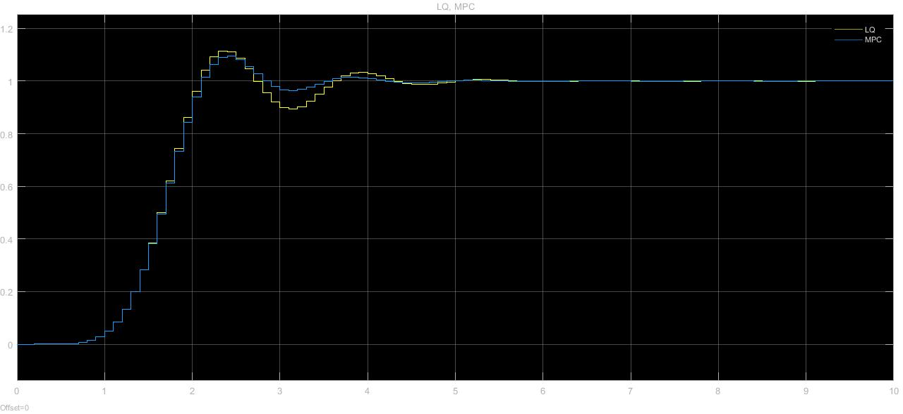
Comparison of Y using MPC with Control Constraint and LQ

Slide 16
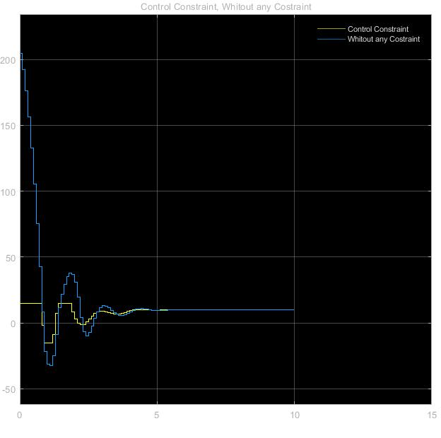
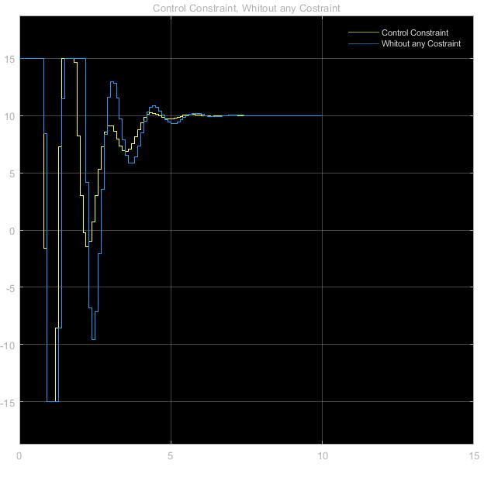
Comparison of U: Control Constraint vs. No Constraint after control saturation block
Comparison of U: Control Constraint vs. No Constraint

Slide 17



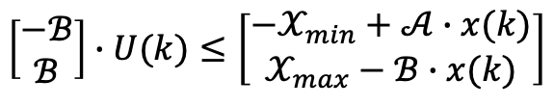
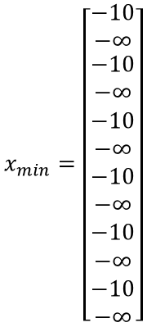
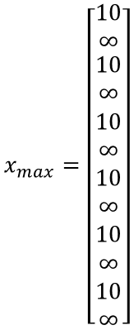
MPC (control and state constraints)
$$x_{max}=\left[\begin{matrix}10 \\ ∞ \\ \begin{aligned}10 \\ ∞ \\ 10 \\ ∞ \\ 10 \\ ∞ \\ 10 \\ ∞ \\ 10 \\ ∞\end{aligned}\end{matrix}\right]$$
$$x_{min}=\left[\begin{matrix}−10 \\ −∞ \\ \begin{aligned}−10 \\ −∞ \\ −10 \\ −∞ \\ −10 \\ −∞ \\ −10 \\ −∞ \\ −10 \\ −∞\end{aligned}\end{matrix}\right]$$
lb
ub
A
b
U = quadprog(H, f, A, b, [ ], [ ], lb, ub, [ ], options);

Slide 18
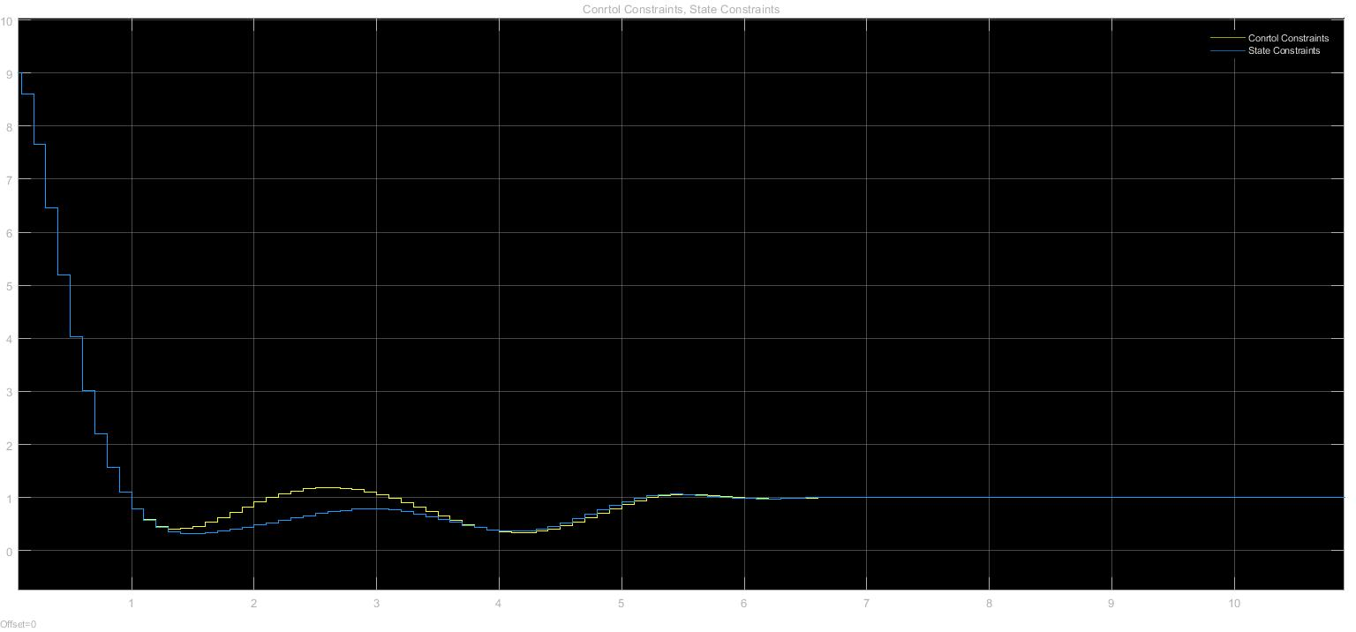
Comparison of Y using MPC with and without State Constraint

Slide 19
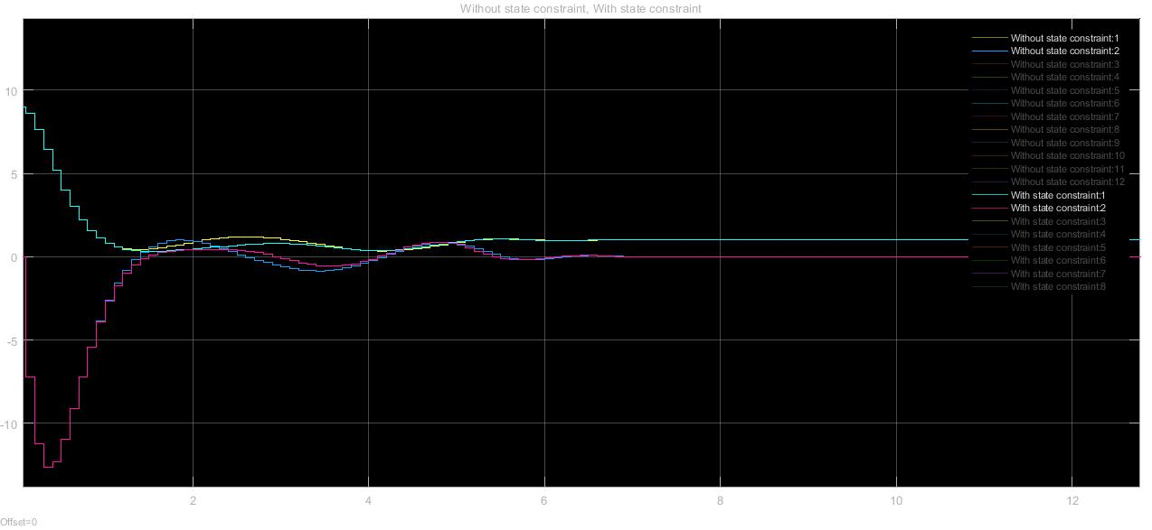
Comparison of First two states using MPC with and without State Constraint

Slide 20
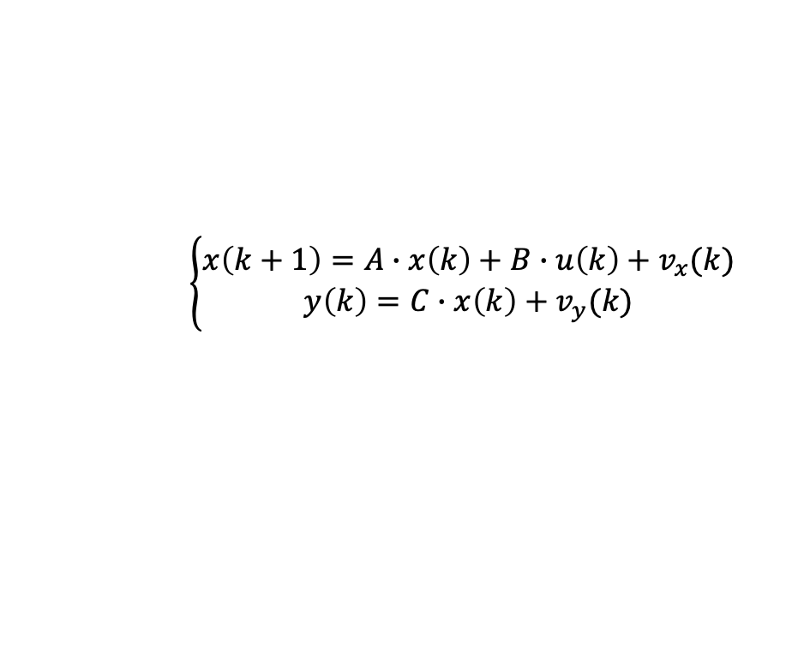
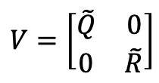
KALMAN FILTER
Suppose that the state is not measurable and that the system is affected by process and
measurement noise.

Slide 21
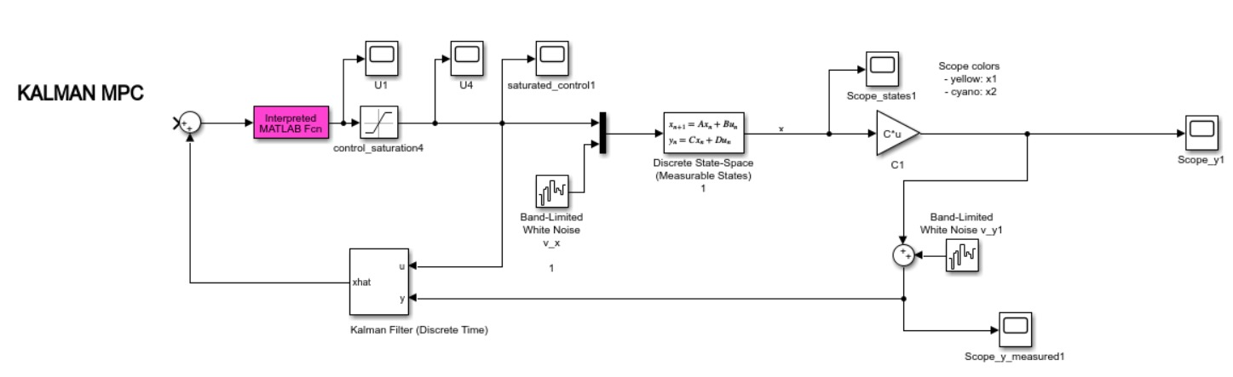





Nk = 0

Slide 22
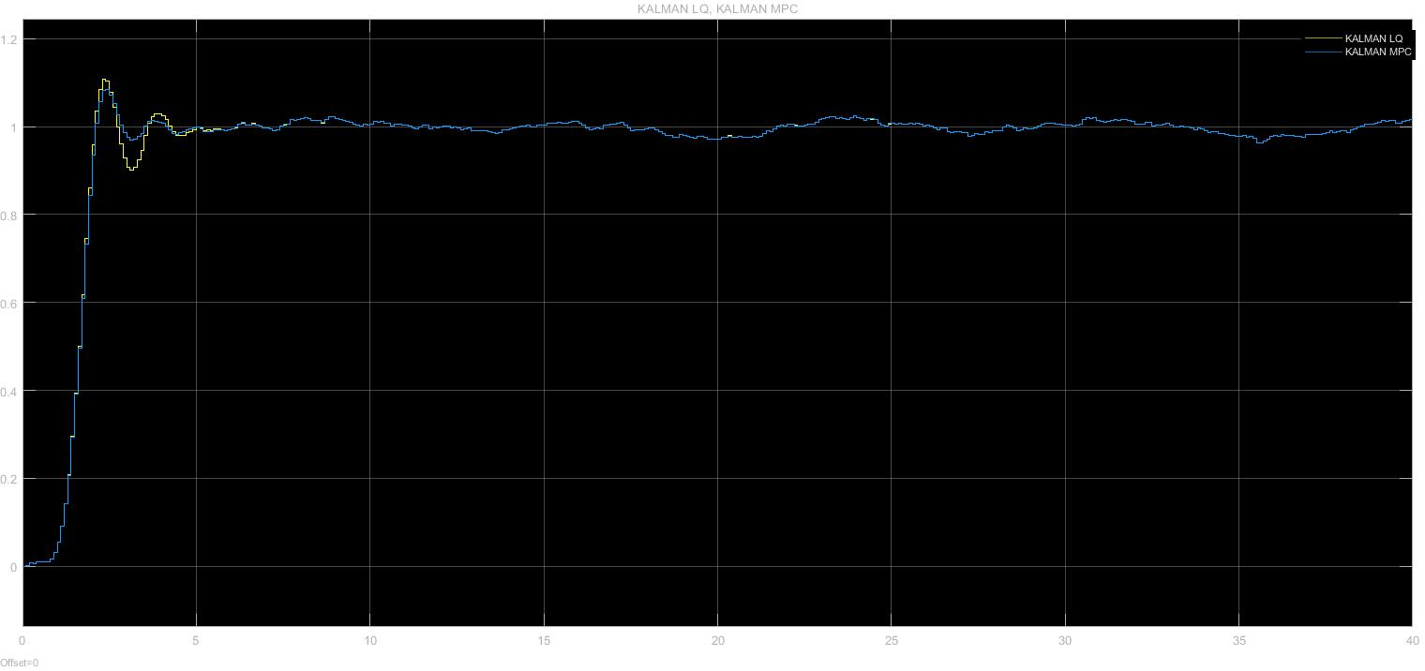
Comparison of MPC and LQ with Kalman Filter

Slide 23
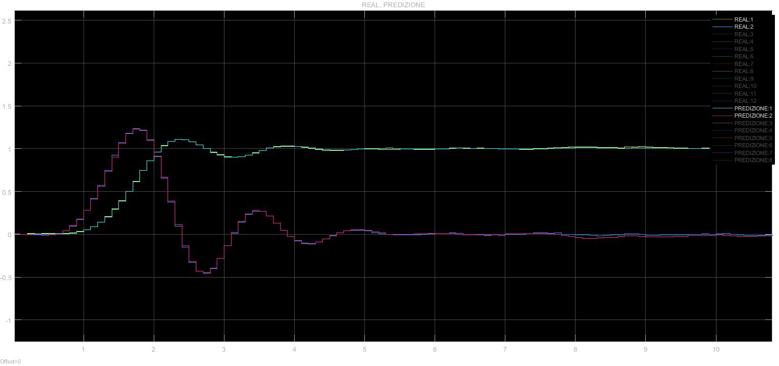
Comparison of First Two States (first mass position and velocity): Real vs Predicted

Slide 24


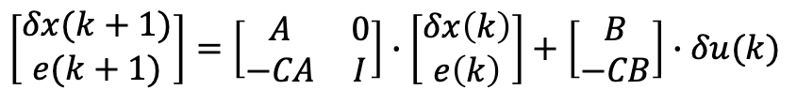
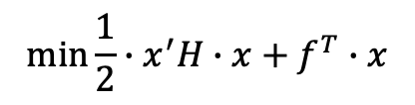


VELOCITY FORM
Suppose that there is some uncertainty in the model used by the MPC, and that the real
value of the spring constant is k = 8.
U = quadprog(H, f, [ ], [ ], [ ], [ ], [ ], [ ], [ ], options);

Slide 25
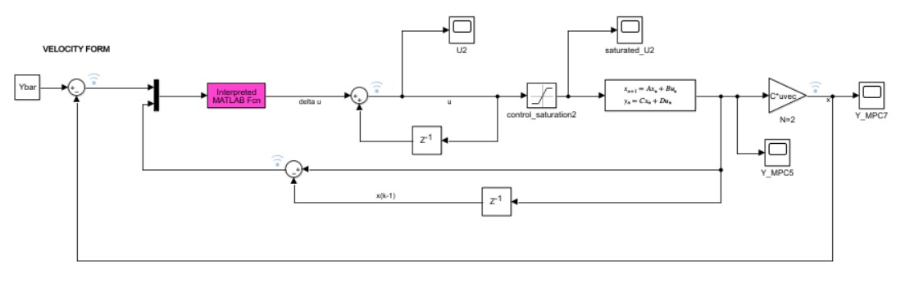

VELOCITY FORM
We've applied quasi infinite horizon MPC, enabling it to anticipate and gradually respond to system variations, maintaining effective control even under variable and complex conditions.
Sufficient condition for the asymptotically stable equilibrium point

Slide 26
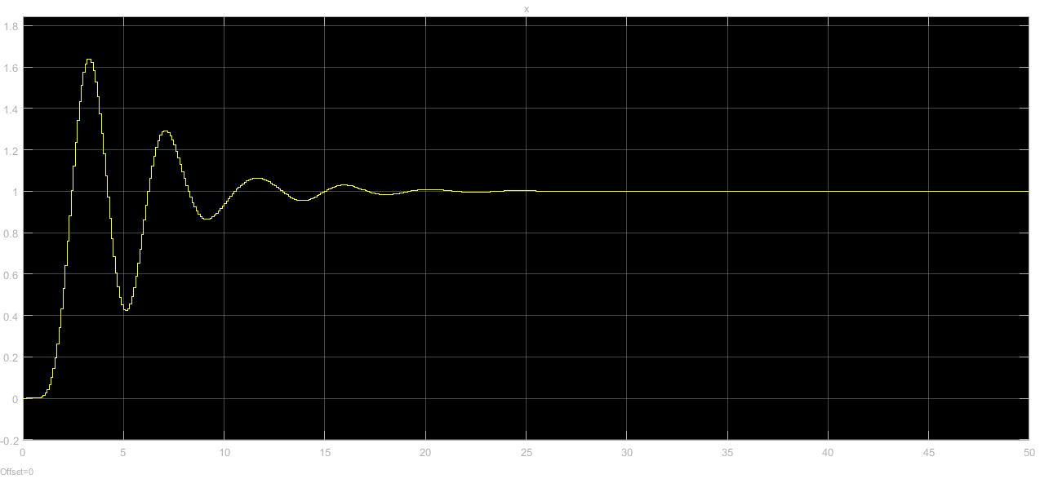
System Output in Velocity Form

Slide 27
THANKS FOR THE ATTENTION
UNIVERSITA’ DEGLI STUDI DI PAVIA

