Slide 1
Anomaly Detection in Time Series Data of Sensex and Nifty 50 With Keras
Paper Id - 351
Authors :
Dhruvil Shah
Soham Khade
Sudesh Pawar

Slide 2
Abstract
Anomaly detection problem for time series refers to finding outlier data points relative to some standard or usual signal.
A price action that contradicts the expected movement of the stock market is called an anomaly. Few anomalies appear only once and disappear, but there are some that appear consistently throughout historical chart analysis.
Traders and investors are benefitted from these unusual market behaviors to find opportunities throughout the stock market. While there are plenty of anomaly types, we have focused only on the most important ones such as unexpected spikes i.e., sudden rise in the prices, drops i.e., sudden fall in the prices, trend changes and level shifts.

Slide 3

Motivation

Slide 4
Proposed Model
Data Preprocessing
Creating Train and Test Splits
Building an LSTM Autoencoder
Train the Autoencoder
Evaluating the Model
Detecting Anomalies in the Index Data Set

Slide 5
Data Preprocessing
The data that we have used has two columns. The first column contains the date and the second column contains the closing points of the index data on that particular date. The StandardScaler function transforms our data such that its distribution will have a standard deviation of 1 and mean value of 0.
Creating train and test splits
Usually for such projects we go for a 80:20 split but we have allocated 90% of the data to train our model and 10% of the data to test the model due to less data and we have trained the model successfully.

Slide 6
Building an LSTM Autoencoder
We are inputting a sequence of 30 closing prices and asking the model to predict the same sequence which is a bit different from memorizing the sequence itself. We are just forcing it to learn the most important features of our data. Doing this helps identifying errors and then we can use those errors and threshold it which would help us predict whether we have an anomaly or not.
Train the Autoencoder
Using the fit function of the sklearn library, statistical analysis of the data and our survey enabled us to deduce that training for 10 epochs would minimize the validation losses. We therefore, train the autoencoder for 10 epochs in batch size of 128 tuples at a time.We finally arrived at 10.63% loss for Sensex data and 9.84% loss for Nifty data.

Slide 7
Evaluating the Model
After 10 epochs there is a gradual decrease in validation loss which means that our model has learnt from the training. We are going to take predictions on the training data which would help us to find the mean absolute error.
Detecting Anomalies in the Index Data Set
The threshold value holds a lot of importance in this model, we need to choose the threshold value appropriately. Using the threshold values, we will create the data frame with points having anomalies.The threshold value is decided from the distplot in such a way that there is not much of the loss is larger than the picked threshold value.

Slide 8
Obtained Result
The threshold value selected for Sensex is 0.27 and the number of possible anomalies detected are 354.
The threshold value selected for Nifty50 is 0.33 and the number of possible anomalies detected are 48.
We obtained an accuracy of 85% for Nifty50 and 82% for Sensex on respective datasets which is better than existing work(~74-76%).

Slide 9
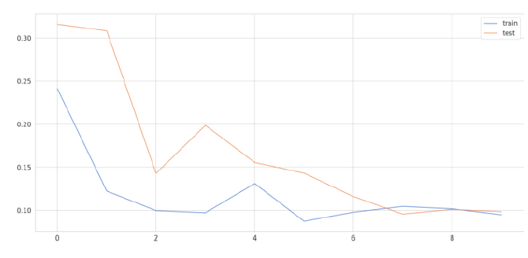
Obtained Result -
Loss vs Epoch for Nifty
As observed , there is no significant improvement after 8 epochs , therefore, the callback function is activated after 8 epochs in case of Nifty 50 data.

Slide 10
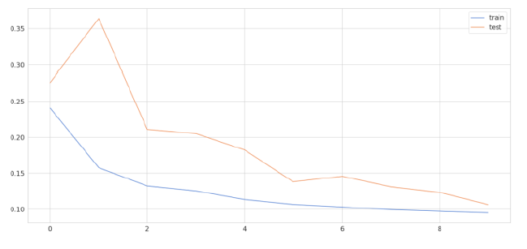
Obtained Result -
Loss vs Epoch for Sensex
As observed , there is no significant improvement after 9 epochs , therefore, the callback function is activated after 9 epochs in case of Sensex data.

Slide 11
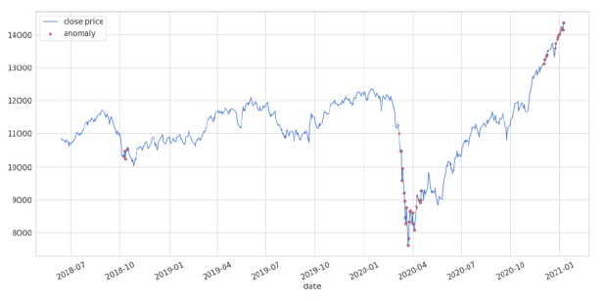
Obtained Result - Detected Anomalies on Nifty

Slide 12
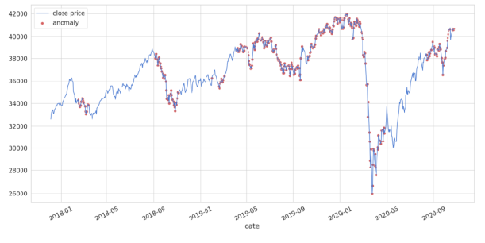
Obtained Result - Detected Anomalies on Sensex

Slide 13
Further Scope
Research and innovation is needed in this field so that one day the no. of detected anomalies are as small as possible as research show number of new dematerialized accounts, opened during financial year 2020 was the most in last 10 years at 4.9 million, a 22.5% increase from the 4 million dematerialized accounts opened in the previous year.

Slide 14
Acknowledgement
We would like to thank our colleagues Kunal Yeola, Gaurav Verma and Shreyas Chaudhari who provided us insights that greatly assisted the research. We would like to show our gratitude to Prof. Saurabh Kulkarni for proofreading and guiding us during the course of the research.

Slide 15


Thank
You!
We would like to also thank ESCI-2021 Team, AISSMS IOIT and IEEE Pune Section for giving us wonderful opportunity to present our valuable research

