Slide 1
JusTalk Application
Gaurav Verma
Dhruvil Shah
Soham Khade
Yash Patil

Slide 2
Introduction
Realtime chatting application is the need of the hour . India is growing and developing at a faster rate and people are getting more busy in their work . Calling has not been a suitable option for communications as it wastes a lot of time even if the user wants to keep the talk small as possible . So chatting applications play a handy role as users can send the messages on our app smaller and faster and the other user can only receive messages when he turns online. Both users can send and receive messages whenever they are free thus not getting disturb again and again in their work . Our app JusTalk serves all this purpose thus motivating us to develop a real time chatting application

Slide 3
Features
1. Login/signup feature
2. Google material design UI
3. Uses Google's way of material design
4. Uses Firebase Realtime Database Users to chat with each other
5. Used different open-source libraries to create the app

Slide 4



Software Specifications:
1. Front End: Android
2. Back End: Firebase, Java

Slide 5
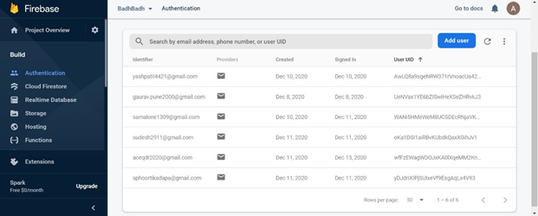

Slide 6
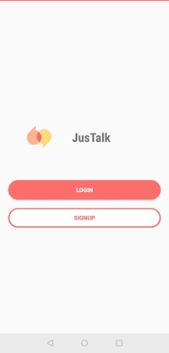
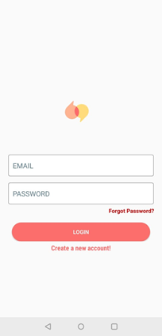
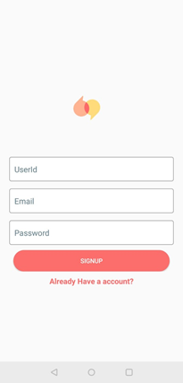

Slide 7
