Slide 1
How To Write Fast Numerical Code Optimal Binary Search Trees
Team 16: Jeremia Bär, Stefan Dietiker
May 30th, 2014

Slide 2
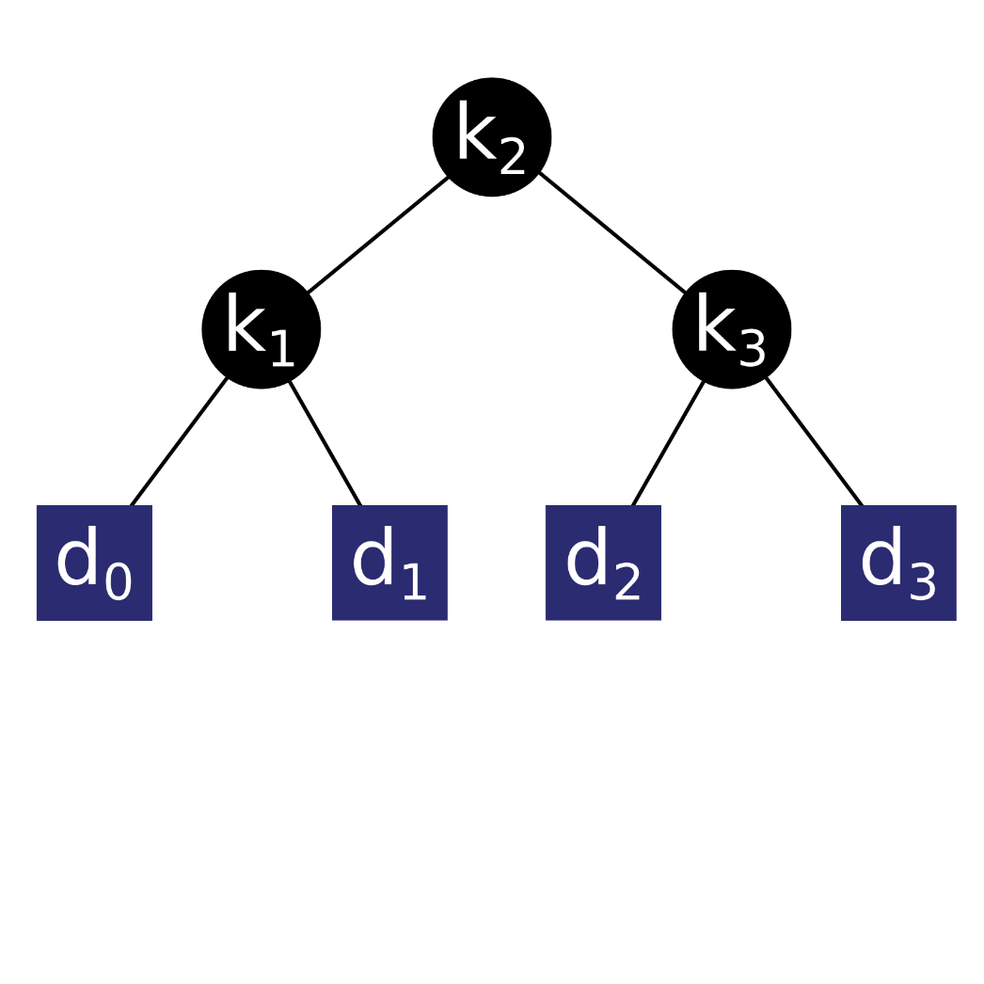
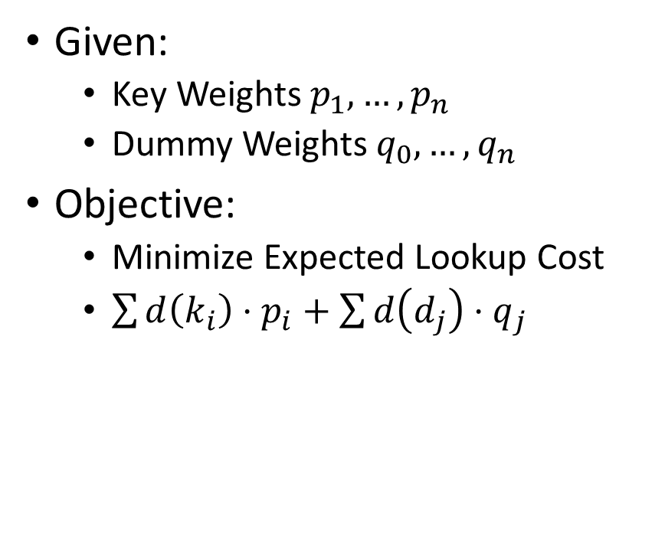
Problem Description
Given:
Key Weights $p_{1}, …, p_{n}$
Dummy Weights $q_{0},…, q_{n}$
Objective:
Minimize Expected Lookup Cost
$\sum{d\left(k_{i}\right)⋅p_{i}}+\sum{d\left(d_{j}\right)⋅q_{j}}$

Slide 3
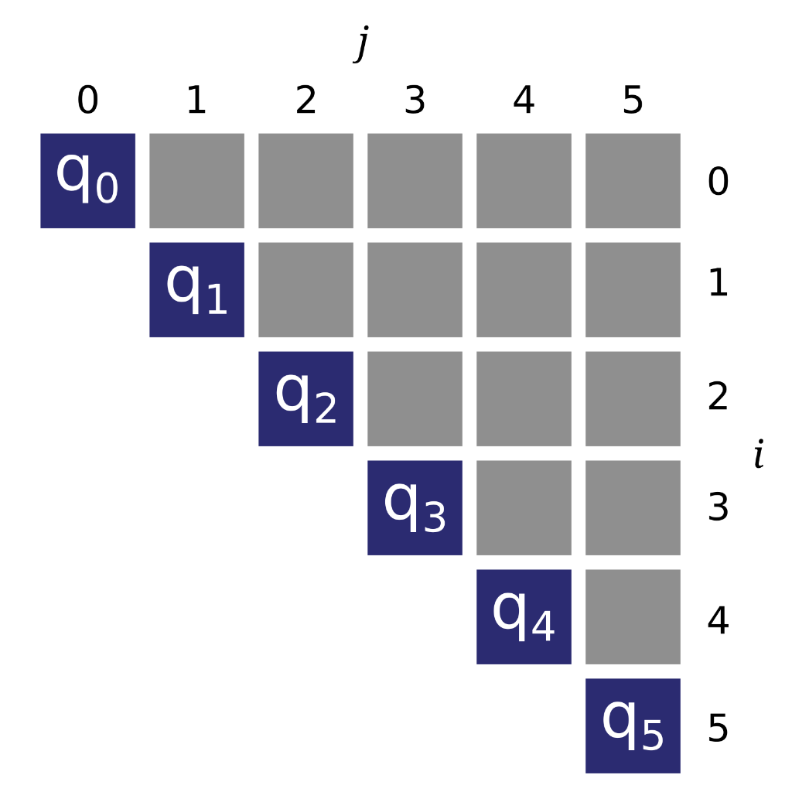
Algorithm: Dynamic Programming

Slide 4
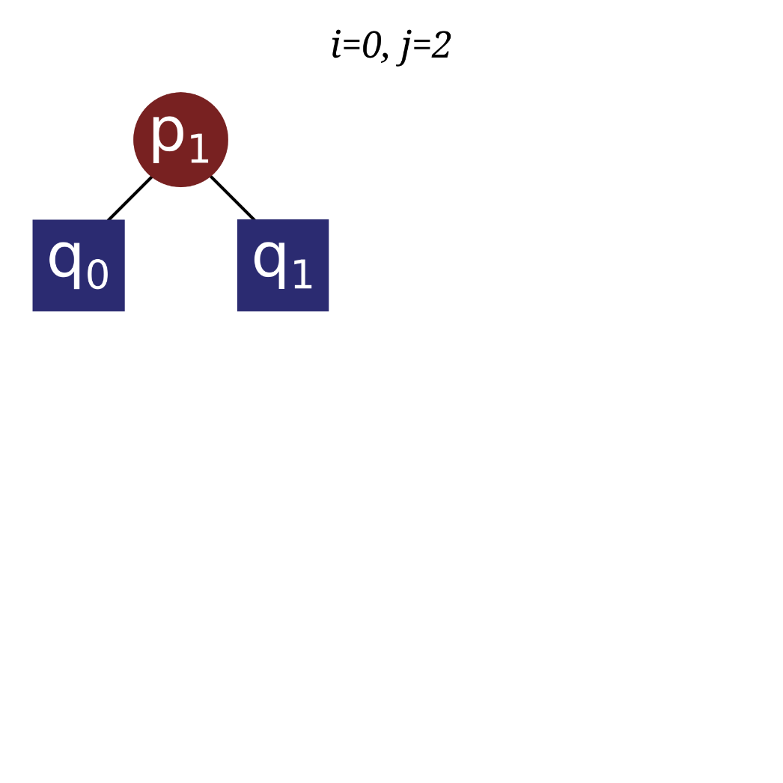
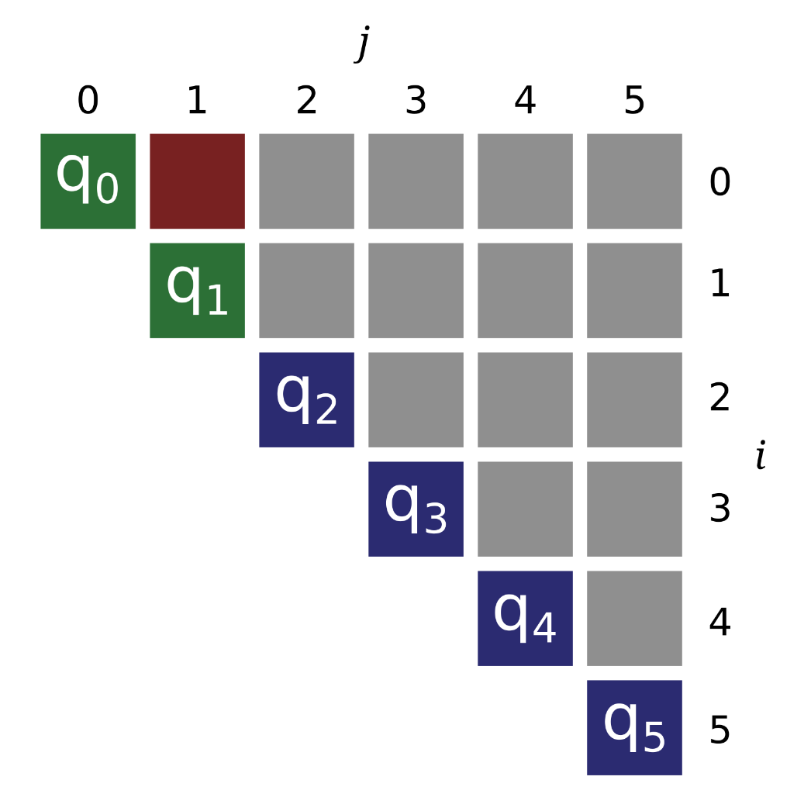
Algorithm: Dynamic Programming

Slide 5
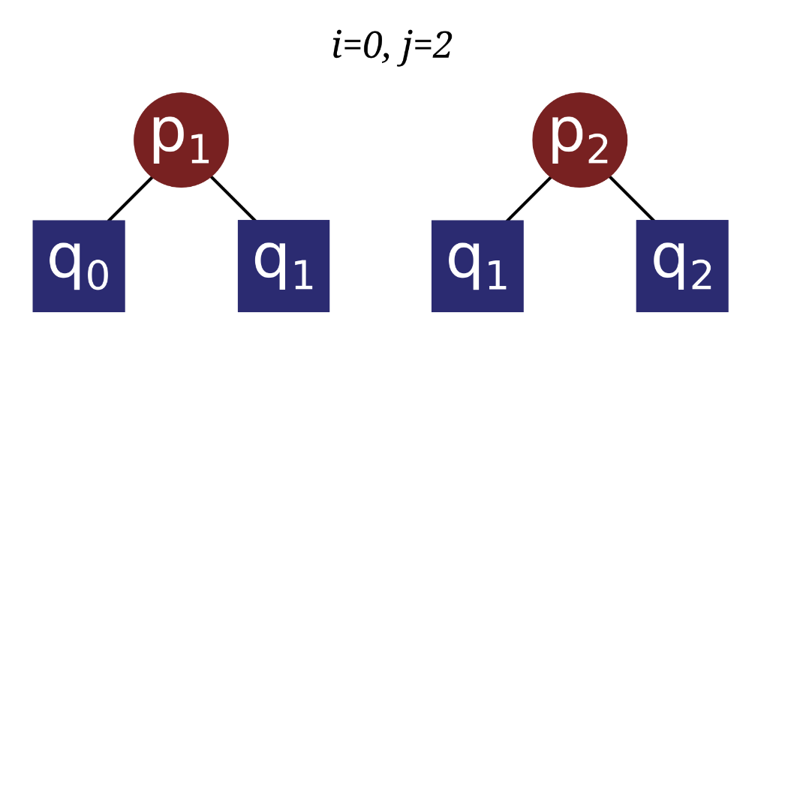
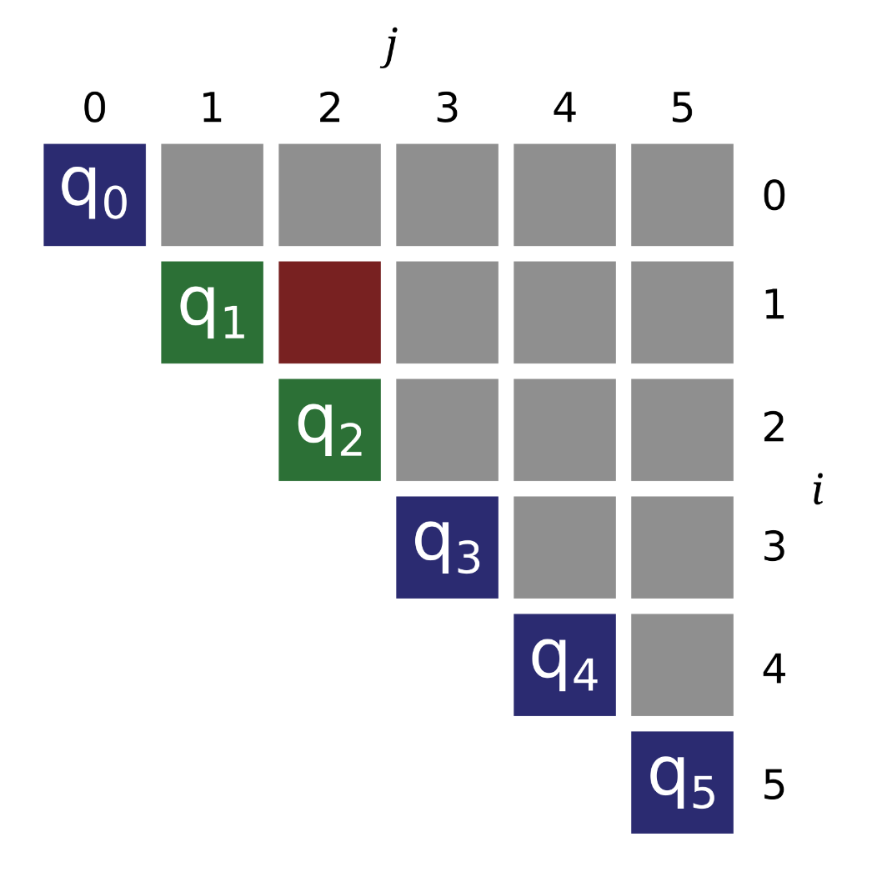
Algorithm: Dynamic Programming

Slide 6
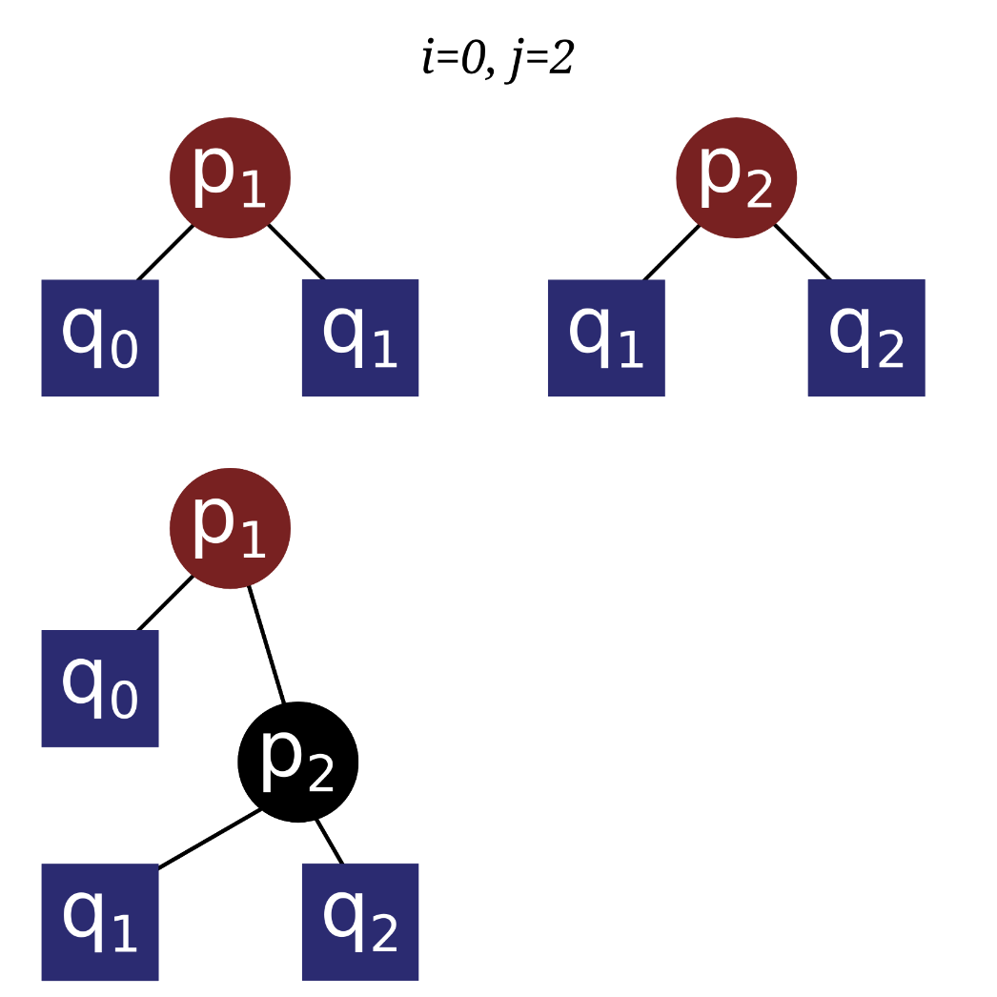
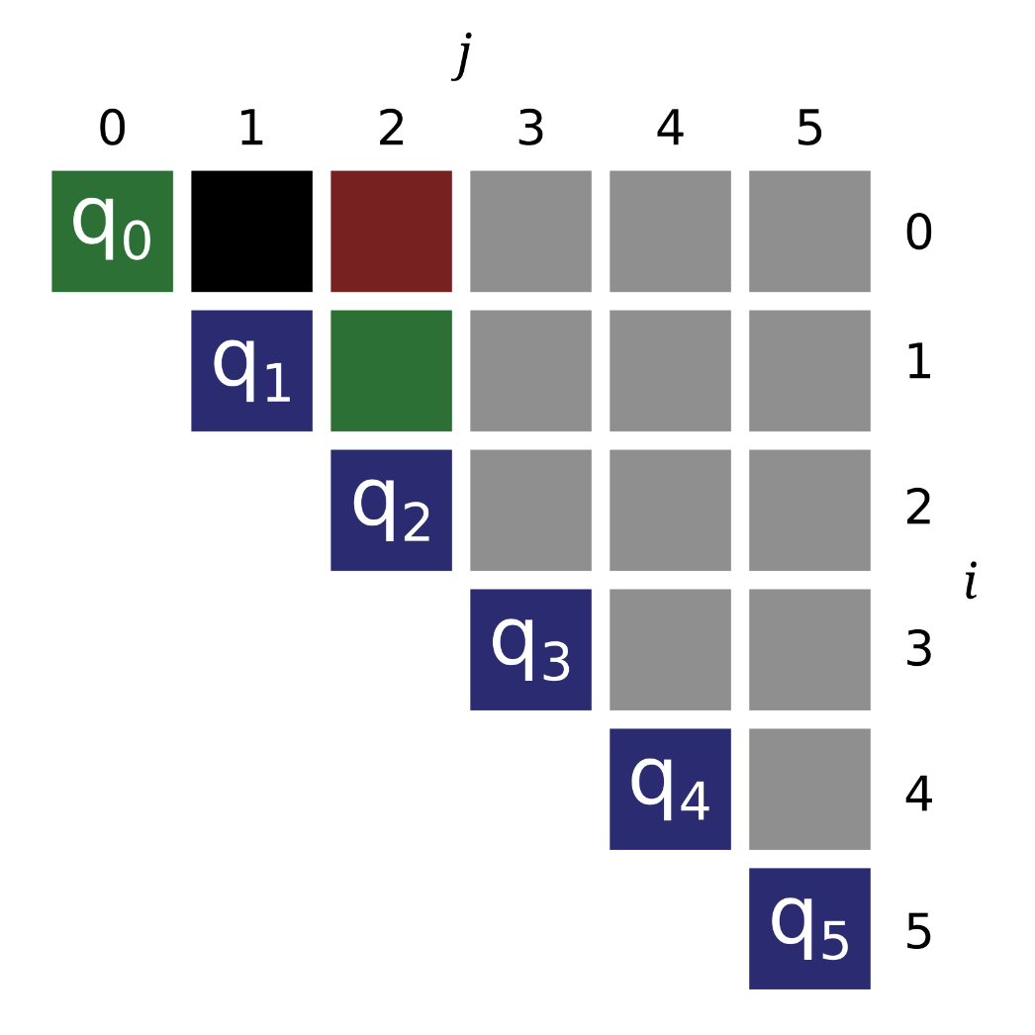
Algorithm: Dynamic Programming

Slide 7
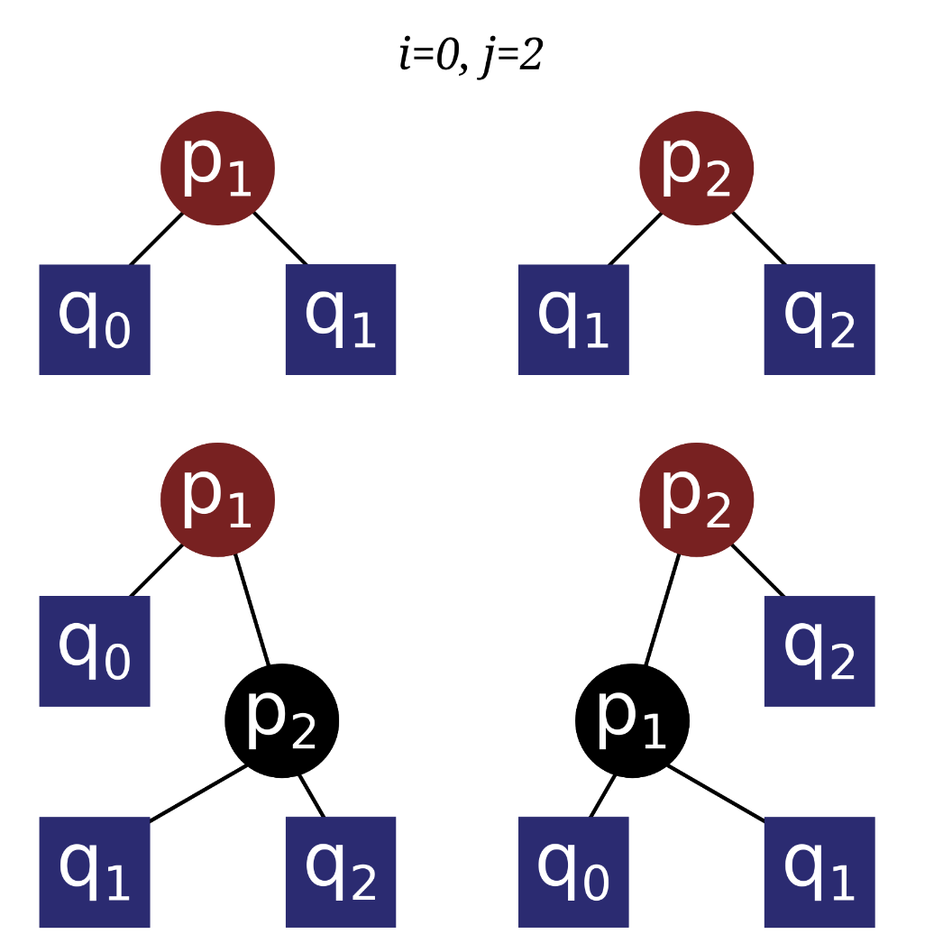
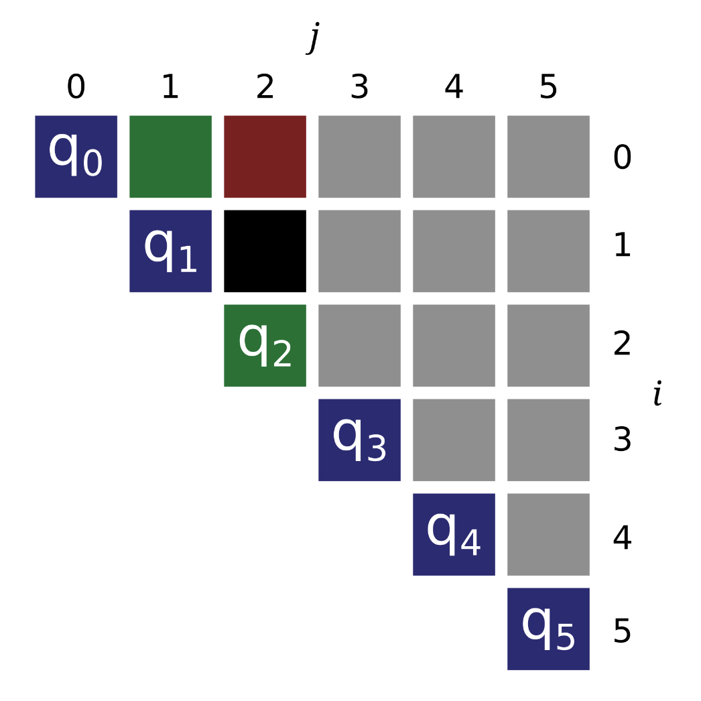
Algorithm: Dynamic Programming

Slide 8
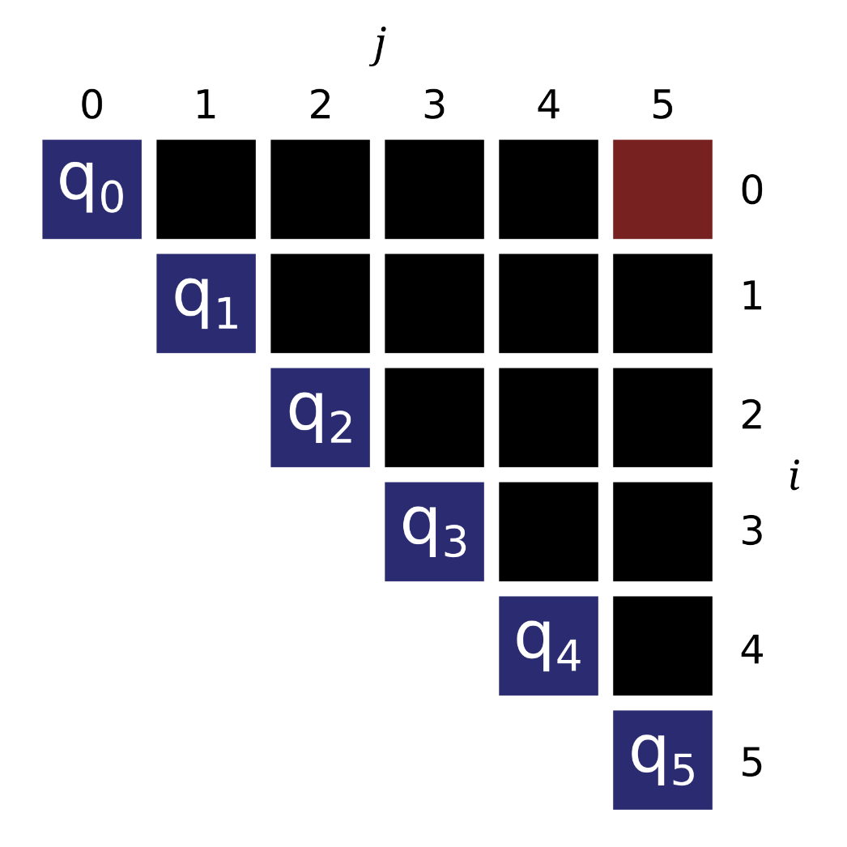
Algorithm: Dynamic Programming

Slide 9
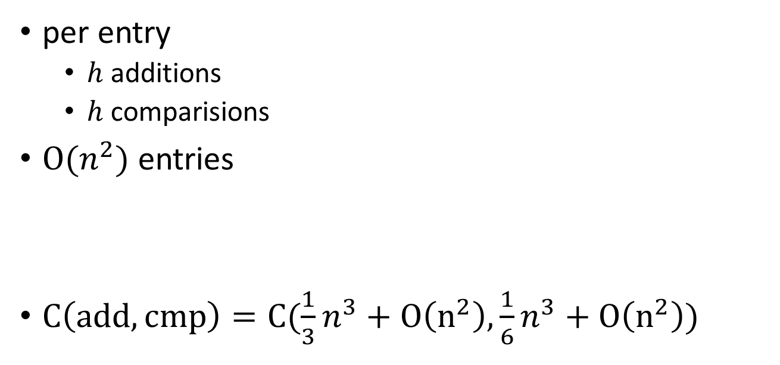
Algorithm: Dynamic Programming
per entry
$h$ additions
$h$ comparisions
$O(n^{2})$ entries
$C\left(add,cmp\right)=C(\frac{1}{3}n^{3}+O\left(n^{2}\right),\frac{1}{6}n^{3}+O\left(n^{2}\right))$

Slide 10
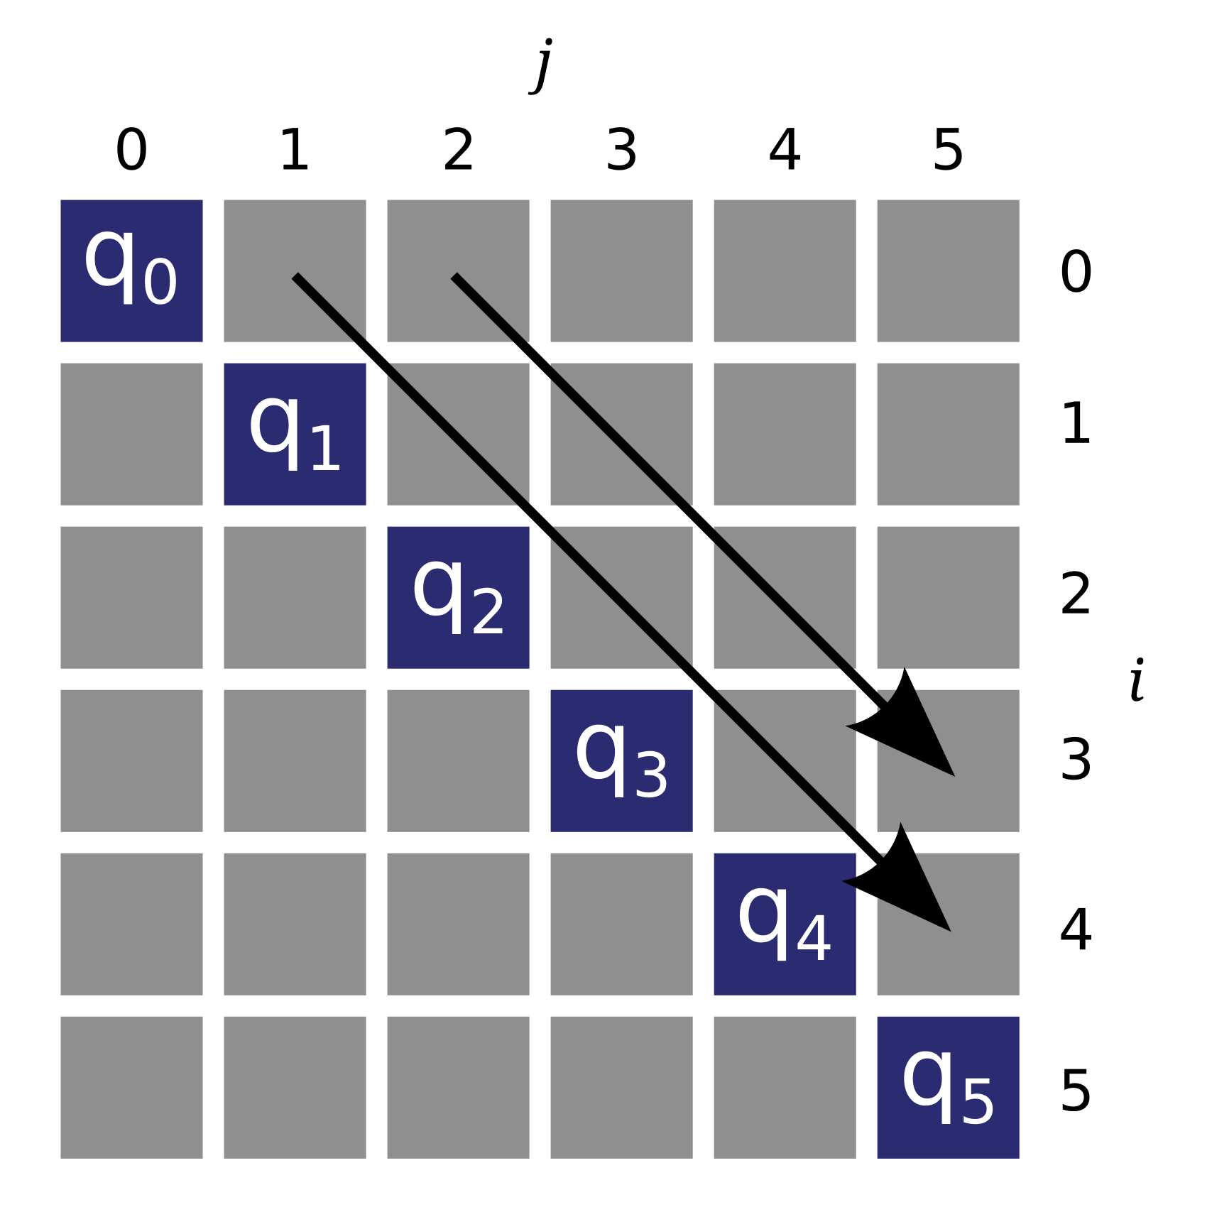
Reference Implementation

Slide 11
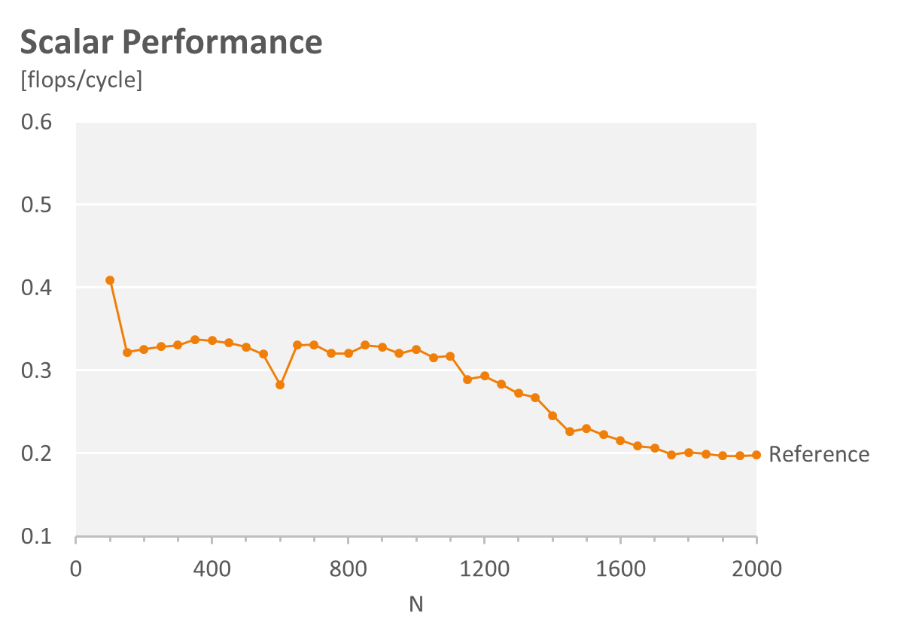
Reference Implementation

Slide 12
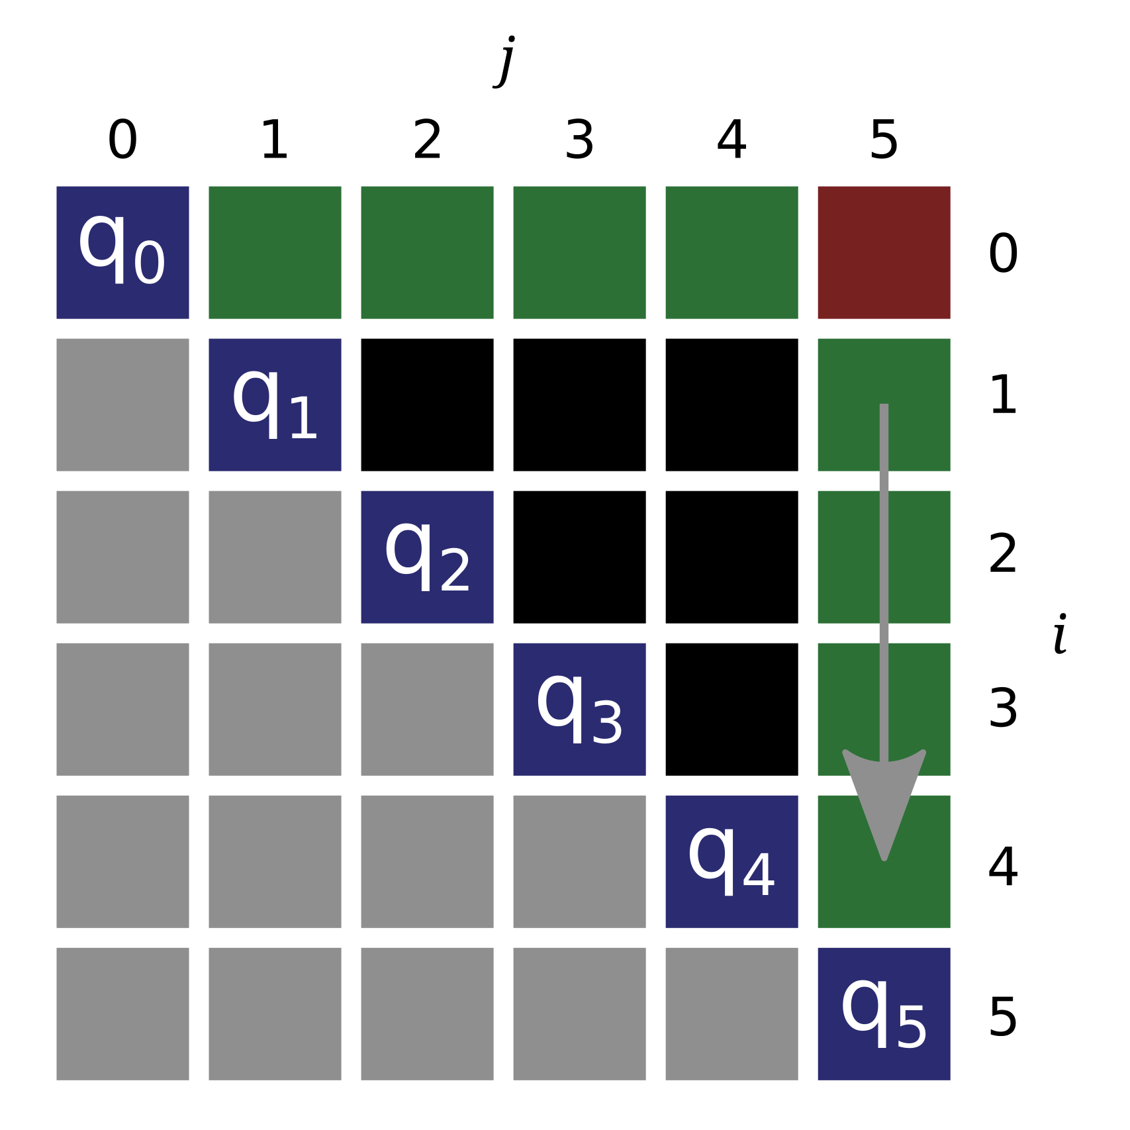
Reference Issues

Slide 13
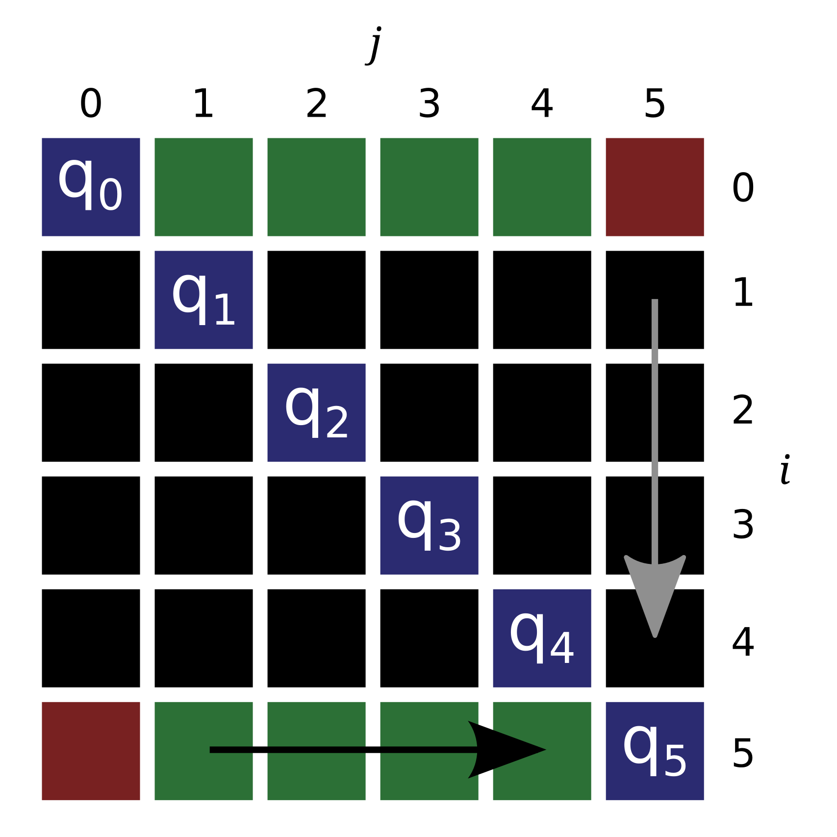
Transposed

Slide 14
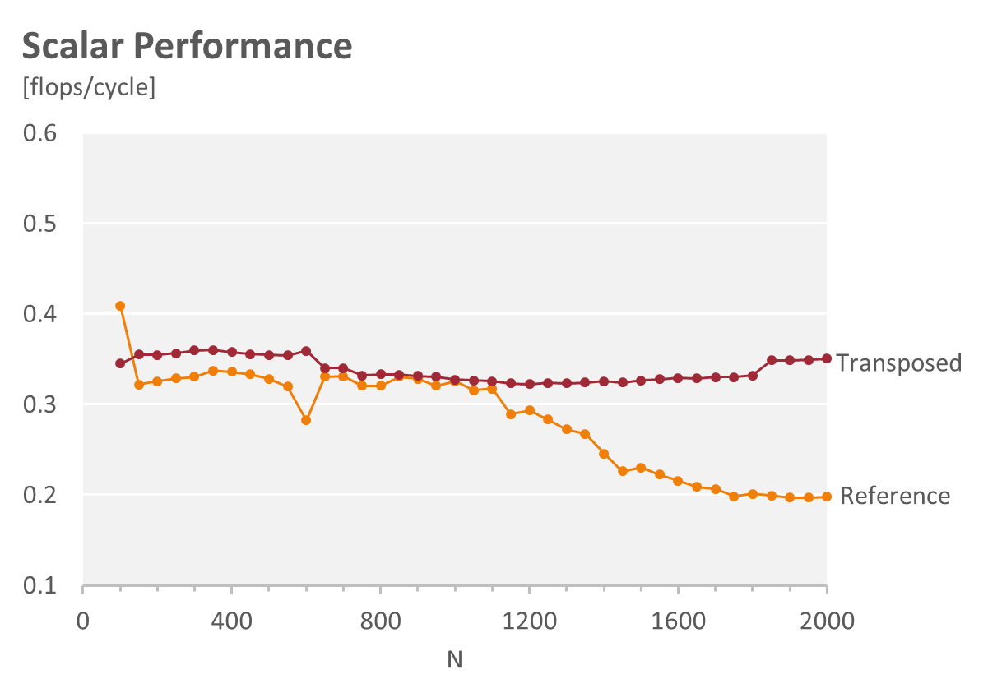
Transposed

Slide 15
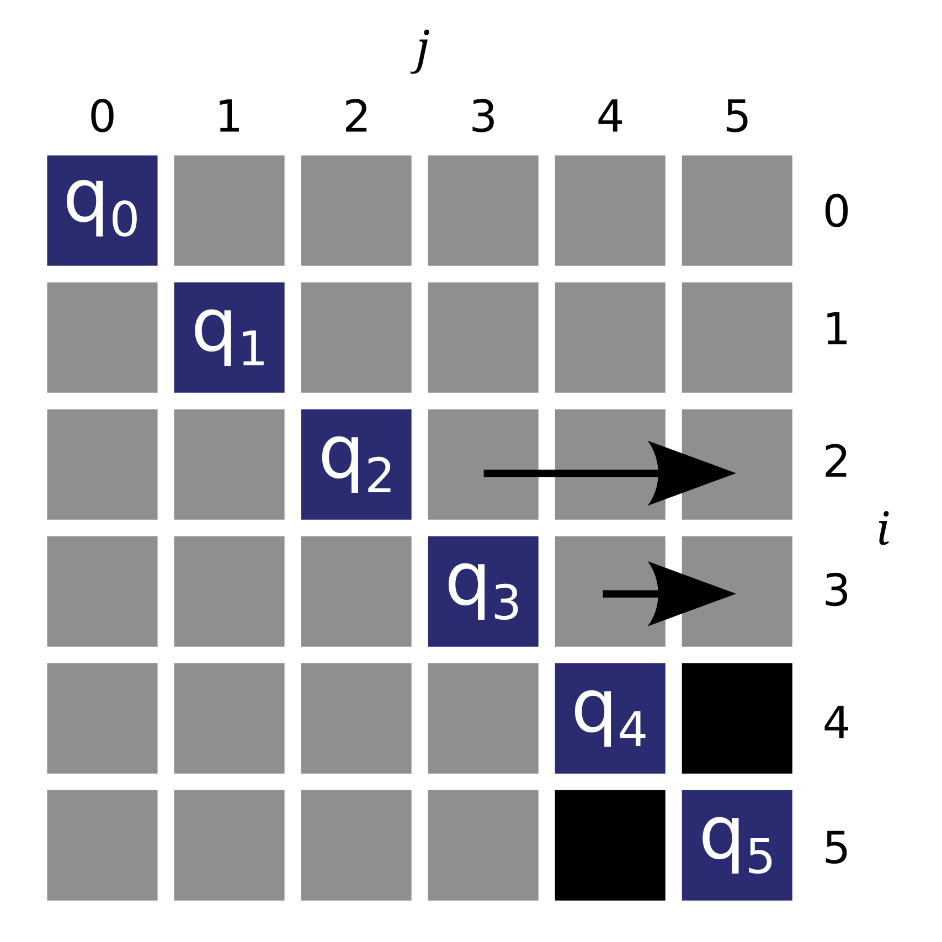
Bottom Up

Slide 16
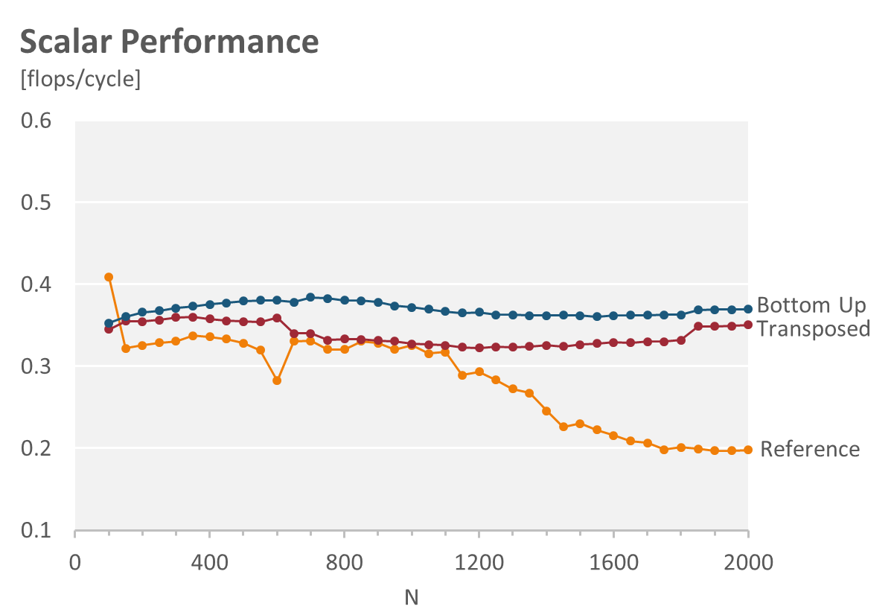
Bottom Up

Slide 17
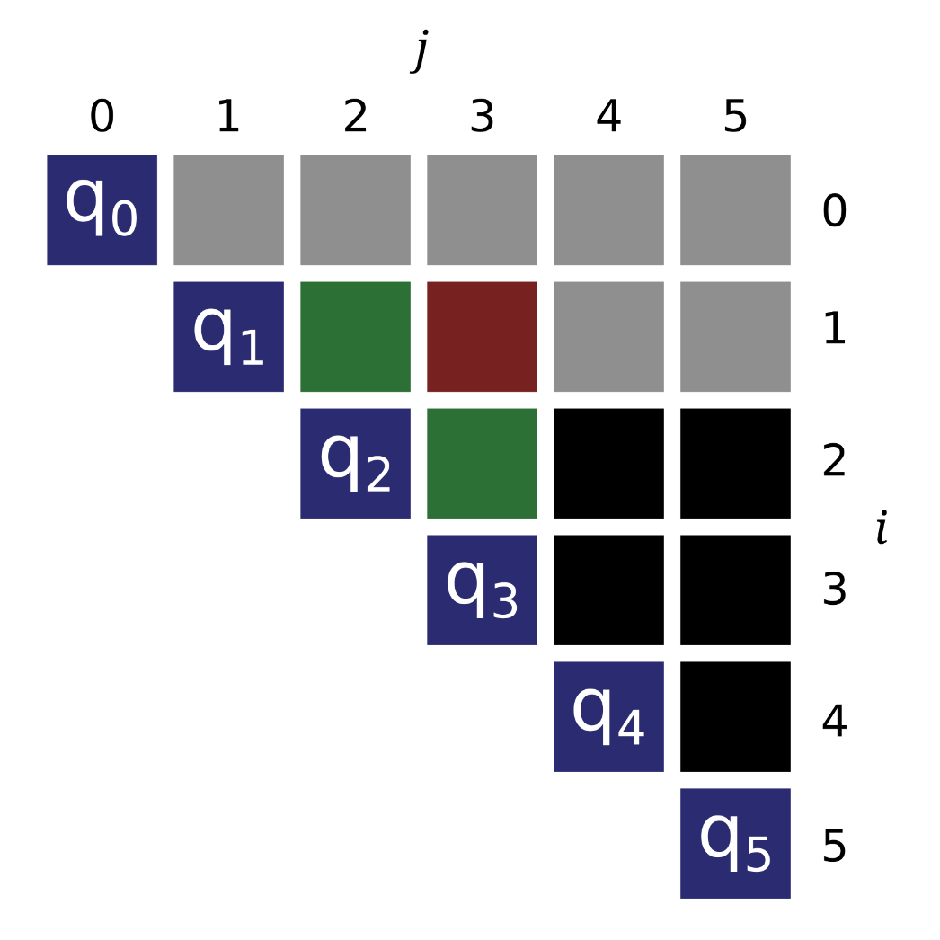
Swap Loops: Triangle

Slide 18
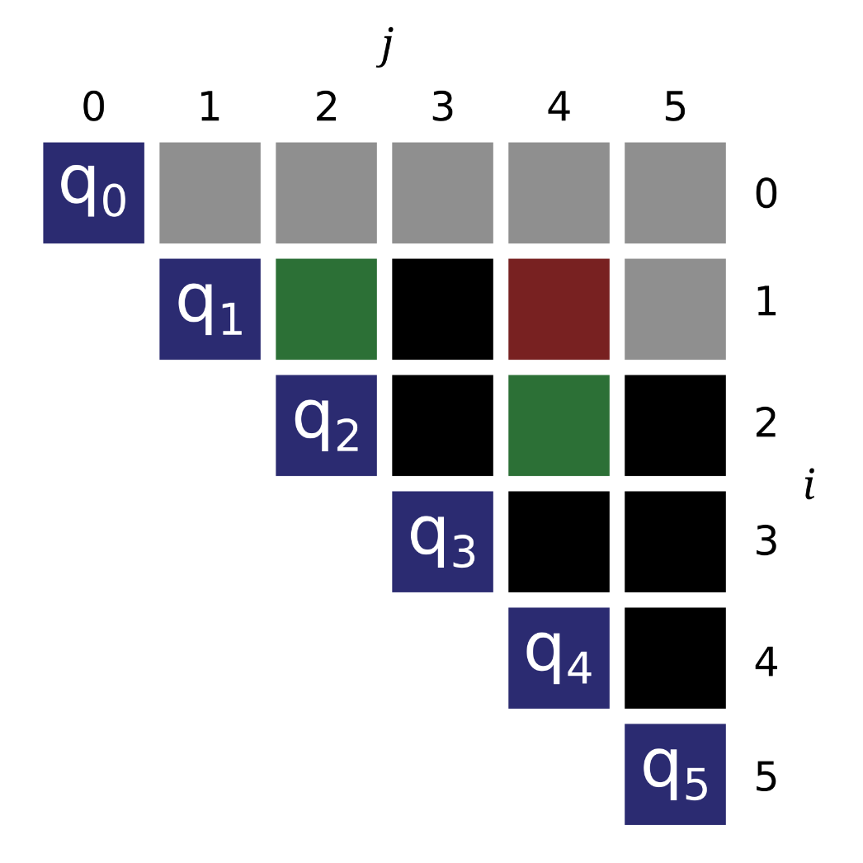
Swap Loops: Triangle

Slide 19
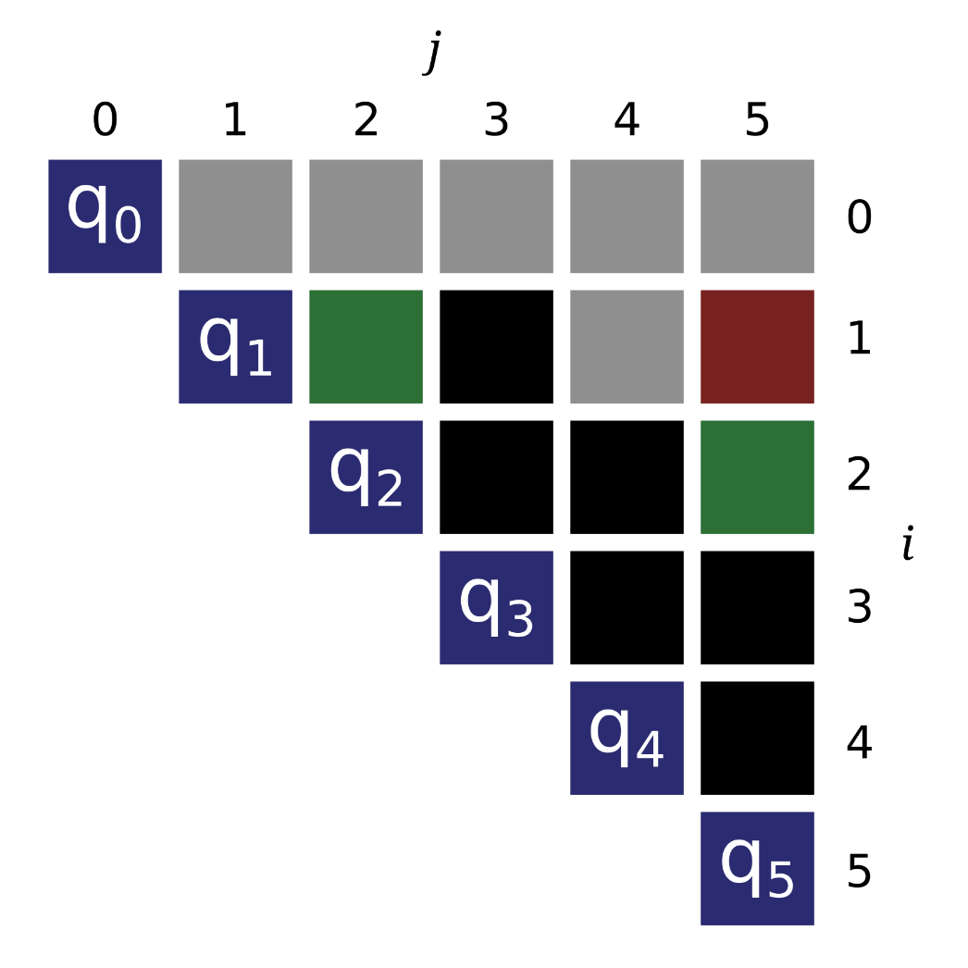
Swap Loops: Triangle

Slide 20
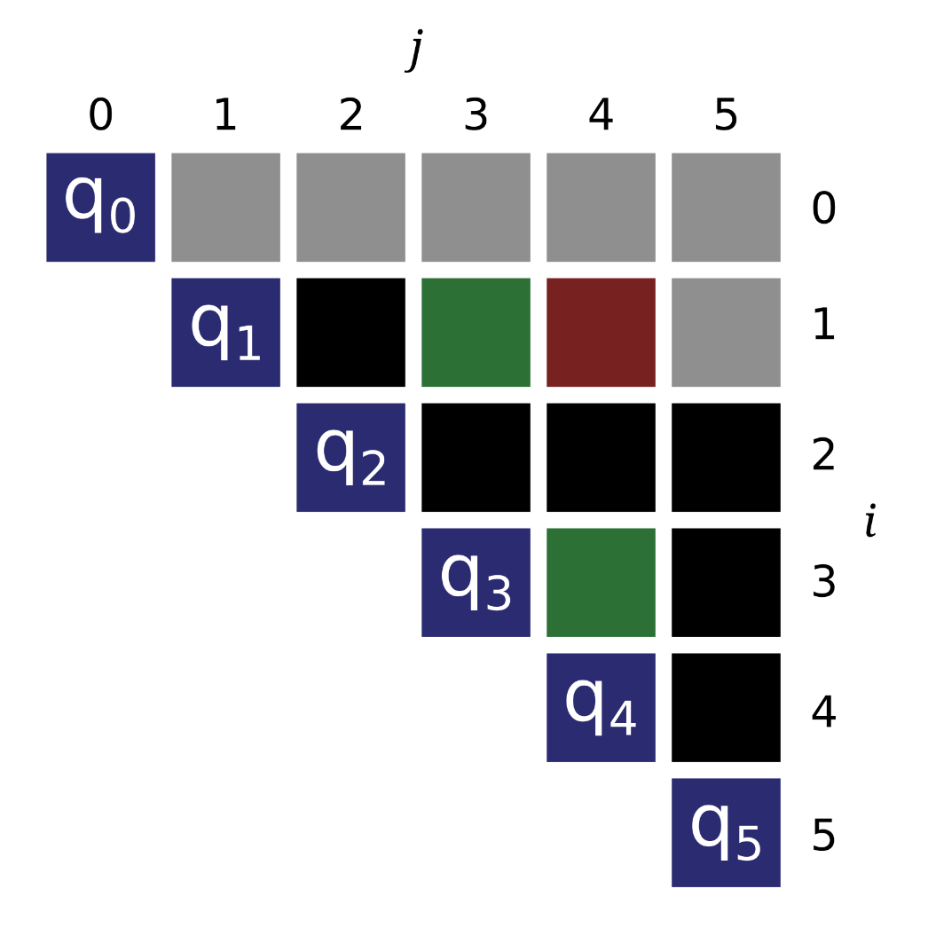
Swap Loops: Triangle

Slide 21
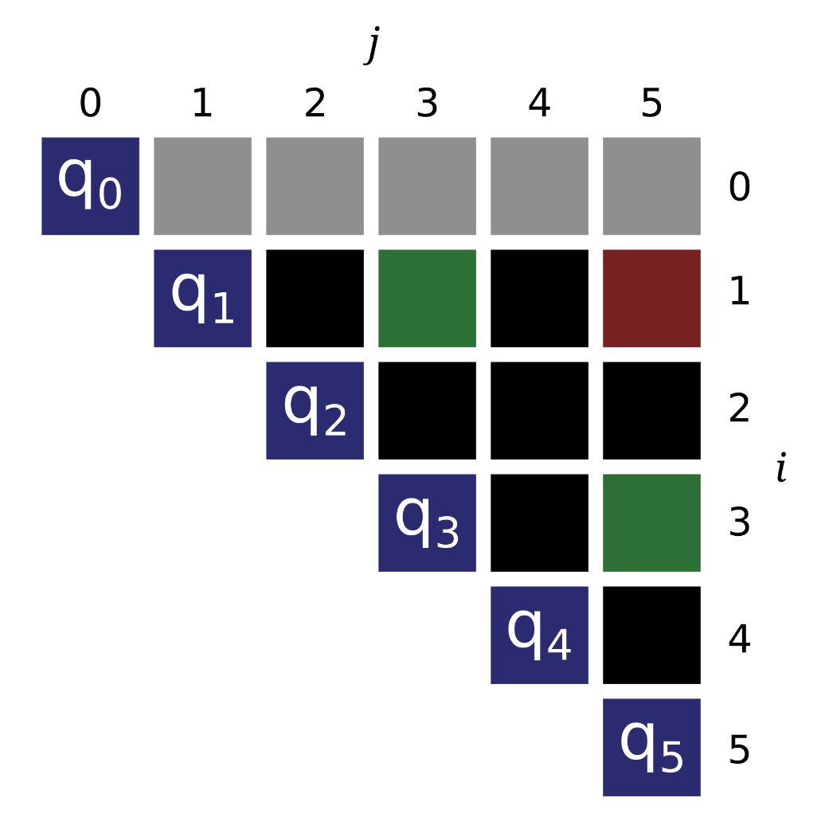
Swap Loops: Triangle

Slide 22
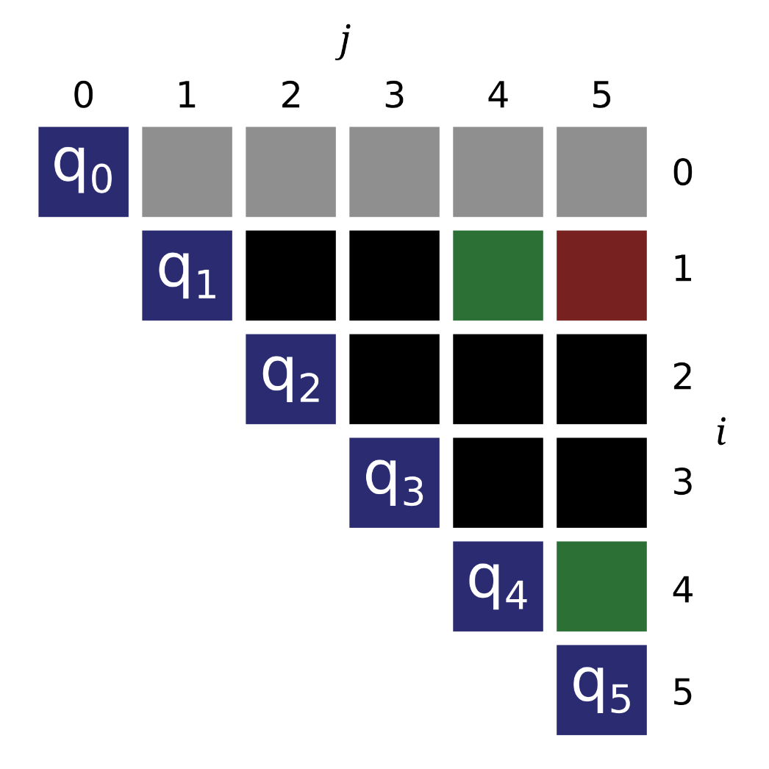
Swap Loops: Triangle

Slide 23
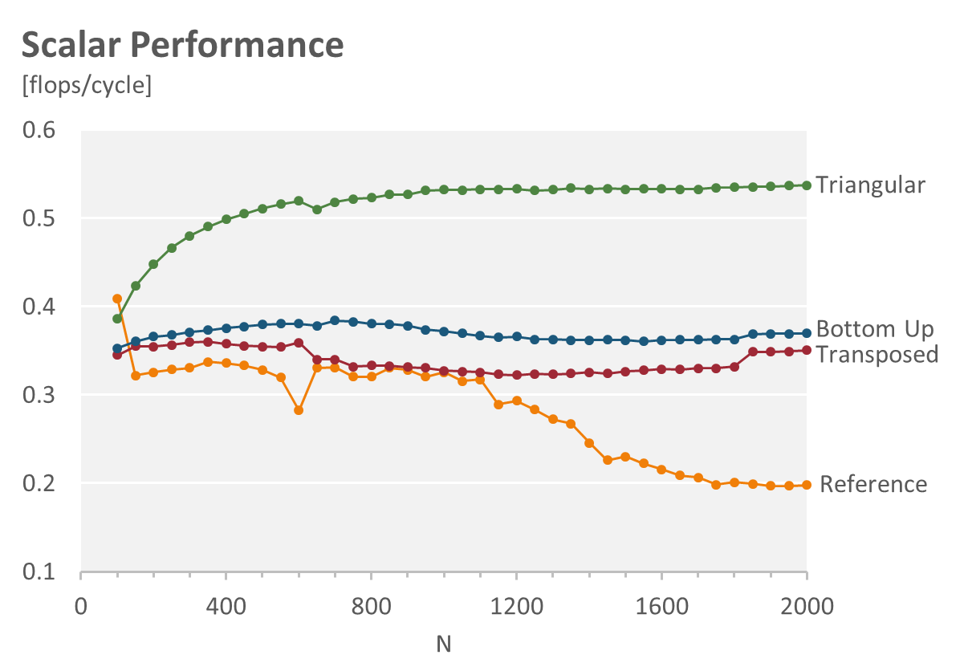
Swap Loops: Triangle

Slide 24
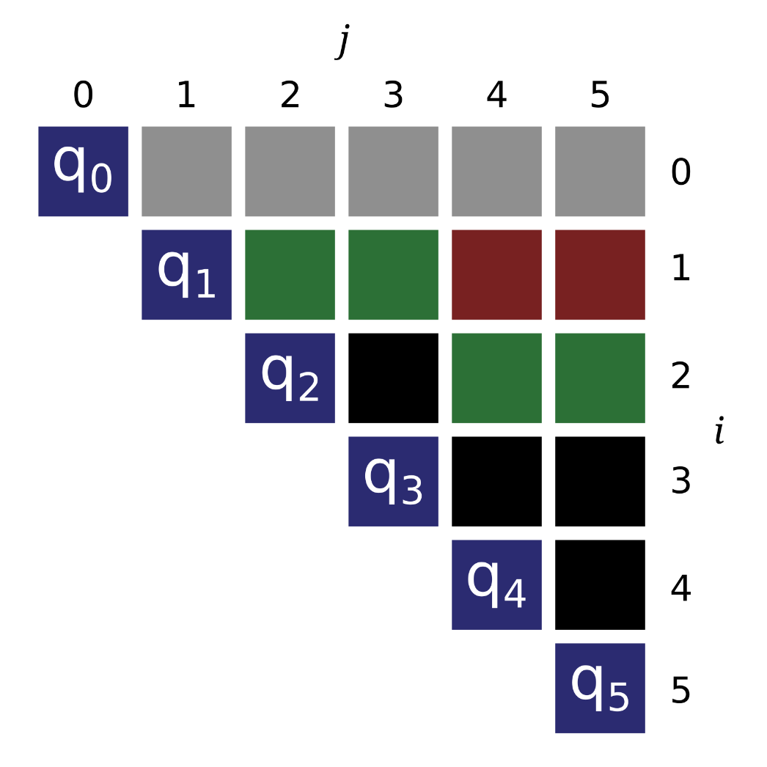
Blocking

Slide 25
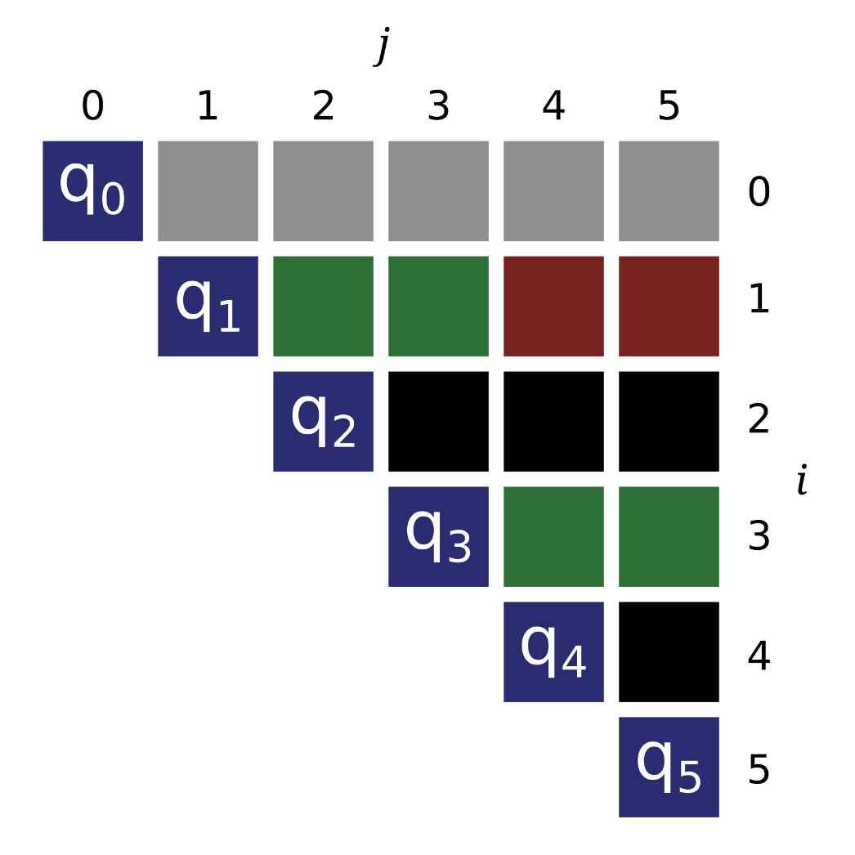
Blocking

Slide 26
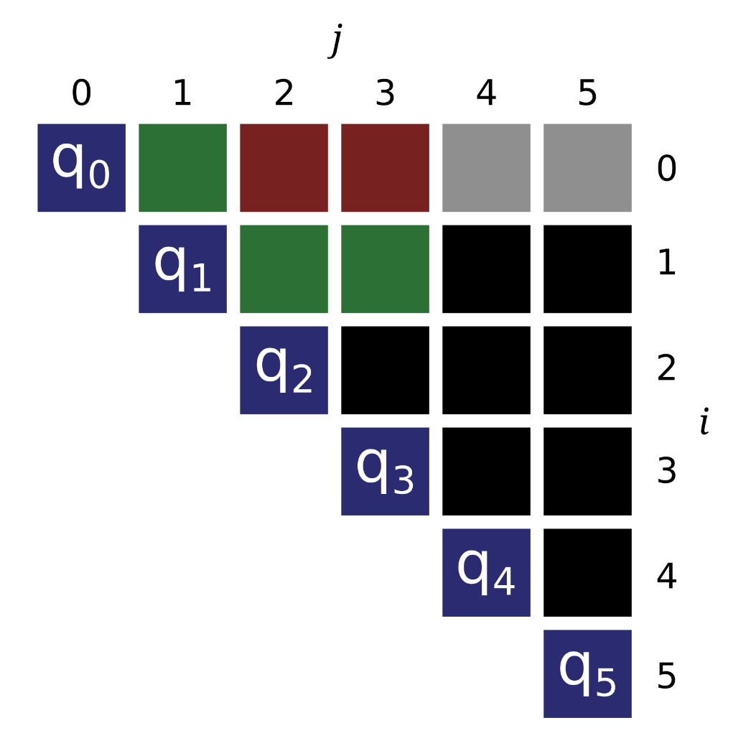
Vectorization

Slide 27
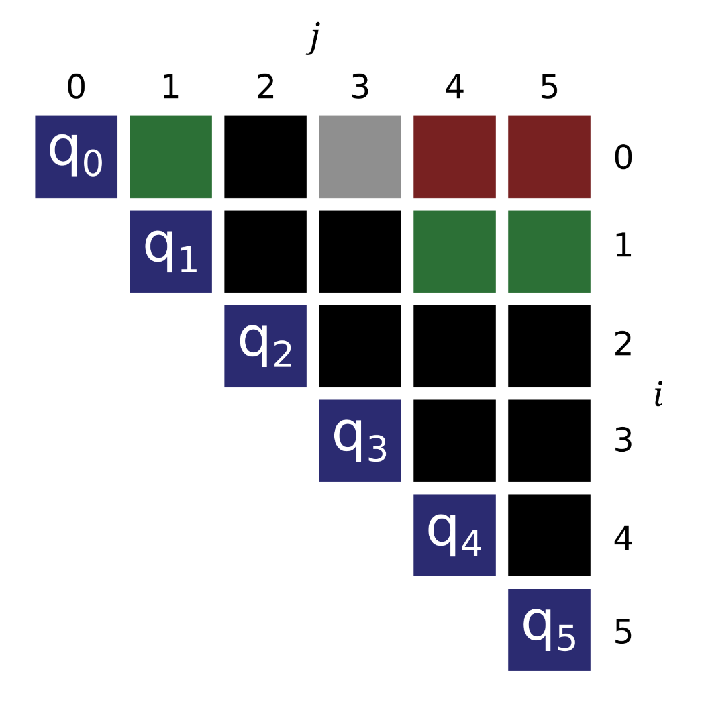
Vectorization

Slide 28
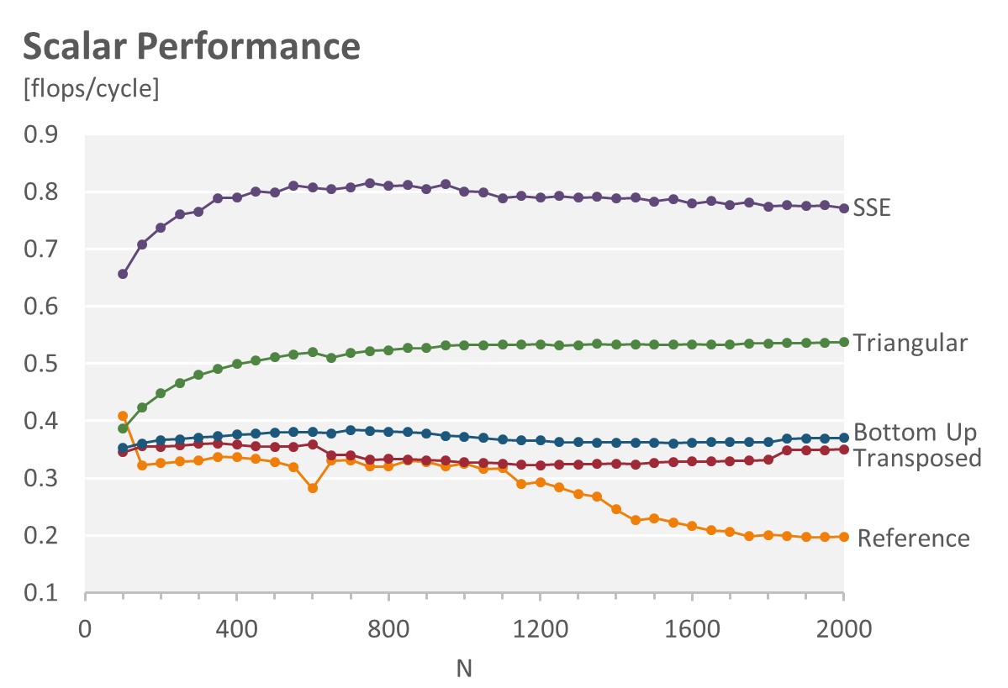
Vectorization

Slide 29
Vectorization Issues: Scheduling
Standard
a = load()
b = load()
c = load()
d = load()
e = add(a,b)
f = add(c,d)
g = add(e,f)
store(g)

Slide 30
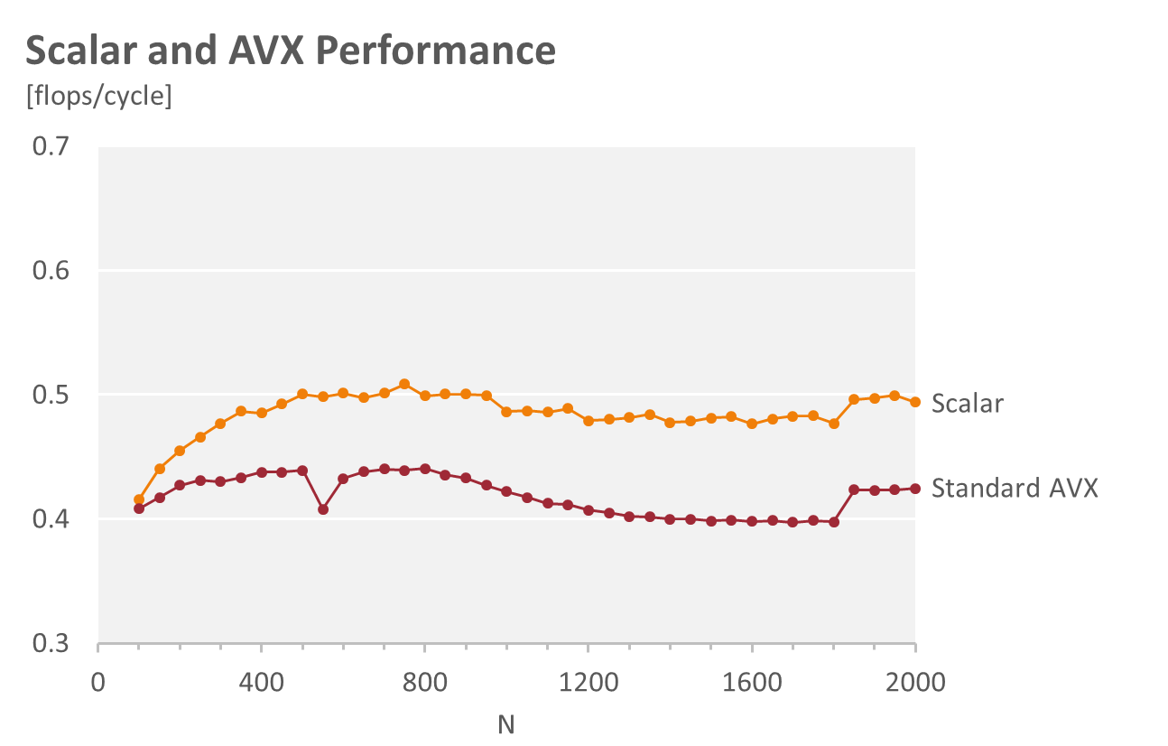
Vectorization Issues: Scheduling
Standard
a = load()
b = load()
c = load()
d = load()
e = add(a,b)
f = add(c,d)
g = add(e,f)
store(g)

Slide 31
Vectorization Issues: Scheduling
Standard
Rescheduled
a = load()
b = load()
c = load()
d = load()
e = add(a,b)
f = add(c,d)
g = add(e,f)
store(g)
a = load()
b = load()
e = add(a,b)
c = load()
d = load()
f = add(c,d)
g = add(e,f)
store(g)

Slide 32
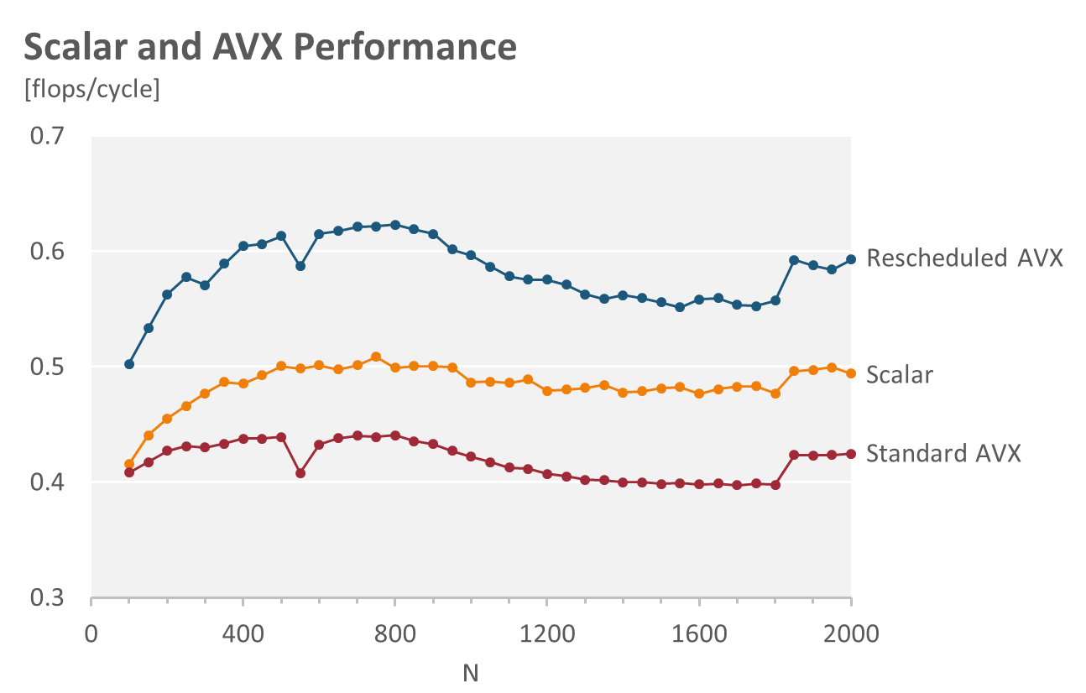
Vectorization Issues: Scheduling
Standard
Rescheduled
a = load()
b = load()
c = load()
d = load()
e = add(a,b)
f = add(c,d)
g = add(e,f)
store(g)
a = load()
b = load()
e = add(a,b)
c = load()
d = load()
f = add(c,d)
g = add(e,f)
store(g)

Slide 33
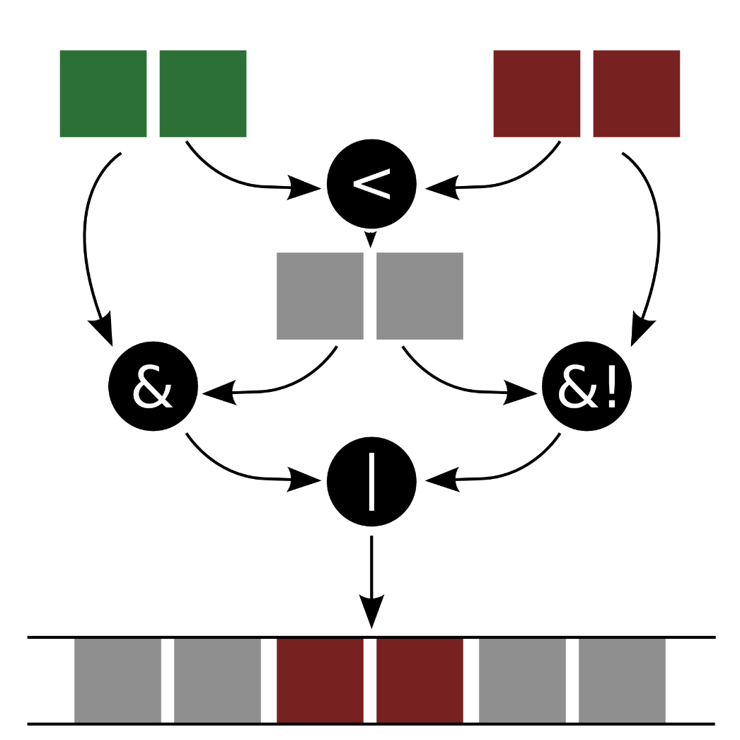
Vectorization Issues: Maskstore

Slide 34
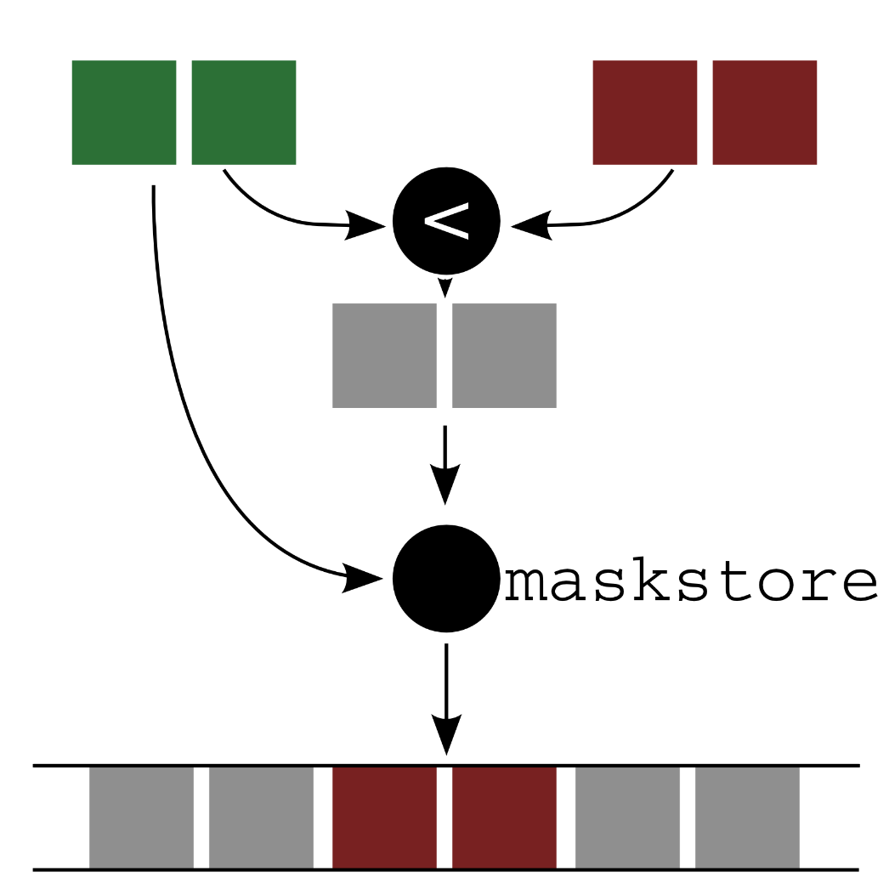
Vectorization Issues: Maskstore

Slide 35
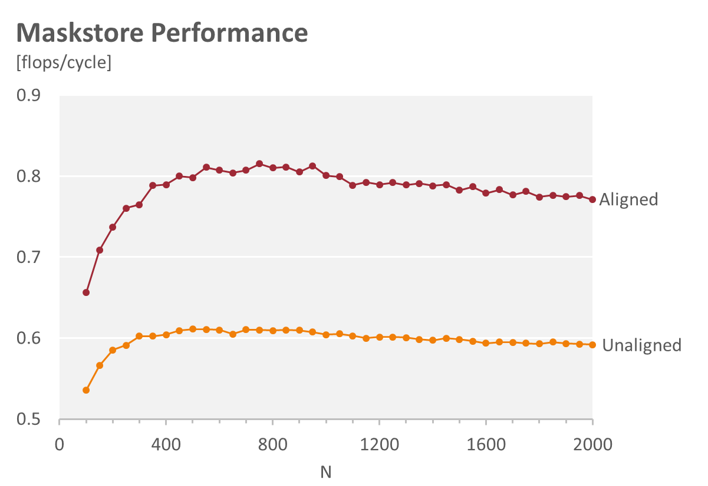
Vectorization Issues: Maskstore

Slide 36
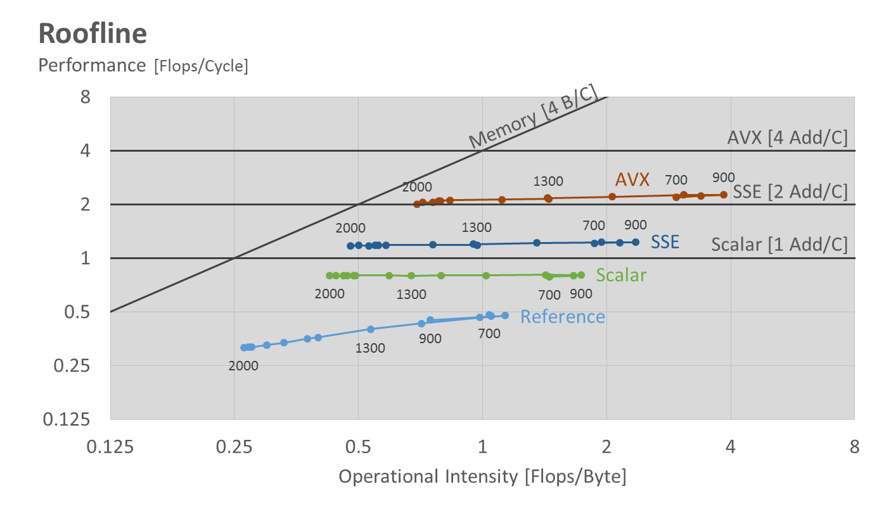
Roofline Plot
6.5 x

Slide 37

Questions…?

