Slide 1
How To Write Fast Numerical Code Optimal Binary Search Trees
Team 16: Jeremia Bär, Stefan Dietiker
May 20th, 2014

Slide 3
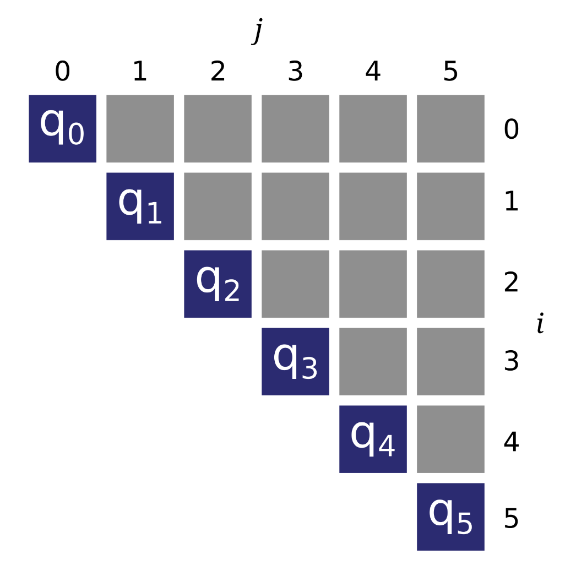
Algorithm

Slide 4
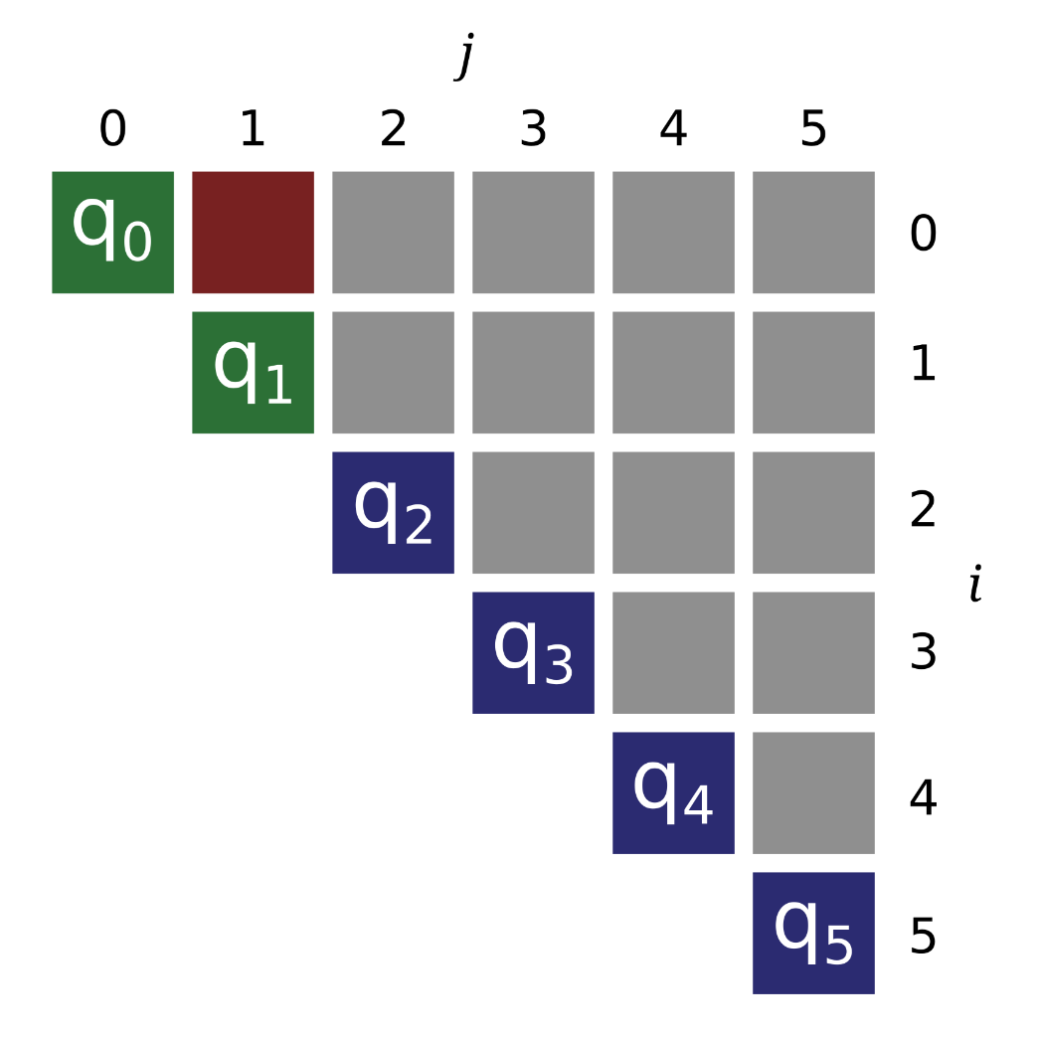
Algorithm

Slide 5
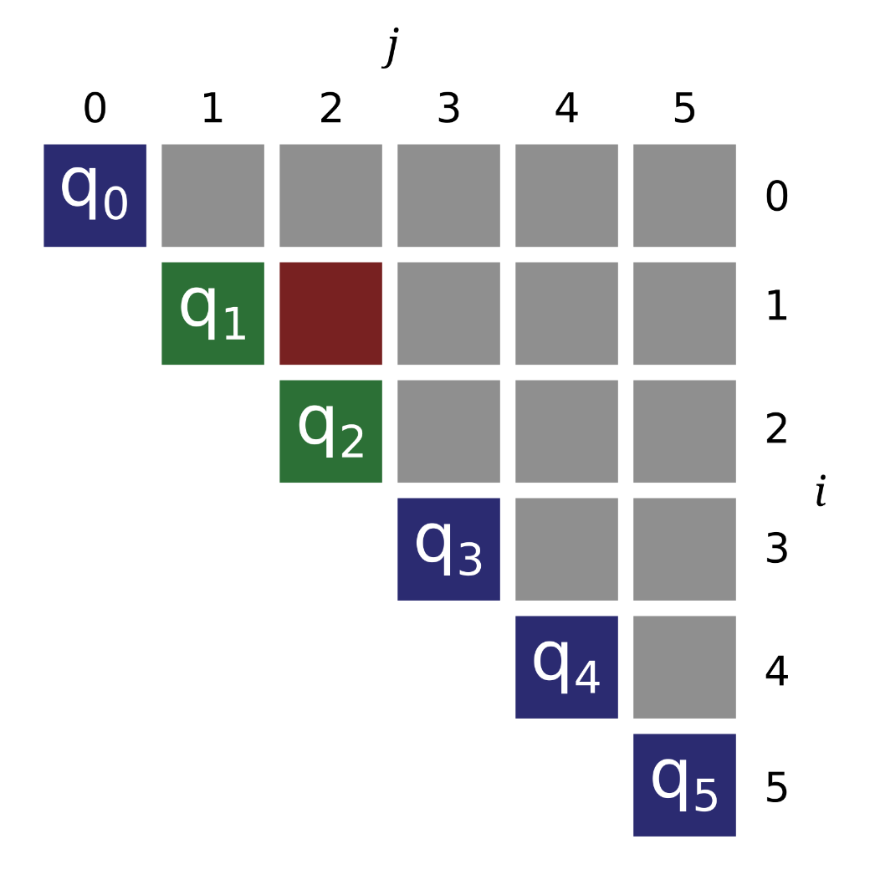
Algorithm

Slide 6
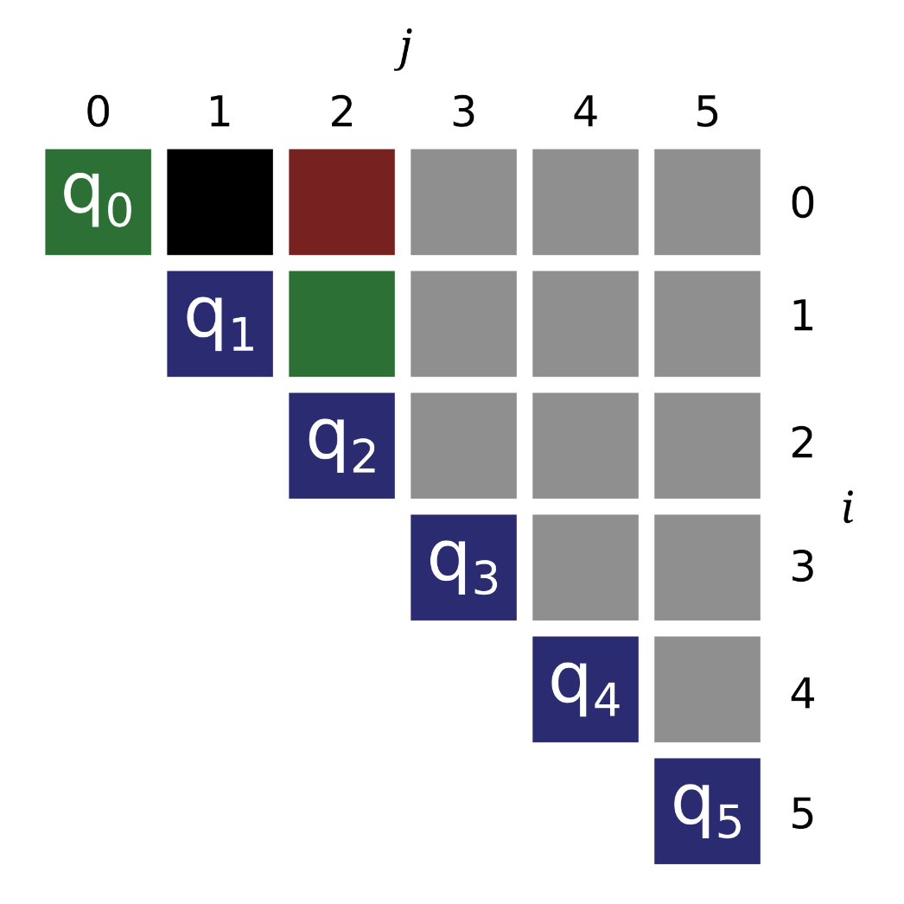
Algorithm

Slide 7
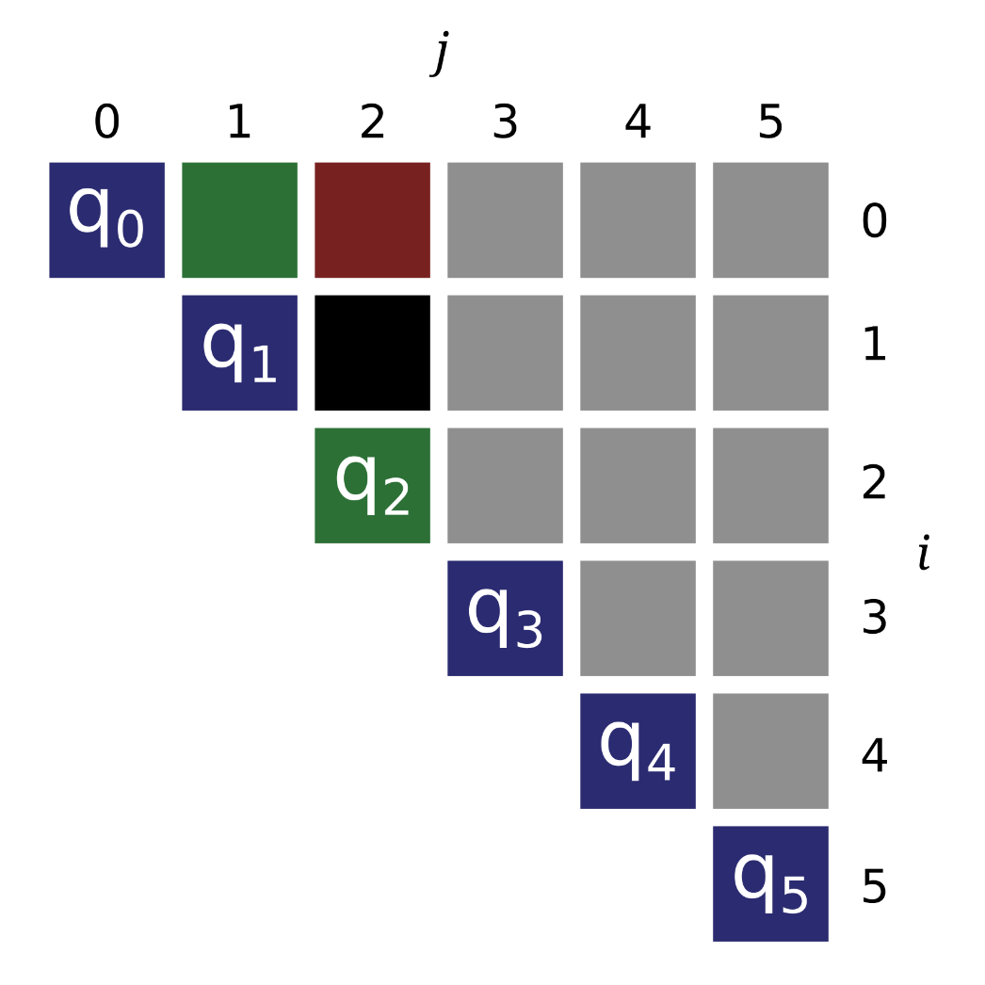
Algorithm

Slide 8
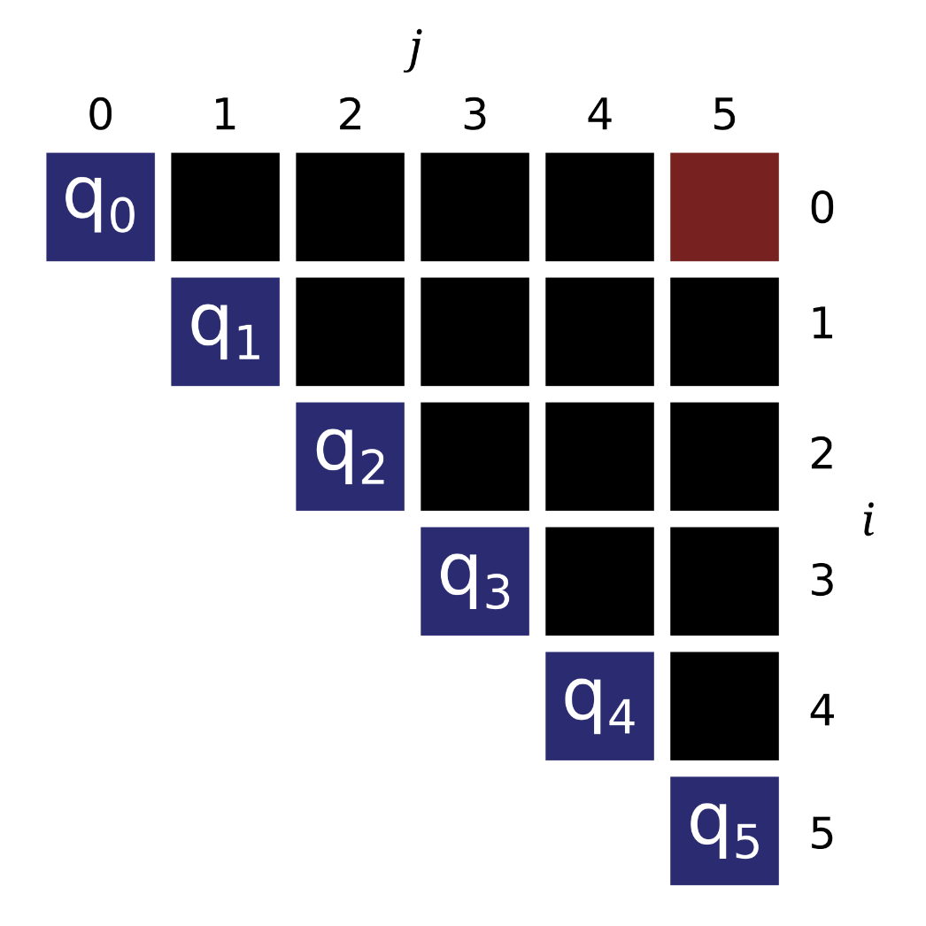
Algorithm

Slide 9
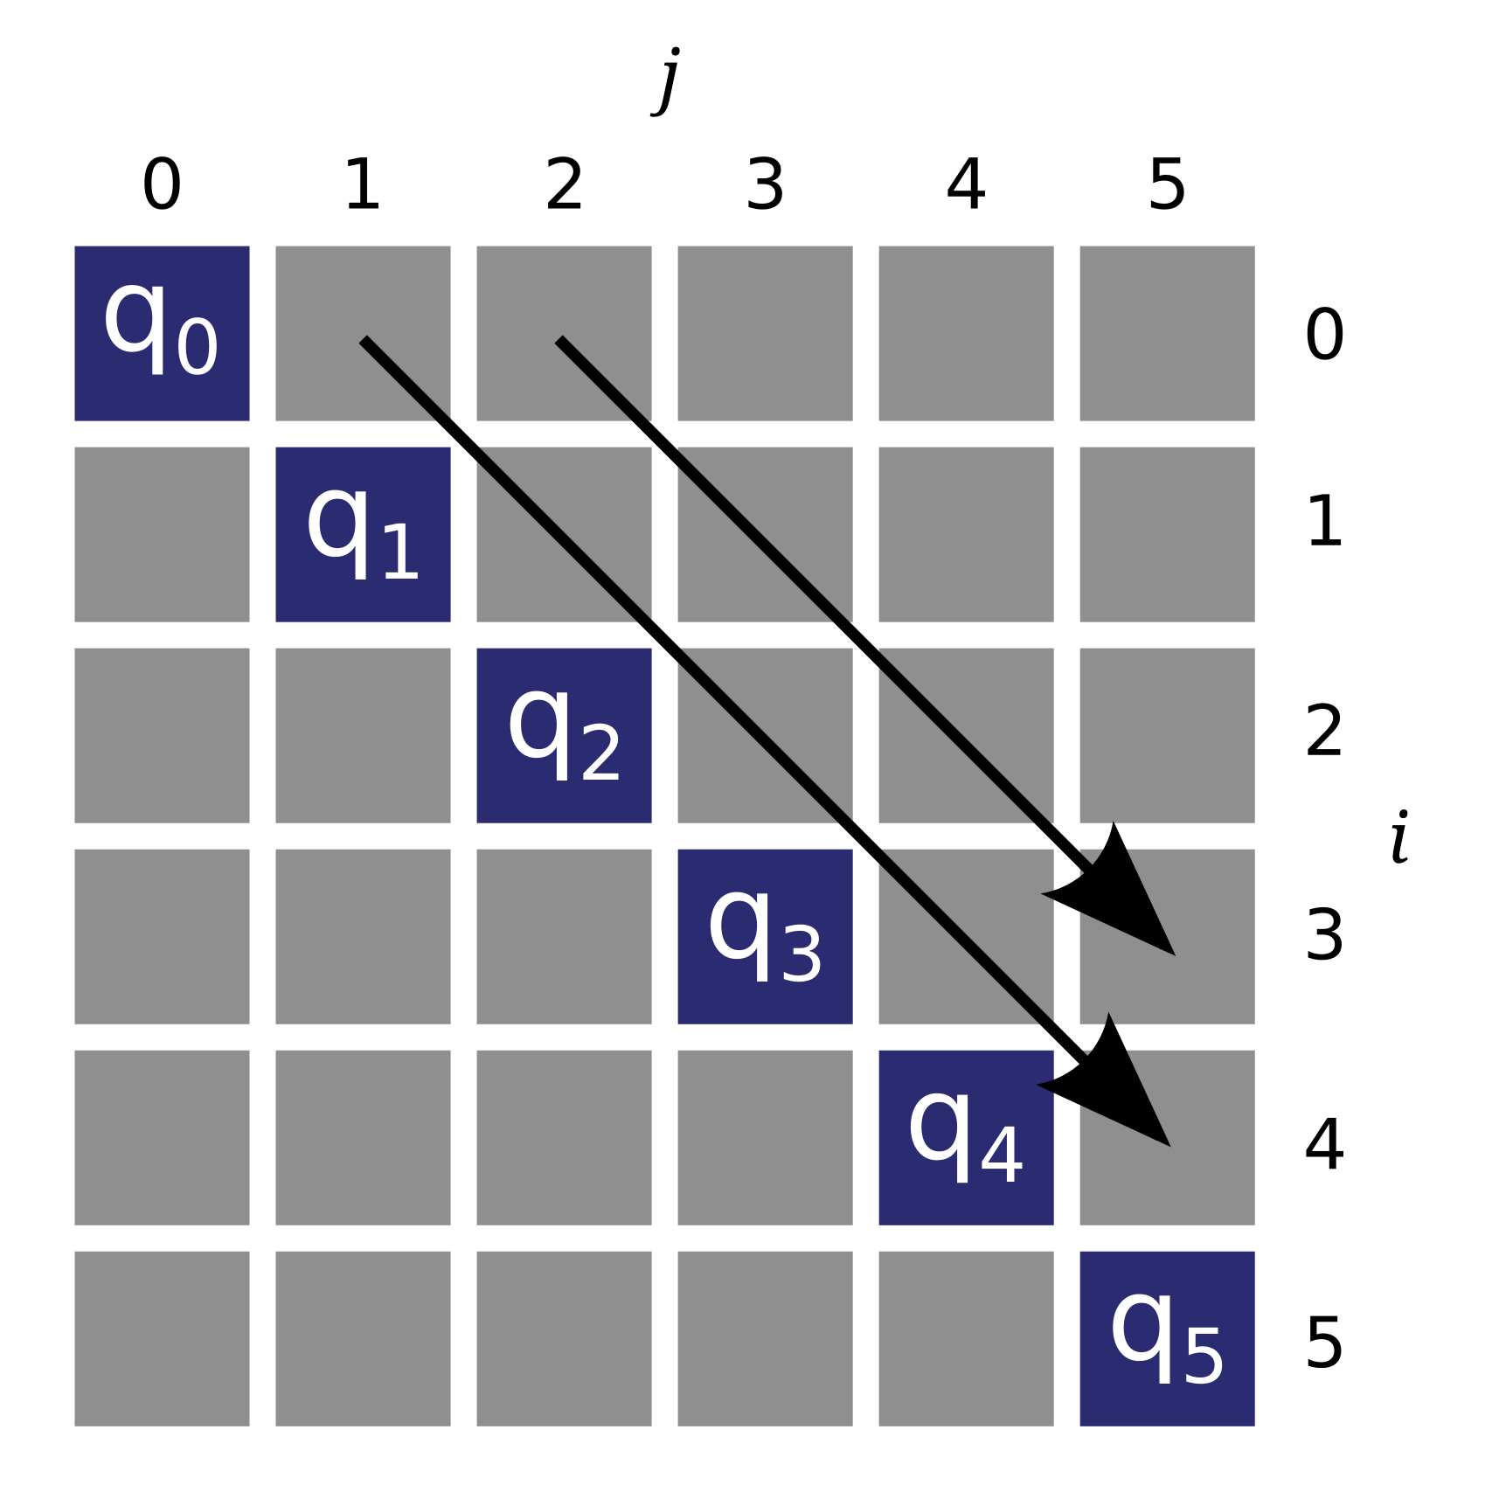
Baseline Implementation

Slide 10
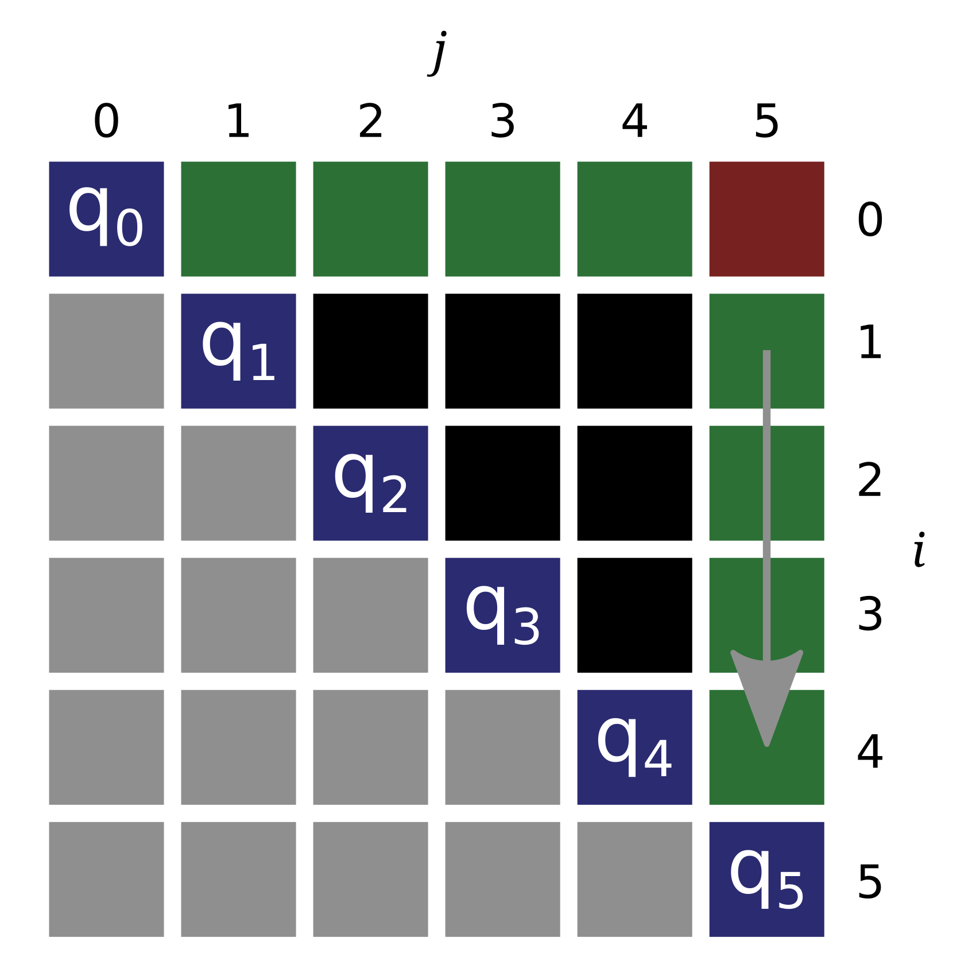
Baseline Issues

Slide 11
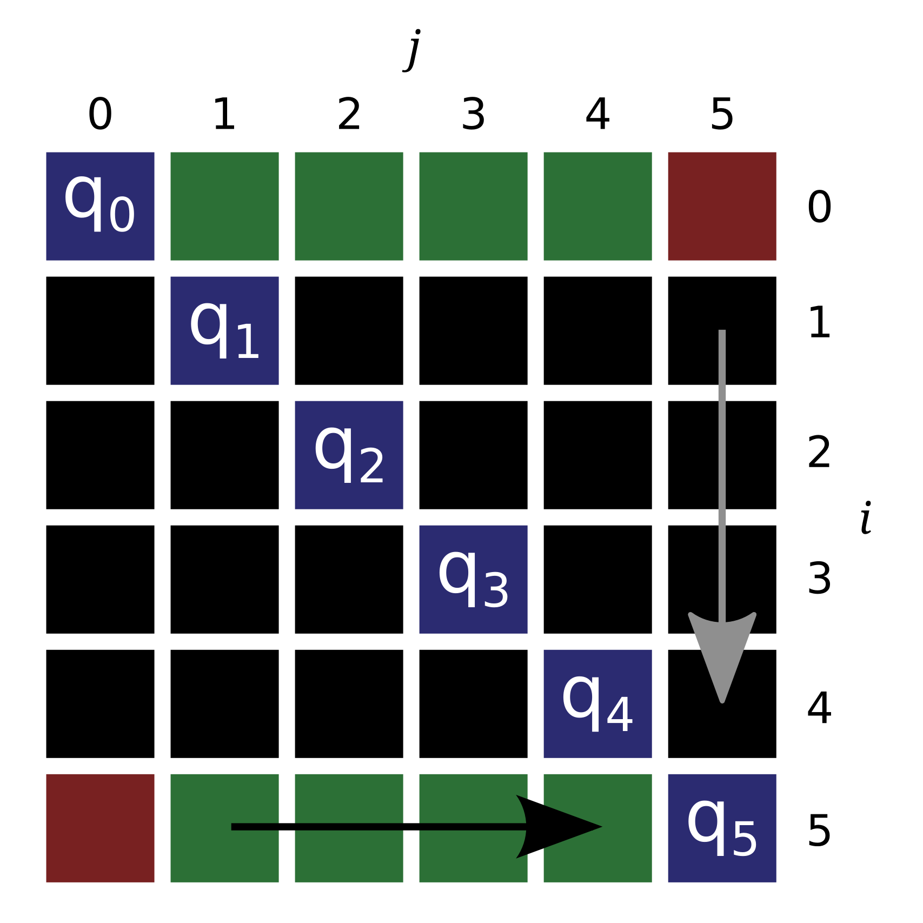
Transposed

Slide 12
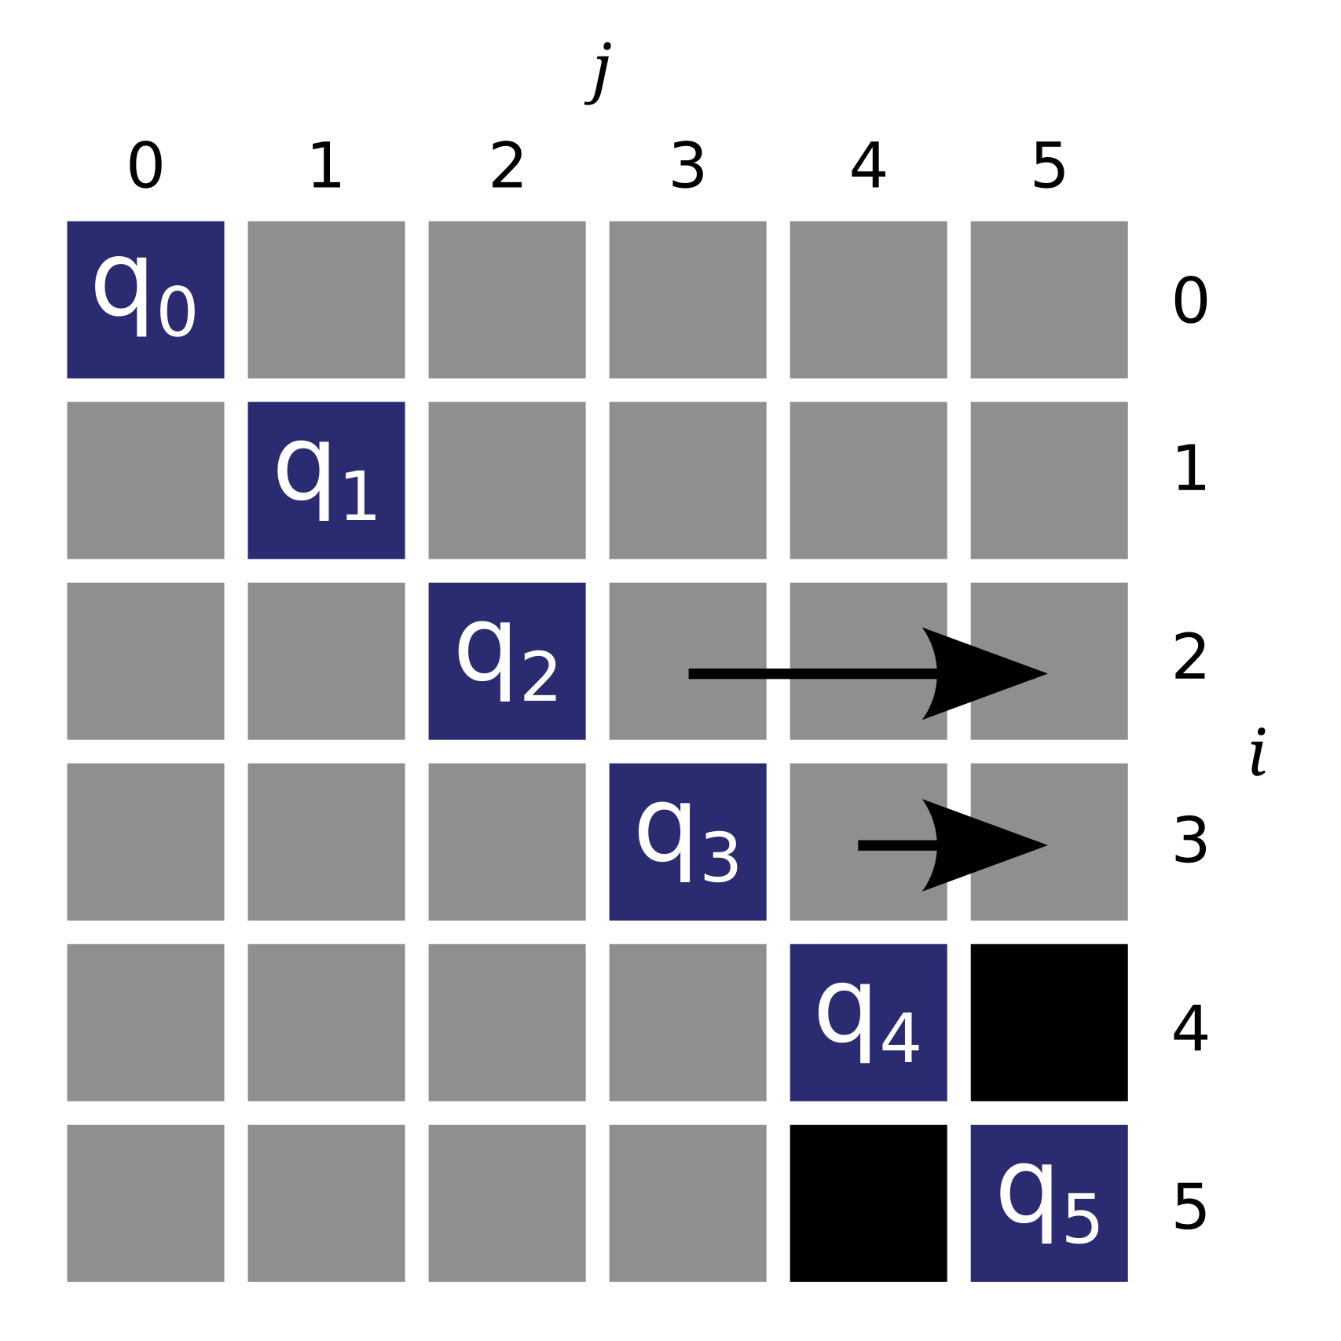
Bottom Up

Slide 13
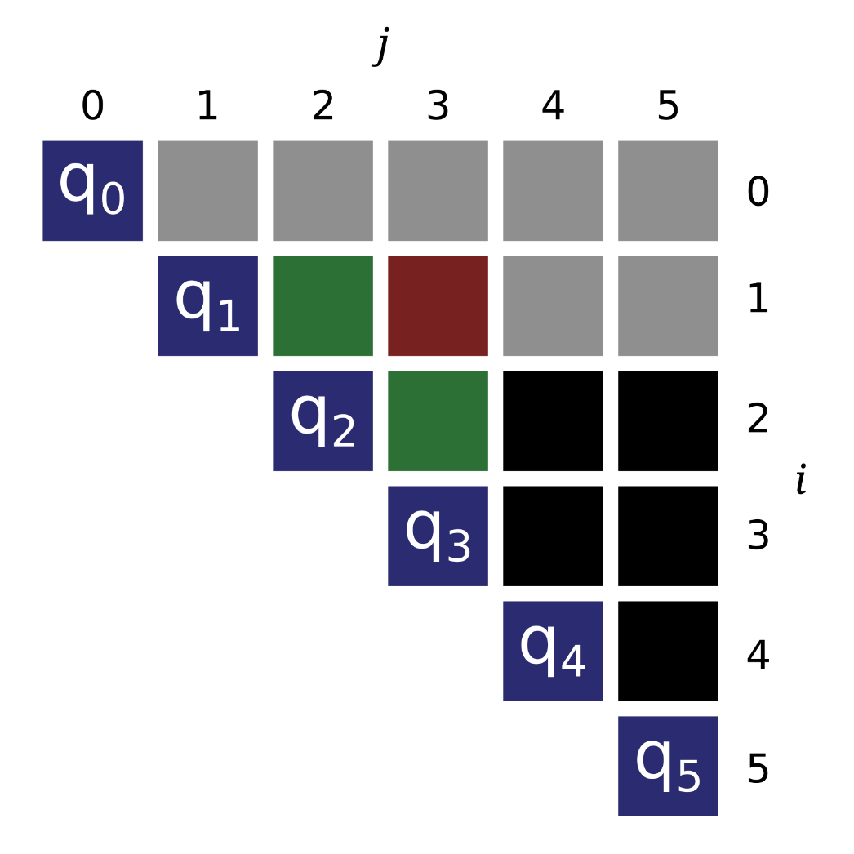
Swap Loops: Triangle

Slide 14
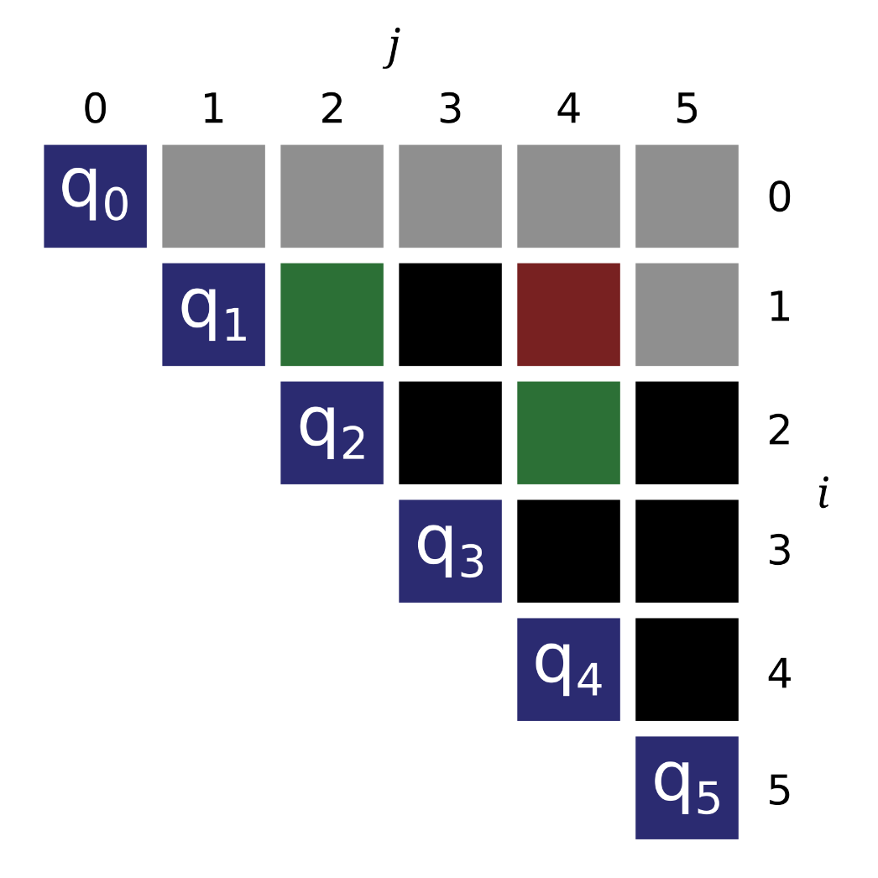
Swap Loops: Triangle

Slide 15
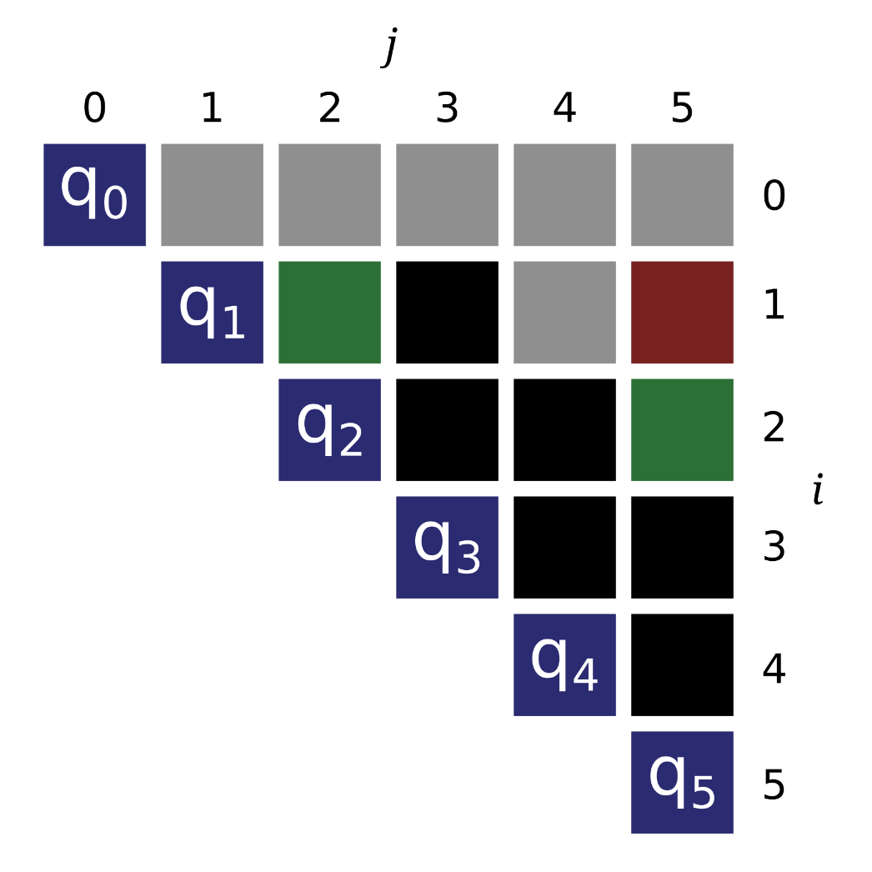
Swap Loops: Triangle

Slide 16
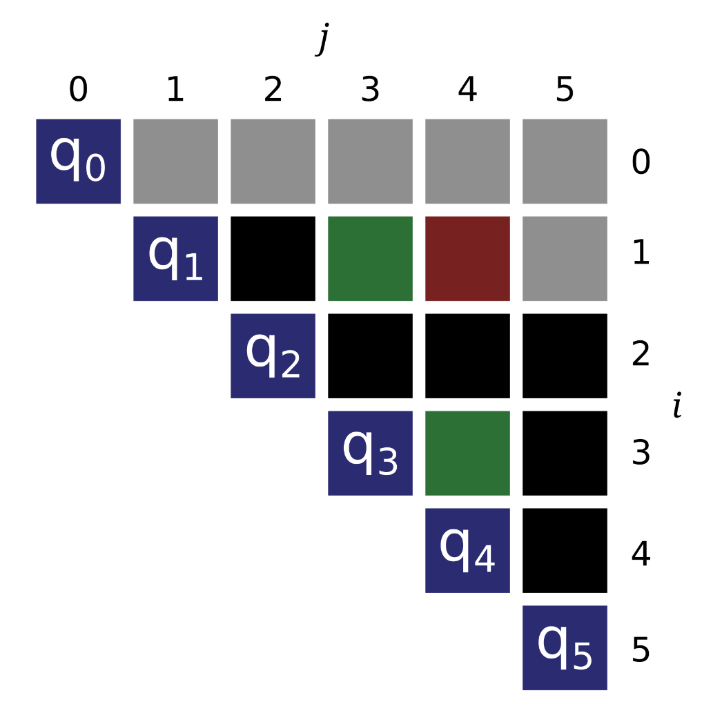
Swap Loops: Triangle

Slide 17
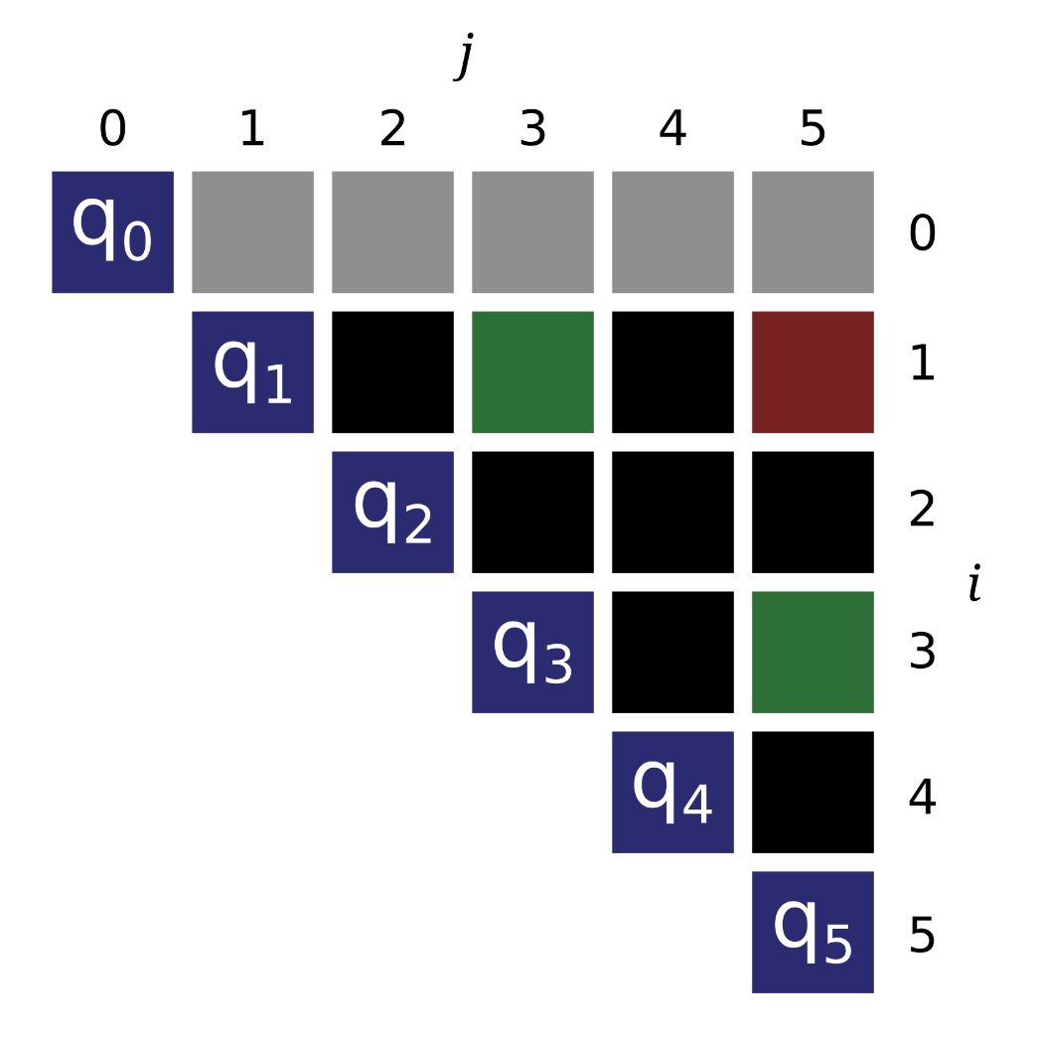
Swap Loops: Triangle

Slide 18
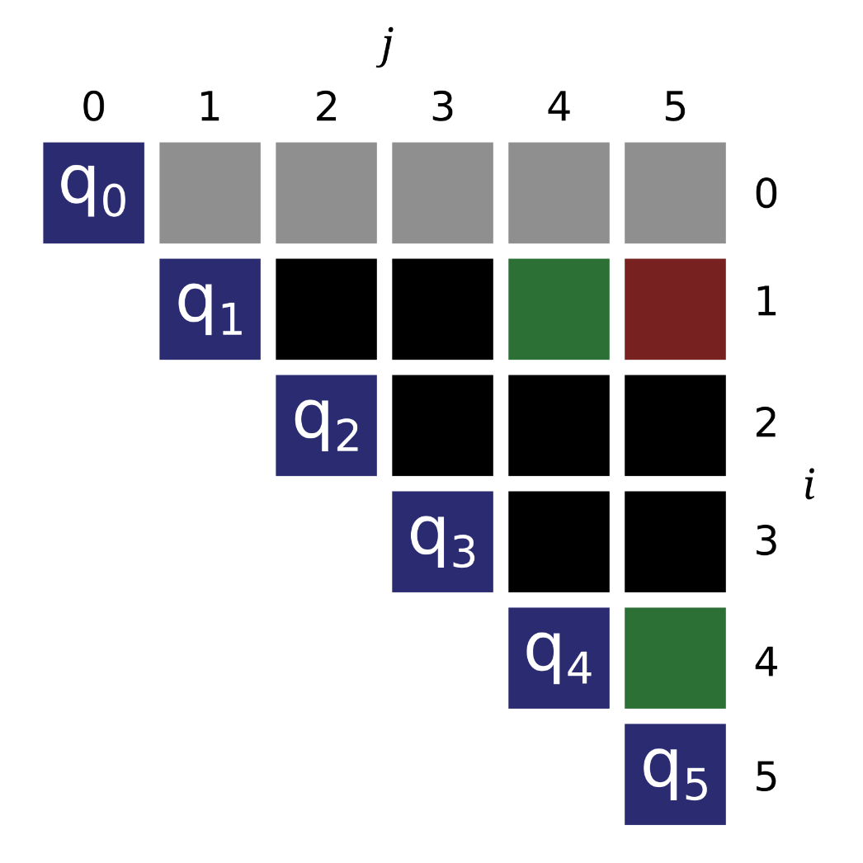
Swap Loops: Triangle

Slide 19
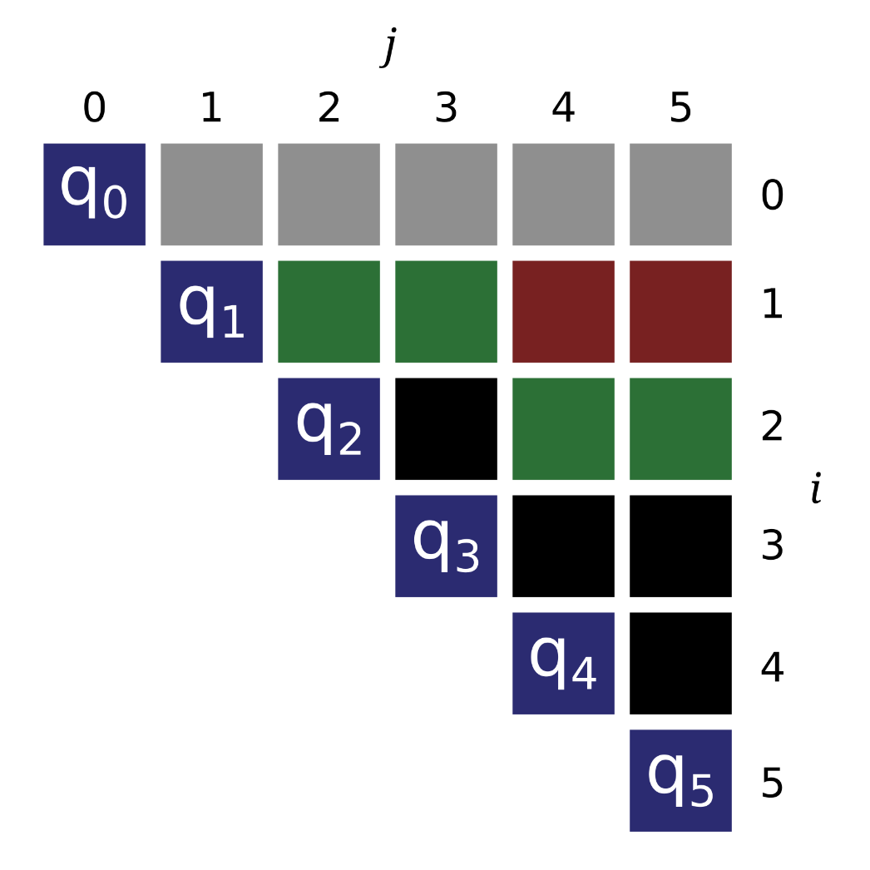
Blocking

Slide 20
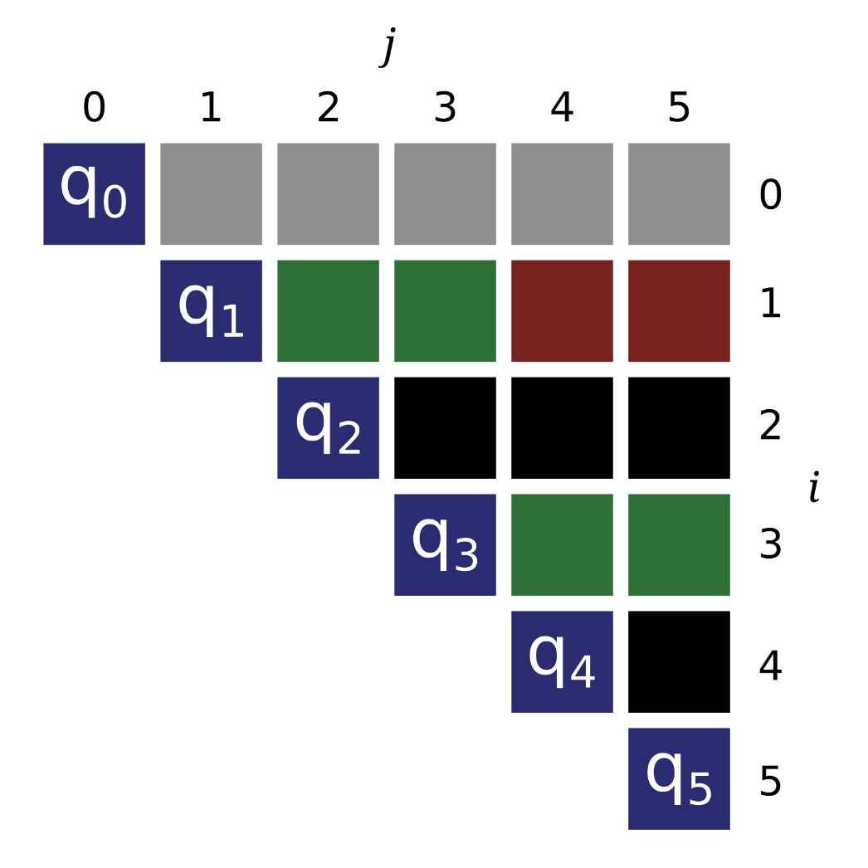
Blocking

Slide 21
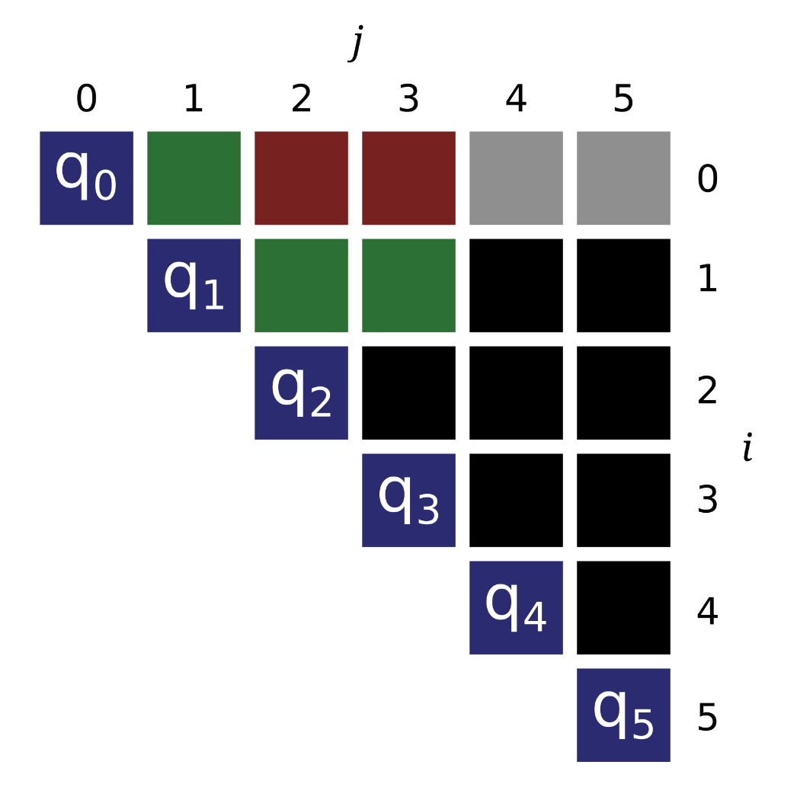
Vectorization

Slide 22

Vectorization

Slide 23
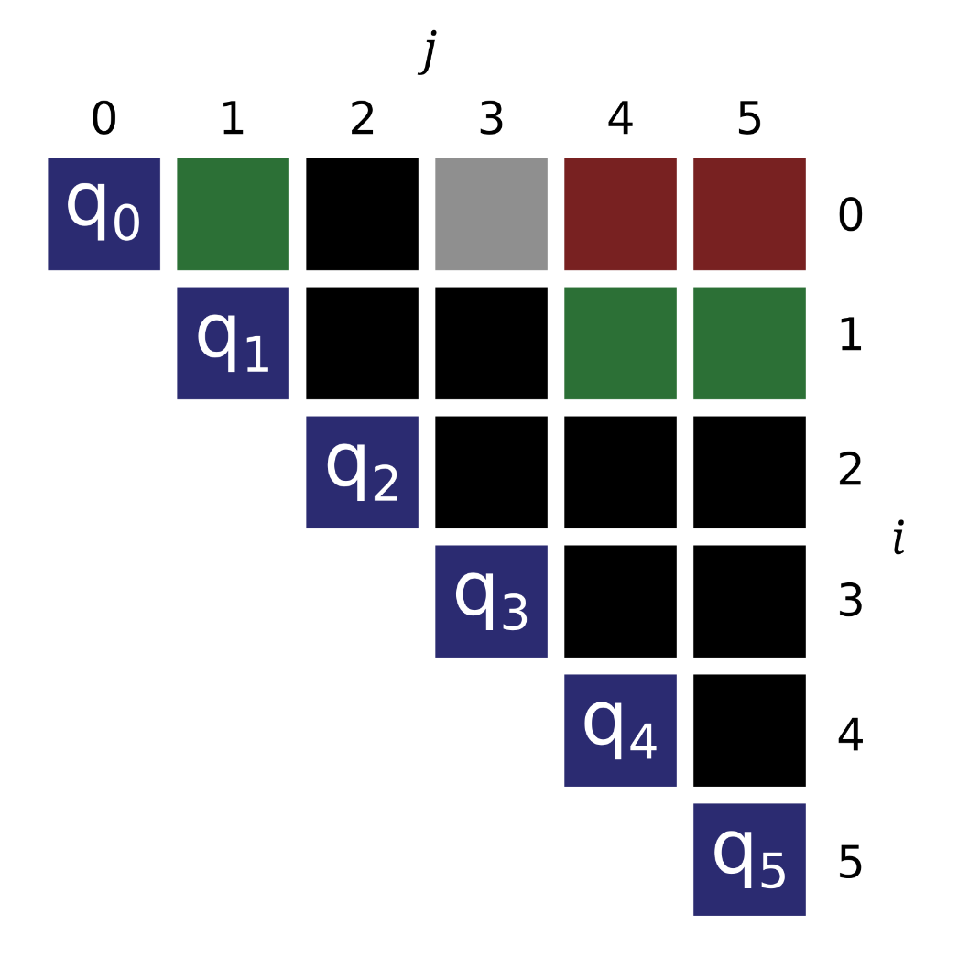
Vectorization

Slide 25
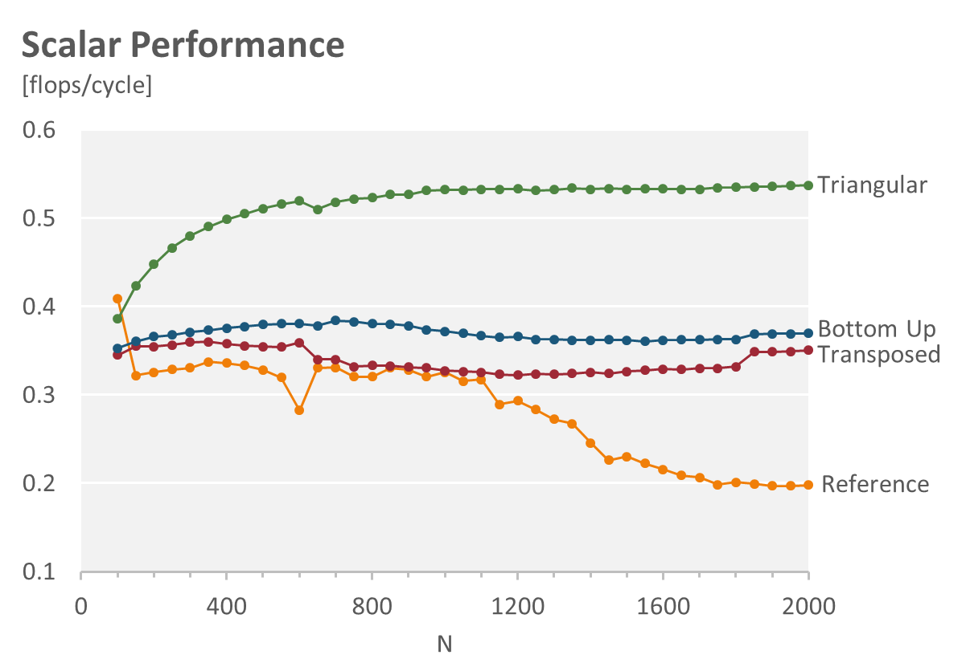
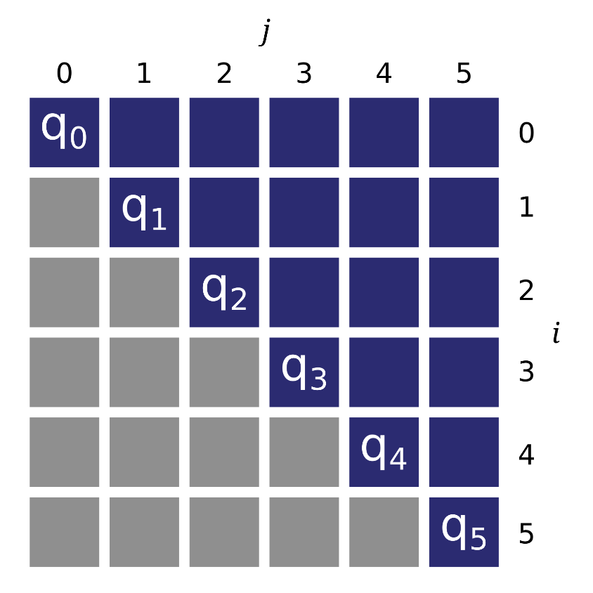
Testfolie so lang wie moeglich iiiiiiiiiiiiiiiiiiiiiiiiiiii

Slide 26
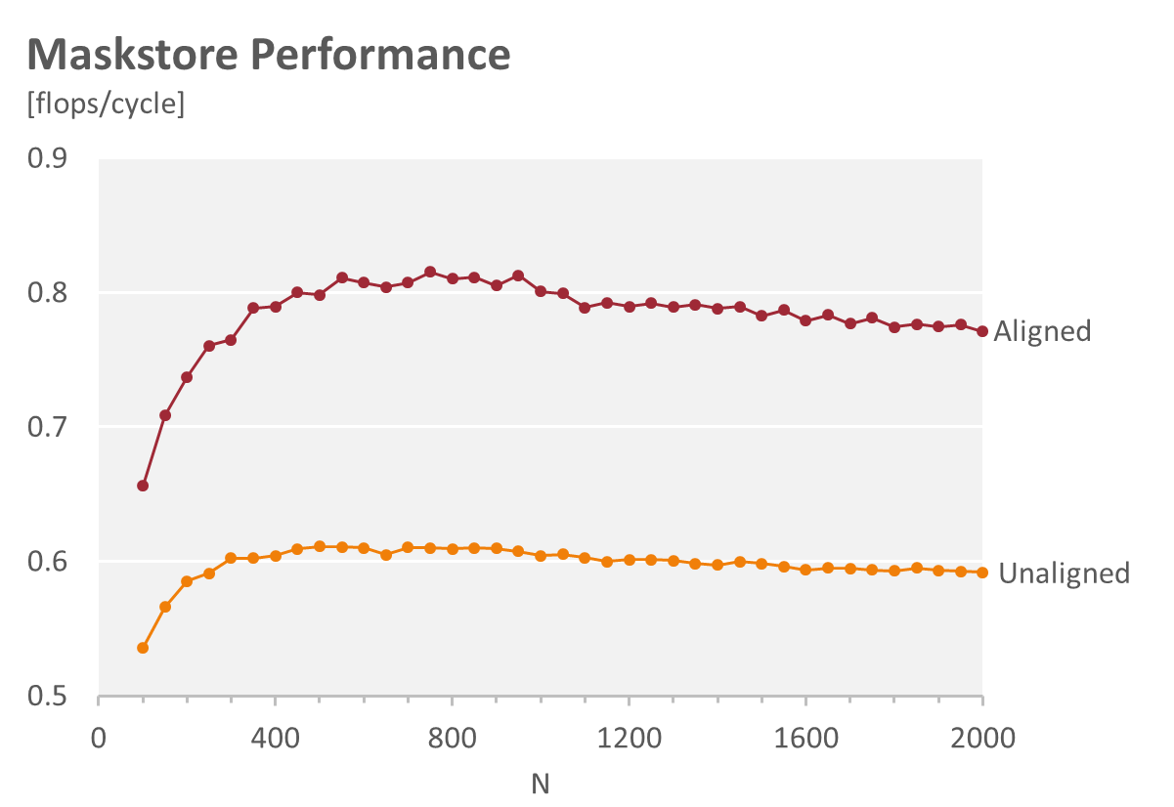
Test

Slide 27

Questions…?

