Slide 1
Bayesian Engine

Slide 2
Coming up…
Estimating the prevalence of Aphantasia
Manually computing probabilities
Writing a simple Bayesian model

Slide 3
A note
Bayesian models might seems scary at the beginning, with all those distributions and math symbols.
But, thankfully we don’t have to solve almost any of the math in the background. We just need to learn how to express theory into models.

Slide 4

A note
Bayesian models might seems scary at the beginning, with all those distributions and math symbols.
But, thankfully we don’t have to solve almost any of the math in the background. We just need to learn how to express theory into models.
Last year was bad I let myself get Sucked in by arithmetic

Slide 5
Aphantasia
Inability to bring images to the “mind’s eye” (Zeman et al., 2015)
Proportion of people with aphantasia is relatively low:
4.2% undergrad students (Dance et al., 2022)
0.7% general population (Zeman et al., 2020)
4.6% - 14.1% general population (Faw, 2009)
A red apple as imagined by an aphantastic person

Slide 6
Aphantasia
Our goal is to estimate the proportion of people with aphantasia. How can we do this?

Slide 7
Aphantasia
Our goal is to estimate the proportion of people with aphantasia. How can we do this?
Survey the population (aka sample)
For every possible true proportion of aphantasia in the population, find how likely the observed data is
We’ll start simple, considering only some possible true proportions before generalizing to the anything from 0 (no one) to 1 (everyone).
The example is an adaptation of the Globe Tossing Model by Richard McElreath

Slide 8
Survey
Probability P_prop = 0.00 to generate sample?
Probability P_prop = 1.00 to generate sample?
Probability P_prop = 0.25 to generate sample?
Probability P_prop = 0.75 to generate sample?
Probability P_prop = 0.50 to generate sample?
0.00
0.25
0.50
0.75
1.00
Possible proportion of aphantasia in the population [P_prop]

Slide 9
Relative
Probability
0.00
0.25
0.50
0.75
1.00

Slide 10
The long inefficient way: counting

Slide 11
The long inefficient way: counting

Slide 12
The long inefficient way: counting
# Ways to produce sample

Slide 13
The long inefficient way: counting
# Ways to produce sample
4
3
2
1
0

Slide 14
The long inefficient way: counting
# Ways to produce sample
4
0
3
1
2
2
1
3
0
4

Slide 15
The long inefficient way: counting
# Ways to produce sample
4
0
4
3
1
3
2
2
2
1
3
1
0
4
0

Slide 16
The long inefficient way: counting
# Ways to produce sample
4
0
4
…
4
3
1
3
…
3
2
2
2
…
2
1
3
1
…
1
0
4
0
…
0

Slide 17
The long inefficient way: counting
# Ways to produce sample
4
X
0
X
4
X
…
X
4
=
0
3
X
1
X
3
X
…
X
3
=
43046721
2
X
2
X
2
X
…
X
2
=
1048576
1
X
3
X
1
X
…
X
1
=
81
0
X
4
X
0
X
…
X
0
=
0

Slide 18
The long inefficient way: counting
# Ways to produce sample
# Probability
0
0 / 44095378 = 0
43046721
43046721 / 44095378 ≈ 0.976
1048576
1048576 / 44095378 ≈ 0.023
81
81 / 44095378 ≈ 0.001
0
0 / 44095378 = 0
TOT = 44095378

Slide 19
In reality, the probability range is continuous, making it challenging to compute the sum of probabilities across all possible proportions of aphantasia.
Relative
Probability
0.00
0.25
0.50
0.75
1.00

Slide 20







In reality, the probability range is continuous, making it challenging to compute the sum of probabilities across all possible proportions of aphantasia.
Relative
Probability
0.00
0.25
0.50
0.75
1.00

Slide 21
SOLUTION = SAMPLING*
*I’m simplifying here

Slide 22
ALSO
This is the probability of the sample given each hypothesis. What we are interested in is the probability of the hypothesis given the sample.
Relative
Probability
0.00
0.25
0.50
0.75
1.00

Slide 23
Bayes Theorem
$$P\left(A_{population} | A_{sample}\right)= \frac{P\left(A_{sample} | A_{population}\right)×P(A_{population})}{P(A_{sample})}$$

Slide 24
Bayes Theorem
Likelihood (what we have computed so far)
Prior (we have to define it)
$$P\left(A_{population} | A_{sample}\right)= \frac{P\left(A_{sample} | A_{population}\right)×P(A_{population})}{P(A_{sample})}$$
Average Probability of the Data
Marginal Likelihood

Slide 25
Bayes Theorem
Likelihood (what we have computed so far)
Prior (we have to define it)
$$P\left(A_{population} | A_{sample}\right)= \frac{P\left(A_{sample} | A_{population}\right)×P(A_{population})}{P(A_{sample})}$$
Average Probability of the Data
Marginal Likelihood
Averaged over the prior
Formally, it is the integral of the probability of Aphantasia in the sample over all the possible proportions of aphantasia in the population

Slide 26
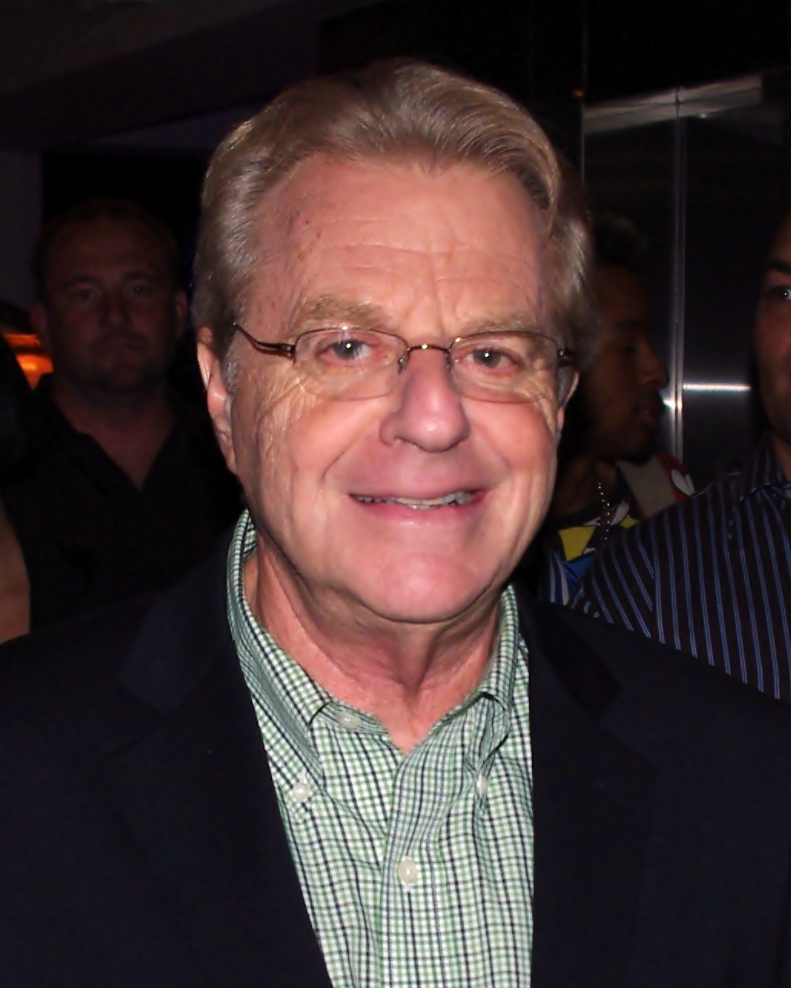

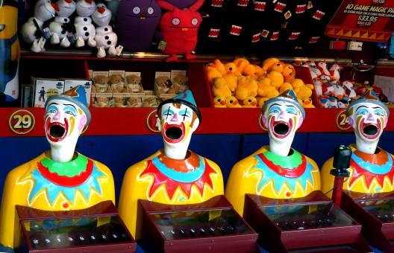
LET’S CODE THIS

