Slide 1
From tests to models

Slide 2
[…] much of the open science movement has been focused on misconduct and questionable-research-practices (like p-hacking), instead of research procedures like data management and justification of modeling choices.
We need to define the phenomenon, the alternative explanations, and what estimates would help us distinguish among them or refine them.
However, the biggest problem with Bayes factors is none of these. Rather it is that people want to use them to do null hypothesis testing, and testing null hypotheses is the fuel of the garbage fire in the first place. Cumulative science needs non-null scientific models and ways to confront them with data.
Richard McElreath

Slide 3
Objectives
Demystifying data modelling
Showing that modelling is more understandable than tests
Showing that we often model without knowing it
Moving to Bayesian models

Slide 4
Approach
Unpacking a simple ANOVA
Showing that ANOVA is a linear model* in disguise
Running a first Bayesian model
* Technically is a method applied to a linear model

Slide 5
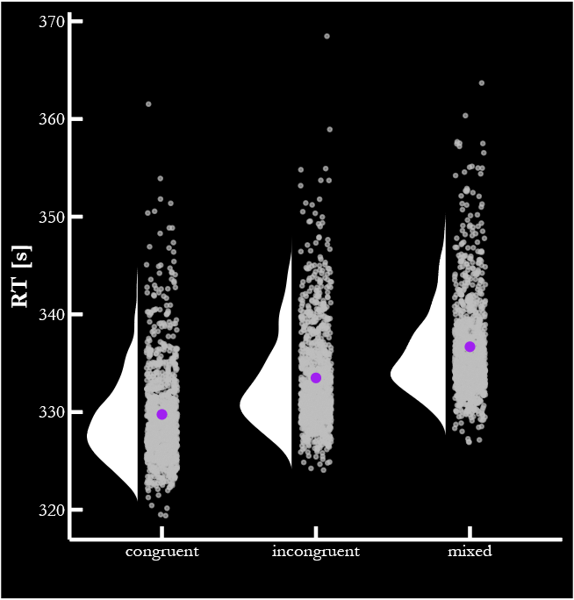
Are the means different?

Slide 6
How can we answer this question?
Frequentist | ANOVA
 | Linear Moel
Bayesian | General Linear Model

Slide 7
How can we answer this question?
Frequentist | ANOVA
 | Linear Moel
Bayesian | General Linear Model
Argument:
ANOVA and Linear Model are equivalent
Linear models are more flexible than standard tests
Bayesian models offer more information than frequentists linear models
Then: we should opt for Bayesian models

Slide 8
Steps
Load data
Compute participants’ and conditions’ averages
Compute Variance Metrics
Get F-statistics
Working on p-value
NOTE: The code needs to be adjusted (do not rush through)

Slide 9
Why Variance
Why do we use analysis of variance to test a difference in means?

Slide 10
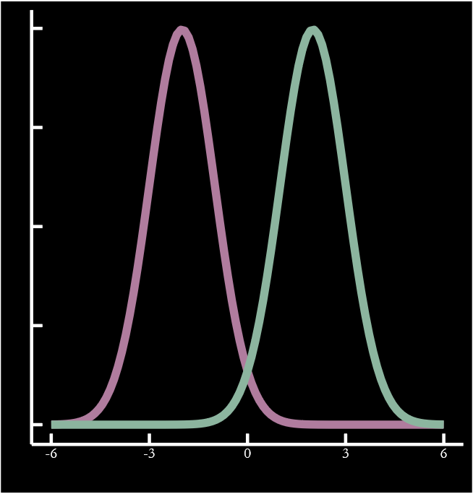
Why Variance
Why do we use analysis of variance to test a difference in means?
If variance between groups is higher than variance within groups, then the observations are likely drawn from two different distributions

Slide 11
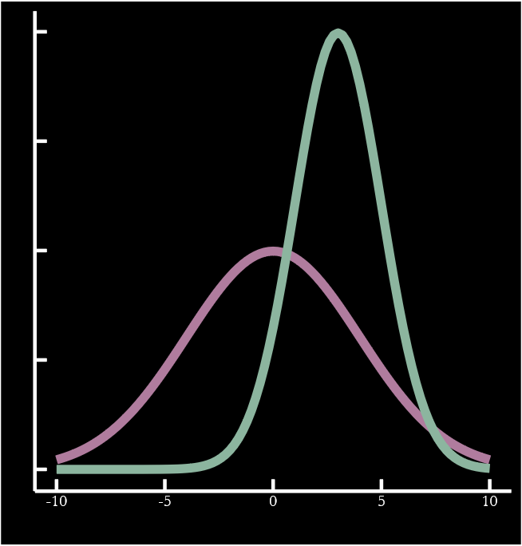
Why Variance
Why do we use analysis of variance to test a difference in means?
Otherwise, it’s hard to tell
NOTE: This has implications for interpreting a null result!

Slide 12
F-value
$$F= \frac{Between Group Variability}{Within Group Variability}= \frac{\frac{{SS}_{between}}{{Df}_{between}}}{\frac{{SS}_{within}}{{Df}_{within}}} = \frac{{SS}_{between}}{{Df}_{between}}×\frac{{Df}_{within}}{{SS}_{within}}= \frac{{SS}_{between}}{{SS}_{within}}×\frac{{Df}_{within}}{{Df}_{between}}$$
SS = Sum of Squares

Slide 13


In case
$${SS}_{within}=\sum{{({\overline{RT}}_{p}− {\overline{RT}}_{g_{p}})}^{2}}$$
$${SS}_{between}= \sum{N_{g}×{({\overline{RT}}_{g}− \overline{RT})}^{2}}$$

Slide 14
Hypothesis Testing
Can you express H0 in words?

Slide 15
Hypothesis Testing
Can you express H0 in words?
We cannot say whether the observations derive from different “populations”
We cannot exclude that the observations are drawn from different distributions

Slide 16
Hypothesis Testing
Can you express H0 in words?
We cannot say whether the observations derive from different “populations”
We cannot exclude that the observations are drawn from different distributions
Can you express H0 formally?

Slide 17
Hypothesis Testing
Can you express H0 in words?
We cannot say whether the observations derive from different “populations”
We cannot exclude that the observations are drawn from different distributions
Can you express H0 formally?
$${\hat{Y}}_{pg}= μ+ ε_{pg}$$
$$ε_{pg} \sim N(0, σ^{2})$$

Slide 18
Hypothesis Testing
Can you express H0 in words?
We cannot say whether the observations derive from different “populations”
We cannot exclude that the observations are drawn from different distributions
Can you express H0 formally?
$${\hat{Y}}_{pg}= μ+ ε_{pg}$$
$$ε_{pg} \sim N(0, σ^{2})$$
ANOVA assumption!

Slide 19



Linear Model
H0 looks like a linear model, right?
Indeed, ANOVA is a method applied to a linear model
F has some similarities with $R^{2}$
$$F= \frac{{SS}_{between}}{{SS}_{within}}×\frac{{Df}_{within}}{{Df}_{between}}$$
$$R^{2}=1 − \frac{{SS}_{residuals}}{{SS}_{total}}$$
Proportion of variance in the outcome captured by the predictor

Slide 20
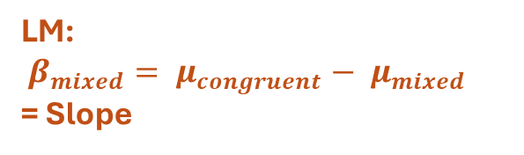

ANOVA: $μ_{congruent}− μ_{mixed}$
LM:
$β_{mixed}= μ_{congruent}− μ_{mixed}$
= Slope

Slide 21
Going Bayesian
A linear model is a more flexible tool than and ANOVA (or any other tests)
The switch between the two it’s quite easy
The switch to a Bayesian approach is quite easy too
In terms of code
As for anything, some aspects require learning and adjusting, BUT…
The benefits in terms of interpretability and general practice outweigh the challenges

Slide 22
Going Bayesian
Both Frequentist and Bayesian approaches use likelihoods
We’ll see the similarity through code

Slide 23
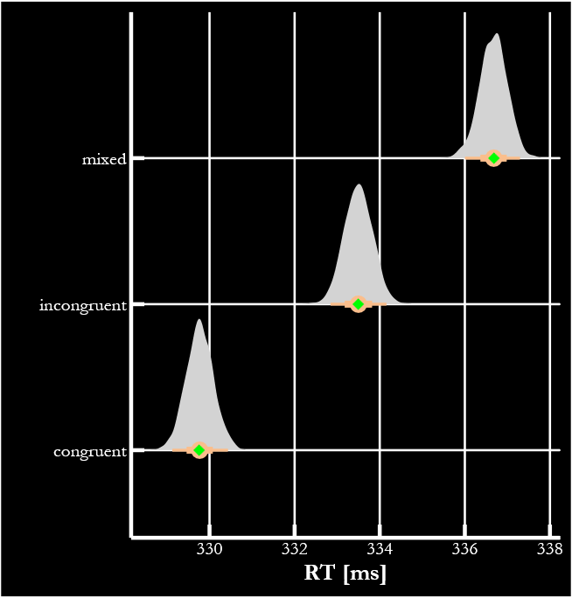
Going Bayesian

