Slide 1
MSE Portfolio Presentation 1
Doug Smith
November 13, 2008
http://people.cis.ksu.edu/~dougs/Site/Welcome.html

Slide 2
Overview
High Level Goals
  Satisfy the software engineering portfolio requirements of the MSE program.
  Solve a technical problem at work while doing so.
Technical Problem
  Scalable replicated metadata caching for an enterprise scale workflow system.
Approach
  Distill the target system to a smaller representation of the essential transactions
  Use the MSE Portfolio software development life-cycle to design and build the pared-down system, using the same architectural patterns and technology stack as the target system.
  Produce a scalable replicated caching solution as part of the MSE project that can be applied to the target system.

Slide 3
What is workflow metadata, and why cache it?
Workflow metadata describes process execution
  Process steps, data, presentation, routing rules, etc.
Good candidate for caching
  Metadata is rarely updated in production environment
  Metadata is constantly read
    Data validation, rule evaluation, etc.
Much easier and cheaper to scale in the application tier
  Cheaper compute cycles in the application tier, scalable via adding boxes to load balanced server pool
  Persistence tier scalability is expensive and complex

Slide 4
What is enterprise scale?
High volumes
  1050 different processes
  600,000 process instances active at any given time
  20% annual growth in the number of active process in a year
  17% annual growth in the number of process instances in a year (and associated transactions)
Business critical
  Service level agreements specify less than one hour unscheduled outage per year

Slide 5
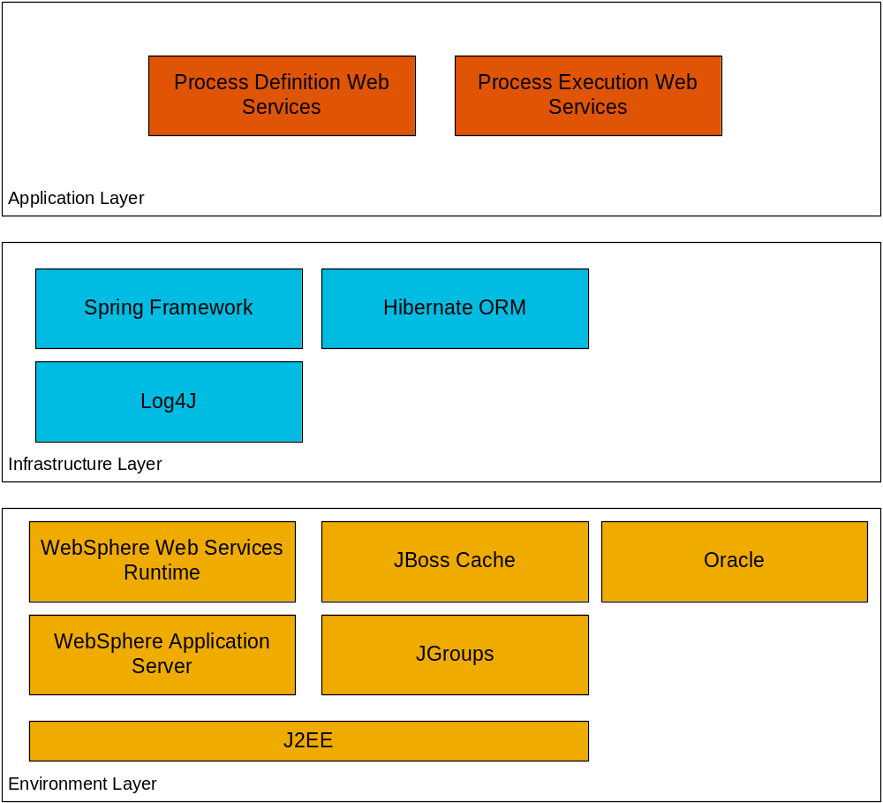
Project Technology Stack

Slide 6
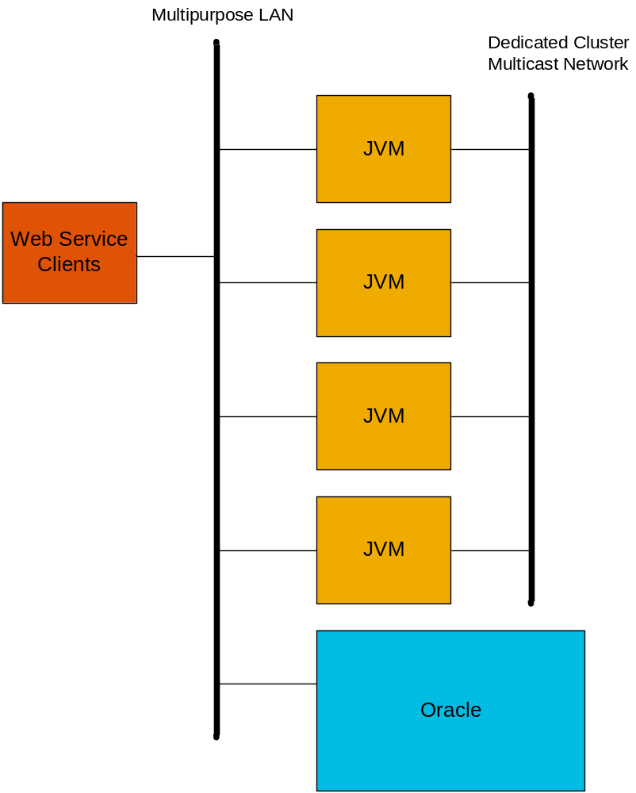
Project Physical Architecture

Slide 7
Project Functional Scope
Design and build a process execution engine
  Engine can execute simple processes based on a subset of BPMN
Engine provides two types of services
  Process definition services for creating the metadata the engine uses at process execution
  Process execution services that use the metadata to control the execution of process instances

Slide 8
Project Quality Attributes
QA1 - The solution may not degrade average response time or throughput for transactions involving cached data.
QA2 - Functional correctness must be maintained when caching is enabled.
QA3 - Application availability must not be compromised by the caching solution. The solution must provide the ability to survive failure of cluster members without compromising application availability or system correctness.
QA4 - The solution shall provide a role-based security model to constrain access to the functions and data associated with the system based on roles.
QA5 – the solution shall provide basic authentication and identity management, where users are required to authenticate prior to accessing the system, and user identities associated with one or more roles.
QA6 – the solution must be scalable to 16 JVMs evenly distributed among 4 physically distinct servers, and reduces database requests for workflow metadata by at least 50%.
QA7 - data access must be consistent across all JVMs serving application requests. It is unacceptable for results produced by the application to differ based on the server or JVM servicing the application request. In other words the view of the data across all cluster members must be consistent.
QA8 - the solution must provide the ability to add and remove cluster members as needed without causing errors.

Slide 9
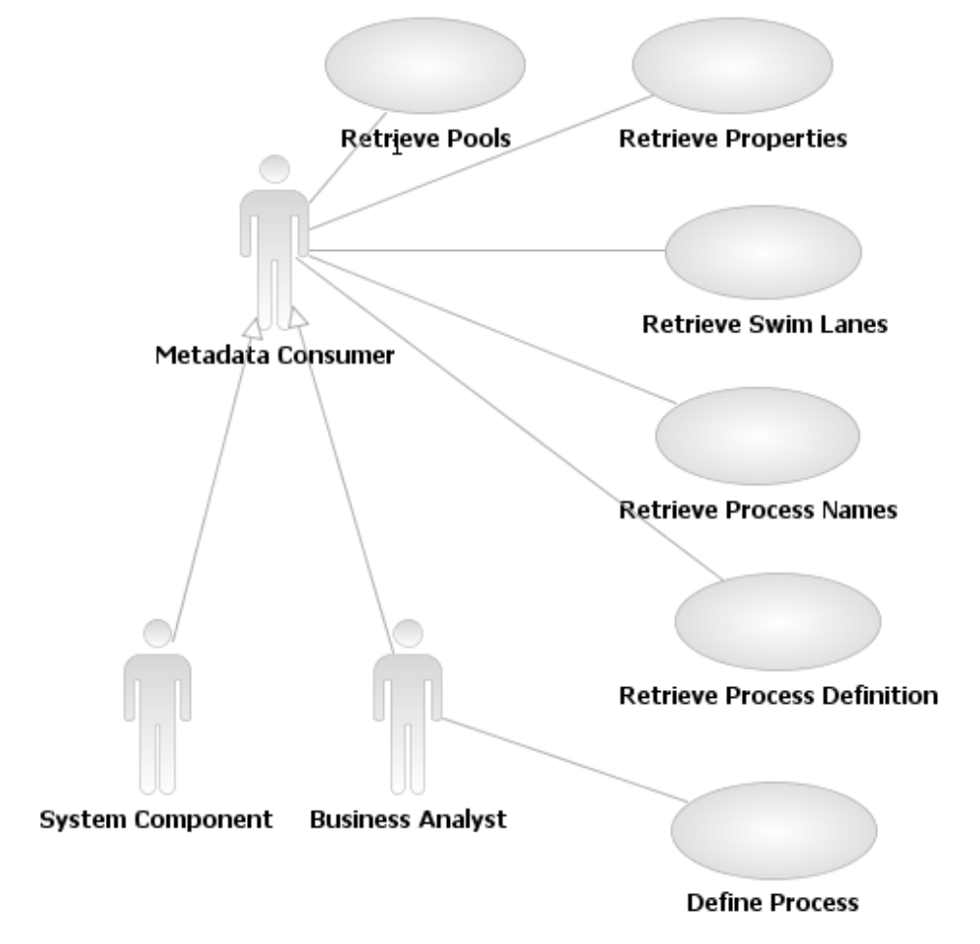
Use Cases – Process Definition

Slide 10
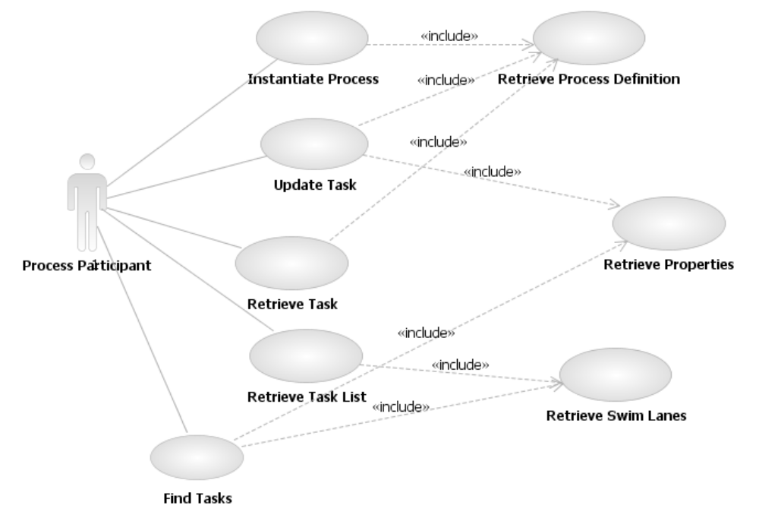
Use Cases – Process Execution

Slide 11
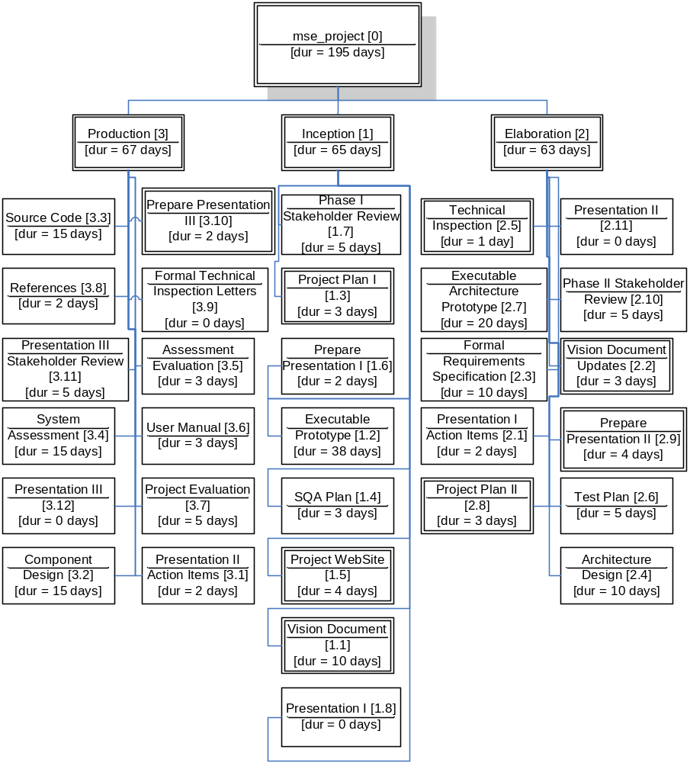
Project Plan – Work Breakdown Structure

Slide 12
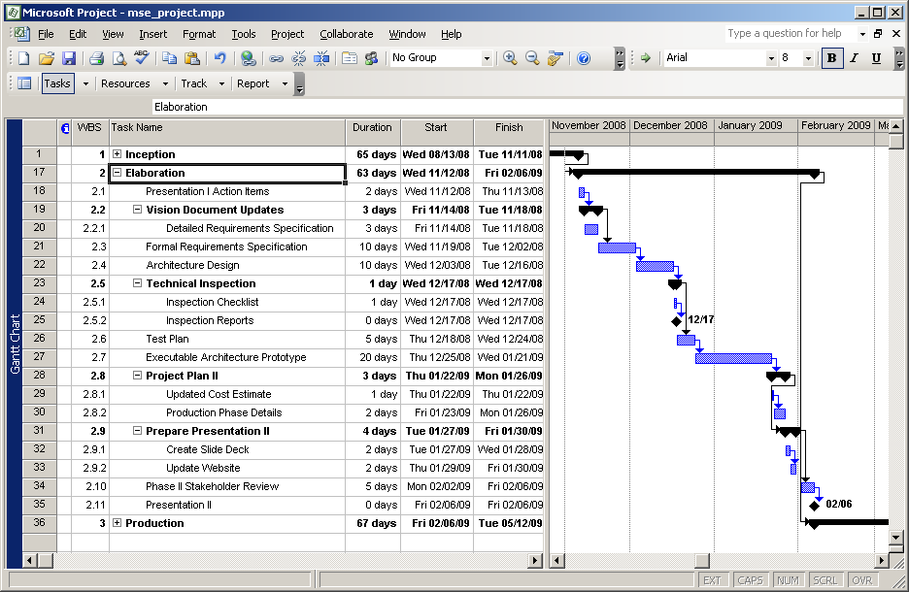
Project Plan – Elaboration Phase

Slide 13
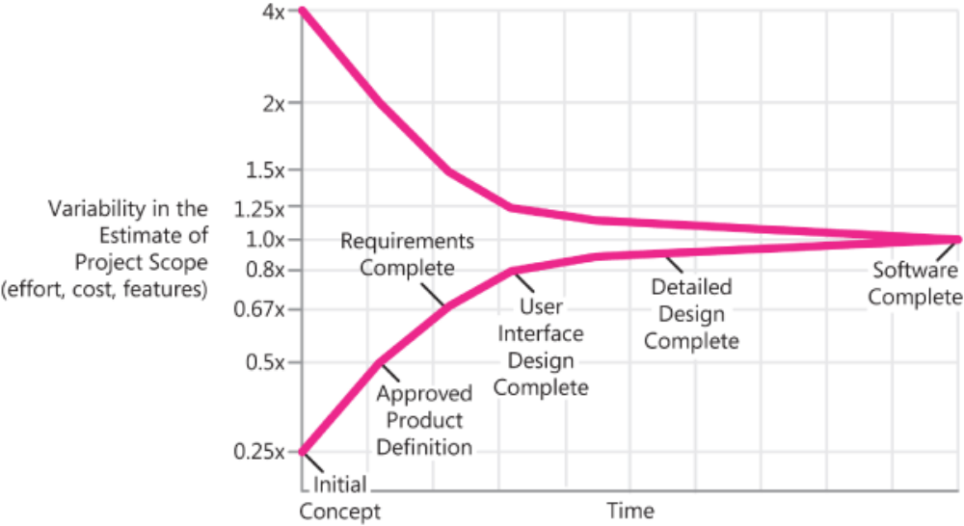
Cost Estimate
COCOMO II Selected
  Allows refinement as project proceeds
  Effort calculated at 1292 hours; project plan effort works out to 555 hours assuming 15 hours/week.
  Conclusion: variance explain by position in the ‘Cone of Uncertainty’ (or the student is doomed).
Figure from Software Estimation: Demystifying the Black Art, Steve McConnell, Microsoft Press, 2006.

Slide 14
SQA Plan Highlights
Project quality must satisfy the project committee.
Documentation set defined by MSE portfolio requirements.
Standards
  Documentation standards – MSE Portfolio
  IEEE Standard for Software Test Documentation (IEEE Std 829-1998)
  IEEE Standard for Software Quality Assurance Plans (IEEE Std 730-1998)
Metrics
  Source lines of code produced by the project
  Time spent during the project
Reviews and Audits
  MSE Portfolio Presentations
  Student Technical Inspections
Testing
  Unit tests using JUnit framework, Integration tests using SoapUI, Scale tests using SoapUI or JMeter (TBD)
  Tests results will be captured and published on the project web site

Slide 15
Demonstration
Goal
  Demonstrate the project is technically feasible
  Demonstrate the student is capable of doing the work
Technical success factors
  Implement web services using Hibernate with JBoss Cache integrated as a second level cache provider
  Show caching and replication of data between multiple JVMs

Slide 16
Action Item - Summarize

