Slide 1
Sepsis State Detection Using Physiological Data
Problem of Interest:
Sepsis is a whole body infection that affects millions of patients in the ICU annually
Sepsis characterized by a progression of states:
SIRS → sepsis → severe sepsis → septic shock → death
Early detection of these states leads to earlier treatment and improved patient outcomes
Distinguishing between patients who will progress from SIRS to severe sepsis or septic shock vs those who will remain in SIRS and return to healthy useful for diagnosis and efficient use of resources
Continuous physiological time series like heart rates, respiratory rates, oxygen saturation levels, and blood pressure readings are readily available in the ICU, but underexplored as a source of disease prediction

Slide 2
Goal
Develop a system that:
Detects (ultimately detects early) the patient’s disease state and probable trajectory
Makes use of continuous physiological measurements
Incorporates temporal information about the progression of the disease when making decisions about the current or future disease state
Incorporates clinical concerns about the rates of false positives and false negatives for different disease states
Makes reliable predictions i.e. the clinician can be confident that the predicted state is accurate within some user-specified tolerance

Slide 3
Related Work
Decision theory:
Previous work on developing a decision policy for transition point detection over a sequence of observations with a montonically increasing cost (Santaniello et al. 2012)
Previous work on deriving a decision policy with a reject state corresponding to refusing to predict a class for a single observation (Grall-Maës and Beauseroy 2009, Chow 1970) Propose to derive an :optimal decision policy with a refusal option over a time series for a general and possibly asymmetric cost function
Neural Nets:
(DF Wulsin et al. 2011) applied Deep Belief Networks (DBNs) to the task of anomaly detection in clinical EEG records. The group found that DBNs were significantly faster than other state of the art methods.
To obtain adequate performance a variety of techniques need to be considered. In (Hinton et al. 2012) a variety of techniques for smart weight initialization and updating is considered.

Slide 4
Approach
Divided into Three Parts:
HMM modeling to learn features from the physiological data
a decision policy to decide what if any state the system should predict
a neural network to estimate the posterior probabilities for each state
The Data
heart rate sampled at 2 Hz derived from the MIMIC II Waveform Database.
Each record contains heart rate for an ICU patient with SIRS, severe sepsis or septic shock, with at least 12 hours preceding the event.

Slide 5
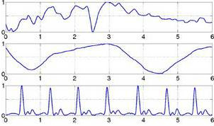
Feature Discovery in Septic Shock
Objective:
Model patients data using a HMM.
learn symptom specific HMM models form patient heart rate data
Trained models could also be used to interpret the prognosis of septic shock.
a
b
a
http://www.spg.tu-darmstadt.de/res/researchprojects_1/eyeresearch_1/eyeresearch.de.jsp

Slide 6
Model Training
Data:
1 min of heart rate represented by standard deviation.
93 Patients with ‘SIRS’ symptom
140 patients with ‘Severe Sepsis’
100 patients with ‘Septic Shock’
Data samples are not mutually exclusive e.g SIRS is always an underlying symptom.
Model:
State: 10dim Multi Variate Gaussian (10 minute window)
State: 10d mean vector, 10x10 covariance matrix
Non – overlapping observations

Slide 7
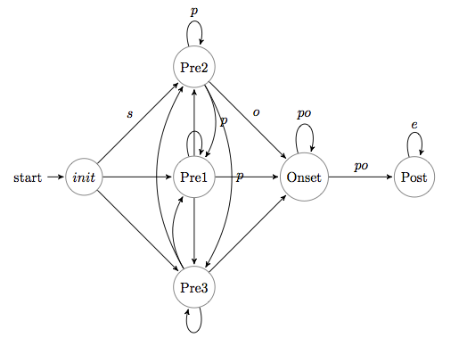
Model Training
Model Initialized with the following transition structure.
Initial estimates of states computed from data.
Pre States: Initial 10 min window of heart rate from patients. Perturbed into multiple states.
Onset State: 10 min window before symptom was observed
Post State: 10 min window centered at the moment of symptom being reported.

Slide 8
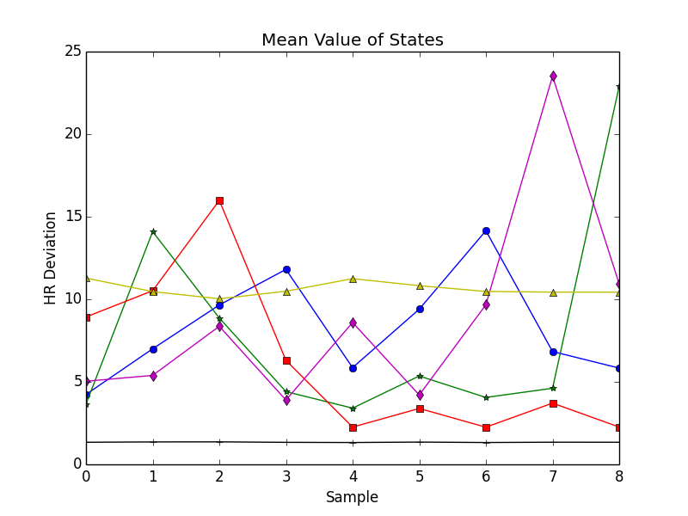
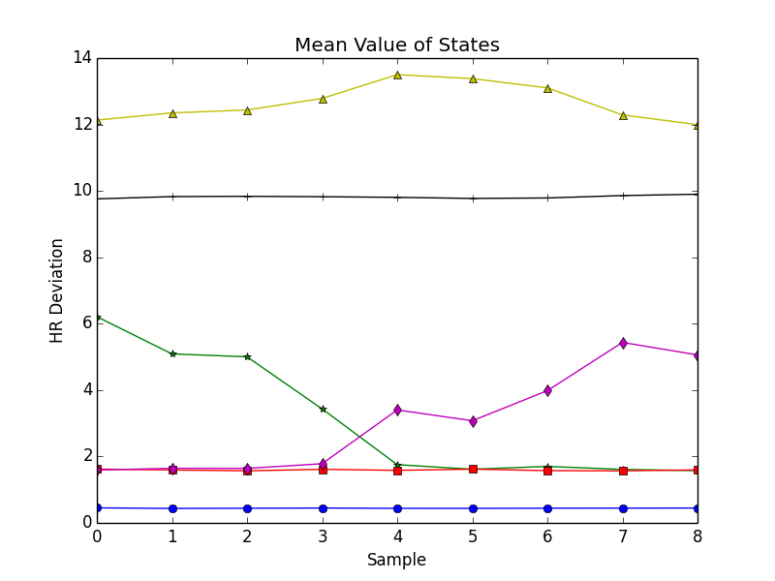
Model Training
Mean vectors of states Initially (left) and after 20 Iterations (right)
The trained states represent ‘motifs’ in the data.
More iterations = more deviation from initial transition structure

Slide 9
Evaluation
What can we say about the modeling performance?
Unseen patient data was used to evaluate the models.
The probability of unseen patient data under each model was computed.
Log-probability of observation sequence given a model marginalizing all possible hidden states.
The highest probability model is assigned as the predicted outcome for the patient.

Slide 10
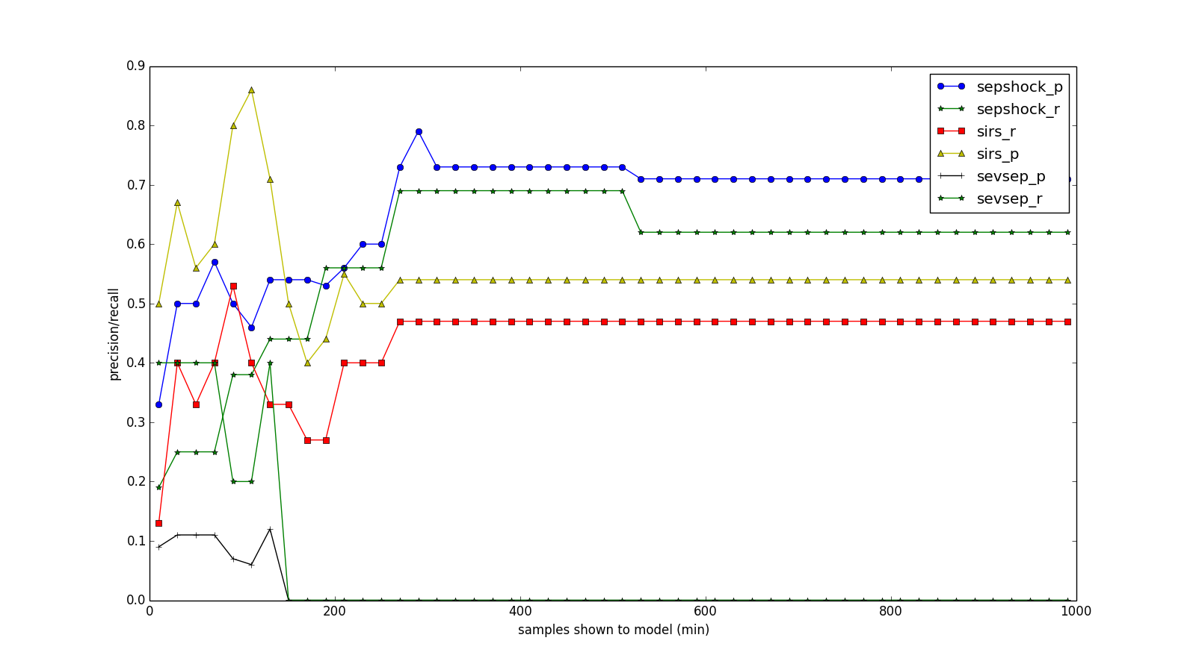
Evaluation by Prediction
 | Sirs | Svp | Shk
Sirs | 7 | 6 | 2
Svp | 4 | 0 | 1
Shk | 2 | 3 | 11

Slide 11
Discussion & Future Work
Difficult to tease apart Severe Sepsis and Septic Shock with out sacrificing accuracy
Initialization did not play important rule in model training. (small number of iterations lead noisy predictions)
Leverage other data sources and of different heart rate features.
Motif discovery in current framework limited by length of observation window.
Increase/Experiment with different observation windows

Slide 12
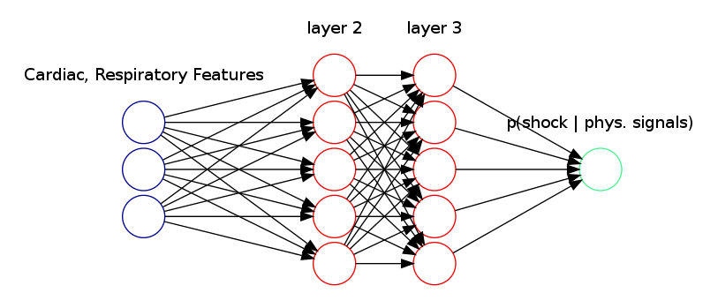
Neural Networks for Septic Shock
Prediction
Use heart rate features to predict septic shock
Neural Network framework developed “from scratch”
Heart rate
features

Slide 13
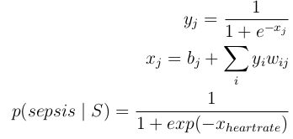


Approach
Interpret Neural Net output as probability with Softmax output function
Corresponding objective function is cross entropy
Features: Mean and Standard Deviation over 1 minute intervals of heart rate
A 1 hour frame:

Slide 14



Approach
Trained with standard Batch Gradient Descent with
Backpropagation. Some numerical issues
Weight initialization:
Learning rate:
Prevent oversaturation in “deep” networks

Slide 15
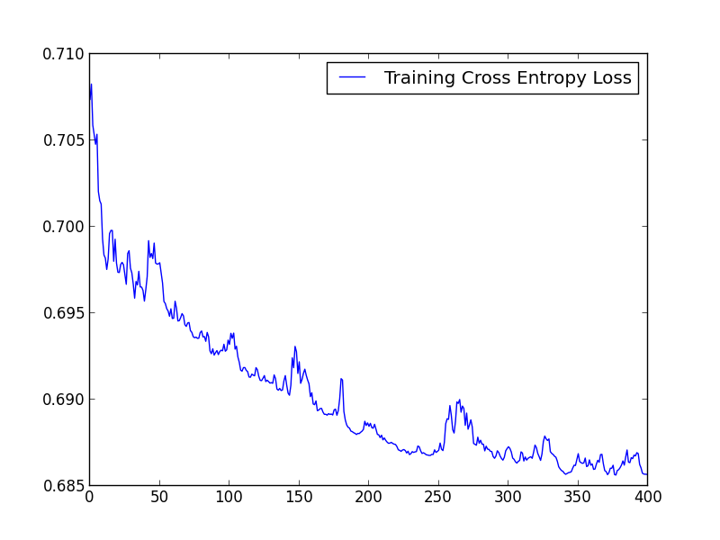
Classification of Septic Shock
120 input
100 hidden
1 output
400 epochs
Lr 0.005
974 Training
examples
epochs

Slide 16
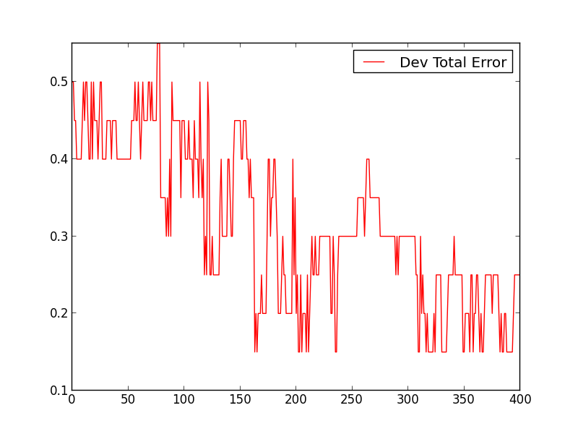
Classification of Septic Shock
120 input
100 hidden
1 output
400 epochs
Lr 0.005
974 Training
examples
epochs

Slide 17
Discussion
Features:
Features extracted over 15 and 7.5 minute intervals don't provide enough structure
Those features extracted from the raw 2 Hz data are too granular
Features over 1 minute intervals are a good compromise here
Neural Net:
More than one layer introduced instability, oversaturation, and overfitting
But that conclusion is unfair—we need more sophisticated pretraining

Slide 18
Future Work
Neural Network:
Deep Neural Network pretraining to explore potential advantages of many layers
Convert classification framework into prediction framework
Prediction over multiple classes (rather than just “sepsis”
and “not sepsis”)
More robust features (instead of only mean and stdev) and additional physiological time series

Slide 19
Reliable Classification
Objective:
Only predict when system is sufficiently confident in the decision
Allow customizable and class-specific tolerances for false positives, false negatives, and refusing to predict
Incorporate univariate potentials from external classification into a time sequence framework
Refuse to predict
Cost function
CRF, semi-Markov CRF

Slide 20
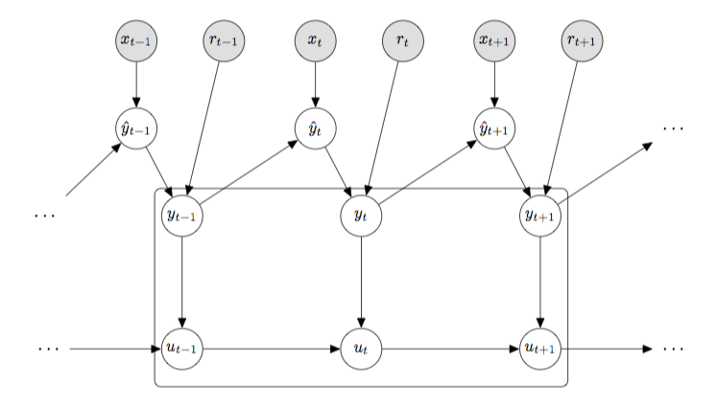
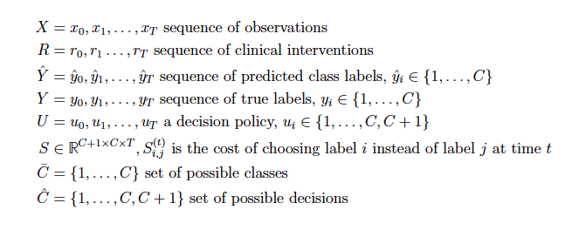
Decision Model
Decision process takes a sequence of distributions over all possible classes and decides
Introduce dependencies between decisions to encourage smooth decision transitions since we consider physiological data measured at 2Hz and expect slow transitions to new states
Allow the distribution over the classes y_{t} to be defined either by the the distribution output from classifier y_{t} or by a clinical intervention r_{t} where a clinician provides a definitive diagnosis

Slide 21
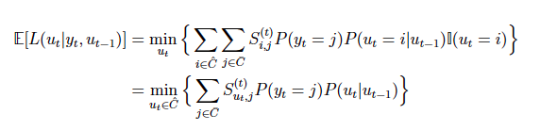
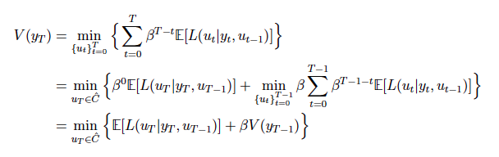

Derivation of the optimal decision policy over time sequence given a cost function S
Define the expected loss of a decision as
Find the decision sequence {u_{t}}_{0≤t≤T} that minimize the total expected posterior loss V
This gives us the following decision policy, where C+1 corresponds to refusing to predict and

Slide 22
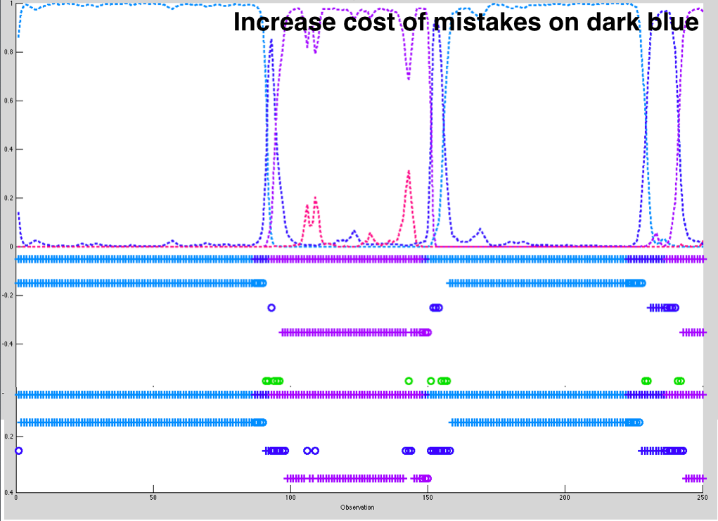
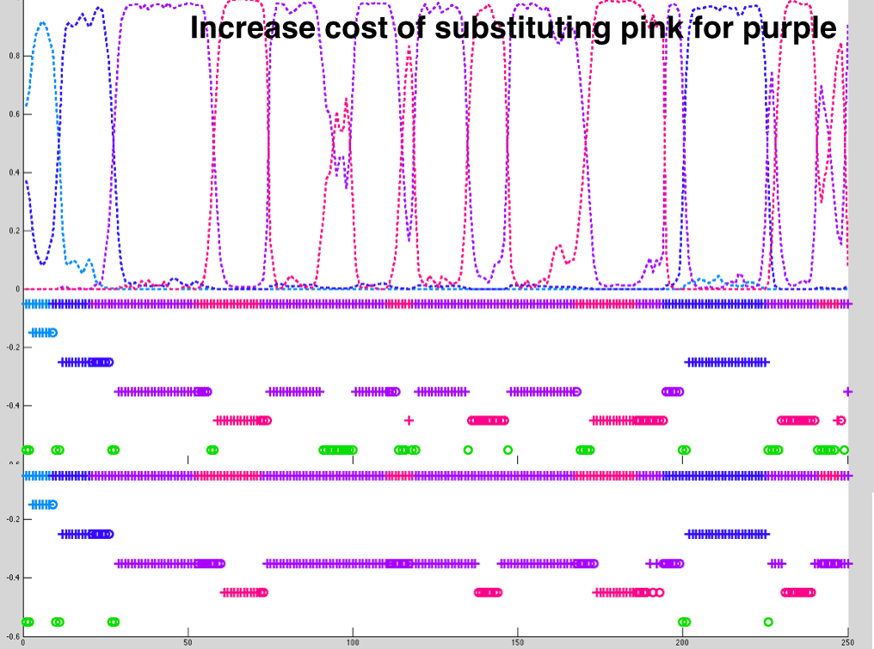
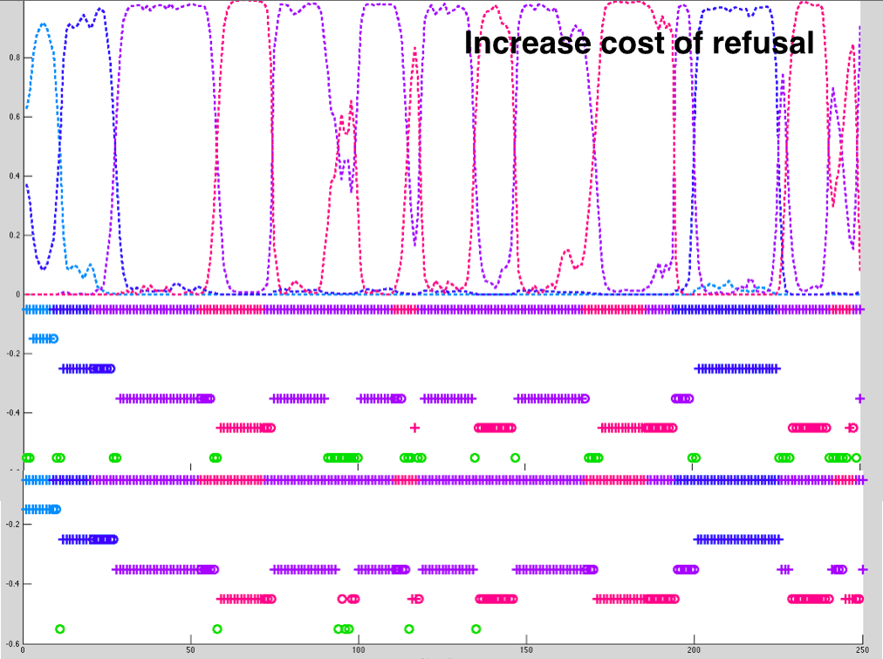
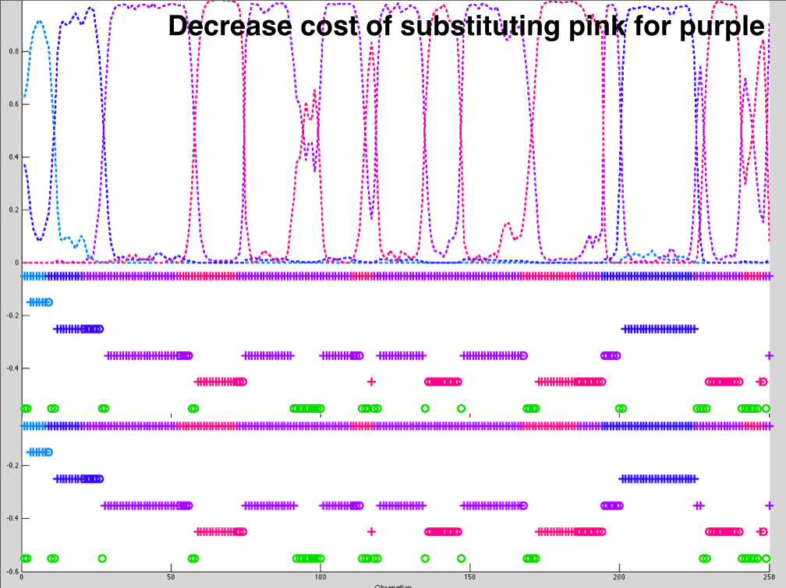
Experiment 1: Implement decision policy on synthetic data

Slide 23
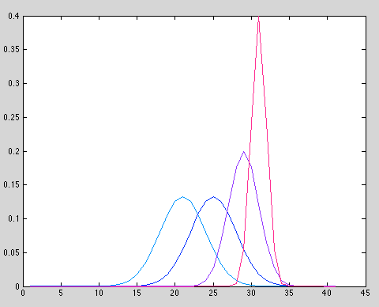
Generated sequences of observations from the following four Gaussians and a transition matrix
Initially used an HMM to calculate P(y_{t}); however, motivated by desire to incorporate potentials P(y_{t}|x_{t}) from deterministic systems, switched to a CRF implementation that computes P(y_{t}|X_{1:t})
Synthetic data classes are fairly separable – each has high probability of that class when in the class, a more realistic experiment might make classes more overlapping
Manipulating the cost function allows us to control false positive, false negative, and refusal rates
Confirmed that returned decision path is less costly than true decision path and that the probabilities implemented with CRF are comparable with those implemented using BayesNet Toolkit

Slide 24


Experiment 2: Implement decision policy on SVM output
Approach:
Take decision values output by an SVM trained for septic shock prediction, use a sigmoid function to map the values to [0,1] and interpret as the univariate potential P(y_{t}|x_{t})
Incorporate potentials into a CRF framework by defining transition potentials P(y_{t-1},y_{t}) for each possible pair of labels and then using the forward algorithm to compute P(y_{t}|Y_{1:t-1}, X_{1:t}) for t = 1, …, T
Initialize:
t>1
Discussion:
See instances of staying in septic shock for only one state, could benefit by explicitly modeling how long patient has been in a given state and learning distributions over the expected duration of each state
Provides labels in areas that were labeled uncertain (pink)
Able to incorporate temporal information that a classifier like an SVM cannot

Slide 25
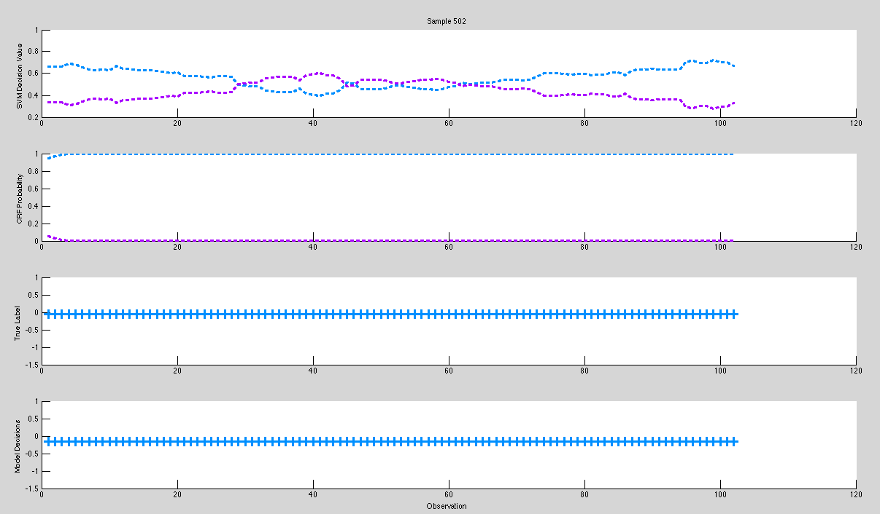
Purple –septic shock
Blue – not septic shock
Pink – uncertain label
Green – IDK
Example 1

Slide 26
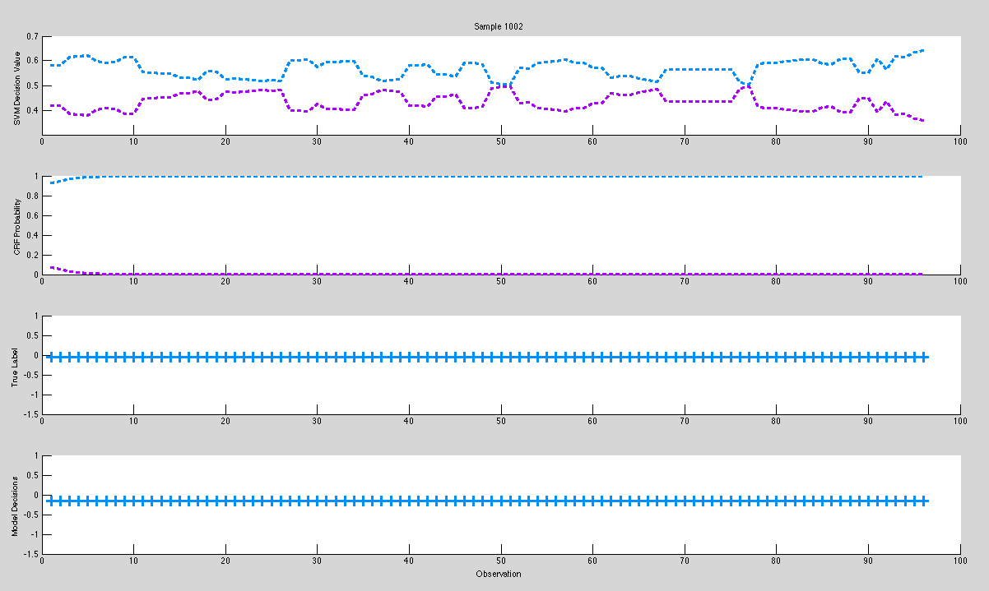
Purple –septic shock
Blue – not septic shock
Pink – uncertain label
Green – IDK
Example 2

Slide 27
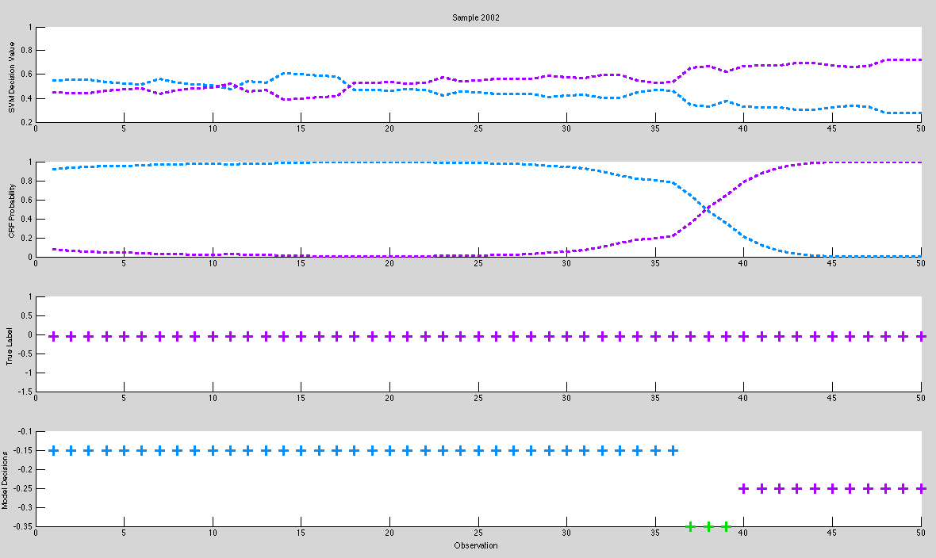
Purple –septic shock
Blue – not septic shock
Pink – uncertain label
Green – IDK
Example 3

Slide 28
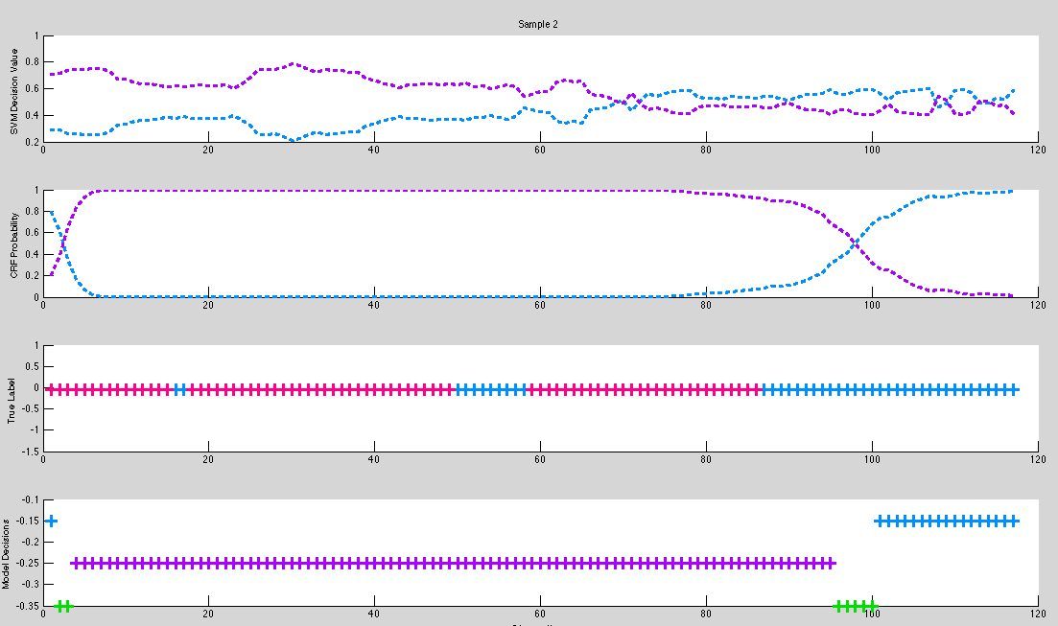
Purple –septic shock
Blue – not septic shock
Pink – uncertain label
Green – IDK
Example 4

Slide 29
Future Work
Reliable Classifier:
Semi-Markov CRF instead of CRF to incorporate knowledge about duration of disease state
Learn parameters for CRF weights instead of defining them
Learn probability distributions for duration of states
Learn cost function subject to clinician-specified constraints
Train model parameters for early detection

Slide 30
Overall Discussion
Physiological Features
Heart rate alone seems insufficient for distinguishing between sepsis states
Heart rate is able to distinguish between SIRS and Septic Shock
Physiological data has predictive power, but additional representations and possibly additional signals would be beneficial
Challenge of working with overlapping labels for classification

Slide 31
Future Work
Integration
HMM tag sequence can be used as categorical features as input to neural network
Probability of observation sequence under each HMM models can be input into the decision policy directly
Conditional probabilities from neural network output can be incorporated into decision policy
Convert neural network classification into a predictive framework to input into the decision policy

