Slide 1
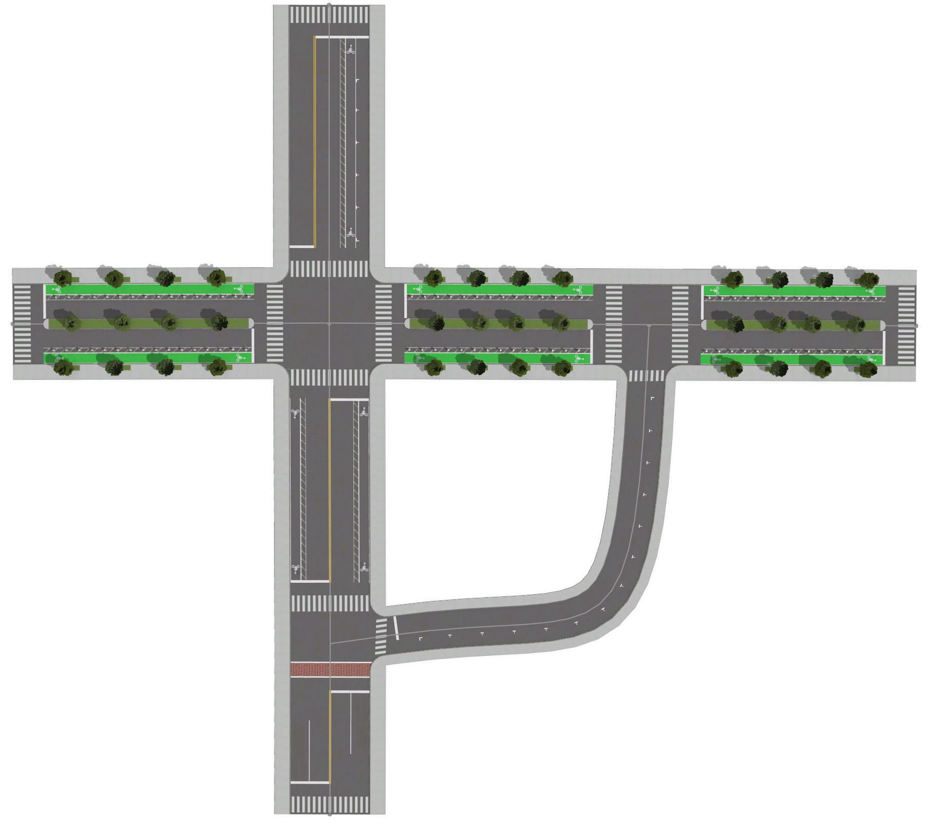
LR2
Additive Representation Sample
SSR 210…1
SSID | Right_Parking_Lane | Right_Bike_Lane | Right_Bike_Buffer
SSR210…1 | 2.4 | 2 | 1
SSR210…2 | 2.4 | 0 | 0
LR1
LR2
Slice Representation Sample
SSR 210…2
{ "type": "Feature",
"properties":
{ "id": “SSR210…1",
{“slices”:[{type: “sidewalk”, width:3,height:.1,direction:”reverse”},{type:“drive_lane”,width:3.048,height:0,direction: “reverse”},{type: “drive_lane”,width:3.048,height:0,direction “forward”}…..],
{“ends”:{[{crosswalk_end:{width:3,height:0,type: “continental”}….],
"geometry": { "type": "Point", "coordinates": [-74.003388, 40.634538]…. } }
LR1

