Slide 1
Gene Therapy: The future of personalized medicine
Michael Huss
BIO 405
Dr. Christina Steel

Slide 2
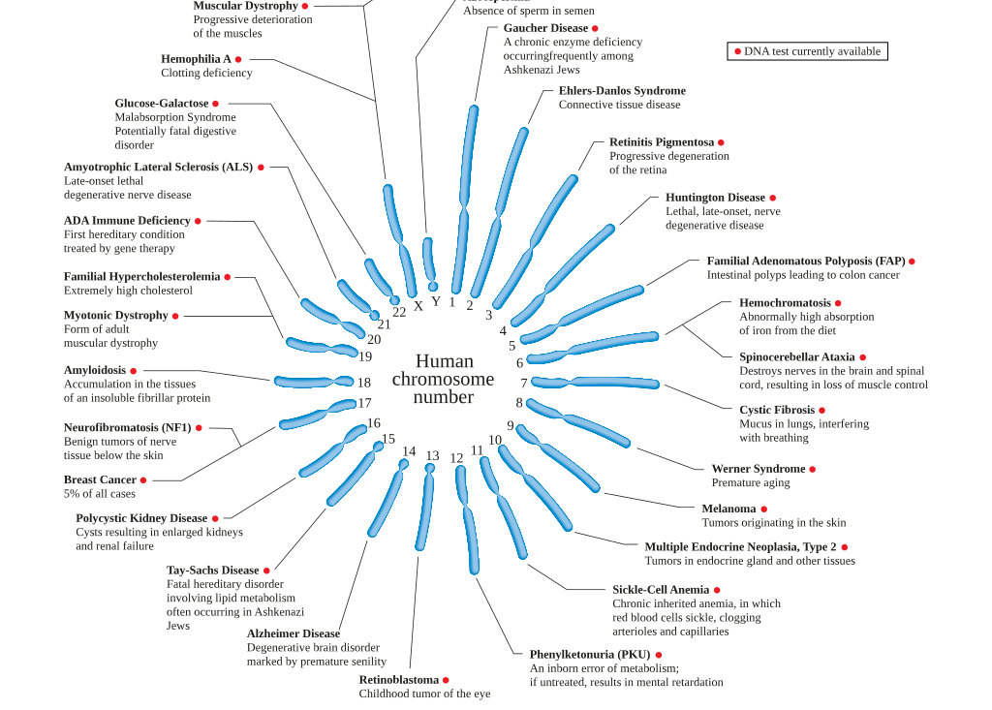
Introduction: Diseases and Disorders
Current treatments
Treatments of autoimmune diseases often involve anti-inflammatory drugs and immunosuppressants.
Treatment of genetic disorders work to improve quality of life of patients, as their symptoms arise from abnormalities in their genes.
Notes:
When you think of diseases you may think of medicines or surgeries, but some diseases cannot be treated this way.

Slide 3
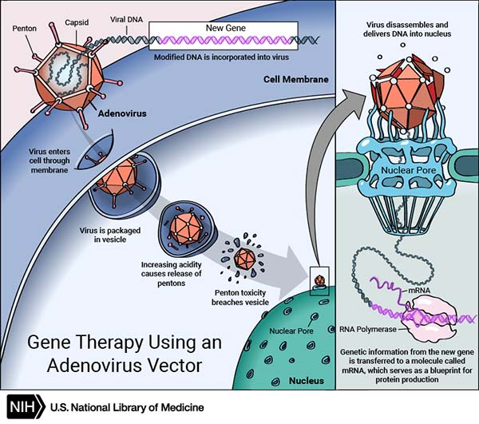
Gene Therapy
Gene therapy is the genetic modification of cells to produce therapeutic effect.
Notable diseases:
Cystic fibrosis
Duchenne muscular dystrophy
Notes:
Gene Therapy a new treatment on the market that has been researched for the last 50 years.

Slide 4
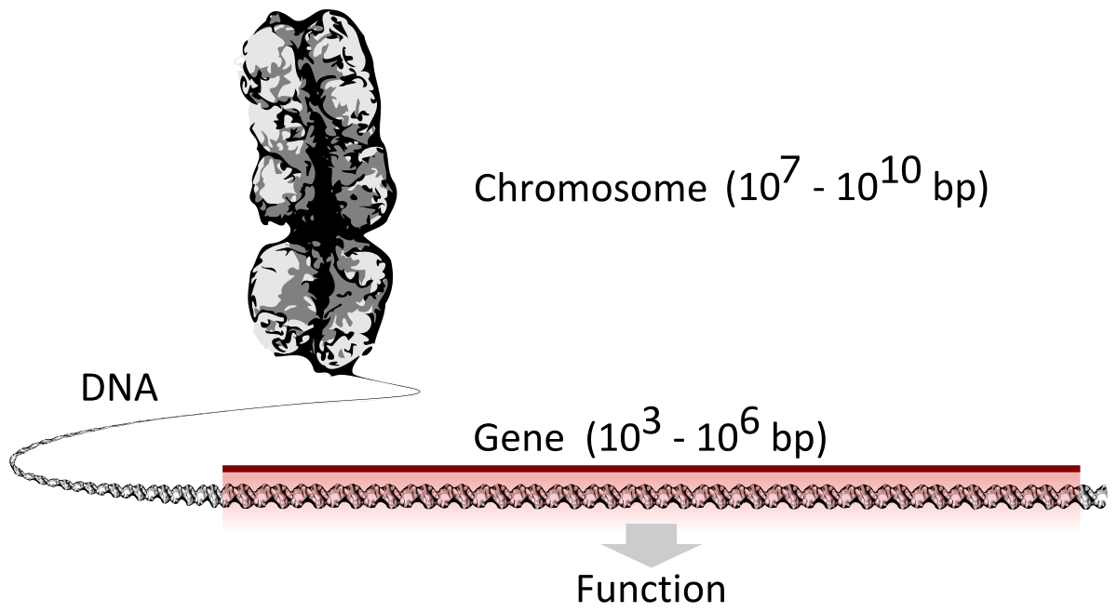
Background
Genes, what are they?
A sequence of nucleotides in DNA that codes for a functional biomolecule called a protein.
How do genes become you?
The genes in a person’s DNA leads to a persons phenotype or physical expression of ones genes.

Slide 5
Central Dogma
DNA
Biological molecule that carries the genetic instructions of the growth, development, homeostasis and reproduction of all known living things.
DNA can be compared to a code in which the nucleotides Cytosine, Guanine, Adenine and Thymine are arranged into a highly specific order.

Slide 6
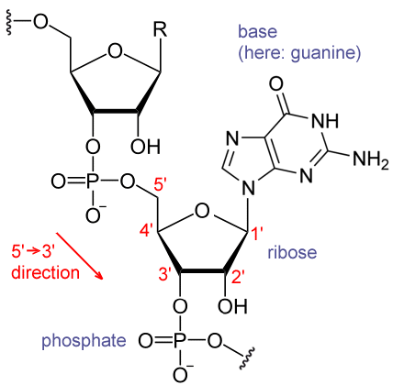
Central Dogma Continued
RNA
Is an important biological molecule that is necessary for the process of translating DNA code into biological functioning proteins.

Slide 7
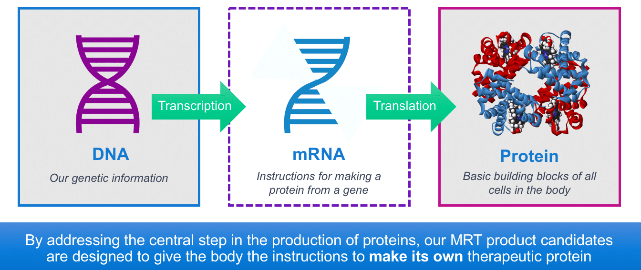
Central Dogma Continued
Protein
Proteins are biological molecules that are made up of amino acids.
Not only are the amino acids important for the chemical makeup of the protein but also for the shape.
Proteins take on specific shapes for them to biologically functioning.

Slide 8
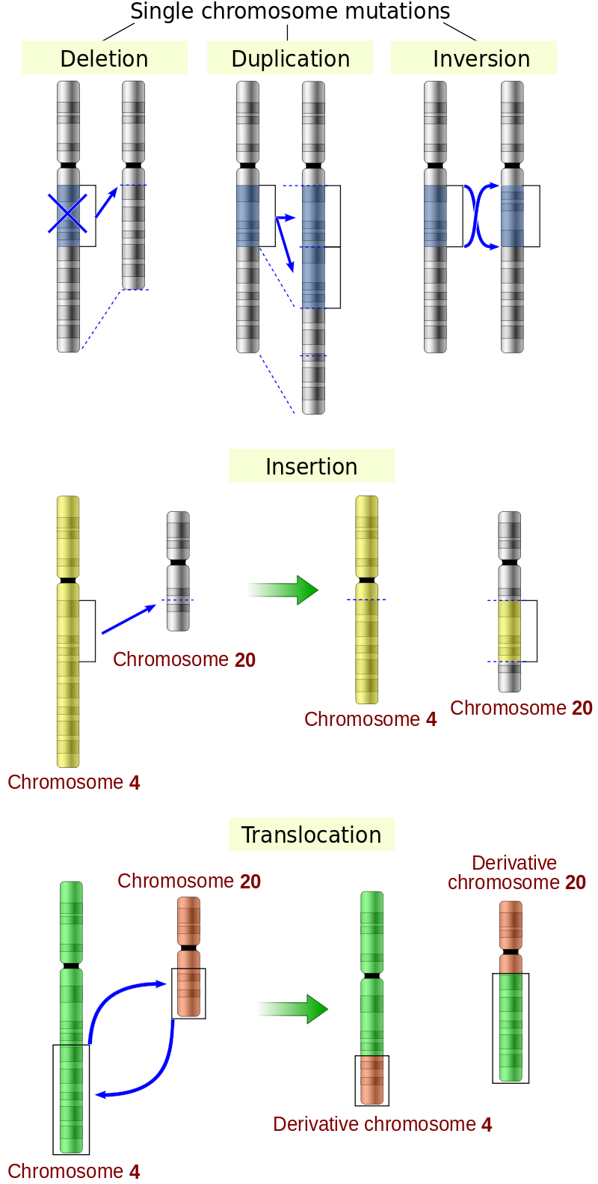
How do changes to your DNA lead to Disease?
Mutations of DNA
Changes in Protein
Disease resulting from these mutations

Slide 9
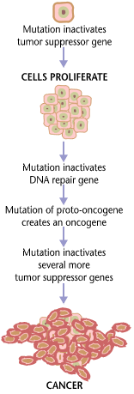
Proof of Concept
Can human genes be altered?
Alterations of the DNA of human cells is not something that only occurs in gene therapy. It is known that in certain genes can become altered and lead to cancer. For example, in metastatic prostate cancers the gene PTEN/MMAC1 in chromosome 10 has been commonly reported as deleted or altered.

Slide 10
Current Studies in Gene Therapy
Vectors
What are vectors?
A vehicle to transport a constructed DNA sequence into a target cell.
The most common vectors are viruses (Adeno-associated viral vectors)
Why are they important?
Under normal conditions your DNA cannot be modified

Slide 11
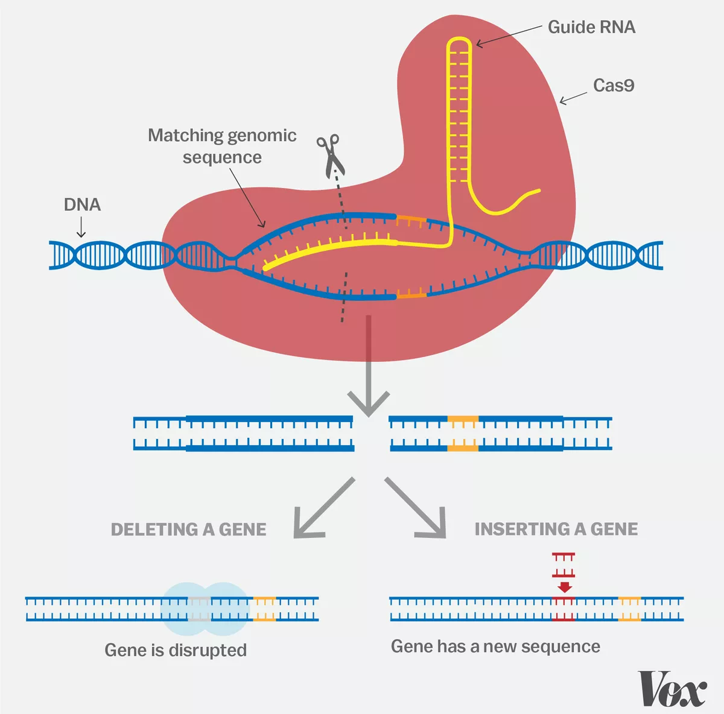
CRISPR
The key to editing genes
What does CRISPR do?
What has been done with CRISPR

Slide 12
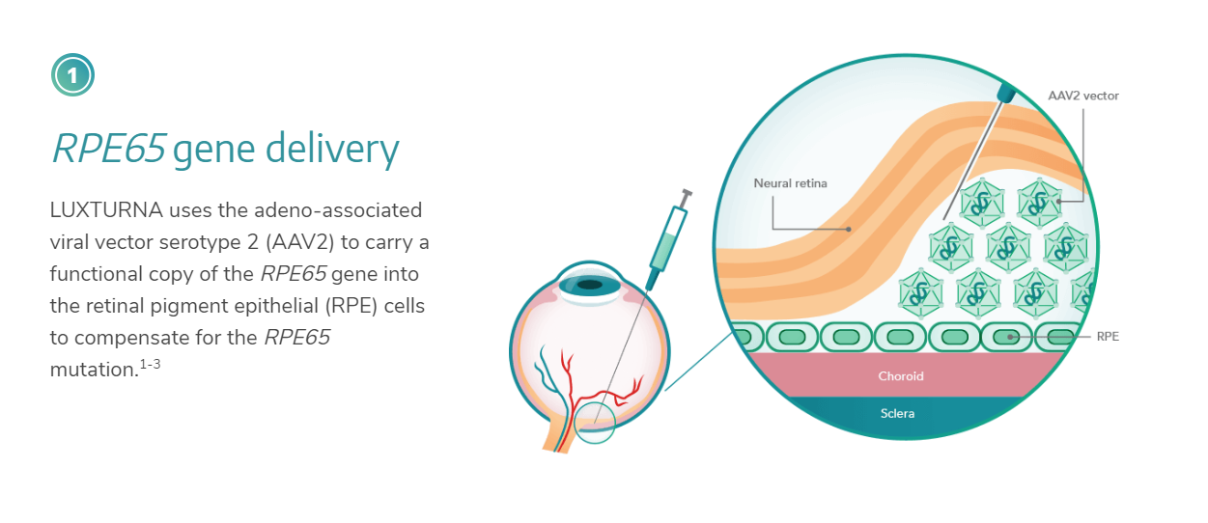
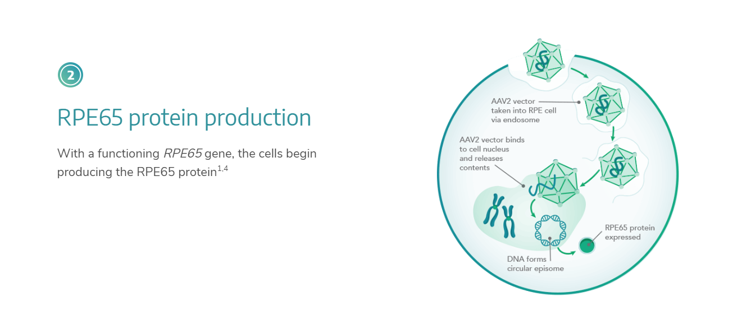
Luxturna™
Notes:
$850,000 price tag

Slide 13
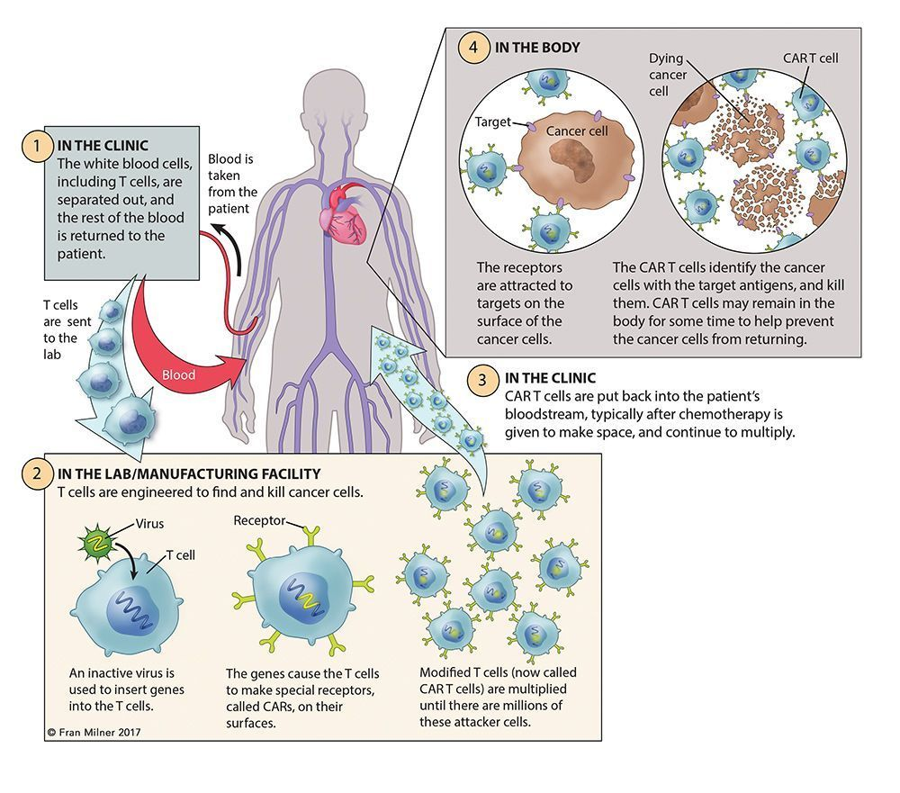
CAR T Cells
Using your immune system to treat yourself
Revolutionary Cancer treatments for Lymphoblastic Leukemia, B-cell lymphoma

Slide 14
Conclusions
Will gene therapy expand to multigenic disorders / other diseases?
More research has to be done, due to the complexity of gene interactions in vivo
Expanding from genetic disorders, to immunodeficiency's (AIDS)

Slide 15
Refrences
Mulligan R. The basic science of gene therapy. Science. 1993;260:926-32.
Knowles MR, Hohneker KW, Zhou Z, Olsen JC, Noah TL, Hu P-C, et al. A Controlled Study of Adenoviral-Vector–Mediated Gene Transfer in the Nasal Epithelium of Patients with Cystic Fibrosis. New England Journal of Medicine. 1995;333:823-31.
Morgan JE. Cell and Gene Therapy in Duchenne Muscular Dystrophy. Human Gene Therapy. 1994;5:165-73.
Suzuki H, Freije D, Nusskern DR, Okami K, Cairns P, Sidransky D, et al. Interfocal Heterogeneity of <em>PTEN/MMAC1</em> Gene Alterations in Multiple Metastatic Prostate Cancer Tissues. Cancer Research. 1998;58:204-9.
Kaji EH, Leiden JM. Gene and Stem Cell Therapies. JAMA. 2001;285:545-50.
Cyranoski D. CRISPR gene-editing tested in a person for the first time. Nature. 2016;539:479.
Couzin-Frankel J. Cancer Immunotherapy. Science. 2013;342:1432-3.
Alton EWFW, Armstrong DK, Ashby D, Bayfield KJ, Bilton D, Bloomfield EV, et al. Repeated nebulisation of non-viral <em>CFTR</em> gene therapy in patients with cystic fibrosis: a randomised, double-blind, placebo-controlled, phase 2b trial. The Lancet Respiratory Medicine. 2015;3:684-91.
Administration UFaD. FDA Approval Brings First Gene Therapy to the United States. CAR T‐Cell Therapy Approved to Treat Certain Children and Young Adults with B‐Cell Acute Lymphoblastic Leukemia. US Food and Drug Administration Newsroom Website2017.
Ginn SL, Amaya AK, Alexander IE, Edelstein M, Abedi MR. Gene therapy clinical trials worldwide to 2017: An update. The Journal of Gene Medicine. 2018;20:e3015.

