Slide 1

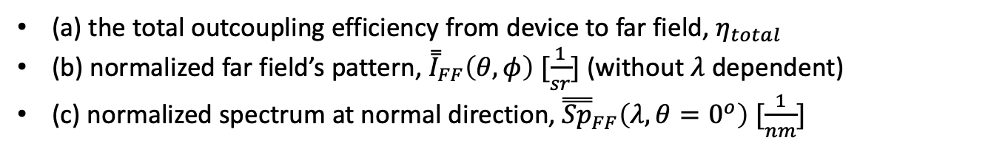
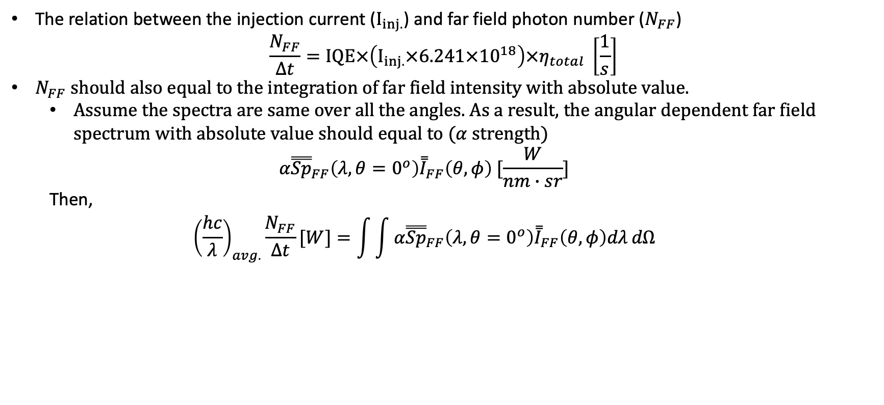
Method (1)
Spectrometer/detector
(area:A_{dec.})
(a) the total outcoupling efficiency from device to far field, $η_{total}$
(b) normalized far field’s pattern, ${\overset{̿}{I}}_{FF}\left(θ,φ\right) [\frac{1}{sr}]$ (without $λ$ dependent)
(c) normalized spectrum at normal direction, ${\overset{̿}{Sp}}_{FF}\left(λ, θ=0^{o}\right) [\frac{1}{nm}]$
Solid angle $Ω$
r
EL device
The relation between the injection current ($I_{inj.}$) and far field photon number ($N_{FF}$)
$$\frac{N_{FF}}{Δt}=IQE×\left(I_{inj.}×6.241×{10}^{18}\right)×η_{total} \left[\frac{1}{s}\right]$$
$N_{FF}$ should also equal to the integration of far field intensity with absolute value.
Assume the spectra are same over all the angles. As a result, the angular dependent far field spectrum with absolute value should equal to ($α$ strength)
$$α{\overset{̿}{Sp}}_{FF}\left(λ, θ=0^{o}\right){\overset{̿}{I}}_{FF}\left(θ,φ\right) [\frac{W}{nm∙sr}]$$
Then,
$${\left(\frac{hc}{λ}\right)}_{avg.}\frac{N_{FF}}{Δt}[W]=\int{\int{α{\overset{̿}{Sp}}_{FF}\left(λ, θ=0^{o}\right){\overset{̿}{I}}_{FF}\left(θ,φ\right)dλ}}dΩ$$

Slide 2

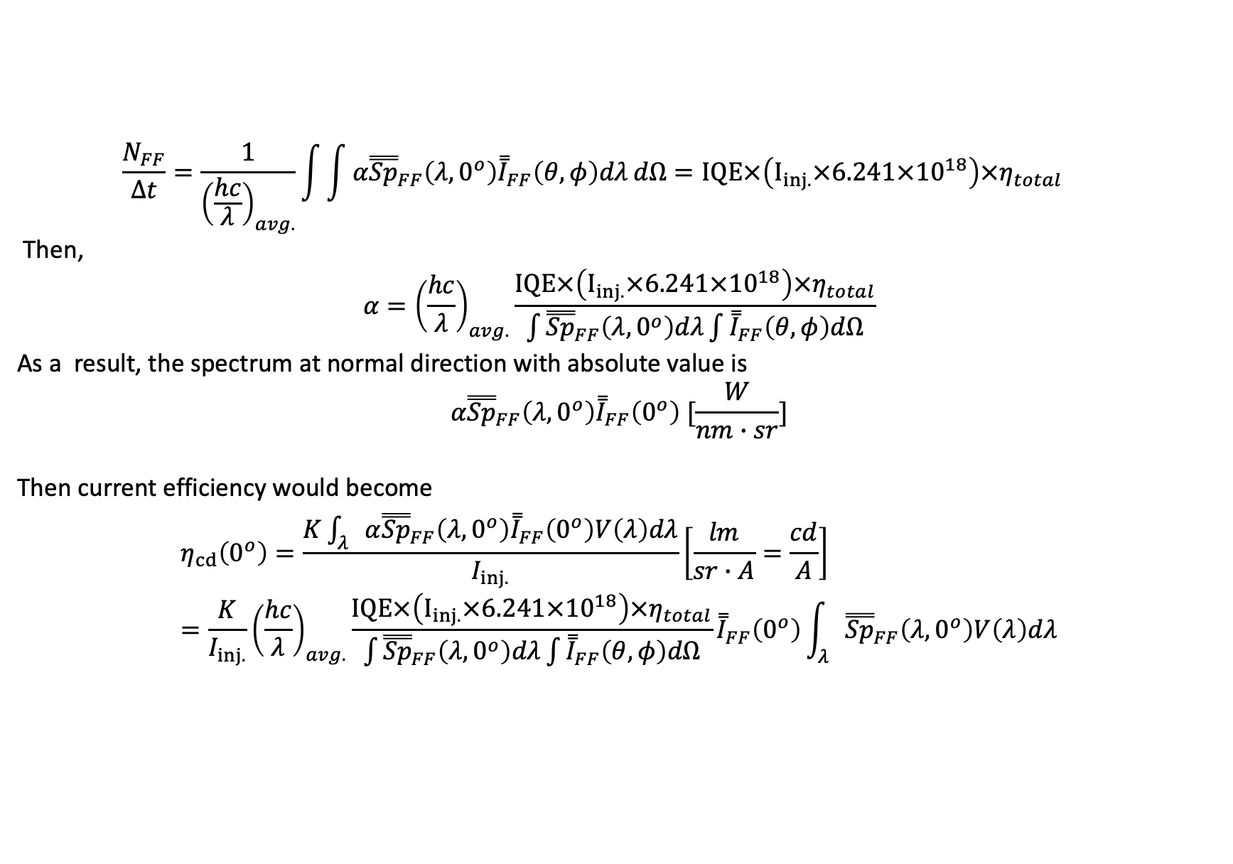
Method (2)
$$\frac{N_{FF}}{Δt}=\frac{1}{{\left(\frac{hc}{λ}\right)}_{avg.}}\int{\int{α{\overset{̿}{Sp}}_{FF}\left(λ, 0^{o}\right){\overset{̿}{I}}_{FF}\left(θ,φ\right)dλ}}dΩ=IQE×\left(I_{inj.}×6.241×{10}^{18}\right)×η_{total}$$
Then,
$$α={\left(\frac{hc}{λ}\right)}_{avg.}\frac{IQE×\left(I_{inj.}×6.241×{10}^{18}\right)×η_{total}}{\int{{\overset{̿}{Sp}}_{FF}\left(λ, 0^{o}\right)dλ}\int{{\overset{̿}{I}}_{FF}\left(θ,φ\right)dΩ}}$$
As a result, the spectrum at normal direction with absolute value is
$$α{\overset{̿}{Sp}}_{FF}\left(λ, 0^{o}\right){\overset{̿}{I}}_{FF}\left(0^{o}\right) [\frac{W}{nm∙sr}]$$
Then current efficiency would become
$$η_{cd}\left(0^{o}\right)=\frac{K\int_{λ}{α{\overset{̿}{Sp}}_{FF}\left(λ, 0^{o}\right){\overset{̿}{I}}_{FF}\left(0^{o}\right)V\left(λ\right)dλ}}{I_{inj.}}\left[\frac{lm}{sr∙A}=\frac{cd}{A}\right]=\frac{K}{I_{inj.}}{\left(\frac{hc}{λ}\right)}_{avg.}\frac{IQE×\left(I_{inj.}×6.241×{10}^{18}\right)×η_{total}}{\int{{\overset{̿}{Sp}}_{FF}\left(λ, 0^{o}\right)dλ}\int{{\overset{̿}{I}}_{FF}\left(θ,φ\right)dΩ}}{\overset{̿}{I}}_{FF}\left(0^{o}\right)\int_{λ}{{\overset{̿}{Sp}}_{FF}\left(λ, 0^{o}\right)V\left(λ\right)dλ}$$
$$α$$

Slide 3
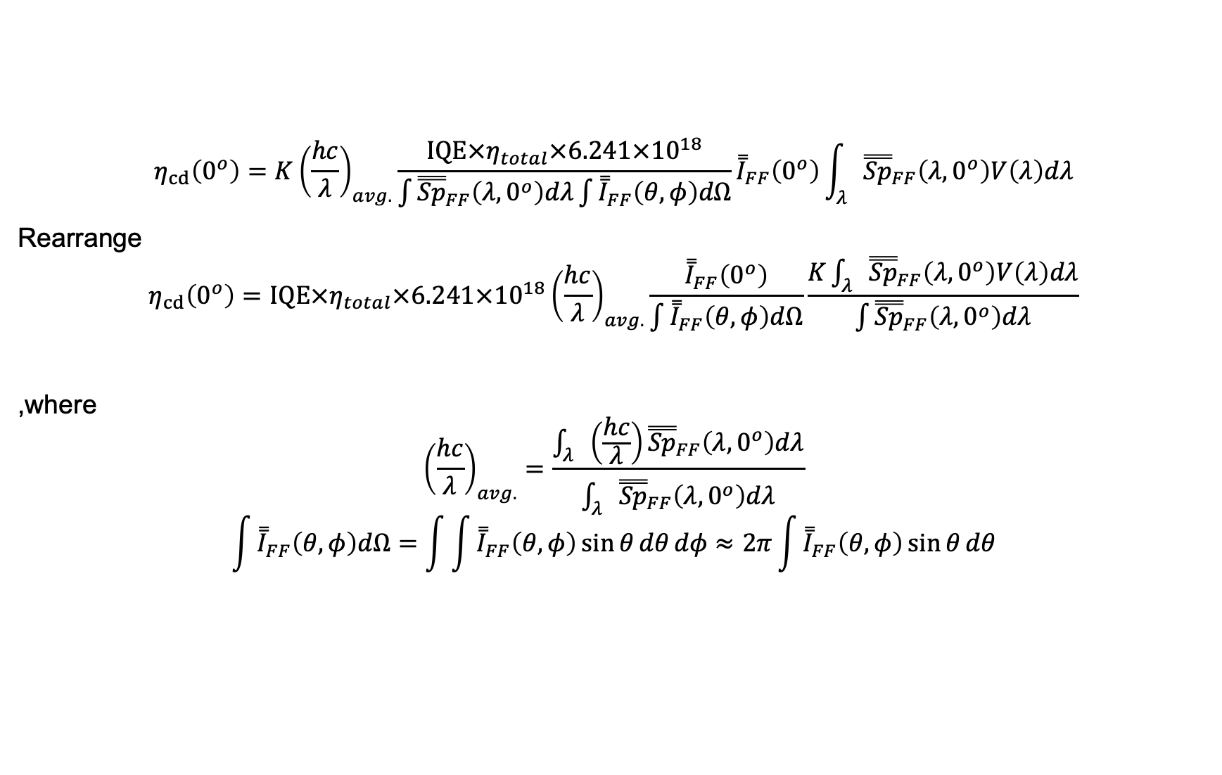
Method (3)
$$η_{cd}\left(0^{o}\right)=K{\left(\frac{hc}{λ}\right)}_{avg.}\frac{IQE×η_{total}×6.241×{10}^{18}}{\int{{\overset{̿}{Sp}}_{FF}\left(λ, 0^{o}\right)dλ}\int{{\overset{̿}{I}}_{FF}\left(θ,φ\right)dΩ}}{\overset{̿}{I}}_{FF}\left(0^{o}\right)\int_{λ}{{\overset{̿}{Sp}}_{FF}\left(λ, 0^{o}\right)V\left(λ\right)dλ}$$
Rearrange
$$η_{cd}\left(0^{o}\right)=IQE×η_{total}×6.241×{10}^{18}{\left(\frac{hc}{λ}\right)}_{avg.}\frac{{\overset{̿}{I}}_{FF}\left(0^{o}\right)}{\int{{\overset{̿}{I}}_{FF}\left(θ,φ\right)dΩ}}\frac{K\int_{λ}{{\overset{̿}{Sp}}_{FF}\left(λ, 0^{o}\right)V\left(λ\right)dλ}}{\int{{\overset{̿}{Sp}}_{FF}\left(λ, 0^{o}\right)dλ}}$$
,where
$${\left(\frac{hc}{λ}\right)}_{avg.}=\frac{\int_{λ}{\left(\frac{hc}{λ}\right){\overset{̿}{Sp}}_{FF}\left(λ, 0^{o}\right)dλ}}{\int_{λ}{{\overset{̿}{Sp}}_{FF}\left(λ, 0^{o}\right)dλ}}$$
$$\int{{\overset{̿}{I}}_{FF}\left(θ,φ\right)dΩ}=\int{\int{{\overset{̿}{I}}_{FF}\left(θ,φ\right)\sin{θ}dθ}dφ}≈2π\int{{\overset{̿}{I}}_{FF}\left(θ,φ\right)\sin{θ}dθ}$$
EQE

