Slide 1
Task 2: Log-based Cyber Threat Analysis
劉名凱
2023/7/11

Slide 2
Outline
Task
AttacKG: Constructing Technique Knowledge Graph from Cyber Threat Intelligence Reports
Goal
Method
Result
Progress
Notes:
先講解我這task的目標，再來是這周讀的論文，最後是目前的進度。

Slide 3
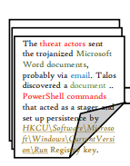
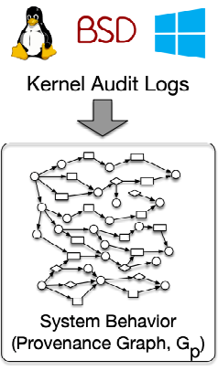
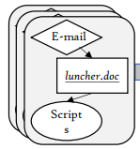
Task
Generating Technique Graph based on MITRE ATT&CK framework.
Perform graph matching between Technique Graph and Audit Log to detect adversaries.
CTI reports, Technique examples
Matching
Technique Graph
Notes:
這個Task是想要增強基於Audit Log偵測出惡意軟體的能力。首先要把Mitre Att&ck底下每個Technique產出對應的Technique Graph。因為一個Technique實作的方法不只一種，所以用Technique Graph去代表這個Technique。 那有了Techinique Graph的資料庫後，就可以和Audit Log轉成Provenance Map 做 Graph Matching，找出Audit Log潛藏的惡意軟體。

Slide 4
AttacKG: Constructing Technique Knowledge Graph from Cyber Threat Intelligence Reports
Zhenyuan Li, Jun Zeng, Yan Chen, Zhenkai Liang
2021
Notes:
接下來是介紹提出 Technique Graph這個概念的論文

Slide 5
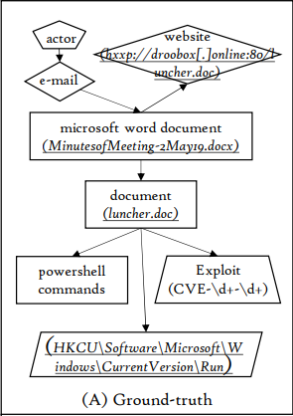
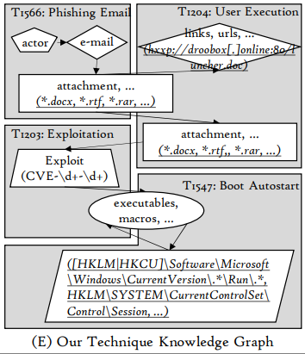
Goal
Generating Technique Knowledge Graph (TKG) from CTI reports
Update Technique Graph using CTI reports
Notes:
論文作者認為說，CTI reports雖然能夠分享網路攻擊的經驗，但因為這個report沒有固定的形式，讓大家很難自動化的去統整這些report。而且單一個CTI report通常會使用到多種Technique，假設一篇report有用到T1025，那這篇report裡可能只會提到T1025一小部分的資訊，因此要統整單一Technique的資訊會不只需要一篇report，透過用CTI report 去更新Technique Graph的來統整出同一種Technique底下不同實作方式的資訊。

Slide 6
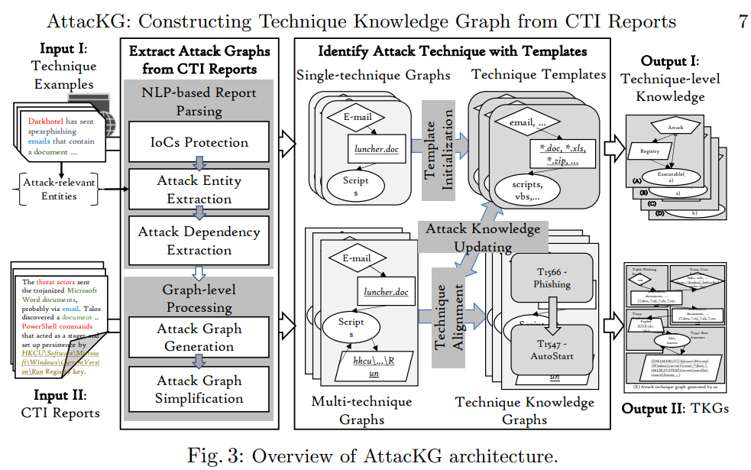
Method
Notes:
這個是AttackG大略的架構。有兩個input，第一個是Technique Examples，這裡的Technique examples包含了所有要用來辨識的technique
在這篇論文裡面選了179個Technique以及每個technique對應的examples。第二個是input 是 CTI reports。這兩個input都會通過第一個階段 Extract attack Graphs from CTI reports

Slide 7
Method
Notes:
第一個階段總共分為兩個部分，第一個是report parsing，第二個是根據parse出來的資訊產生attack Graph。第一部分report parsing，IoCs Protection是把pretrained NLP 模型不常見到的domain specific的名詞替換掉，例如執行檔的檔名。再來是Attack Entity Extraction，將句子中的entity也就是單字分類然後取出，這篇作者總共分了7類。再來是Attack Dependency Extraction，用pretrained NLP model得出句子中的dependency tree，然後將有dependency的entity記錄起來。接著進到Graph generation的部分。Attack Graph的node就是從句子中取出的entity，因為node就是entity，兩個entity之間如果在dependency tree中有dependency，就建一條edge把他們連起來。

Slide 8
Method
Notes:
那有了technique template以及CTI report的attack graph之後，就可以用作者設計的graph alignment演算法去做matching。對CTI report的attack graph裡的每個connected component，跟要辨識的所有technique template做matching，如果matching的分數大於一個threshold，這個connected component跟對應的technique就叫作一個match。Match成功就代表component有使用到這個technique，同時也會用connected component的資訊去update technique template裡的資訊。

Slide 9
Method

Slide 10
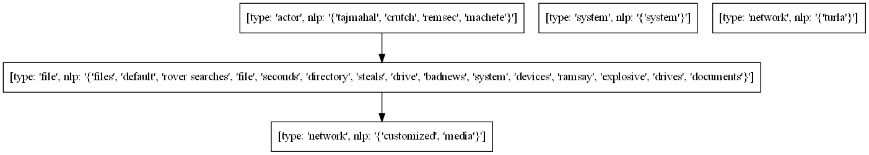
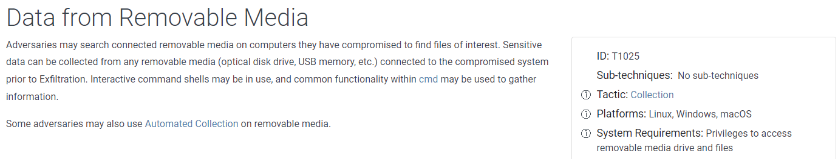
Result
Example of Technique Template (T1025)

Slide 11
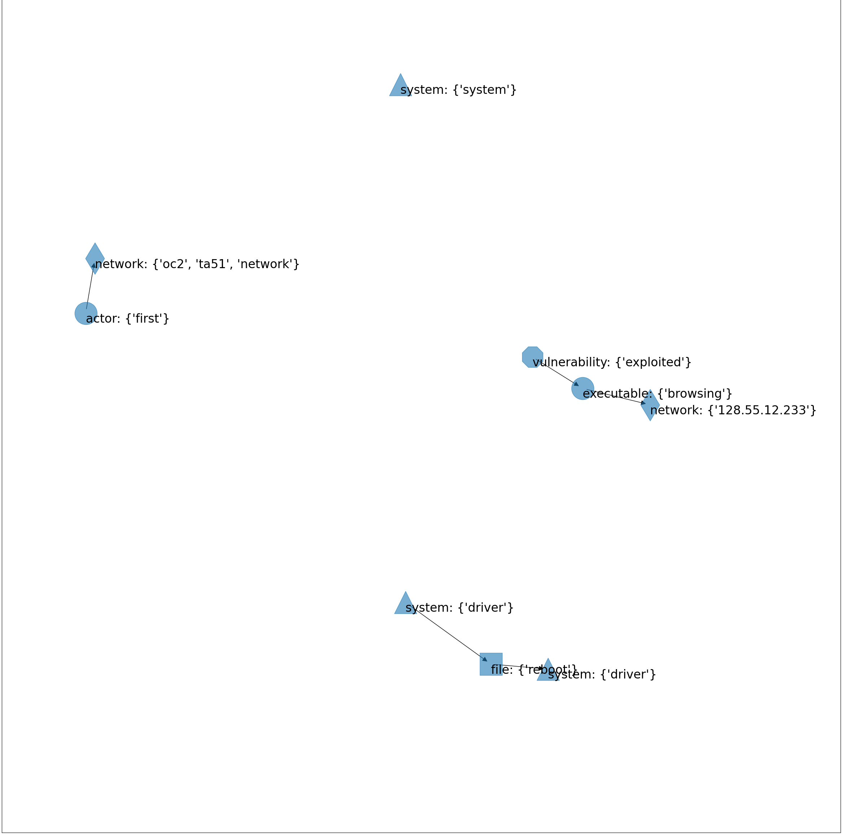
Result
Entity type: {NLP description}
First attacked ta51-pivot-2 and deployed OC2, allowing us to run our attack from within the target network. Exploited Firefox backdoor by again browsing to http://128.55.12.233. Loader Drakon was executed in Firefox memory and connected out to 128.55.12.233:8000 and 128.55.12.233:443 for C2. After the BBN reboot, driver was disabled, and we would now be able to use privilege escalation via our perfmon driver. We loaded the copykatz module to recon data from the system.
CTI reports
Attack Graph

Slide 12
Result
Entity type: {NLP description}
T1007 - System Service Discovery
T1008 - Fallback Channels
T1049 - System Network Connections Discovery
T1068 - Exploitation for Privilege Escalation
T1071 - Application Layer Protocol
T1082 - System Information Discovery
T1090 - Proxy
T1102 - Web Service
T1105 - Ingress Tool Transfer
T1187 - Forced Authentication
T1190 - Exploit Public-Facing Application
T1204 - User Execution
T1566 - Phishing
T1573 - Encrypted Channel
T1187, T1082
T1049, T1071, T1573
T1007, T1008, T1068, T1090, T1102, T1105, T1190, T1204, T1566
Technique Identification Result

Slide 13
Progress
Finished
Generating Technique Graph
Identify techniques in CTI reports
Future
Debugging to acquire reasonable identification result
Find a way to transform high-level description in Technique Graph into low-level artifacts

