Slide 1
Log-based Cyber Threat Analysis
劉名凱
2023/7/19

Slide 2
Outline
Task (current goal)
Future direction

Slide 3
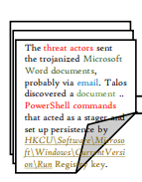
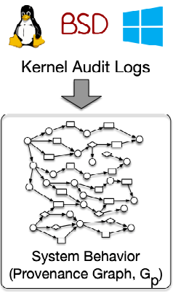
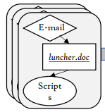
Task
Generating Technique Graph based on MITRE ATT&CK framework.
Perform graph matching between Technique Graph and Audit Log to detect adversaries.
CTI reports, Procedure examples
Matching
Technique Graph (Technique Template)

Slide 4
Task
Generating Technique Graph based on MITRE ATT&CK framework.
Perform graph matching between Technique Graph and Audit Log to detect adversaries.
CTI reports, Procedure examples
Matching
Technique Graph
(Technique Template)

Slide 5
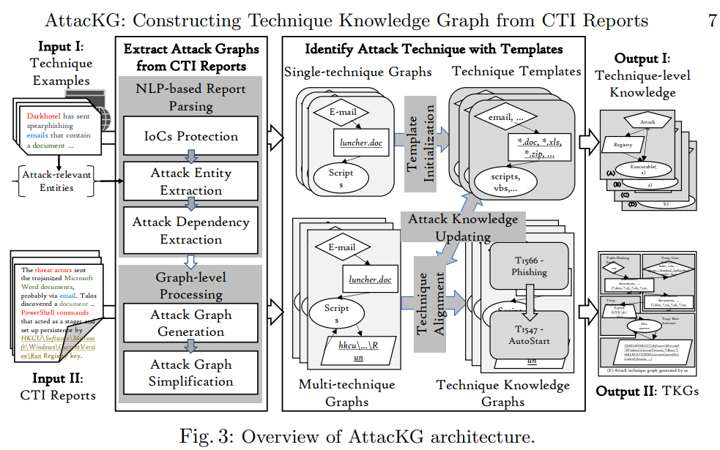
Task

Slide 6
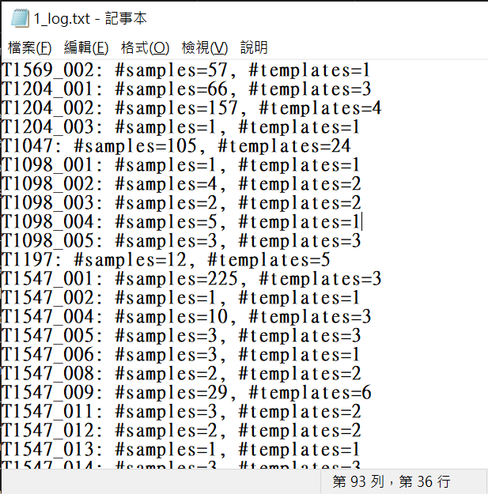
Task
Different ways of generating Technique Template from procedure examples
Technique level (original paper)
Sub Technique level
Procedure examples level
m similar examples -> n Technique Template
1 examples -> 1 Technique Template
coarse
fine-grained

Slide 7
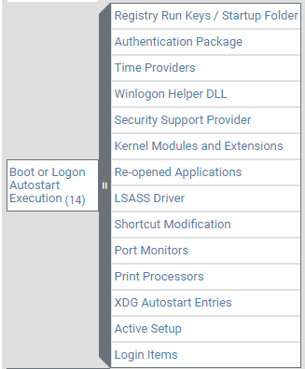
Method 1
Generating Technique Graph from procedure examples - Technique level (original paper)
T1547
Technique Template

Slide 8
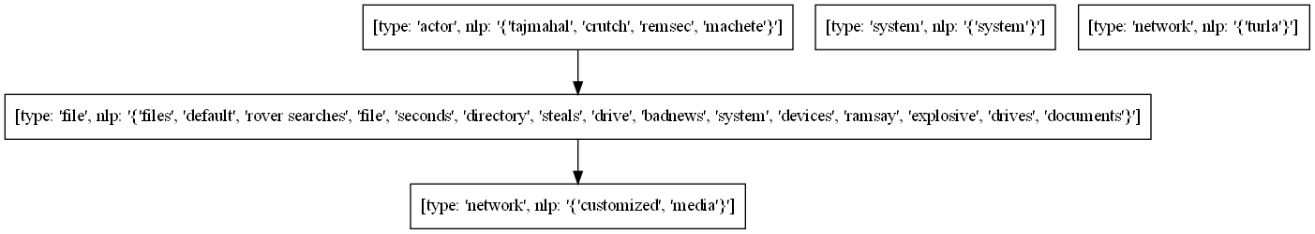
Method 1
Generating Technique Graph from procedure examples - Technique level (original paper)
→ Generated Technique Template contains too much information, which is difficult for human
to read and understand.
Example of Technique Template (T1025)

Slide 9

Method 2
Generating Technique Graph from procedure examples – Sub Technique level
→ Haven’t tried yet, but highly possible to yield same result as using Technique level
T1595

Slide 10



Method 3
Generating Technique Graph from procedure examples – Procedure examples level
T1595
2 example
$n_{1}$ Technique Template
1.
3 example
$n_{2}$ Technique Template
2 example
$n_{3}$ Technique Template
T1595
2 example
2 Technique Template
2.
3 example
3 Technique Template
2 example
2 Technique Template

Slide 11
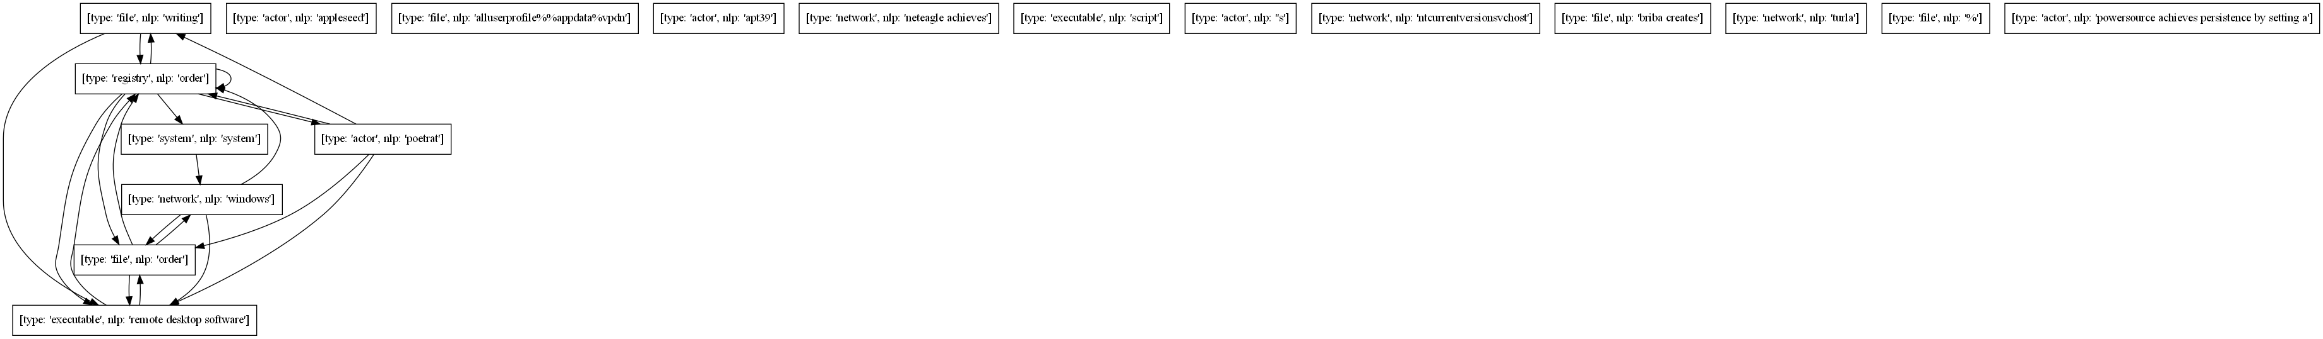
Method 3
Generating Technique Graph from procedure examples – Procedure examples level
1.
Example of Technique Template (T1547_001_01)

Slide 12
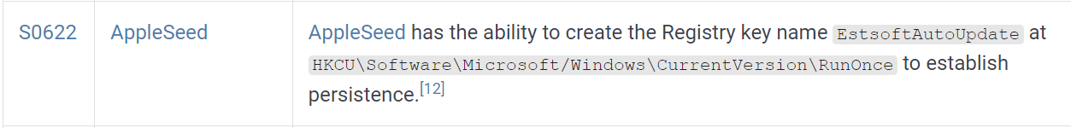
Method 3
Generating Technique Graph from procedure examples – Procedure examples level
2.
type: ‘actor’, nlp:’AppleSeed’
Ideal Technique Template
type: ‘file’, nlp:’’, IoC: ‘HKCU\Software\Microsoft/Windows\CurrentVersion\RunOnce’
type: ‘register’, nlp:’’, IoC: ‘EstofAutoUpdate’

Slide 13
Method 3
Generating Technique Graph from procedure examples – Procedure examples level
2.
type: ‘actor’, nlp:’AppleSeed’
Ideal Technique Template
access
create
type: ‘file’, nlp:’’, IoC: ‘HKCU\Software\Microsoft/Windows\CurrentVersion\RunOnce’
type: ‘register’, nlp:’’, IoC: ‘EstofAutoUpdate’

Slide 14
Future Direction
Generate Technique Template with quality (human readable)
Focus on Procedure-level Technique Template
Draw Technique Template with 3 different way
Type level
IoC level
Nlp level
Focus on T1547_001 and T1547_009 to determine whether AttacKG method is feasible

