Slide 1
Log-based Cyber Threat Analysis
劉名凱
2023/7/26

Slide 2
Outline
Technique Template
Future Direction

Slide 3
Technique Template
Different ways of generating Technique Template from procedure examples
Technique level (original paper)
Sub Technique level
Procedure examples level
m examples -> n Technique Template
1 examples -> 1 Technique Template
coarse
fine-grained

Slide 4
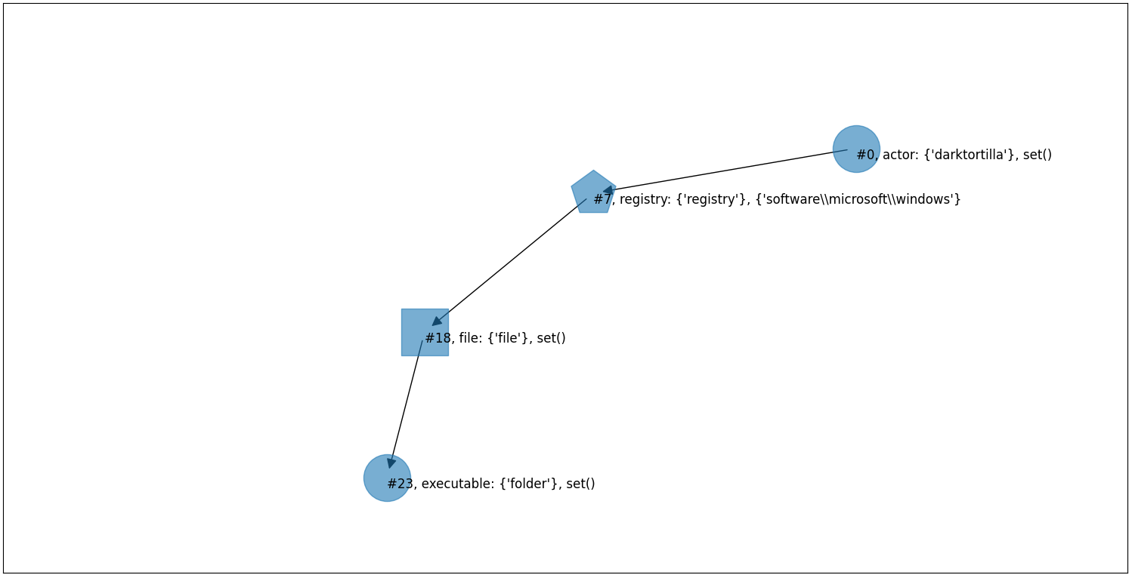
Technique Template
DarkTortilla has established persistence via the Software\Microsoft\Windows NT\CurrentVersion\Run registry key and by creating a .lnk shortcut file in the Windows startup folder.

Slide 5
Technique Template
New sample
DarkTortilla has established persistence via the Software\Microsoft\Windows NT\CurrentVersion\Run registry key and by creating a .lnk shortcut file in the Windows startup folder.
Update
Current Template
Technique Level

Slide 6
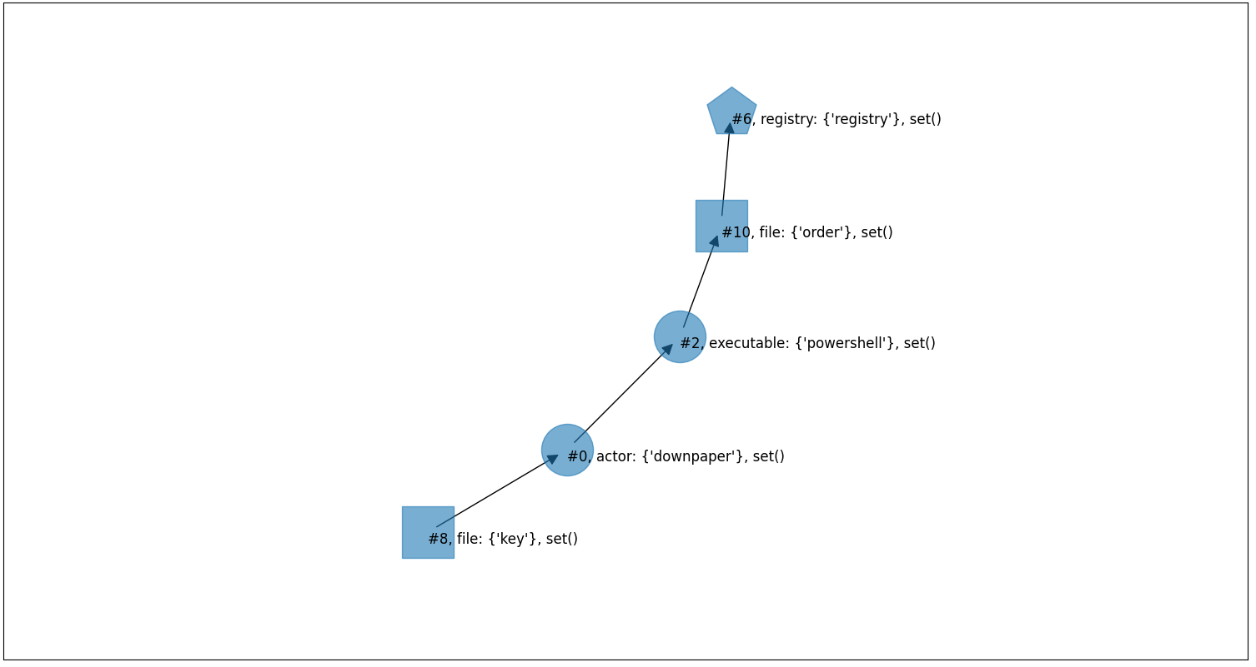
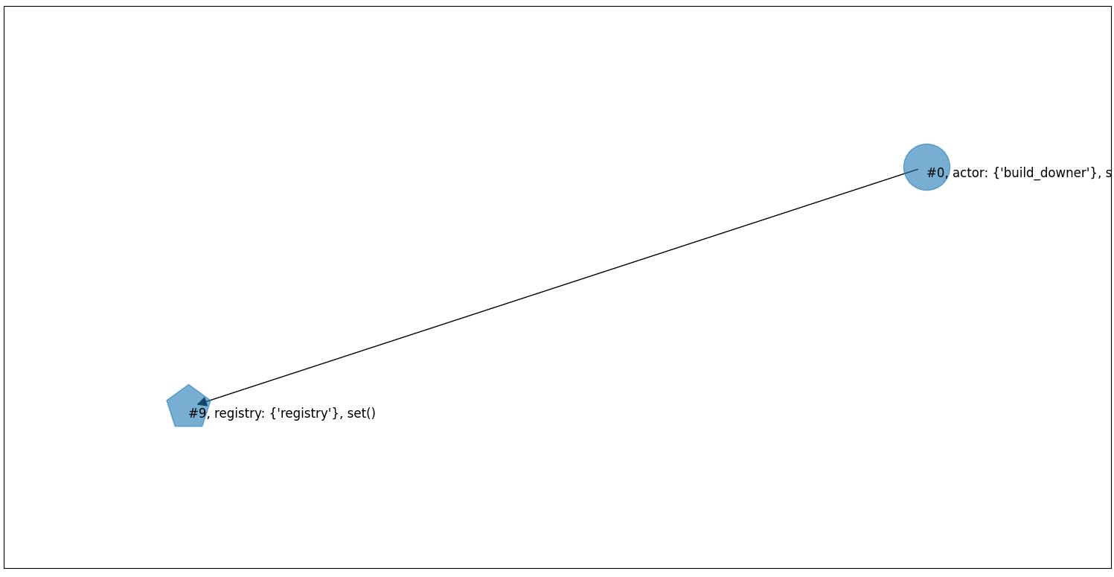
Technique Template
DownPaper uses PowerShell to add a Registry Run key in order to establish persistence
build_downer has the ability to add itself to the Registry Run key for persistence.

Slide 7
Technique Template
New sample
DownPaper uses PowerShell to add a Registry Run key in order to establish persistence
Similarity1
Similarity2
Similarity3
Template
T1547_001_0
Template
T1547_001_1
Template
T1547_001_2
Procedure Level

Slide 8
Technique Template
Update
Template
T1547_001_0
Template
T1547_001_1
Template
T1547_001_2
Update template with maximum similarity using current procedure example
> Threshold
Max Similarity
< Threshold
Create a new template using current procedure example
max(Similarity1, Similarity2,Similarity3)
Similarity1
Similarity2
Similarity3
Template
T1547_001_0
Template
T1547_001_1
Template
T1547_001_2
Template
T1547_001_3
Template
T1547_001_0
Template
T1547_001_1
Template
T1547_001_2
add
Procedure Level

Slide 9
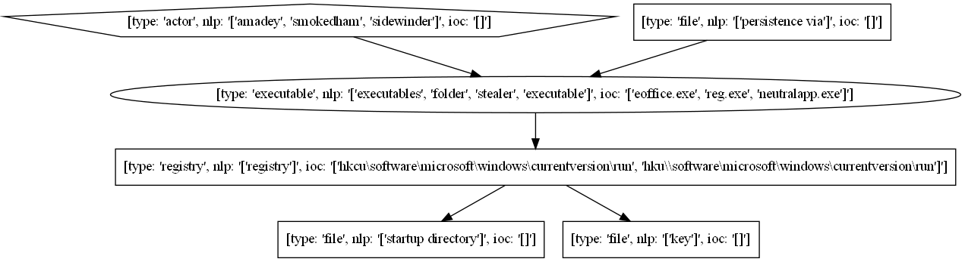
Technique Template
Amadey has changed the Startup folder to the one containing its executable by overwriting the registry keys.
SMOKEDHAM has used reg.exe to create a Registry Run key.
Sidewinder has added paths to executables in the Registry to establish persistence.

Slide 10
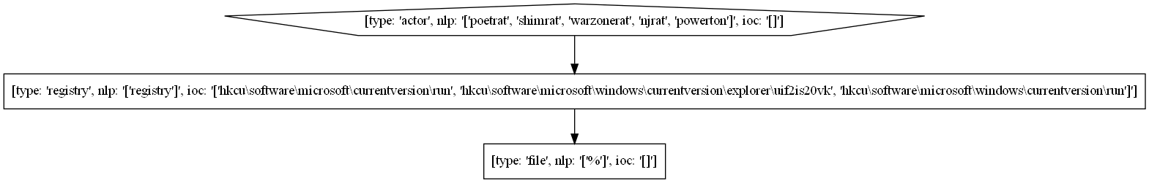
Technique Template
PoetRAT has added a registry key in the hive for persistence.
ShimRat has installed a registry based start-up key HKCU\Software\microsoft\windows\CurrentVersion\Run to maintain persistence should other methods fail.
WarzoneRAT can add itself to the HKCU\Software\Microsoft\Windows\CurrentVersion\Run and
HKCU\Software\Microsoft\Windows\CurrentVersion\Explorer\UIF2IS20VK Registry keys.
njRAT has added persistence via the Registry key HKCU\Software\Microsoft\CurrentVersion\Run and dropped a shortcut in %STARTUP%.

Slide 11
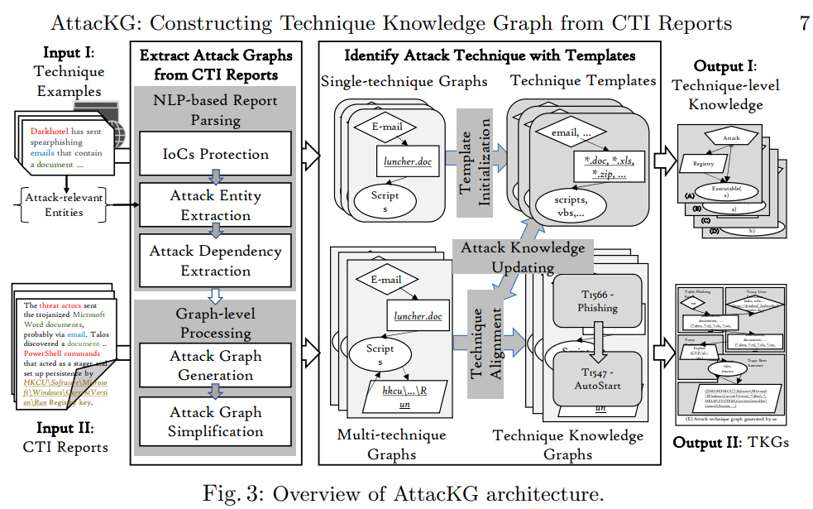
Future Direction
Modifying the process of Report Parsing?

