Slide 1
2023/7/27
劉名凱

Slide 2
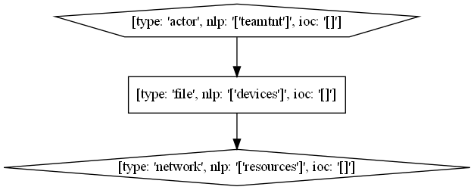

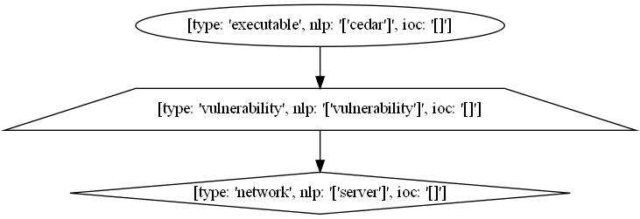
T1595.002 - Active Scanning: Vulnerability Scanning
#Procedure Examples=9, Valid=4 → #templates=4

Slide 3
T1595.002 - Active Scanning: Vulnerability Scanning
#Procedure Examples=9 → #templates=4
Aquatic Panda has used publicly accessible DNS logging services to identify servers vulnerable to Log4j (CVE 2021-44228).
Magic Hound has conducted widespread scanning to identify public-facing systems vulnerable to CVE-2021-44228 in Log4j and ProxyShell vulnerabilities; CVE-2021-26855, CVE-2021-26857, CVE-2021-26858, and CVE-2021-27065 in on-premises MS Exchange Servers; and CVE-2018-13379 in Fortinet FortiOS SSL VPNs.
TeamTNT has scanned for vulnerabilities in IoT devices and other related resources such as the Docker API.
Volatile Cedar has performed vulnerability scans of the target server.

Slide 4
T1595.002 - Active Scanning: Vulnerability Scanning
Template 0
Aquatic Panda has used publicly accessible DNS logging services to identify servers vulnerable to Log4j (CVE 2021-44228).

Slide 5
T1595.002 - Active Scanning: Vulnerability Scanning
Template 1
Magic Hound has conducted widespread scanning to identify public-facing systems vulnerable to CVE-2021-44228 in Log4j and ProxyShell vulnerabilities; CVE-2021-26855, CVE-2021-26857, CVE-2021-26858, and CVE-2021-27065 in on-premises MS Exchange Servers; and CVE-2018-13379 in Fortinet FortiOS SSL VPNs.

Slide 6
T1595.002 - Active Scanning: Vulnerability Scanning
Template 2
TeamTNT has scanned for vulnerabilities in IoT devices and other related resources such as the Docker API.

Slide 7
T1595.002 - Active Scanning: Vulnerability Scanning
Template 3
Volatile Cedar has performed vulnerability scans of the target server.

Slide 8
T1598.003 - Phishing for Information: Spearphishing Link
#Procedure Examples=13, Valid=10→ #templates=6
APT32 has used malicious links to direct users to web pages designed to harvest credentials.
AADInternals can send phishing emails containing malicious links designed to collect users’ credentials.
Dragonfly has used spearphishing with PDF attachments containing malicious links that redirected to credential harvesting websites.
APT28 has conducted credential phishing campaigns with embedded links to attacker-controlled domains.
Kimsuky has used links in e-mail to steal account information.
Magic Hound has used SMS and email messages with links designed to steal credentials or track victims.
Patchwork has used embedded image tags (known as web bugs) with unique, per-recipient tracking links in their emails for the purpose of identifying which recipients opened messages.
Sidewinder has sent e-mails with malicious links to credential harvesting websites.

Slide 9

T1598.003 - Phishing for Information: Spearphishing Link
Template 0
APT32 has used malicious links to direct users to web pages designed to harvest credentials.
AADInternals can send phishing emails containing malicious links designed to collect users’ credentials.
Dragonfly has used spearphishing with PDF attachments containing malicious links that redirected to credential harvesting websites.

Slide 10
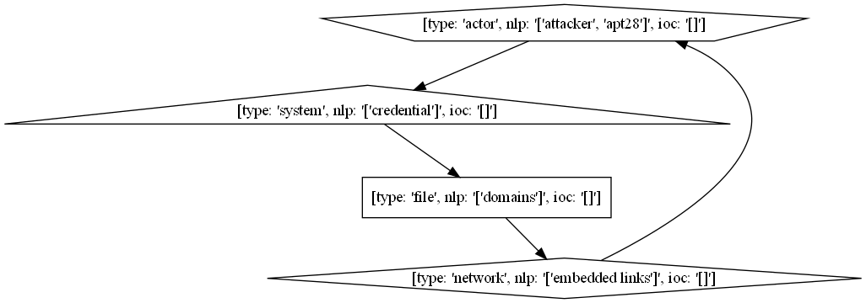
T1598.003 - Phishing for Information: Spearphishing Link
Template 1
APT28 has conducted credential phishing campaigns with embedded links to attacker-controlled domains.

Slide 11
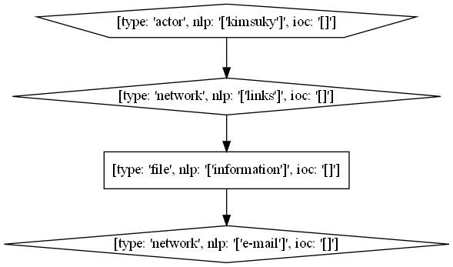
T1598.003 - Phishing for Information: Spearphishing Link
Template 2
Kimsuky has used links in e-mail to steal account information.

Slide 12
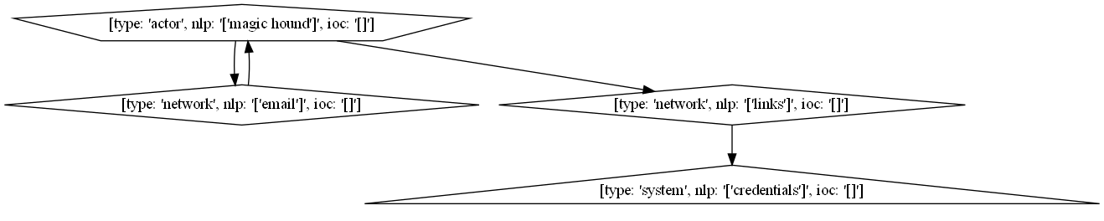
T1598.003 - Phishing for Information: Spearphishing Link
Template 3
Magic Hound has used SMS and email messages with links designed to steal credentials or track victims.

Slide 13
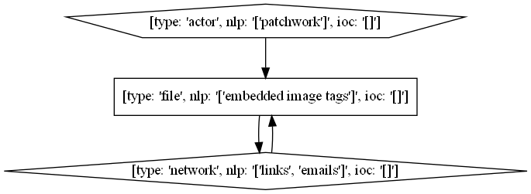
T1598.003 - Phishing for Information: Spearphishing Link
Template 4
Patchwork has used embedded image tags (known as web bugs) with unique, per-recipient tracking links in their emails for the purpose of identifying which recipients opened messages.

Slide 14
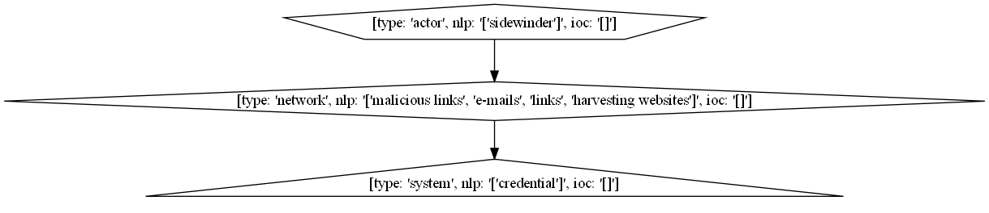
T1598.003 - Phishing for Information: Spearphishing Link
Template 5
Sidewinder has sent e-mails with malicious links to credential harvesting websites.

Slide 15
T1595.002 - Active Scanning: Vulnerability Scanning
#Procedure Examples=29, Valid=7 → #templates=7
Gorgon Group malware can create a .lnk file and add a Registry Run key to establish persistence.
Lazarus Group malware has maintained persistence on a system by creating a LNK shortcut in the user’s Startup folder.
Leviathan has used JavaScript to create a shortcut file in the Startup folder that points to its main backdoor.
MarkiRAT can modify the shortcut that launches Telegram by replacing its path with the malicious payload to launch with the legitimate executable.
RogueRobin establishes persistence by creating a shortcut (.LNK file) in the Windows startup folder to run a script each time the user logs in.
S-Type may create the file %HOMEPATH%\Start Menu\Programs\Startup\Realtek {Unique Identifier}.lnk, which points to the malicious msdtc.exe file already created in the %CommonFiles% directory.
To establish persistence, SslMM identifies the Start Menu Startup directory and drops a link to its own executable disguised as an "Office Start," "Yahoo Talk," "MSN Gaming Z0ne," or "MSN Talk" shortcut.

Slide 16
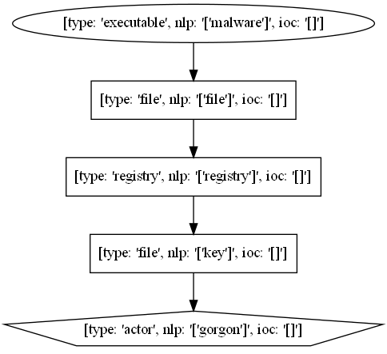
T1598.003 - Phishing for Information: Spearphishing Link
Template 0
Gorgon Group malware can create a .lnk file and add a Registry Run key to establish persistence.

Slide 17
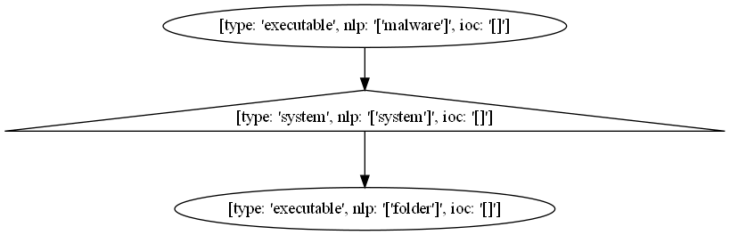
T1598.003 - Phishing for Information: Spearphishing Link
Template 1
Lazarus Group malware has maintained persistence on a system by creating a LNK shortcut in the user’s Startup folder.

Slide 18
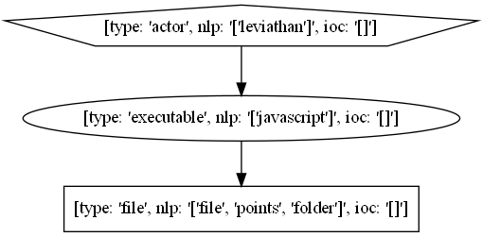
T1598.003 - Phishing for Information: Spearphishing Link
Template 2
Leviathan has used JavaScript to create a shortcut file in the Startup folder that points to its main backdoor.

Slide 19
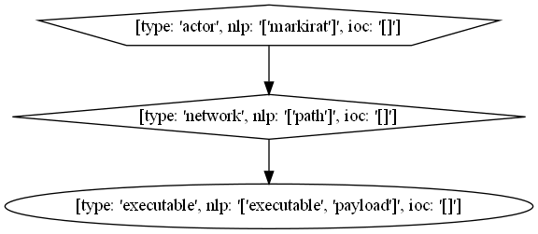
T1598.003 - Phishing for Information: Spearphishing Link
Template 3
MarkiRAT can modify the shortcut that launches Telegram by replacing its path with the malicious payload to launch with the legitimate executable.

Slide 20
T1598.003 - Phishing for Information: Spearphishing Link
Template 3
MarkiRAT can modify the shortcut that launches Telegram by replacing its path with the malicious payload to launch with the legitimate executable.

Slide 21
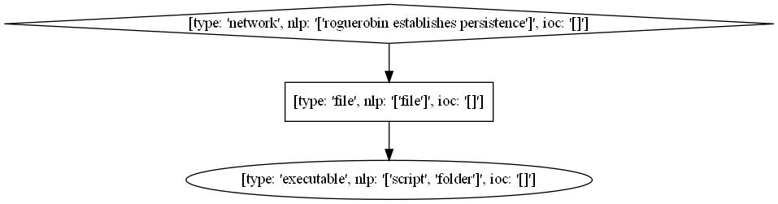
T1598.003 - Phishing for Information: Spearphishing Link
Template 4
RogueRobin establishes persistence by creating a shortcut (.LNK file) in the Windows startup folder to run a script each time the user logs in.

Slide 22
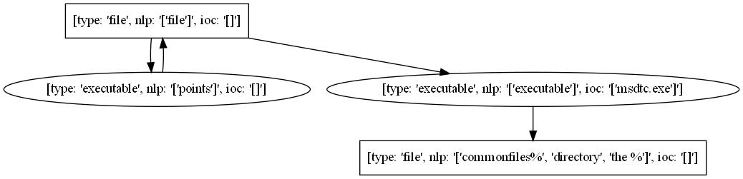
T1598.003 - Phishing for Information: Spearphishing Link
Template 5
S-Type may create the file %HOMEPATH%\Start Menu\Programs\Startup\Realtek {Unique Identifier}.lnk, which points to the malicious msdtc.exe file already created in the %CommonFiles% directory.

Slide 23
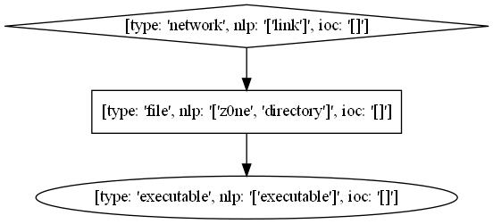
T1598.003 - Phishing for Information: Spearphishing Link
Template 6
To establish persistence, SslMM identifies the Start Menu Startup directory and drops a link to its own executable disguised as an "Office Start," "Yahoo Talk," "MSN Gaming Z0ne," or "MSN Talk" shortcut.

