Slide 1
研究主題和方向
劉名凱
2023/7/5

Slide 2
Contents
Task
Related work
Future direction

Slide 3
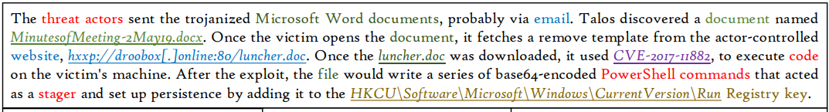
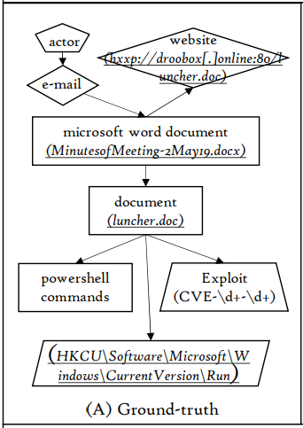
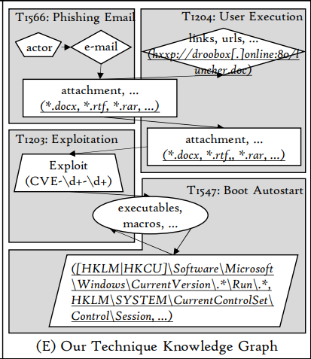
Task
To generate Technique Knowledge Graphs(TKGs) base on cyber threat intelligence(CTI) reports
CTI report

Slide 4
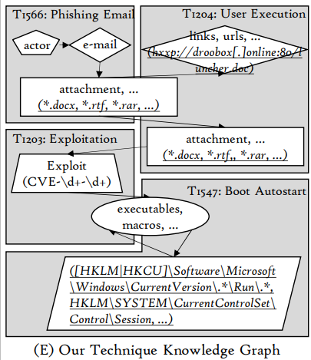
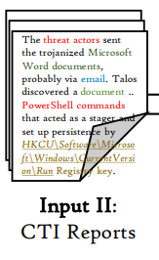
Task
To generate Technique Knowledge Graphs(TKGs) base on cyber threat intelligence(CTI) reports
Model
s

Slide 5
Related work
AttacKG: Constructing Technique Knowledge Graph from Cyber Threat Intelligence Reports ^{[1]}
Poirot: Aligning Attack Behavior with Kernel Audit Records for Cyber Threat Hunting ^{[2]}
Looking Beyond IoCs: Automatically Extracting Attack Patterns from External CTI ^{[3]}

Slide 6
Future direction
Get familiar with Mitre Att&ck
Finish reading AttacKG: Constructing Technique Knowledge Graph from Cyber Threat Intelligence Reports

