Slide 1
Log-based Cyber Threat Analysis
劉名凱
2023/8/16

Slide 2
Outline
Current Progress
Future Direction

Slide 3
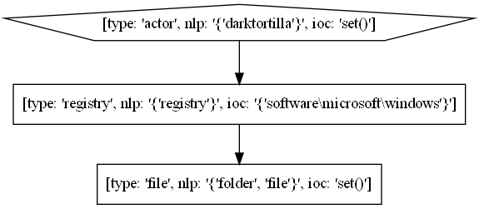
Current Progress
Extract relation between nodes in Technique Template
DarkTortilla has established persistence via the Software\Microsoft\WindowsNT\CurrentVersion\Run registry key and by creating a .lnk shortcut file in the Windows startup folder.
create?
?

Slide 4
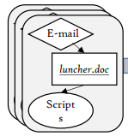
Current Progress
Selecting nodes using Named Entity Recognition (nodes with better quality)
Selecting edges using Semantic Role Labeling (yielding more reasonable relations)
DarkTortilla
DarkTortilla has established persistence via the Software\Microsoft\WindowsNT\CurrentVersion\Run registry key and by creating a .lnk shortcut file in the Windows startup folder.
Named Entity Recognition
Software\Microsoft\WindowsNT\CurrentVersion\Run
Semantic Role Labeling
.lnk shortcut file
Procedure Example
Windows startup folder
Named Entities
Technique Graph

Slide 5
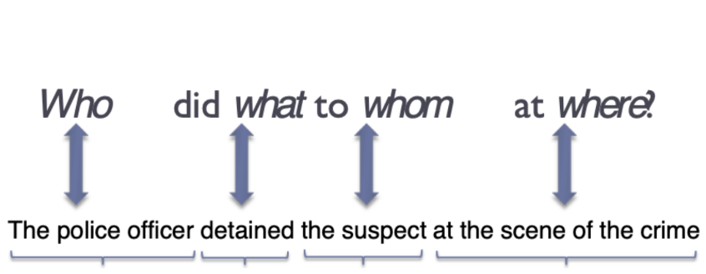
Semantic Role Labeling (SRL)
Assigning labels to words or phrases in a sentence that indicates their semantic role in the sentence
Arg0
Verb
Arg1
ArgM-LOC
Notes:
Semantic role labeling 是 Extractor裡面主要使用的方法。那SRL是想要把句子中不同單字的semantic role找出來。Semantic Role聽起來有點難懂，可以直接看下面這張圖。Semantic Role就是想找出 Who did what to whom。主詞會被標成arg0，受詞被標成arg1。所以對這個句子做SRL會產生圖下方那樣的label。

Slide 6
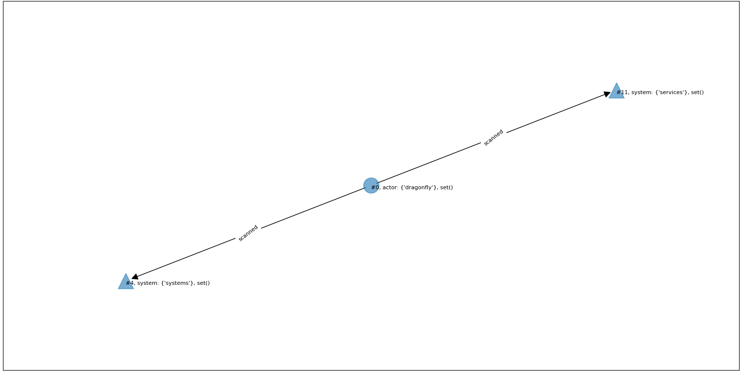
Current Progress–Successful cases
node
[entity type]: [nlp description], [ioc]
Dragonfly has scanned targeted systems for vulnerable Citrix and Microsoft Exchange services.
[ARG0: Dragonfly] [V: scanned] [ARG1: targeted systems for vulnerable Citrix and Microsoft Exchange services]

Slide 7
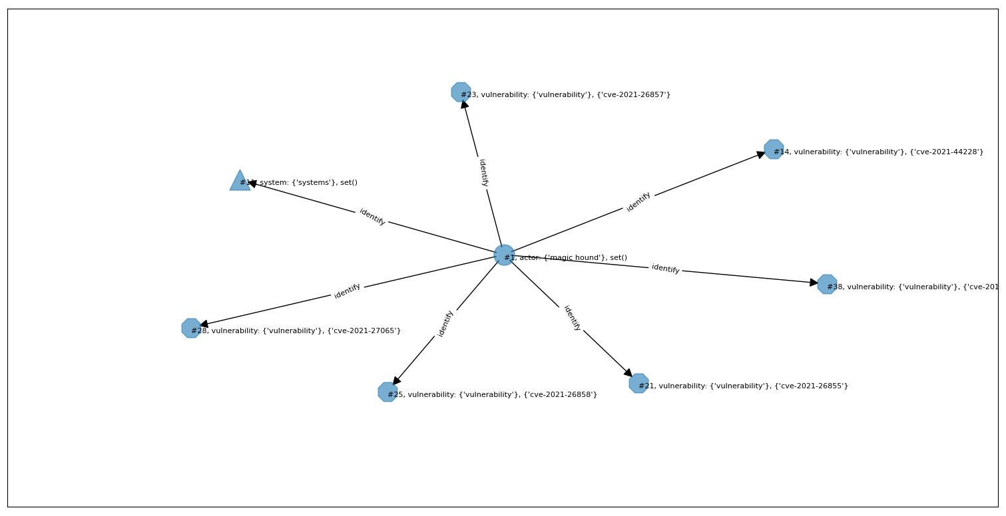
Current Progress–Successful cases
Magic Hound has conducted widespread scanning to identify public-facing systems vulnerable to CVE-2021-44228 in Log4j and ProxyShell vulnerabilities; CVE-2021-26855, CVE-2021-26857, CVE-2021-26858, and CVE-2021-27065 in on-premises MS Exchange Servers; and CVE-2018-13379 in Fortinet FortiOS SSL VPNs.
[ARG0: Magic Hound] [V: identify] [ARG1: public - facing systems vulnerable to CVE-2021 - 44228 in Log4j and ProxyShell vulnerabilities ; CVE-2021 - 26855 , CVE-2021 - 26857 , CVE-2021 - 26858 , and CVE-2021 - 27065 in on - premises MS Exchange Servers ; and CVE-2018 - 13379 in Fortinet FortiOS SSL VPNs]

Slide 8
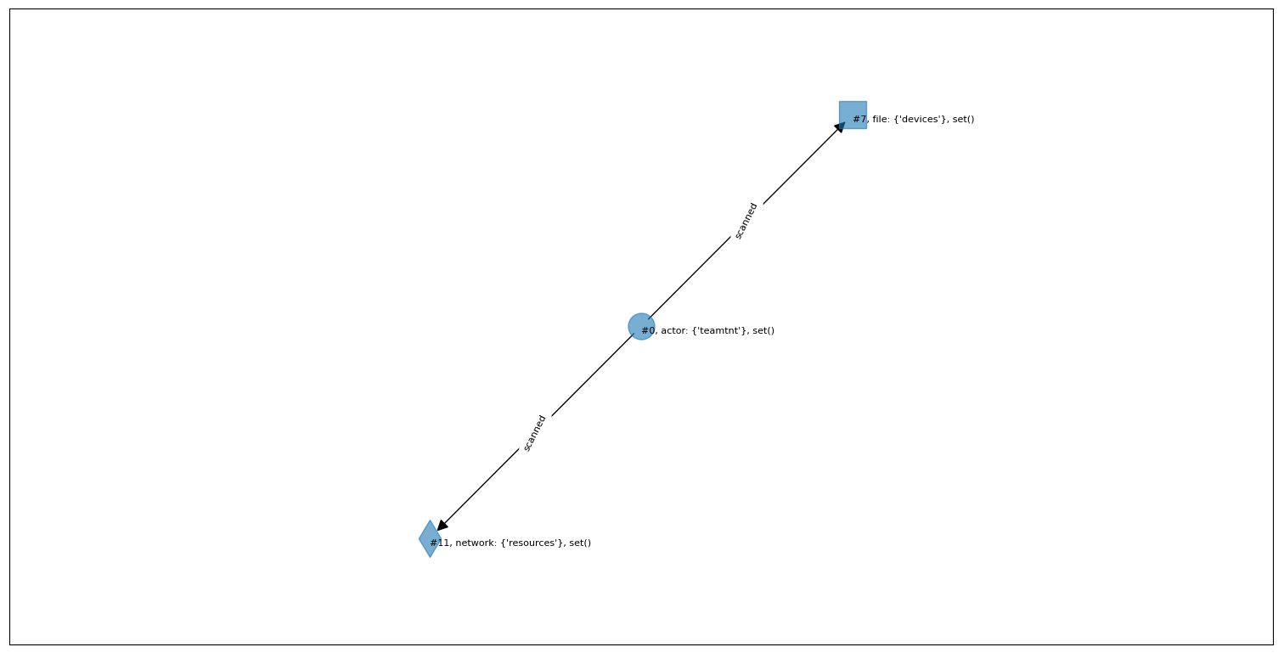
Current Progress–Successful cases
TeamTNT has scanned for vulnerabilities in IoT devices and other related resources such as the Docker API.
[ARG0: TeamTNT] [V: scanned] [ARG1: for vulnerabilities in IoT devices and other related resources such as the Docker API]

Slide 9
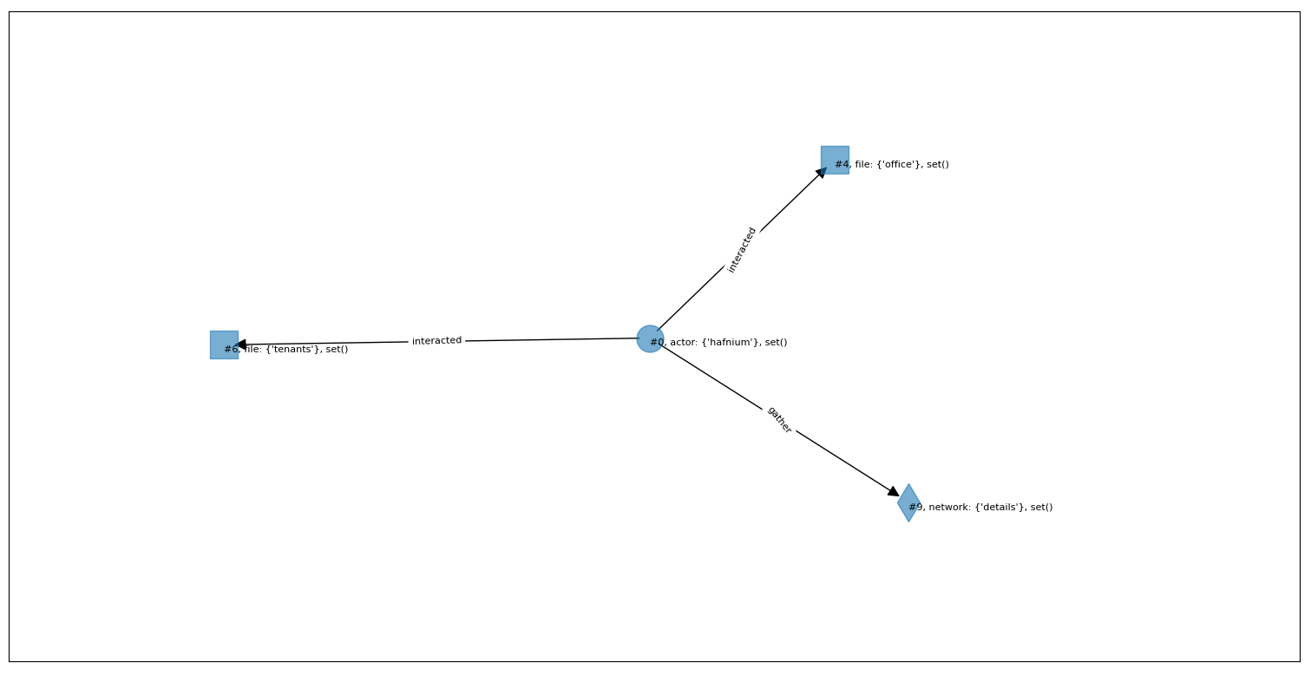
Current Progress–Successful cases
HAFNIUM has interacted with Office 365 tenants to gather details regarding target's environments.
[ARG0: HAFNIUM] [V: interacted] [ARG1: with Office 365 tenants] [ARGM-PRP: to gather details regarding target 's environments]
[ARG0: HAFNIUM] [V: gather] [ARG1: details regarding target 's environments]
[ARG0: details] [V: regarding] [ARG1: target 's environments]

Slide 10
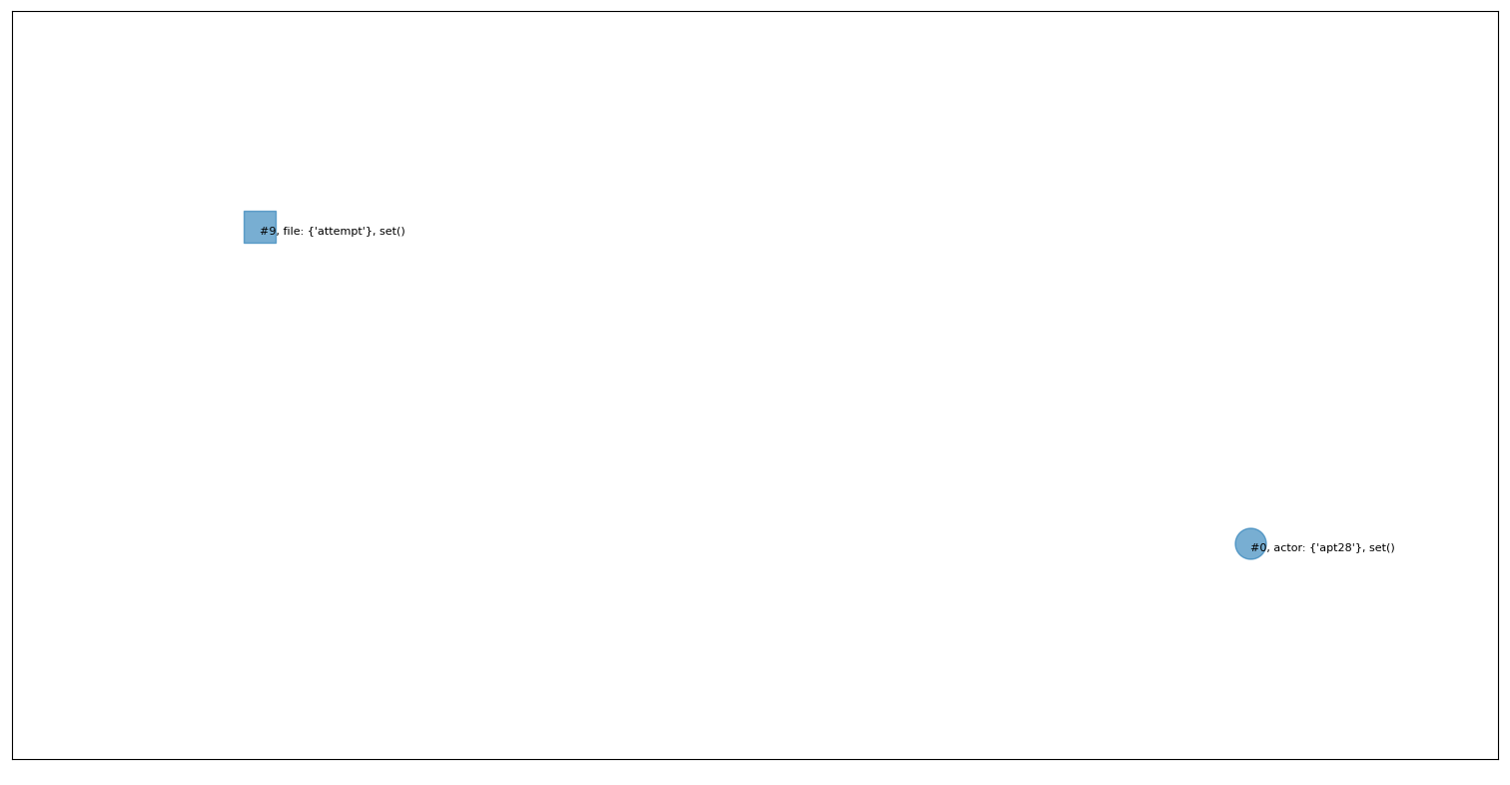
Current Progress–Failed cases
APT28 has performed large-scale scans in an attempt to find vulnerable servers
[ARG0: APT28] [V: performed] [ARG1: large - scale scans] [ARGM-PRP: in an attempt to find vulnerable servers]
[ARG0: APT28] [V: find] [ARG1: vulnerable servers]

Slide 11
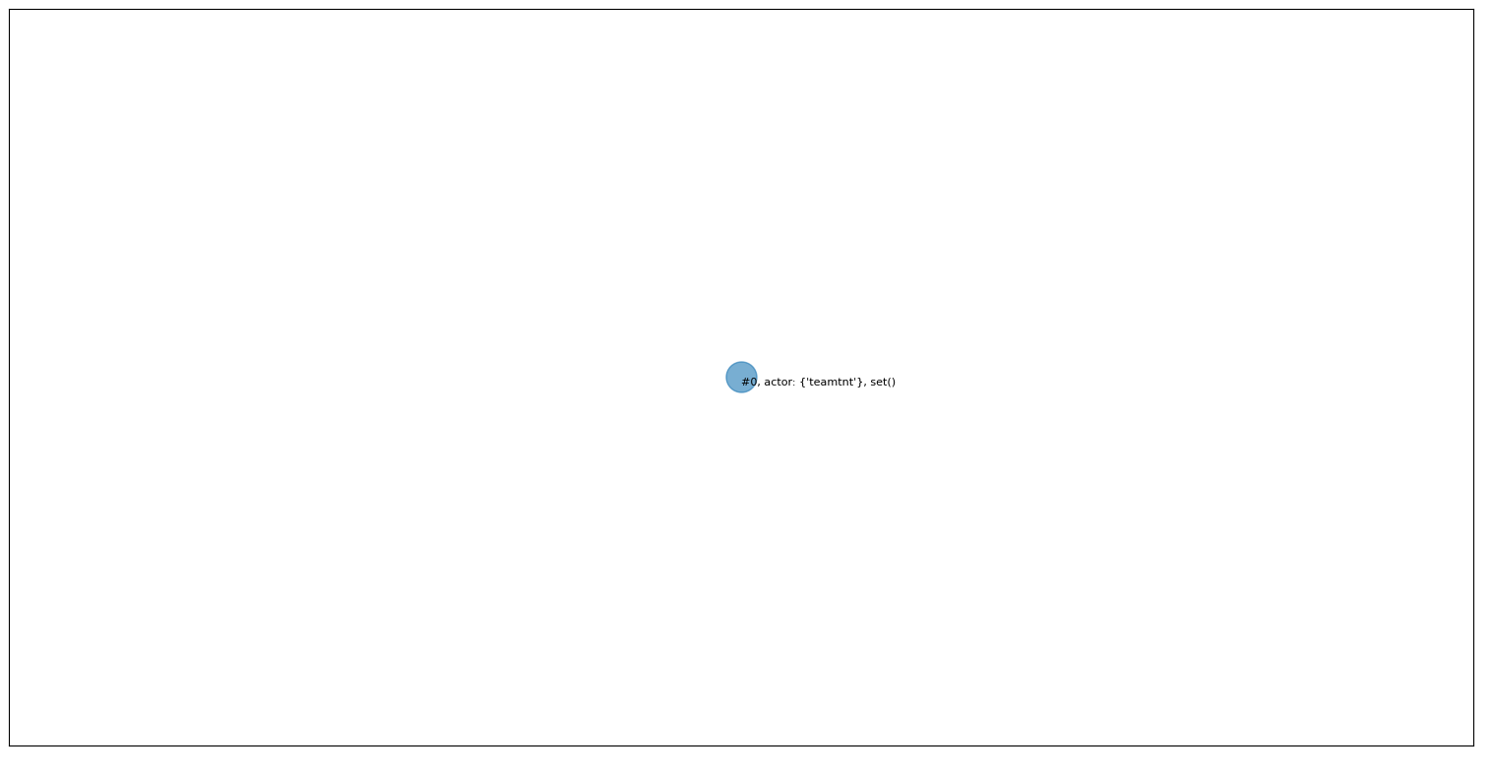
Current Progress–Failed cases
TeamTNT has scanned specific lists of target IP addresses.
[ARG0: TeamTNT] [V: scanned] [ARG1: specific lists of target IP addresses]

Slide 12
Future direction
Extracting Named Entities greatly affects the quality of resulted Technique Graph.
Find a stronger NLP model to perform Named Entity Recognition?
DarkTortilla
DarkTortilla has established persistence via the Software\Microsoft\WindowsNT\CurrentVersion\Run registry key and by creating a .lnk shortcut file in the Windows startup folder.
Named Entity Recognition
Software\Microsoft\WindowsNT\CurrentVersion\Run
Semantic Role Labeling
.lnk shortcut file
Procedure Example
Windows startup folder
Bottleneck!
Named Entities
Notes:
所以我目前想要用NER去抓node，讓graph裡面的node都是我們想要的東西，然後用SRL去抓edge，這樣比起用NER去抓edge，更能合理的表示node跟node之間的relation。

