Slide 1
Log-based Cyber Threat Analysis
劉名凱
2023/8/2

Slide 2
Outline
Technique Template
Future direction

Slide 3
Technique Template
Classify Entities into seven types:
Actor
Executable
File
Network
Registry
Vulnerability
System
Actor
DarkTortilla has established persistence via the Software\Microsoft\WindowsNT\CurrentVersion\Run registry key and by creating a .lnk shortcut file in the Windows startup folder.
Registry
File
File

Slide 4
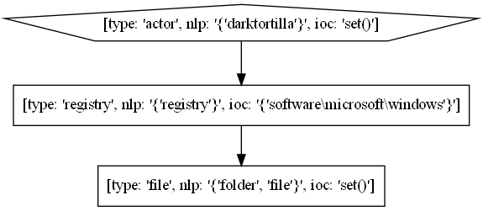
Technique Template
Actor
DarkTortilla has established persistence via the Software\Microsoft\WindowsNT\CurrentVersion\Run registry key and by creating a .lnk shortcut file in the Windows startup folder.
Registry
File
File

Slide 5
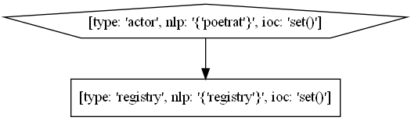
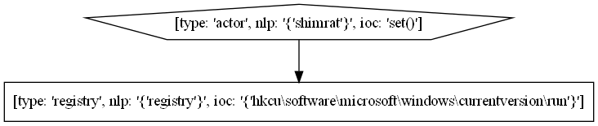
Technique Template
PoetRAT has added a registry key in the hive for persistence.
ShimRat has installed a registry based start-up key HKCU\Software\microsoft\windows\CurrentVersion\Run to maintain persistence should other methods fail.

Slide 6
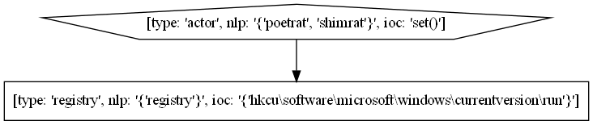
Technique Template
combine

Slide 7
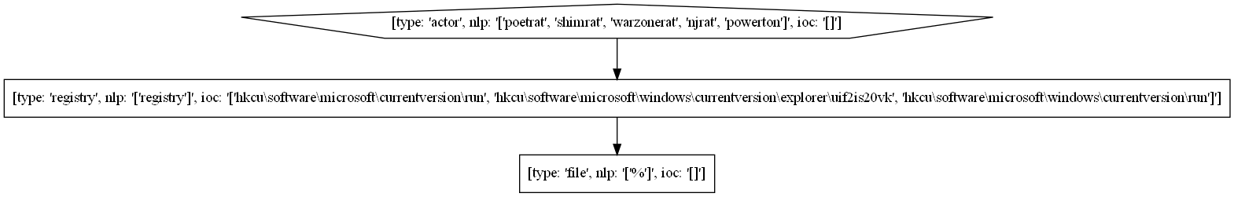
Technique Template
PoetRAT has added a registry key in the hive for persistence.
ShimRat has installed a registry based start-up key HKCU\Software\microsoft\windows\CurrentVersion\Run to maintain persistence should other methods fail.
WarzoneRAT can add itself to the HKCU\Software\Microsoft\Windows\CurrentVersion\Run and
HKCU\Software\Microsoft\Windows\CurrentVersion\Explorer\UIF2IS20VK Registry keys.
njRAT has added persistence via the Registry key HKCU\Software\Microsoft\CurrentVersion\Run and dropped a shortcut in %STARTUP%.

Slide 8
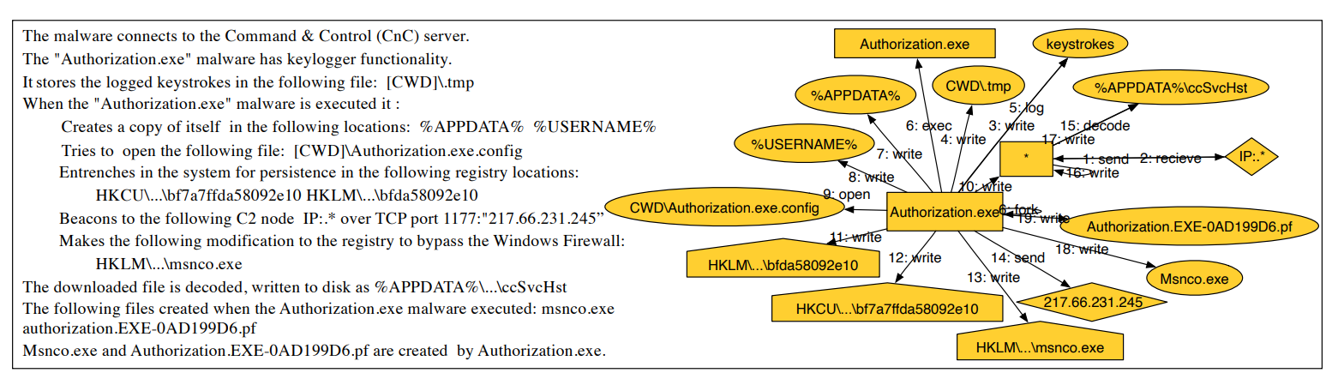
Future Direction
EXTRACTOR: Extracting Attack Behavior from Threat Reports [1]

Slide 9
Future Direction
Actor
DarkTortilla has established persistence via the Software\Microsoft\WindowsNT\CurrentVersion\Run registry key and by creating a .lnk shortcut file in the Windows startup folder.
Registry
File
File

Slide 10
Future Direction
First attacked ta51-pivot-2 and deployed OC2, allowing us to run our attack from within the target network. Exploited Firefox backdoor by again browsing to http://128.55.12.233. Loader Drakon was executed in Firefox memory and connected out to 128.55.12.233:8000 and 128.55.12.233:443 for C2. After the BBN reboot, driver was disabled, and we would now be able to use privilege escalation via our perfmon driver. We loaded the copykatz module to recon data from the system.

Slide 11
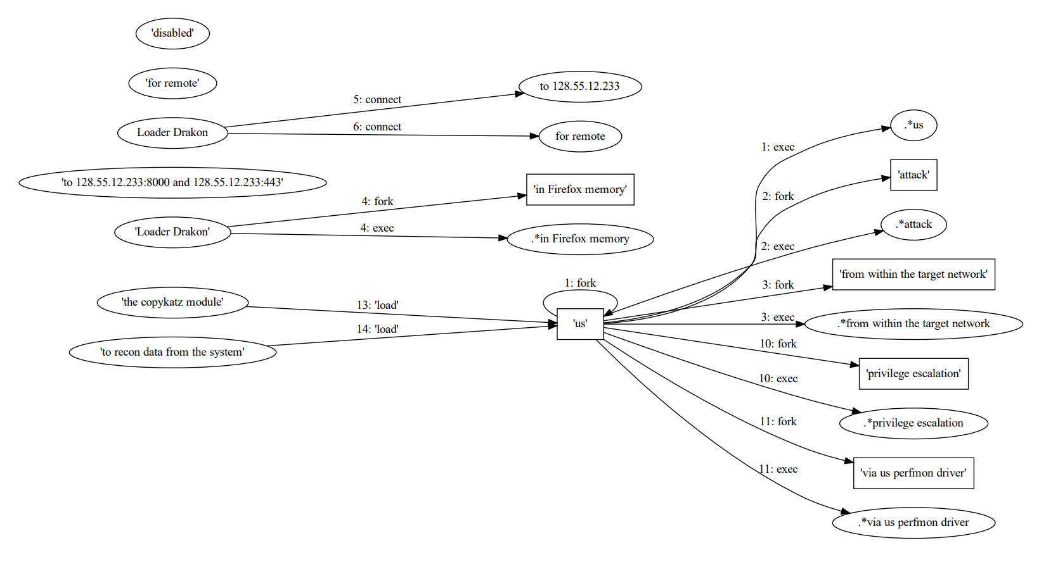
Future Direction

Slide 12
Future Direction
Try to combine Extractor and AttackG

