Slide 1
Log-based Cyber Threat Analysis
劉名凱
2023/8/30

Slide 2
Outline
Technique Graph (7/3~8/25)
Task
Workflow
Improvement
Result
Labeling (8/25~)
Task
Result

Slide 3
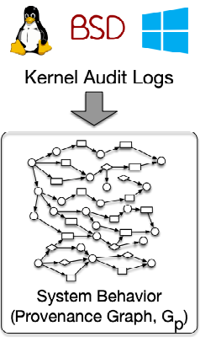
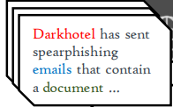
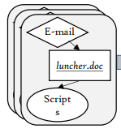
Task
Generating Technique Graphs based on MITRE ATT&CK framework.
Perform graph matching between Technique Graph and Provenance Graph to detect adversaries.
Procedure examples
T1547
T1562
T1070
Matching
Add to Database
T1112, T1601
…
T1622
Technique Database
Detected techniques
Technique Graph (Technique Template)
Notes:
根據 Mitre Attack TTPs framework 產生Technique Graph。看圖這邊，用mitre attack關往上爬到的technique底下的procedure example去產生technique graph，加入technique database裡面。這個database裡面會有每個technique 對應的 technique Graph。有了這個database，我們就可以拿來跟graph做matching，這裡舉例的graph是audit log 轉成的 provenance graph，也可以是document轉成的graph，做matching找出潛藏的technique，已檢測malware 的存在。

Slide 4
Technique Graph
Proposed by AttacKG: Constructing Technique Knowledge Graph from Cyber Threat Intelligence Reports[1]
Technique Graph summarizes attack workflow in specific technique.
Node (entity)
Entity type, nlp, ioc
Entity Type:
1. actor
2. executable
3. file
4. network
5. registry
6. vulnerability
7. system
Indicator of Compromise:
Natural language description that is replaced during IoCs_Protection
e.g. The malware utilizes the CVE-2017-21880. ->
The malware utilizes the vulnerability.
Natural Language Description
Notes:
接下來大略介紹一下technique graph。他是由這篇attackg提出的概念，technique graph 把一個technique底下的workflow統整到一張graph裡面。graph裡面的每個node，或者可以說entity長這樣，第一個是entity type，也這就是個node屬於這7個type裡面的哪一個。再來是nlp，也就是這個node代表的單字，或者說是entity的單字。最後是ioc，在把文字轉成graph的過程中，有一個階段叫做ioc protection，這個階段會把文字當中一些較特殊的資安專有名詞像是CVE-2017-21880轉成一般NLP 模型比較常見的字，ioc就代表了被換掉的這個字。

Slide 5
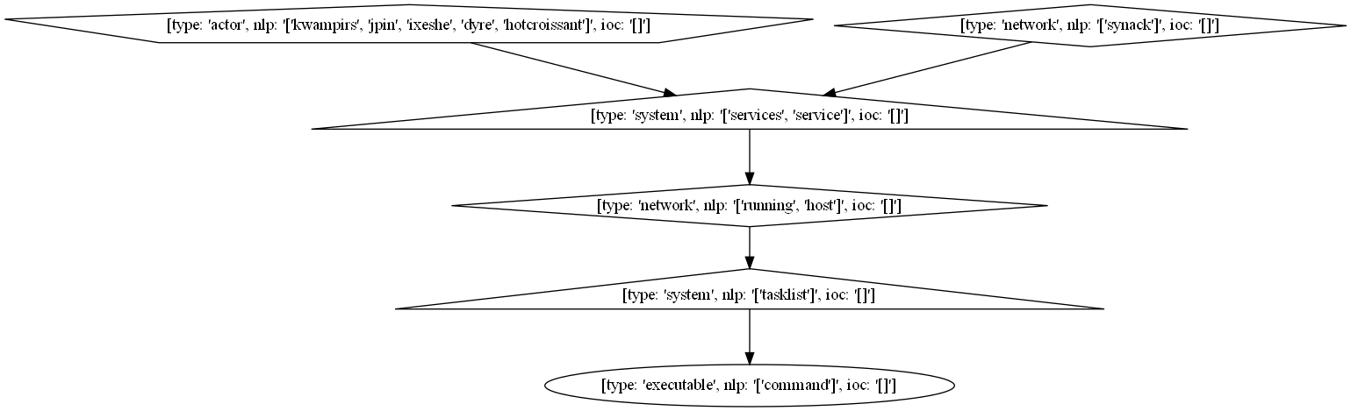
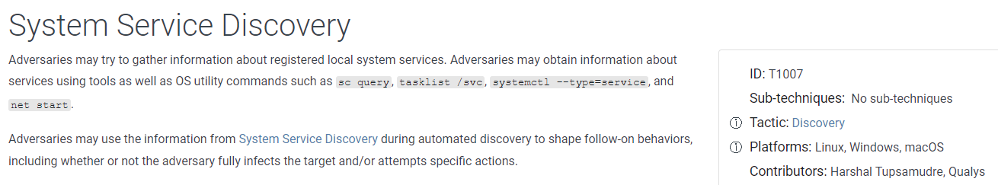
Technique Graph
Technique Graph summarizes attack workflow in technique T1007.
Notes:
接下來就是T1007這個technique的technique graph，首先T1007的定義是惡意程式會投過一些os的指令來取得local system service。呈現出來的technique graph就是長這樣。

Slide 6
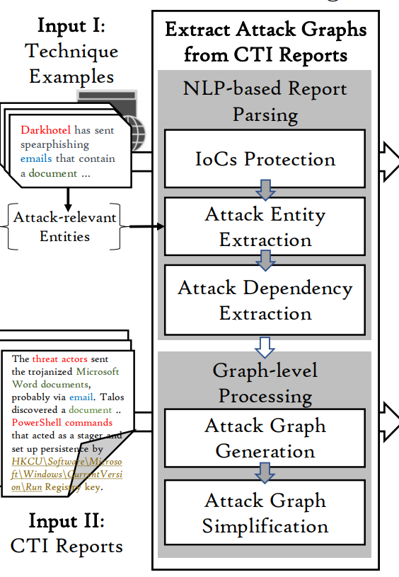
Technique Graph - Workflow
.
.
.
combine
Input text
(procedure example)
Attack Graph
Technique Graph
Attack Graphs
Notes:
接下來是產生technique graph的workflow，input text會經過這些function轉換成attack graph，attack graph的定義是僅由一個input text轉換出來的graph。接著把多個attack graph的資訊融合起來，這個才叫做technique graph。那這個最終的technique graph就統整了這些attack graph的資訊。

Slide 7
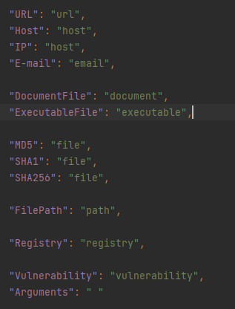
Technique Graph - Workflow
CTI report contains IoCs such as CVE-2017-21880 or /etc/passwd/ that will confuse off-the-shelf NLP model. During this stage, identify IoCs and replace them with commonly used words according to their entity type.

Slide 8
Technique Graph - Workflow
Adopt a learning-based Named Entity Recognition (NER) model to recognize entity in CTI reports.
Entity Type:
1. actor
2. executable
3. file
4. network
5. registry
6. vulnerability
7. system
Extracted entity will be consider as a node in resulted graph. Therefore, the more powerful the NER model is, the better the resulted graph’s quality is.

Slide 9
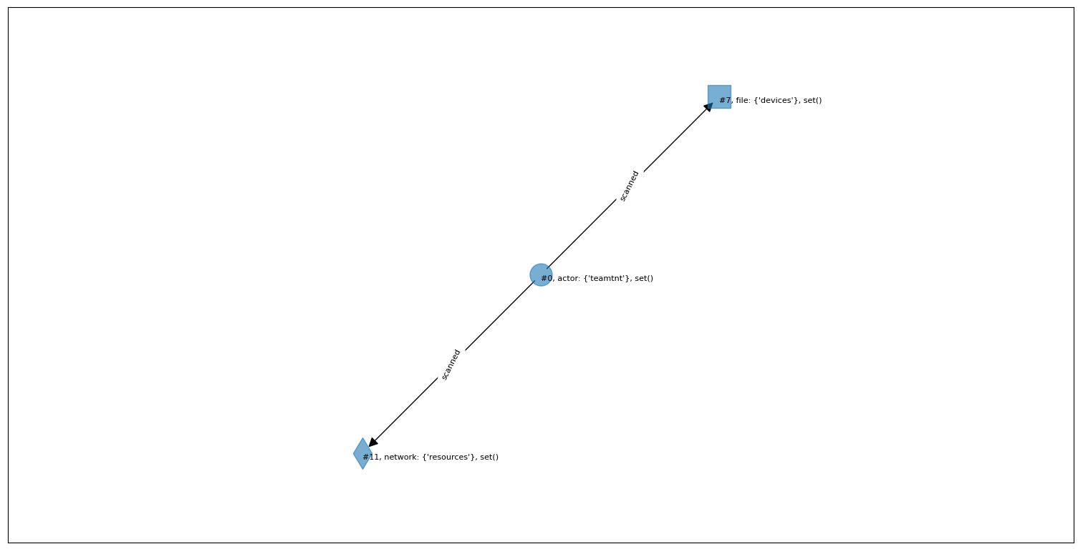
Technique Graph - Workflow
Successful case:
TeamTNT has scanned for vulnerabilities in IoT devices and other related resources such as the Docker API.

Slide 10
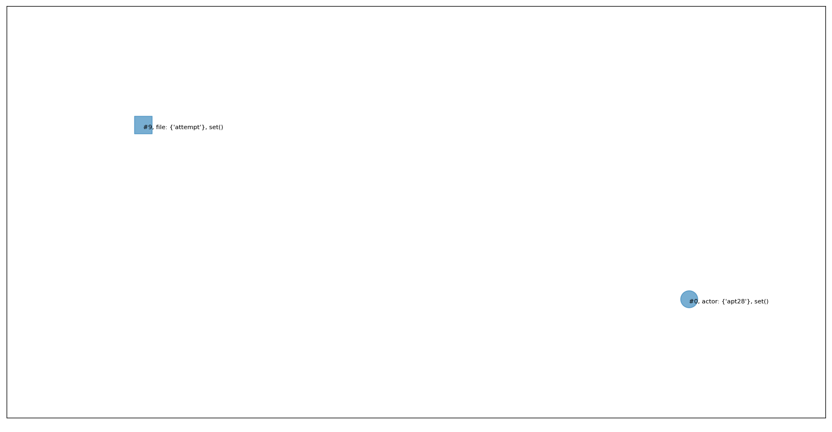
Technique Graph - Workflow
Failed case:
APT28 has performed large-scale scans in an attempt to find vulnerable servers

Slide 11

Technique Graph - Workflow
I’ve tried other open-sourced NER model$^{[2]}$ that is specialized for Cyber Security, but didn’t acquire better result.
Currently, NER is the biggest bottleneck.
[2] CyNER: https://github.com/aiforsec/CyNER

Slide 12
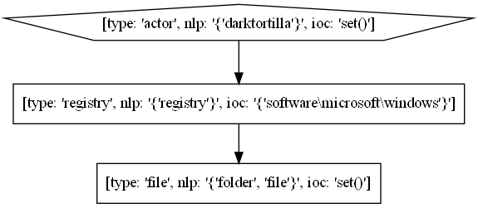
Technique Graph - Workflow
Originally, AttacKG uses Dependency Parsing to yield edges between nodes(entities). However, edges derived from Dependency Parsing are often not reasonable and lack of relation between nodes (who did what to whom)
For example:
DarkTortilla has established persistence via the Software\Microsoft\WindowsNT\CurrentVersion\Run registry key and by creating a .lnk shortcut file in the Windows startup folder.
Ideal version
Dependency Parsing

Slide 13
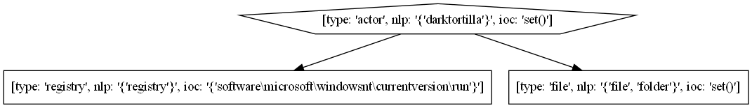
Technique Graph - Workflow
Referring to EXTRACTOR: Extracting Attack Behavior from Threat Reports[3], utilize Semantic Role Labeling (SRL) to extract edge between nodes.
By using SRL, I am able to acquire more reasonable edges and the relation(Verb) between nodes.
DarkTortilla has established persistence via the Software\Microsoft\WindowsNT\CurrentVersion\Run registry key and by creating a .lnk shortcut file in the Windows startup folder.
Semantic Role Labeling

Slide 14

Technique Graph - Workflow
Entity -> node
Dependency Parsing / Semantic Role Labeling -> edge
Co-reference done by pre-trained NLP model (Spacy$^{[4]}$)
Simplification Algorithm that combine similar nodes to simplify node.
[4] Spacy: https://spacy.io/

Slide 15
Technique Graph - Workflow
Done
Different ways of generating Technique graph from procedure examples (Attack Graphs)
Technique level (original paper)
Sub Technique level
Procedure example level
m examples -> n Technique Template
.
.
.
combine
Input text
(procedure example)
How?
Attack Graph
Technique Graph
Attack Graphs
Notes:
那我已經能夠將一段input text轉換成graph了，接下來的問題是要怎麼把好幾個attack graph combine成一個technique graph。這邊我指的是要選擇把哪幾張attack graph combine在一起，不是講解把圖合併的演算法。總共有三種方法，第一種，把technique底下的所有procedure example都combine成一張graph，也就是attackG原始論文裡的做法; 第二種把sub technique也視為獨立的technique，把所有sub technique底下的procedure example combine到一張graph裡面。最後一種，把sub technique底下，只要是workflow相似的procedure example 就融進同一張圖，也就是說假設這個sub technique底下有10個procedure example，但是可以大略分為三種workflow，那麼用procedure level產生出來的technique graph會有三張。

Slide 16

Technique Graph - Workflow
Technique Level
T1595
Too much information in single graph!

Slide 17
Technique Graph - Workflow
Sub Technique Level
T1595
Many techniques still consist of large number of procedure examples, resulted Technique Graph is still overwhelmed with information.

Slide 18



Technique Graph - Workflow
Procedure example level
T1595
2 example
$n_{1}$ Technique Template
3 example
$n_{2}$ Technique Template
2 example
$n_{3}$ Technique Template
Combine similar procedure examples into same Technique Graph.

Slide 19
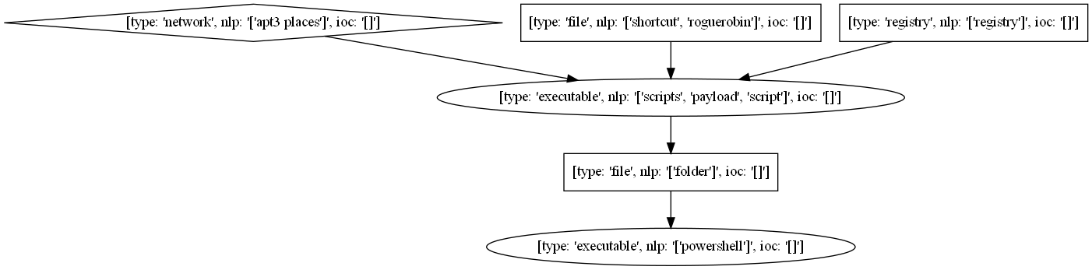
Technique Graph - Workflow
Procedure example level
1. APT3 places scripts in the startup folder for persistence.
2. RogueRobin created a shortcut in the Windows startup folder to launch a PowerShell script each time the user logs
in to establish persistence.
3. Smoke Loader adds a Registry Run key for persistence and adds a script in the Startup folder to deploy the payload.

Slide 20
Improvement
Debugged the released code.
Combine Semantic role labeling in Extractor and Named Entity Recognition in AttacKG to acquire more reasonable edges.
Generate procedure level Technique Graph Database

Slide 21
Result
I haven’t finish completing whole Project. Therefore, I only tested my code with one CTI report “Frankenstein Campaign”.
Evaluating the performance of my code by identifying techniques appears in CTI report using generated Database
 | Predicted | True Positive
Original (technique level + dependency parsing) | 20 | 2
My (Procedure level + dependency parsing) | 13 | 9
My (Procedure level + Semantic Role labeling) | ? | ?

Slide 22
Task
Given a document, identify and label techniques appears in the document.
Exact matching (finished)
Incorporating ChatGPT3.5 (OpenAI API requires payment)
AttacKG (Technique Graph)
Dataset
144 html
26 pdf
Ground truth csv file records which techniques were used in that document (considering 67 techniques)

Slide 23
Result – Exact Matching
 | TP | TN | FP | FN
html + pdf | 30 | 10700 | 29 | 966
Precision: 0.51
Recall: 0.03

Slide 24
Result – AttackG
 | TP | TN | FP | FN
html + pdf | 436 | 9027 | 1702 | 560
Precision: 0.204
Recall: 0.4377

Slide 25
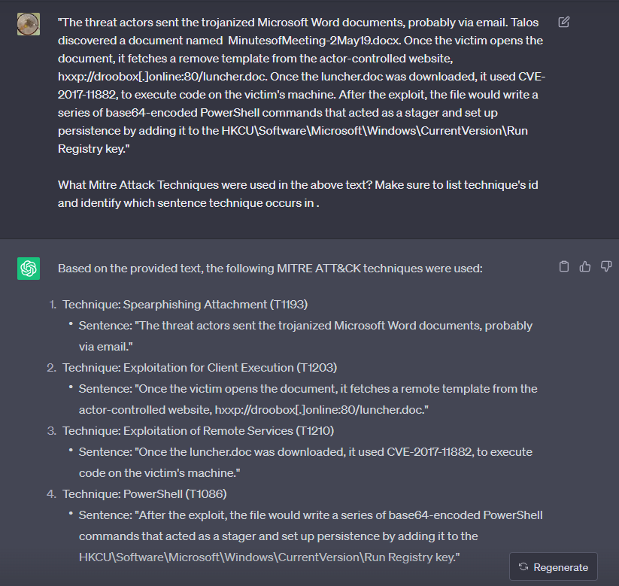
Result – ChatGPT3.5
→ T1566.001
→ T1059.001

Slide 26
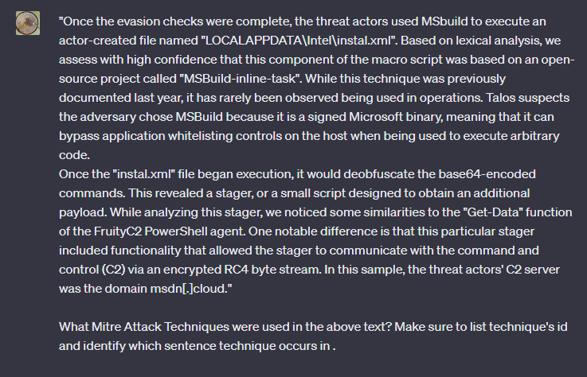
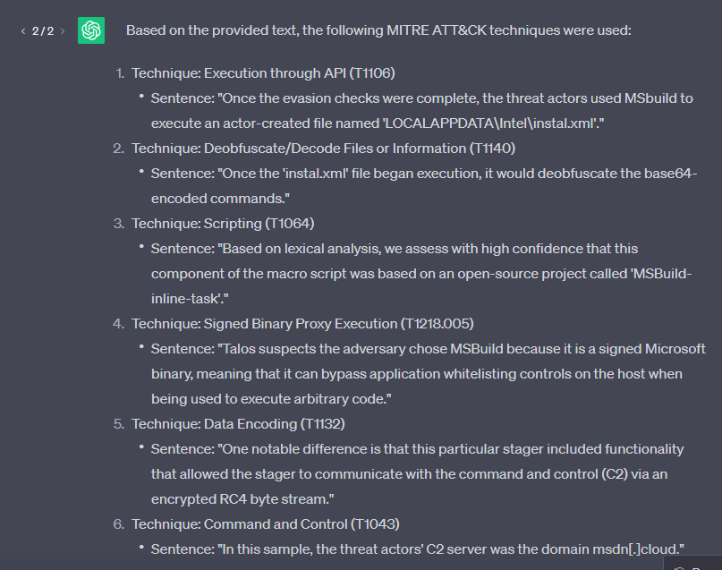
Result – ChatGPT3.5
→ T1059

Slide 27
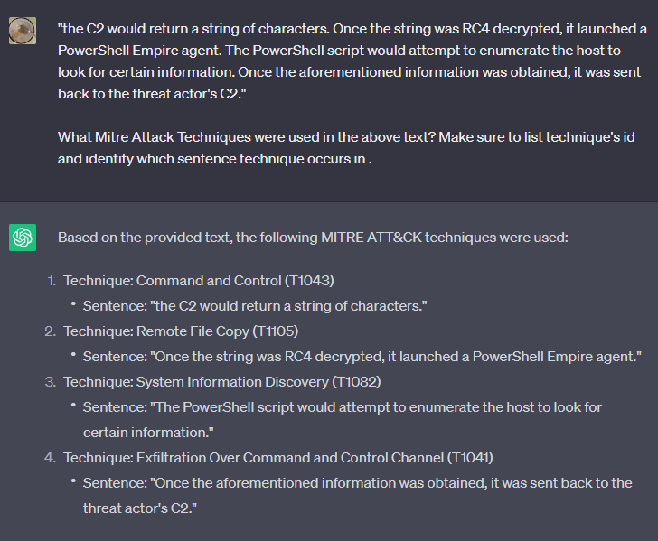
Result – ChatGPT3.5

Slide 28
Result – ChatGPT3.5
 | Predicted | True Positive
ChatGPT3.5 | 12 | 6

