Slide 1
Log-based Cyber Threat Analysis
劉名凱
2023/8/9

Slide 2
Outline
Current Goal
Named Entity Recognition
Semantic Role Labeling
Future Direction

Slide 3
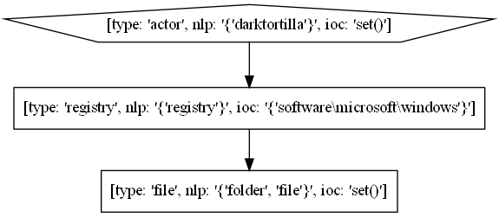
Current goal
Extract relation between nodes in Technique Template
DarkTortilla has established persistence via the Software\Microsoft\WindowsNT\CurrentVersion\Run registry key and by creating a .lnk shortcut file in the Windows startup folder.
create?
?

Slide 4
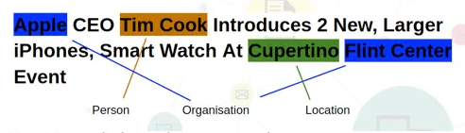
Named Entity Recognition (NER)
Named Entity: A real-world object, such as a person, location, organization, product, etc. (Registry, executable… in the field of Cyber Security)
AttackG proposed 7 types of Entities. ( Actor, Executable, File, Network, Registry, Vulnerability and System)
AttacKG: Constructing Technique Knowledge Graph from Cyber Threat Intelligence Reports [1]
Notes:
Named Entity Recognition是AttackG這篇論文裡面主要使用的方法。Named Entity 是一個real-world object，而這個object在我想要的應用領域中，具有重要的意義。NER就是把一個句子裡面的Named Entity抽取出來。

Slide 5
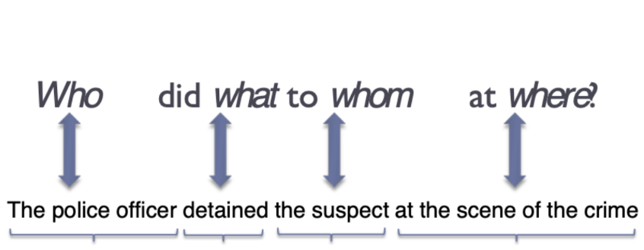
Semantic Role Labeling (SRL)
Assigning labels to words or phrases in a sentence that indicates their semantic role in the sentence
Arg0
Verb
Arg1
ArgM-LOC
EXTRACTOR: Extracting Attack Behavior from Threat Reports [2]
Notes:
Semantic role labeling 是 Extractor裡面主要使用的方法。那SRL是想要把句子中不同單字的semantic role找出來。Semantic Role聽起來有點難懂，可以直接看下面這張圖。Semantic Role就是想找出 Who did what to whom。主詞會被標成arg0，受詞被標成arg1。所以對這個句子做SRL會產生圖下方那樣的label。

Slide 6
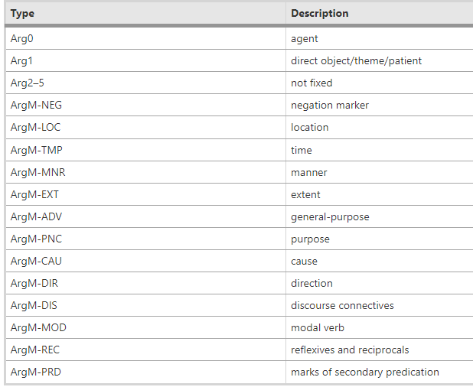
Semantic Role Labeling (SRL)
Assigning labels to words or phrases in a sentence that indicates their semantic role in the sentence
Notes:
這些是SRL裡面的不同種label，最重要的就是arg0跟arg1

Slide 7
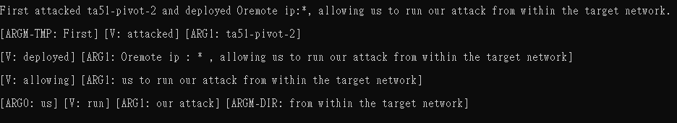
Semantic Role Labeling
Assigning labels to words or phrases in a sentence that indicates their semantic role in the sentence
sentence
Notes:
這是我實際跑出來的結果。一個句子里總共抓出四組關係

Slide 8
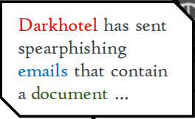
Future direction
AttacKG: Constructing Technique Knowledge Graph from Cyber Threat Intelligence Reports [1]
EXTRACTOR: Extracting Attack Behavior from Threat Reports [2]
Main difference between the graph of AttackG and that of Extractor is how they select nodes and edges.
Graph
Notes:
AttackG跟Extractor同樣都是將一段文字轉成Graph，因為Graph是由node跟edge組成，所以兩篇論文主要的差別在於如何選取node跟edge，兩個方法各有好壞。我目前的目標就是把兩篇論文的優點融合在一起。

Slide 9
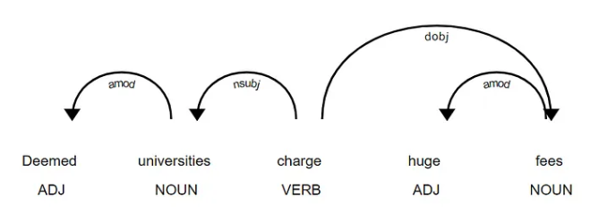
Future direction
AttackG:
Nodes: Named Entity Recognition
Edges: Dependency parsing
DarkTortilla has established persistence via the Software\Microsoft\WindowsNT\CurrentVersion\Run registry key and by creating a .lnk shortcut file in the Windows startup folder.
Dependency parsing
Notes:
AttackG取node是透過NER，抓出句子裡的named Entity。這樣的好處是Graph裡面的node都會是我們想要的東西，不會是跟資安不相關的字。但是AttackG的edge是透過dependency parsing來決定，所以node跟node之間的relation會有點怪，而且也沒辦法得知兩個node之間做了什麼動作。像是右上角這個procedure example，register key跟file都是由darktortilla創造的，所以圖應該要長成darktortilla這個node指向兩個node，一個是file，一個是registry key。但是實際產生出來的圖就不是這樣。

Slide 10
Future direction
Extractor:
Nodes: Semantic Role labeling
Edges: Semantic Role labeling
DarkTortilla has established persistence via the Software\Microsoft\WindowsNT\CurrentVersion\Run registry key and by creating a .lnk shortcut file in the Windows startup folder.
Notes:
Extractor取node跟edge都是透過Semantic role labeling，把取出來的arg0 跟 arg1當作node。那這樣的方法就會取到一些不重要的node。像是這個procedure example就會抓到persistence。但是SRL能夠很好的抓到物件跟物件之間的relation。像是這邊可以看到SRL有抓到Darktortilla create .lnk shortcut file。

Slide 11
Future direction
Selecting nodes using Named Entity Recognition (nodes with better quality)
Selecting edges using Semantic Role Labeling (yielding more reasonable relations)
Notes:
所以我目前想要用NER去抓node，讓graph裡面的node都是我們想要的東西，然後用SRL去抓edge，這樣比起用NER去抓edge，更能合理的表示node跟node之間的relation。

