Slide 1
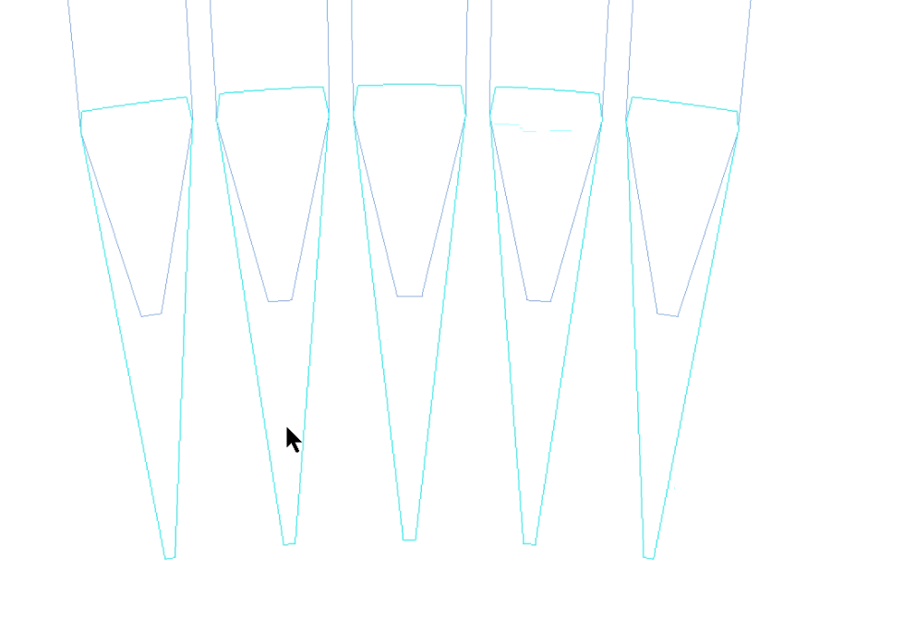
W
R_{o}+L_{ot}+0.5
R_{o}+L_{ot}
R_{o}+0.5×L_{ot}+0.5
R_{o}
W_{ot}

