Slide 1
OpenGL Basics

Slide 2
What is OpenGL?
OpenGL is a software specification. It acts as a layer between our program and graphics driver.
OpenGL is implemented as a software interface(API) that allows the programmer to create 2D and 3D graphics images.

Slide 3
Why OpenGL?
Device independence
Platform independence
  SGI Irix, Linux, Windows
Abstractions (GL, GLU, GLUT)
Open source
Hardware-independent software interface
Support of client-server protocol
Other APIs
  OpenInventor (object-oriented toolkit)
  DirectX (Microsoft)
  Java3D (Sun)

Slide 4
Modes of operation/design:
Immediate mode: draw calls directly render to screen.
Retained mode: draw calls fill a buffer(abstract data model) and OpenGL decide when to render.
We’ll be dealing with immediate mode.

Slide 5

Immediate mode pipeline:

Slide 6
Primitives
Supports several basic primitives such as points, lines, triangles, quadrilaterals and general polygons.
Primitives are specified using a sequence of vertices.
Syntax:
glBegin(<primitive type>);
  glVertex2f(x0,y0);
  glVertex2f(x1,y1);
  .
  .
glEnd();
Where x0, y0, x1, y1 ... are variables of GLfloat type.

Slide 7

Primitive types:
The numbers indicate the order in which the vertices have been specified.

Slide 8
Colours in OpenGL
Colors are specified in RGB/RGBA mode. Values of [0...1] or [0...225] are acceptable depending on the function called.
Function used: glColor();
Function format: glColor[data type nemonic]();
glColor() has different forms depending upon the color values you want to specify.
  For eg.:
  glColor3f(0.0f, 1.0f, 0.0f); // sets green color using GLfloat.
  glColor3ui(255,0,0); // sets color to red using GLuint.
  glColor4f(1.0f, 0.0f, 0.0f, 1.0f); // sets color to red using GLfloat and sets alpha value to max.
  glColor3fv(cv); // sets color based on cv of type GLfloat *.

Slide 9

Coordinate system in OpenGL
Different coordinates are used to make calculations easier.
OpenGL expects coordinates to be in Normalised Device Coordinates(NDC) range -1 to 1.
Models are defined based on their local origin.

Slide 10
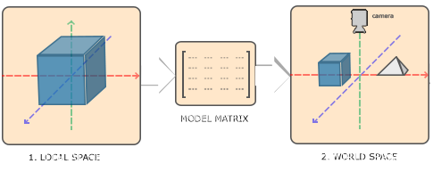
Model Matrix
Local coordinates are relative to its local origin at (0,0,0).
The model matrix transforms a position in a model to the position in the world by combining translation, scale and rotation.

Slide 11
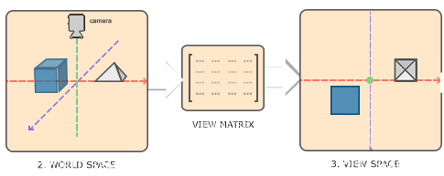
View / Camera matrix
View space coordinates are relative to the viewer(camera or eye view).
This matrix transforms the objects/vertices to mimic a camera/observer location.

Slide 12
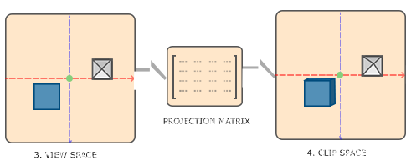
Projection matrix
It is used to create a viewing box/frustum that defines what should be visible and what should be clipped based on view-space coordinates.
All the coordinates outside this frustum after transforming them to clip space get clipped.
Projection matrix transforms the coordinates to normalised device coordinates(NDC) [-1...1].
Projection matrices are of two types:
  Perspective: objects farther away look smaller
  Orthographic: objects are not affected.

Slide 13
MVP matrix
MVP matrix: Model View Projection Matrix is a transformation matrix that is used to convert local coordinated to clip coordinates.
Vclip = Mproj·Mview·Mmodel·Vlocal

Slide 14
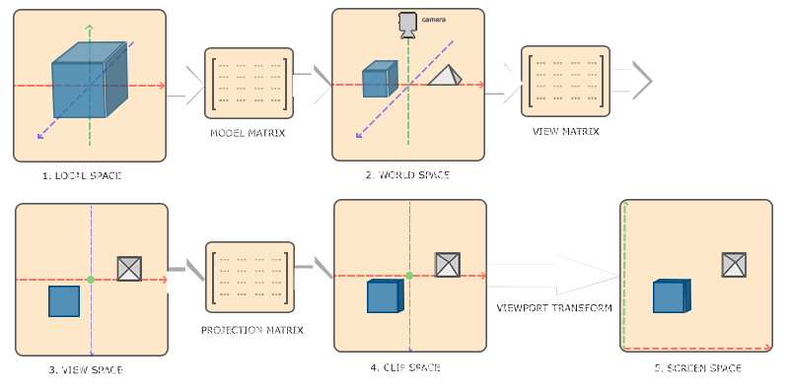
Coordinate system in OpenGL

Slide 15
Going 3D
3D graphics use the concept of MVP matrix, Lighting, shading, textures etc. to convert 3 dimensional vertices into 2D pixels.
We’ll see 2d & 3d examples later.

Slide 16
Windows setup – Sayli Patil
Glut introduction & setup – Abhishek Gawade
Linux setup & demos – Mukesh Tandale

