Slide 1
PFP
Python Format Parser
James Johnson
@d0c_s4vage
https://github.com/d0c-s4vage/pfp

Slide 2
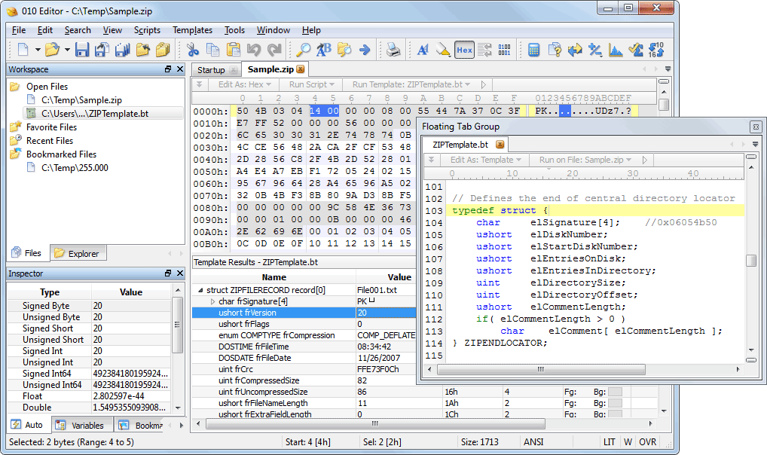
What is it?
An 010 template interpreter written in Python

Slide 3

What is it? (contd)
AWESOME!

Slide 4
What is it? (contd)
Quick Example (demo 1)

Slide 5
Motivation
Because I can
Lost of existing 010 templates
Extensions
Scriptability
Hate being tied to one OS (e.g. windows)
Fuzzing

Slide 6
How it Works
Uses py010parser (https://github.comm/d0c-s4vage/py010parser), a modified pycparser
handles nodes from the parsed AST to interpret it
Treated it ~same as browsers handle javascript (inspired at least)

Slide 7
Motivation
Because I can
Lost of existing 010 templates
Extensions
Scriptability
Hate being tied to one OS (e.g. windows)
Fuzzing

Slide 8
010 Compatability
All 010 functions are (should be!) at least stubbed out
  e.g. Strlen, FEof, FSkip, etc.
Common ones are implemented
SHOULD be compatible

Slide 9
Debugger
010 Editor does not let you debug your script
Pfp does
Demo 2

Slide 10
Manipulation
010 Editor is an EDITOR
Main motivation for pfp
Demo 3

Slide 11
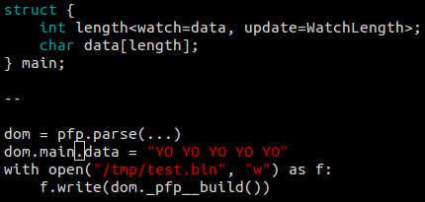
Manipulation
010 Editor is an EDITOR
Main motivation for pfp

Slide 12

Metadata
010 Editor metadata (aka special attributes)
E.g.

Slide 13
Metadata
010 Editor metadata (aka special attributes)
What about length fields, checksums, etc?

Slide 14

Metadata - Watch
Length fields, CRC, etc.

Slide 15
Metadata - Watch
Length fields, CRC, etc.
Demo 4

Slide 16
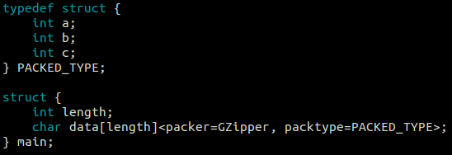
Metadata - Pack
Compressed/encoded data, etc

Slide 17
Metadata - Pack
Compressed/encoded data, etc
Demo 5

Slide 18

Vim Plugin

Slide 19
Vim Plugin
https://github.com/d0c-s4vage/pfp-vim

Slide 20

EOF

