Slide 1

Web Development & Design Foundations with HTML5
Tenth Edition
Chapter 11
WEB MULTIMEDIA AND INTERACTIVITY
Copyright © 2021, 2019, 2017 Pearson Education, Inc. All Rights Reserved

Slide 2
Learning Outcomes (1 of 2)
In this chapter, you will learn how to ...
Describe the purpose of media containers and codecs
Describe types of multimedia files used on the Web
Configure hyperlinks to multimedia files
Configure audio and video on a web page
Describe features and common uses of JavaScript, Ajax, and jQuery
Create an interactive image gallery with CSS

Slide 3
Learning Outcomes (2 of 2)
Create an interactive drop-down navigation menu with CSS
Configure a widget with the HTML5 details and summary elements
Configure the CSS3 transform, transition, and animation properties
Describe the purpose of geolocation, web storage, manifest, service workers, and canvas HTML5 APIs.

Slide 4
Containers & Codecs
Container
Designated by the file extension – contains the media and metadata
Codec
The algorithm used to compress the media
HTML5 audio & video
Native to the browser
ISSUE: Browsers do not all support the same codecs
http://www.longtailvideo.com/html5/ (2017)
https://caniuse.com/#search=video%20format (current)

Slide 5
Common Audio File Types
.wav Wave File
.aiff Audio Interchange File Format
.mid Musical Instrument Digital Interface (MIDI)
.au Sun UNIX sound file
.mp3 MPEG-1 Audio Layer-3
.ogg Ogg Vorbis (open-source)
. m4a MPEG 4 Audio. This audio-only MPEG-4 format is supported by Quicktime, iTunes, and iPods.

Slide 6
Common Video File Types
.avi Microsoft Audio Video Interleaved
.av1 Alliance for Open Media (open-source)
.wmv Windows Media File
.mpg MPEG (Motion Picture Experts Group)
.m4v .mp4 (MPEG-4)
.ogv Ogg Theora (open-source)
.webm VP8 codec (open video format, free)

Slide 7
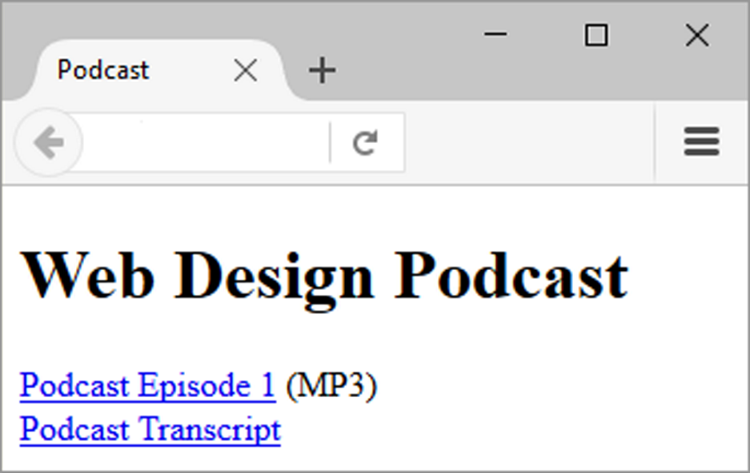
Configure Audio & Video
Hyperlink The most basic method to provide audio or video files
<a href="wdfpodcast.mp3" title="Web Design Podcast">Web Design Podcast</a>
Figure 11.1 The default MP3 player will launch in the browser when the visitor clicks on Podcast Episode 1

Slide 8
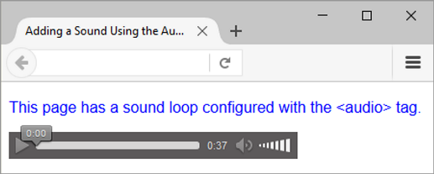
Figure 11.2 The Firefox browser supports the HTML5 audio element.

Slide 9
HTML5 Audio & Source Elements
<audio controls="controls">
<source src="soundloop.mp3" type="audio/mpeg">
<source src="soundloop.ogg" type="audio/ogg">
<a href="soundloop.mp3">Download the Audio File</a> (MP3)
</audio>

Slide 10
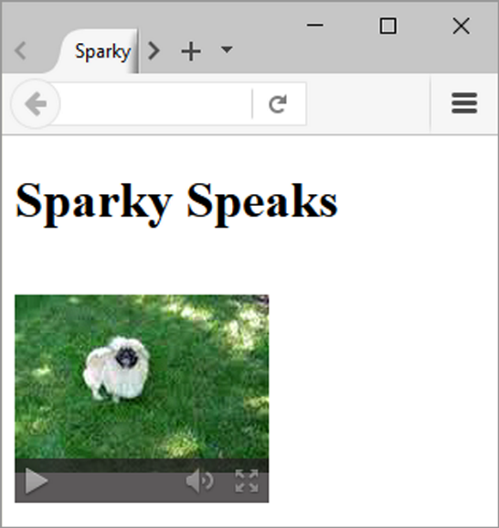
Figure 11.4 The Firefox browser. Screenshots of Mozilla Firefox. Courtesy of Mozilla Foundation.

Slide 11
HTML5 Video & Source Elements
<video controls="controls" poster="sparky.jpg"
width="160" height="150">
<source src="sparky.m4v" type="video/mp4">
<source src="sparky.ogv" type="video/ogg">
<a href="sparky.mov">Sparky the Dog</a> (.mov)
</video>

Slide 12
Copyright Issues
Only publish web pages, images, and other media that you have personally created or have obtained the rights or license to use.
Ask permission to use media created by another person instead of simply “grabbing” it.
All work (including web pages) are automatically copyrighted even if there is not copyright mark or date.
Fair Use Clause of the Copyright Act
Creative Commons – A new approach to copyright

Slide 13
Multimedia & Accessibility
Provide alternate content
Transcript (for audio)
Captions (for video)
Text format

Slide 14
Checkpoint (1 of 3)
Describe the HTML needed to display a video on a web page, including what happens if the browser or device does not support the video file.
Describe the purpose of the poster attribute on the video element.
Students can use anything they find on the Web for school assignments. Do you agree with this statement? Justify your answer.

Slide 15
CSS Drop Down Menu
Configure nav container with position relative
Code submenu (drop down menu) ul element with the parent li element
Configure submenu ul element to initially not display
Configure submenu ul element with absolute positioning

Slide 16
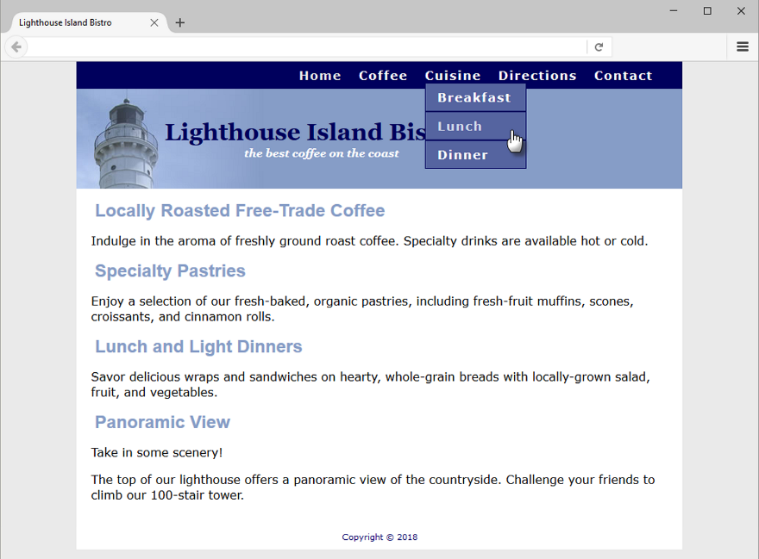
Figure 11.6 An interactive navigation menu with CSS

Slide 17
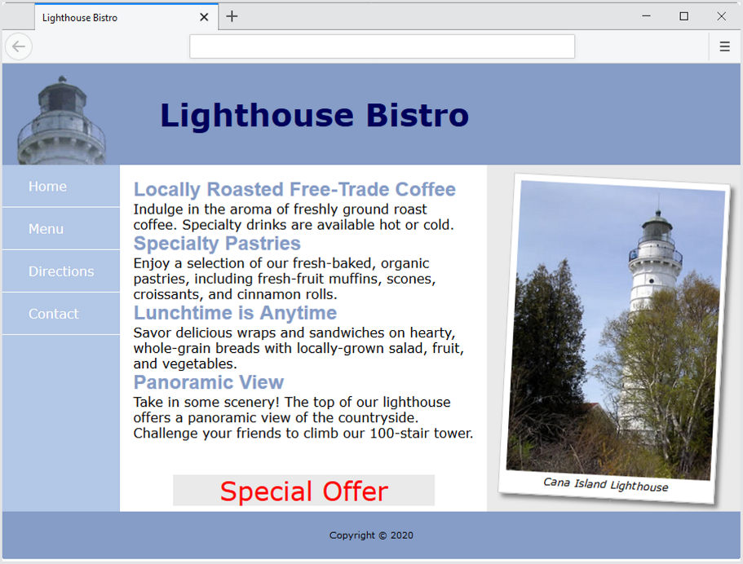
CSS Transform Property
Allows you to rotate, scale, skew, or move an element
Example:
transform: rotate(3deg);
Figure 11.8 The transform property in action

Slide 18
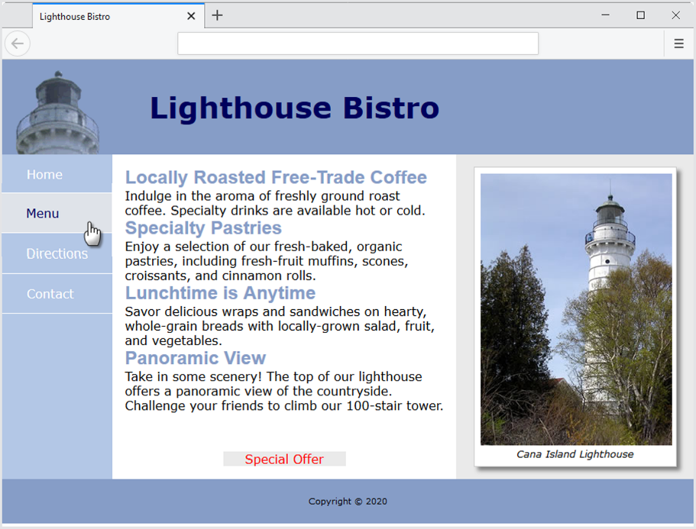
CSS Transition Property
Provides for changes in property values to display in a smoother manner over a specified time.
Example:
nav a:hover { color: #869dc7; background-color: #EAEAEA;
transition: background-color 2s linear; }
Figure 11.10 The transition in action

Slide 19
CSS Image Gallery (1 of 2)
Configure each thumbnail image:
<li><a href="photo1.jpg"><img src="photo1thumb.jpg" width="100" height="75" alt="Golden Gate Bridge">
<span><img src="photo1.jpg" width="400" height="300“ alt="Golden Gate Bridge"><br>Golden Gate Bridge </span></a>
</li>

Slide 20
CSS Image Gallery (2 of 2)
The key CSS:
#gallery span { position: absolute; opacity: 0;
transition: opacity 3s ease-in-out;
left: -1000px; }
#gallery a:hover span { position: absolute;
top: 16px; left: 320px;
text-align: center; }

Slide 21
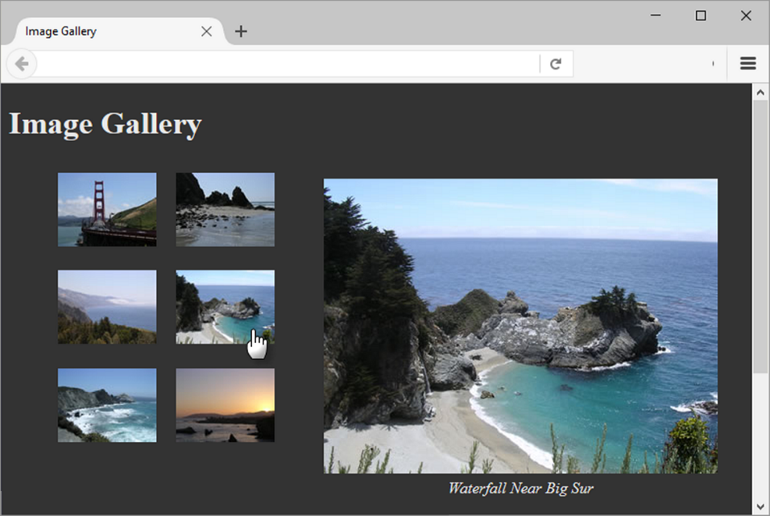
Figure 11.12 The new photo gradually displays

Slide 22
CSS Animations
Provide a way to animate the values of CSS properties over time
Two Steps:
Define the animation with the @keyframes rule
Apply the animation using the CSS animation property

Slide 23
HTML Details & Summary Elements (1 of 2)
Used together to configure an interactive widget
Details element contains one summary element and detailed information
Summary element contains the text initially displayed

Slide 24
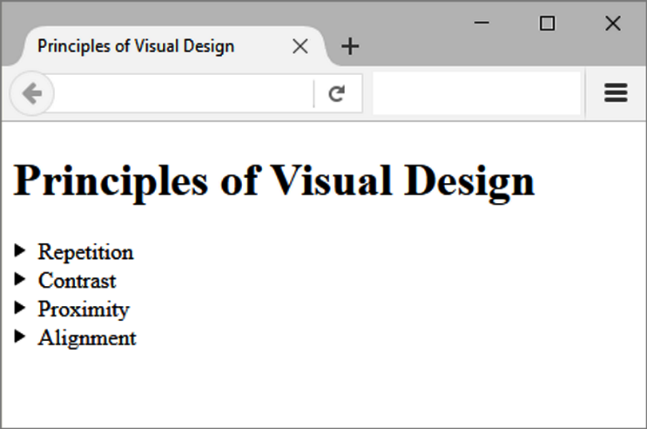
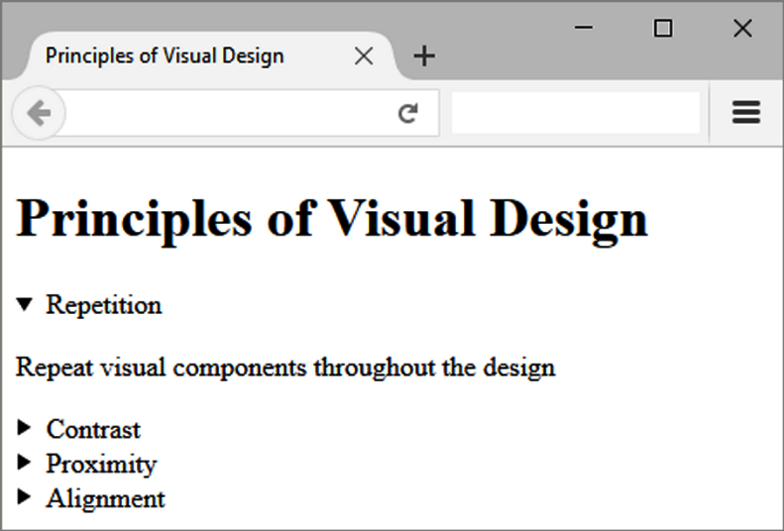
HTML Details & Summary Elements (2 of 2)
Figure 11.14 Initial browser display
Figure 11.15 Detailed information displays

Slide 25
Checkpoint (2 of 3)
What is the purpose of the transform property?
What is a keyframe? When is it used?
What is the purpose of the details and summary elements?

Slide 26
What is JavaScript?
Object-based client-side scripting language
Originally developed by Brendan Eich at Netscape
Manipulates the objects associated with a web page document:
the window
the document
the elements such as forms, images, hyperlinks, and so on

Slide 27
Common Uses of JavaScript
Display a message box
Select list navigation
Edit and validate form information
Create a new window with a specified size and screen position
Image Rollovers
Status Messages
Display Current Date
Calculations

Slide 28
Document Object Model (DOM)
A portion of the DOM is shown at the left.
Defines every object and element on a Web page
Hierarchical structure
Accesses page elements and apply styles to page elements

Slide 29
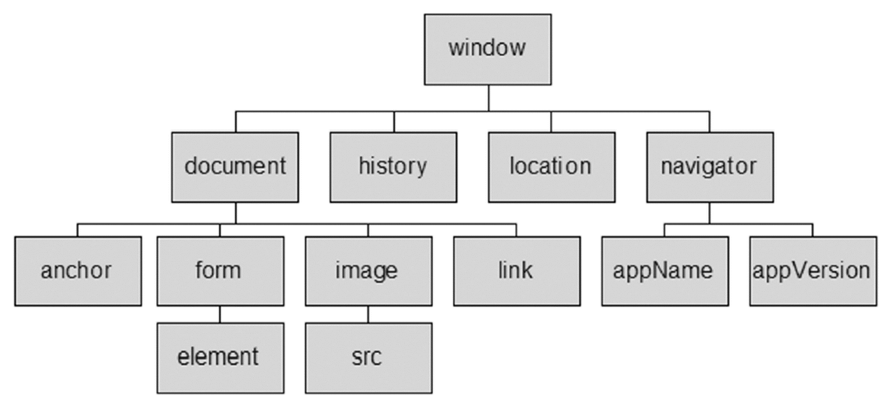
Figure 11.18 The Document Object Model (DOM)

Slide 30
What is Ajax?
Asynchronous JavaScript and XML
Existing technologies used in a new way
Standards-based XHTML and CSS
Document Object Model
XML (and the related XSLT technology)
Asynchronous data retrieval using XMLHttpRequest
JavaScript

Slide 31
Exploring JQuery (1 of 2)
A JavaScript library intended to simplify client-side scripting
Example: http://webdevfoundations.net/jquery
API – Application Programming Interface
A protocol that allows software components to communicate – interacting and sharing data.

Slide 32
Exploring JQuery (2 of 2)
The jQuery API can be used to configure many interactive features, including:
image slideshows
animation (moving, hiding, fading)
event handling (mouse movements and mouse clicking)
document manipulation

Slide 33
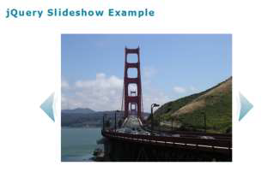
Figure 11.19 jQuery is used to configure a slideshow

Slide 34
HTML5 APIs
API – a protocol that allows software components to communicate – interacting and sharing data
A variety of APIs that are intended to work with HTML5, CSS, and JavaScript are currently under development and in the W3C approval process, including:
geolocation
web storage
manifest
service workers
canvas

Slide 35
HTML5 Geolocation
Allows your web page visitors to share their geographic location
Their location may be determined by the IP address, wireless network connection, local cell tower, or GPS hardware depending on the type of device and browser.
JavaScript is used to work with the latitude and longitude coordinates provided by the browser.
Examples:
https://developers.google.com/maps/documentation/javascript/examples/map-geolocation

Slide 36
HTML5 Web Storage (1 of 2)
Traditionally, the JavaScript cookie object has been used to store information in key-value pairs on the client (the website visitor’s computer).
NEW FOR HTML5: Web Storage API
provides two new ways to store information on the client side: local storage and session storage.
Advantage: increase in the amount of data that can be stored (5MB per domain).
The localStorage object stores data without an expiration date.

Slide 37
HTML5 Web Storage (2 of 2)
The sessionStorage object stores data only for the duration of the current browser
JavaScript is used to work with the values stored in the localStorage and sessionStorage objects.
Examples:
http://webdevfoundations.net/storage and http://html5demos.com/storage

Slide 38
Progressive Web Application (PWA) (1 of 2)
A web application (app) can be written with HTML, CSS and JavaScript and can run in any browser – as long as you are online.
Progressive Web Application (PWA)
Rich user experience similar to a native iPhone or Android app
Provides some level of functionality even when the user is offline.

Slide 39
Progressive Web Application (PWA) (2 of 2)
Key Progressive Web Application APIs:
Manifest API Provides information about the PWA; including the data needed for the PWA’s icon to be added to the home screen of a device.
Service Workers API JavaScript that runs in the background; Provides for push notifications and background data syncing; Requires HTTPS

Slide 40
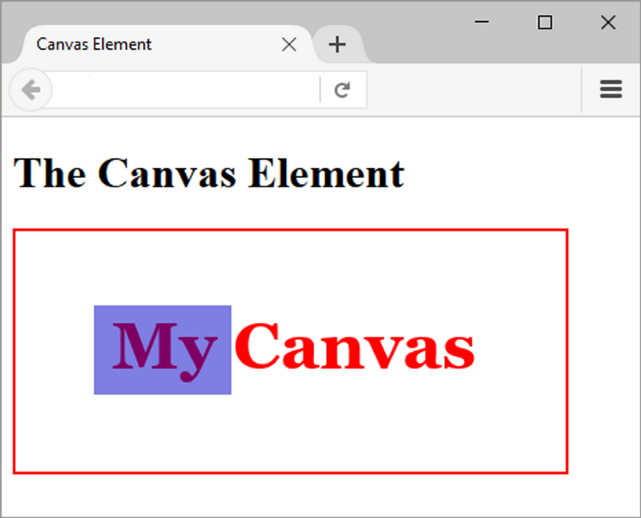
HTML Canvas Element
Purpose:
Configure dynamic graphics
Draw lines, shapes, text, image
Interact with actions taken by the user
Technologies:
HTML
JavaScript
Canvas API
Figure 11.20 The canvas element

Slide 41
Multimedia, Animation, & Accessibility
Provide text descriptions and captions
Verify keyboard access
Verify functionality if JavaScript is disabled
If media is used for main navigation, provide plain text links
WCAG 2.1 Success Criterion 2.3.1
https://www.w3.org/WAI/WCAG21/quickref/#three-flashes-or-below-threshold
WCAG 2.1 Success Criterion 2.2.2
https://www.w3.org/WAI/WCAG21/quickref/#pause-stop-hide

Slide 42
Checkpoint (3 of 3)
Describe two uses of JavaScript.
Describe a feature of a PWA.
Describe the purpose of the HTML5 canvas element.

Slide 43
Summary
This chapter introduced many HTML & CSS techniques and technologies used to configure sound, video, animation, and interactivity on web pages.
Issues related to accessibility and copyright were also discussed.

