Slide 1
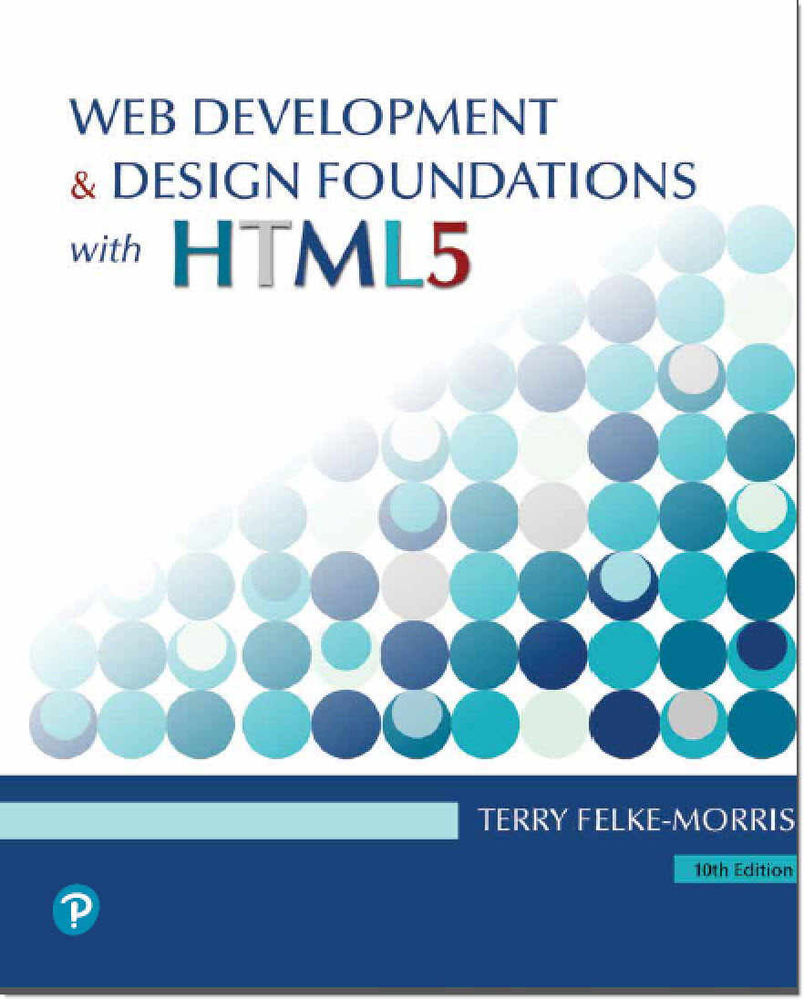
Web Development & Design Foundations with HTML5
Tenth Edition
Chapter 14
A Brief Look At Javascript and jQuery
Copyright © 2021, 2019, 2017 Pearson Education, Inc. All Rights Reserved

Slide 2
Learning Outcomes (1 of 2)
In this chapter, you will learn how to ...
Describe common uses of JavaScript in web pages
Describe the purpose of the Document Object Model and list some common events
Create a simple JavaScript using the script element and the alert() method.
Code JavaScript methods, properties, event handlers, and event listeners
Use variables, operators and the if control structure
Create a basic form validation script

Slide 3
Learning Outcomes (2 of 2)
Describe common uses of jQuery
Describe how to obtain jQuery
Use jQuery selectors and methods
Configure an image gallery with jQuery
Describe the purpose of jQuery plugins.

Slide 4
What is JavaScript? (1 of 2)
Object-based scripting language
Works with the objects associated with a Web page document
the window
the document
the elements
such as forms, images, hyperlinks, etc.

Slide 5
What is JavaScript? (2 of 2)
Originally developed by Netscape
Named LiveScript
Netscape & Sun Microsystems Collaboration
LiveScript renamed JavaScript
JavaScript is NOT Java

Slide 6
Common Uses of JavaScript
Display a message box
Select list navigation
Edit and validate form information
Create a new window with a specified size and screen position
Image Rollovers
Status Messages
Display Current Date
Calculations

Slide 7
Coding JavaScript
JavaScript statements can be coded on a web page using two different techniques:
Place JavaScript code between <script> tags
Place JavaScript code as part of an event attached to an HTML element

Slide 8
JavaScript: Using the script Element
The script element
A container tag
May be placed in either the head or the body section of a web page
<script>
alert("Welcome to Our Site");
</script>

Slide 9
Checkpoint (1 of 5)
Describe at least three popular uses for JavaScript.
How many JavaScript code blocks can be embedded in an HTML document?
Describe a method that can be used to find an error in a JavaScript code block.

Slide 10
Document Object Model (DOM)
A portion of the DOM is shown at the left.
Defines every object and element on a web page
Hierarchical structure
Accesses page elements and apply styles to page elements

Slide 11
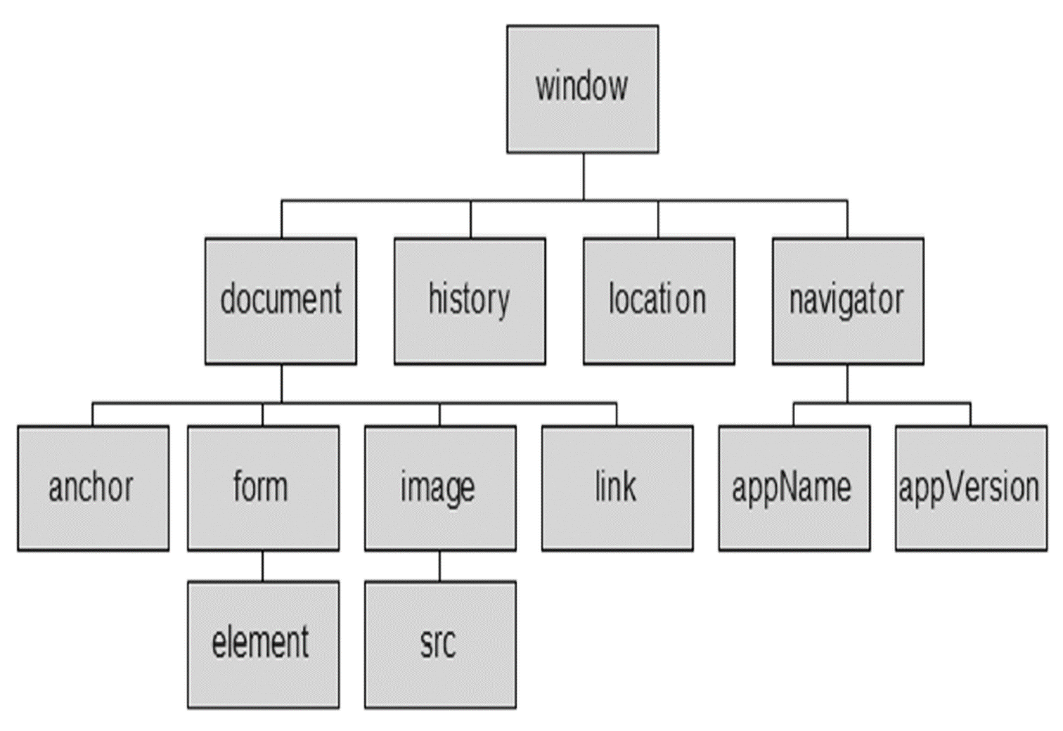
Figure 11.18 The Document Object Model (DOM)

Slide 12
Object
An object is a thing or entity.
Browser window
Submit button
Web page document

Slide 13
Property
A property is a characteristic or attribute of an object.
The background color of a web page document document.bgcolor
The date the web page file was last modified document.lastmodified
The src file of an image object
image1.src

Slide 14
Method
A method is an action (a verb)
Writing text to a web page document document.write()
Submitting a form
form1.submit()

Slide 15
JavaScript and Events (1 of 2)
Events: actions taken by the web page visitor
clicking (onclick),
placing the mouse on an element (onmouseover),
removing the mouse from an element (onmouseout),
loading the page (onload),
unloading the page (onunload), etc.

Slide 16
Events
Table 14.2 Events and event handler properties
Event | Event Handler
click | onclick
load | onload
mouseover | onmouseover
mouseout | onmouseout
submit | onsubmit
unload | onunload

Slide 17
JavaScript and Events (2 of 2)
JavaScript can be configured to perform actions when events occur.
The event name is coded as an attribute of an HTML tag
The value of the event attribute contains the JavaScript code
Example: Display an alert box when the mouse is placed over a hyperlink.
<a href="home.htm" onmouseover="alert('Click to go home')">Home</a>

Slide 18
JavaScript Debugging(1)
Check the syntax of the statements
Pay very close attention to upper and lower case letters, spaces, and quotations
Verify that you have saved the page with your most recent changes
Verify that you are testing the most recent version of the page (refresh or reload the page)
If you get an error message, use the error messages that are displayed by the browser
In Firefox: Select Tools > Error Console

Slide 19
JavaScript Debugging(2)
Using the Firefox browser:
Select the top right menu icon (“Hamburger” icon)
Select Developer > Web Console
The Web Console will indicate an issue and the line number
This may not be exactly where the problem is
Sometimes the error is one or two lines above the indicated line number.

Slide 20
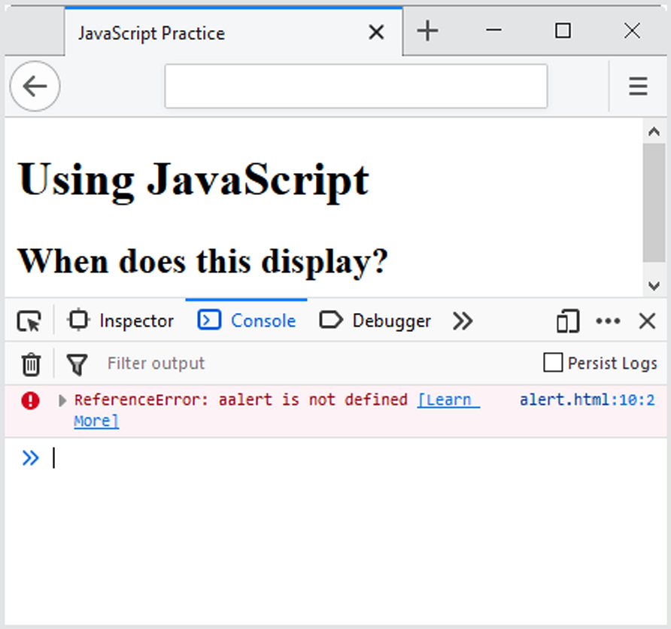
Figure 14.7 The Web Console displays an error

Slide 21
Checkpoint (2 of 5)
With respect to objects, describe the difference between a property and a method. Feel free to use words like “thing,” “action,” “description,” “attribute,” and so forth.
What is the difference between an event and an event handler?
Where are event handlers placed in the HTML document?

Slide 22
Variable
A variable is a placeholder for information.
The variable is stored in the computer’s memory (RAM).
var userName;
userName = "Karen";
document.write(userName);

Slide 23
Prompts
prompt() method
Displays a message and accepts a value from the user myName = prompt(“prompt message”);
The value typed by the user is stored in the variable myName

Slide 24
Arithmetic Operators
Table 14.3 Commonly used arithmetic operators
Operator | Description | Example | Value of Quantity
= | assign | quantity = 10 | 10
+ | addition | quantity = 10 + 6 | 16
- | subtraction | quantity = 10 - 6 | 4
* | multiplication | quantity = 10 * 2 | 20
/ | division | quantity = 10 / 2 | 5

Slide 25
Comparison Operators
Table 14.4 Commonly used comparison operators
Operator | Description | Example | Sample Values of Quantity that Would Result in True
= = | Double equals sign (equivalent) “is exactly equal to” | quantity = = 10 | 10
> | Greater than | quantity > 10 | 11, 12 (but not 10)
> = | Greater than or equal to | quantity > = 10 | 10, 11, 12
< | Less than | quantity < 10 | 8, 9 (but not 10)
< = | Less than or equal to | quantity < = 10 | 8, 9, 10
! = | Not equal to | quantity ! = 10 | 8, 9, 11 (but not 10)

Slide 26
Decision Making
if (condition) {
… commands to execute if condition is true
}
else {
… commands to execute if condition is false
}

Slide 27
Function
A function is a block of one or more JavaScript statements with a specific purpose, which can be run when needed.
function function_name() {
... JavaScript statements …
}

Slide 28
Using Functions
Defining the Function
function showAlert() {
alert("Please click OK to continue.");
}
Calling the Function
showAlert();

Slide 29
Checkpoint (3 of 5)
Describe a method that can be used to gather a piece of data such as the user’s age.
Write the JavaScript code to display an alert message for users who are under 18 years old and a different alert message for users who are 18 years or older.
What is a function definition?

Slide 30
Form Validation
It is common to use JavaScript to validate form information before submitting it to the web server.
Is the name entered?
Is the e-mail address of correct format?
Is the phone number in the correct format?
See Hands-on Practice 14.8

Slide 31
Validating Form Fields
Use the "" or null to check to determine if a form field has information
if (document.forms[0].userName.value == "" ) {
alert("Name field cannot be empty.");
return false;
} // end if

Slide 32
JavaScript & Accessibility
Don’t expect JavaScript to always function for every visitor
Some may have JavaScript disabled
Some may be physically unable to click a mouse
Provide a way for your site to be used if JavaScript is not functioning
Plain text links
E-mail contact info

Slide 33
Checkpoint (4 of 5)
What is meant by the term “form data validation”?
Give three examples of form data that may require validation.
Should you always expect your JavaScript to “work” – why or why not?

Slide 34
What is jQuery?
jQuery is a free open-source JavaScript Library
Provides interaction and dynamic effects on web pages
Resources
http://jquery.com
http://jquery.org

Slide 35
Common Uses of JQuery
Dynamically manipulate the CSS properties of elements
Detect and react to events – such as mouse movements
Animate elements on a web page – such as image slideshows
And much more...

Slide 36
Adding jQuery to a Web Page
Two Options:
Download jQuery
http://jquery.com/download
Access jQuery via a CDN
<script src= "https://ajax.googleapis.com/ajax/libs/jquery/3.4.1/jquery.min.js"> </script>

Slide 37
The Ready Event
Triggered when the browser has loaded the Document Object Model(DOM) for the web page
$(document).ready(function() {
Your JavaScript statements and other jQuery statements go here
})

Slide 38
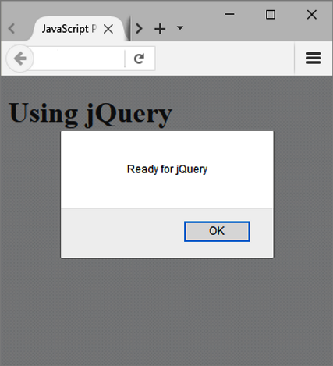
Display an Alert When the page loads
<script>
$(document).ready(function() {
alert("Ready for jQuery");
})
</script>
Figure 14.22 Ready for jQuery

Slide 39
jQuery Selectors (1 of 2)
A selector indicates which DOM elements jQuery will affect. Some commonly used jQuery selectors:

Slide 40
jQuery Selectors (2 of 2)
Table 14.5 Commonly used jQuery selectors
Selector | Purpose
$('*') | wildcard – selects all elements
$('li') | HTML element selector – selects all li elements
$('.myclass') | Class selector – selects all elements assigned to the class named myclass
$('#myid') | Id selector – selects the element assigned to the id named myid
$('nav a') | HTML element selector – selects all anchor elements contained within the nav element
$('#resources a') | Id selector and HTML element selector – selects all anchor elements contained within the id named resources
$('li:first') | Positional selector that selects the first element of that type on the page
$('li:odd') | Positional selector- selects every other li element on the page

Slide 41
jQuery Methods (1 of 2)
A method acts upon the DOM elements you have selected. Some commonly used jQuery methods:

Slide 42
jQuery Methods (2 of 2)
Table 14.6 Commonly used jQuery methods
Method | Purpose
click() | Binds a jQuery event handler to the JavaScript click event
css() | Sets the specified CSS property for the selected element(s
fadeToggle() | Displays or hides the selected element(s) by animating their opacity
hover() | Binds a jQuery event handler to the JavaScript onmouseover event
slideToggle() | Displays or hides the selected element(s) with a sliding motion
toggle() | Displays or hides the selected element(s)
attr() | Gets or sets attributes for the selected element(s)
html() | Gets or sets HTML contents for the selected element(s)

Slide 43
Using the click() and CSS() Methods
<script>
$(document).ready(function() {
$('a').click(function(){
$('li:even').css('color','#006600');
});
});
</script>

Slide 44
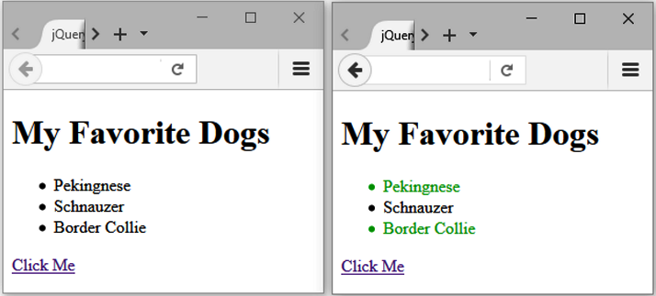
Figure 14.23 The changeme.html file displayed in a browser; the browser on the right shows the resulting web page after the “Click Me” hyperlink is clicked.

Slide 45
Using the toggle() Method
<script>
$(document).ready(function() {
$('#more').click(function(){
$('#details').toggle();
});
});
</script>

Slide 46
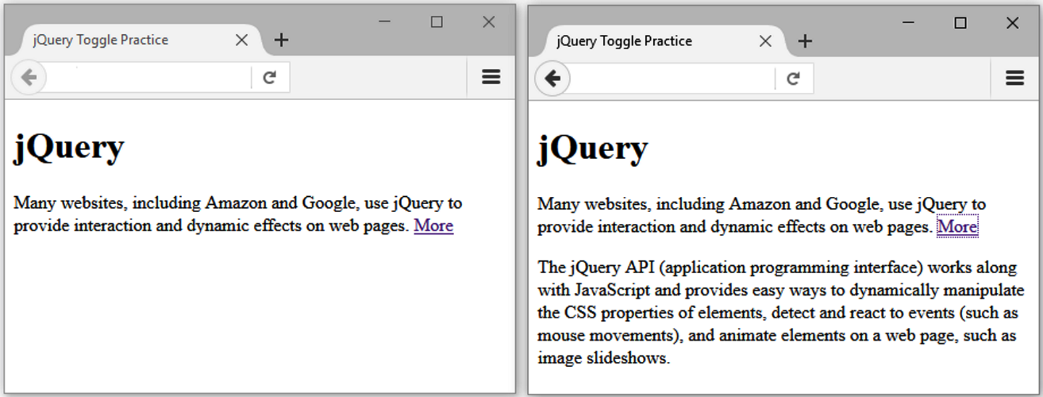
Figure 14.24 The toggle.html file displayed in a browser; the browser on the right shows the resulting web page after the “More” hyperlink is clicked.

Slide 47
jQuery Image Gallery
<script> $(document).ready(function(){ $('#gallery a').click(function(){ var galleryHref = $(this).attr('href'); var galleryAlt = $(this).attr('title'); $('figure img').attr({ src: galleryHref, alt: galleryAlt }); $('figcaption').html(galleryAlt); return false; }); }); </script>

Slide 48
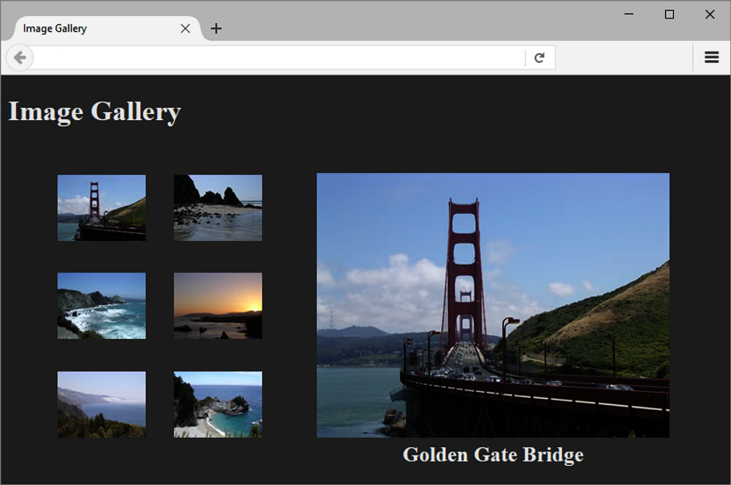
Figure 14.25 Image gallery with jQuery interactions

Slide 49
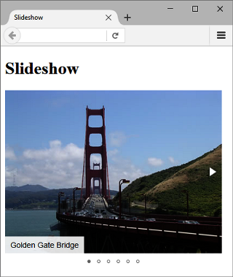
jQuery Plugin
JavaScript that extends the functionality of jQuery
http://plugins.jquery.com
MIT license: http://opensource.org/licenses/MIT
Examples:
fotorama plugin
http://fotorama.io
Validate plugin
https://jqueryvalidation.org
Figure 14.26 jQuery plugin slideshow

Slide 50
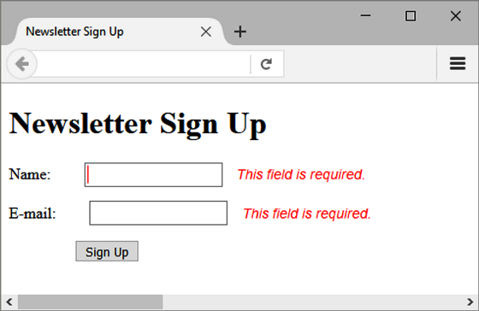
Figure 14.28 jQuery validate plugin error messages

Slide 51
Checkpoint (5 of 5)
Describe the two ways the web developers can obtain the jQuery JavaScript Library
Explain the purpose of the css() method.
Describe the purpose of the ready event.

Slide 52
Summary
This chapter introduced the use of JavaScript and jQuery on web pages.

