Slide 1

Web Development & Design Foundations with HTML5
Tenth Edition
Chapter 10
WEB DEVELOPMENT
Copyright © 2021, 2019, 2017 Pearson Education, Inc. All Rights Reserved

Slide 2
Learning Outcomes (1 of 2)
In this chapter, you will learn how to ...
Describe the skills, functions, and job roles needed for a successful web project development
Utilize the stages in the standard System Development Life Cycle
Identify other common system development methodologies
Apply the System Development Life Cycle to web development projects

Slide 3
Learning Outcomes (2 of 2)
Describe the activities in the Conceptualization, Analysis, Design, Production, Testing, Launch, Maintenance, and Evaluation stages of a website project. Compare the goals of the website to the results as part of the Evaluation phase
Describe best practices for website file organization
Find the right web host provider for your website
Choose a domain name for your website

Slide 4
Skills and Functions Needed for a Successful Large-Scale Project
Project Manager
Information Architect
User Experience Designer
Marketing Representative
Copy Writer & Editor
Content Manager
Graphic Designer
Database Administrator
Network Administrator
Web Developer / Web Designer

Slide 5
Skills and Functions Needed for a Successful Small Project
The skills and functions are essentially the same as on a large project
Each person may wear many “hats” and juggle their job roles
Example: The web designer may also be the graphic designer.
Some job roles may be outsourced
Most Common: An external web site provider is used so there is less (if any) need for a Network Administrator.

Slide 6
Project Staffing Criteria
Finding the right people to work on a project is crucial
Consider:
work experience
portfolio
formal education
industry certifications
Alternative: Outsource all or portions of the project to a web design/development firm

Slide 7
Project Job Roles
Project Manager
Information Architect
UX Designer
Marketing Representative
Copywriter & Editor
Content Manager
Graphic Designer
Web Designer
Web Developer
Front-End Web Developer
Back-End Web Developer
Database Administrator
Network Administrator

Slide 8
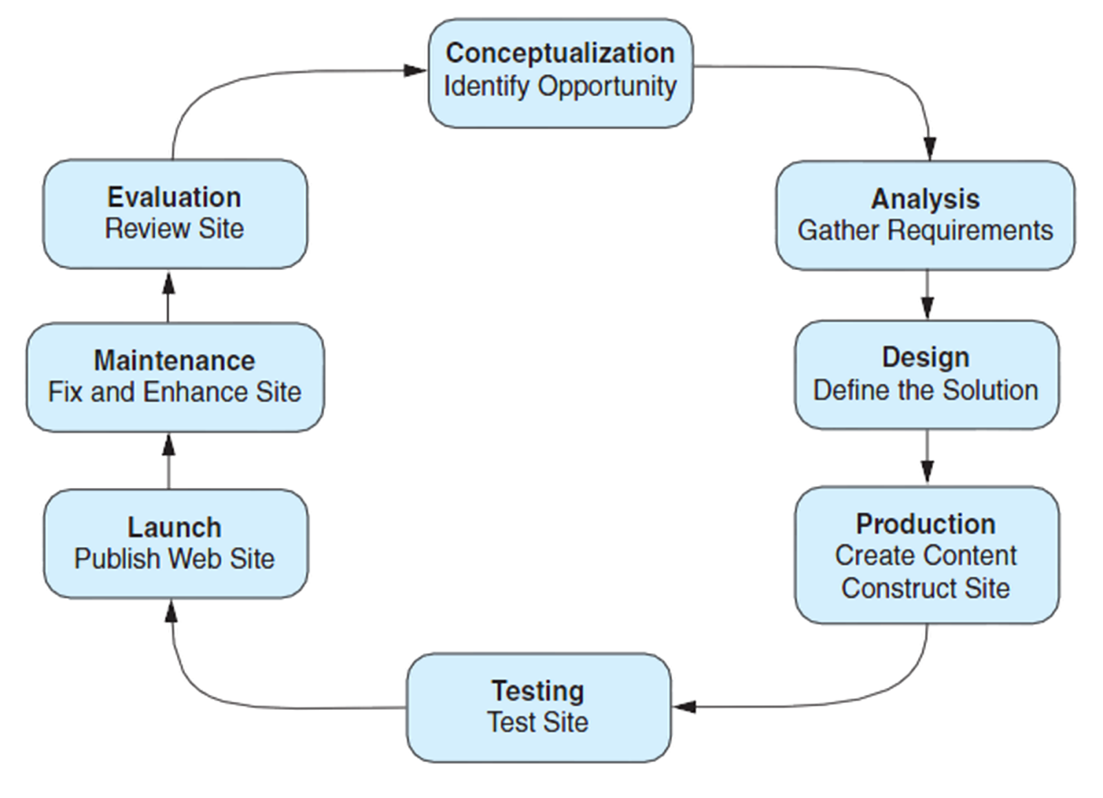
Website Development Cycle
Figure 10.2 The Website Development Cycle

Slide 9
Web Development: Conceptualization
Determine the intended audience
Determine the goals or mission of the web site
Short-term goals
Long-term goals
Develop measurable objectives such as:
Number of visitors
Percent of product sales

Slide 10
Web Development: Analysis
Determine the following:
information topics
functionality requirements (high-level)
Determine “what” a site will do – not “how” it will do it
environmental requirements
content requirements
If a redesign, compare the old approach with the new approach
Review competitor’s sites
Estimate costs
Cost/Benefit analysis

Slide 11
Web Development: Design
Determine the site organization
Prototype the design
Determine a page layout design
Document each page

Slide 12
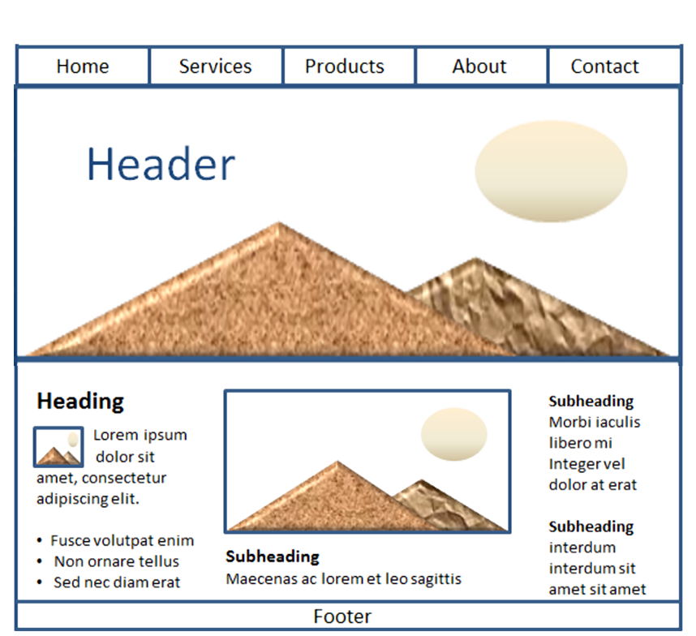
Wireframe
A sketch or blueprint of a web page
Shows the structure of the basic page elements, including:
Header
Navigation
Content
Footer
Image locations
Figure 5.35 This wireframe page layout a top navigation area and a hero image

Slide 13
Web Development: Production
Choose a web authoring tool
Organize your site files
Develop and individually test components
Add content

Slide 14
Web Development: Testing
Test on different web browsers and browser versions
Test with different screen resolutions
Test using different bandwidths
Test from another location
Test, Test, Test

Slide 15
Web Development: Types of Testing
Automated Testing Tools and Validation
Automated Testing (Link checkers, etc.)
W3C HTML and CSS validation tests
Usability Testing
Testing how actual web page visitors use a web site
Can be done at almost any stage of development
Early – use paper and sketches of pages
Design – use prototype
Production & Testing – use actual pages

Slide 16
Web Development: Approval & Launch
User or Client Testing
Client will test site before giving official approval for site launch
Approval & Launch
Obtain sign-off form or email from client
Upload files to web server
Create backup copies of files
TEST THE WEB SITE AGAIN AFTER UPLOAD!

Slide 17
Web Development: Maintenance
Maintenance – the never-ending task…
Enhancements to site
Fixes to site
New areas added to site
A new opportunity or issue is identified and another loop through the development process begins.

Slide 18
Web Development: Evaluation
Re-visit the goals, objectives, and mission of the website
Determine how closely they are being met
Develop a plan to better meet the goals, objectives and mission

Slide 19
Checkpoint (1 of 2)
Describe the role of the project manager.
Explain why so many different roles are needed on a large-scale web project.
List three different techniques used to test a website. Describe each technique in one or two sentences.

Slide 20
File Organization (1 of 2)
Relative links from the canyon.html page in the rooms folder
<a href="javelina.html">Javelina</a>
<a href="../index.html">Home</a>
<a href="../events/weekend.html">Weekend Events</a>

Slide 21
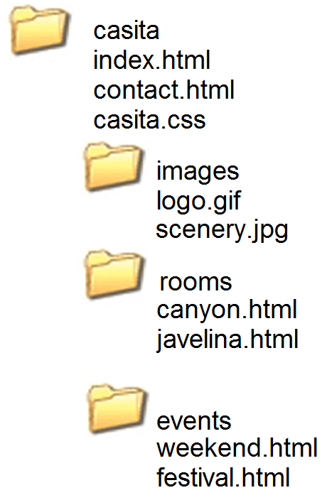
File Organization (2 of 2)
Figure 10.5 The web page files are organized in folders.

Slide 22
Domain Names
Establishes a web presence for your business or organization
New Business
choose domain name while selecting company name
Established Business
choose a domain name that relates to your established business presence

Slide 23
Choosing a Domain Name
Describe your business
Be brief, if possible
Avoid hyphens
TLD (top level domain name)
.com, .net, .biz, .us, .mobi and others
.org for non-profits
Brainstorm potential keywords
Avoid trademarked words or phrases
Know the territory (use Google!)
Verify Availability

Slide 24
Registering a Domain Name
There are many domain name registrars, including
https://register.com
https://networksolutions.com
https://godaddy.com
Visit Registrar, choose name, pay
Private registration – additional fee but personal information is kept private and out of the WHOIS database

Slide 25
Web Hosting
Some organizations administer a web server in-house and host their own website.
Many companies use a web host provider.
A good web hosting service will provide a robust, reliable home for your website.
A poor web hosting service will be the source of problems and complaints.
Do not use free web hosting for a commercial website.

Slide 26
Types of Web Hosting (1 of 3)
Hosting Needs: Small to Medium Website
Virtual Hosting
The web host provider’s server is divided into a number of virtual domains and multiple websites are set up on the same computer.

Slide 27
Types of Web Hosting (2 of 3)
Consider:
Future growth and scalability of web host
Operating System
Types of server-side processing supported
Bandwidth of Internet connection
Both local and national web host providers
Guaranteed uptime – service level agreement (SLA)
Technical support

Slide 28
Types of Web Hosting (3 of 3)
Hosting Needs: Large to Enterprise Website
Dedicated web Server
Co-located web Server
Consider:
National web host providers
Guaranteed uptime – service level agreement (SLA)
Bandwidth of Internet connection
Technical Support

Slide 29
Dedicated Web Server
Dedicated Web Server
The exclusive use of a rented computer and connection to the Internet that is housed in the web hosting company's premises.
The server can usually be configured and operated remotely from the client company or you can pay the web host provider to administer it for you.

Slide 30
Co-Located Web Server
Co-Located Web Server
A computer that your organization has purchased and configured.
Your organization effectively rents space at the web host provider's location.
Your server is kept and connected to the Internet at their location.
Your organization administers this computer.

Slide 31
Choosing a Virtual Host
See the Web Host Checklist (Table 10.1)
Operating System
Web Server Software
Bandwidth
Technical Support
Service Agreement
Disk Space
E-mail
Uploading Files
Canned Scripts
Scripting Support
Database Support
E-Commerce Packages
SSL Encryption
Scalability
Backups
Site Statistics
Domain Name
Price

Slide 32
Checkpoint (2 of 2)
Describe the type of web host that would meet the needs of a small company for their initial web presence.
Describe the difference between a dedicated web server and a co-located web server.
Explain why price is not the most important consideration when choosing a web host.

Slide 33
Summary
This chapter introduced you to the system development life cycle and its application to web development projects.
The job roles related to website development were also discussed.
An introduction to selecting a domain name and a web host was provided.

