Slide 1

Predicting
Flight Delays
Is it possible to know if your flight will be delayed before it comes up on the departure boards?
This project was taken as part of the course Machine Learning by Professor Lee-Ad Gottlieb
Autor : Dolev Abuhazira

Slide 2
Data:
The dataset comes from Kaggle, consisting of multi-year data ranging from 2009 to 2018 separated into 10 different files.
Each dataset has an average of 28 categories/features with a few million rows.
Preprocessing workflow :
Handling missing values:
Cleaning the data set from various examples that contain missing information.
Features format change:
Some features will be difficult to exploratory and analyze for example dates and IATA codes that describe the airlines,
origin, and destination airports.
Features selection:
I modeled the problem in such a way that a late flight does not take into account features that are carried out during the flight
such as wheels off, wheels on, canceled flight, etc.
Distribution of the sample space:
Since the data set contains almost 7 million records, and in addition, since the information is not balanced at all,
I used the under-sampling method which means removing observations from the majority class such that the dataset will have
an equal number of observations for each class.

Slide 3
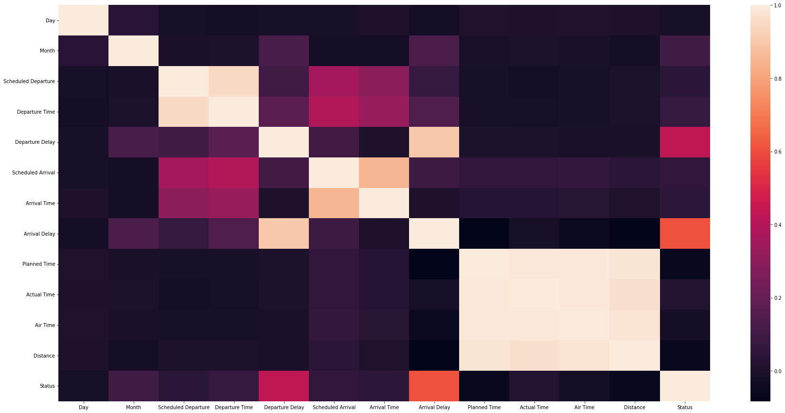
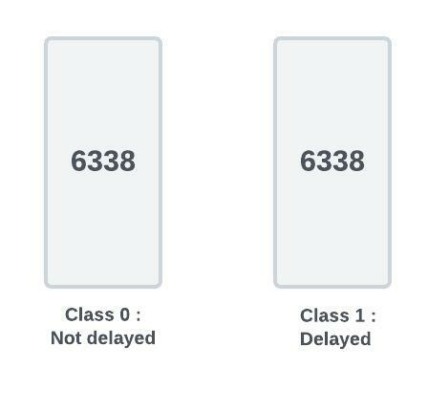
Detecting multicollinearity:
Is a situation in which linear relationships between the explanatory
variables in the sample interfere with the estimation of regression.
Therefore, in order to hold the regression assumption, I removed
Planned Time and Air Time from the data set.
Even after performing all the above methods, the data set was very large and it contained, among other things, categorical features such as origin and destination.
In order not to work with a very large data set, I chose to work on a sub-sample containing all the flights of the Virgin America airline, And to deal with the categorical features, I used the One Hot Encoding method.

Slide 4

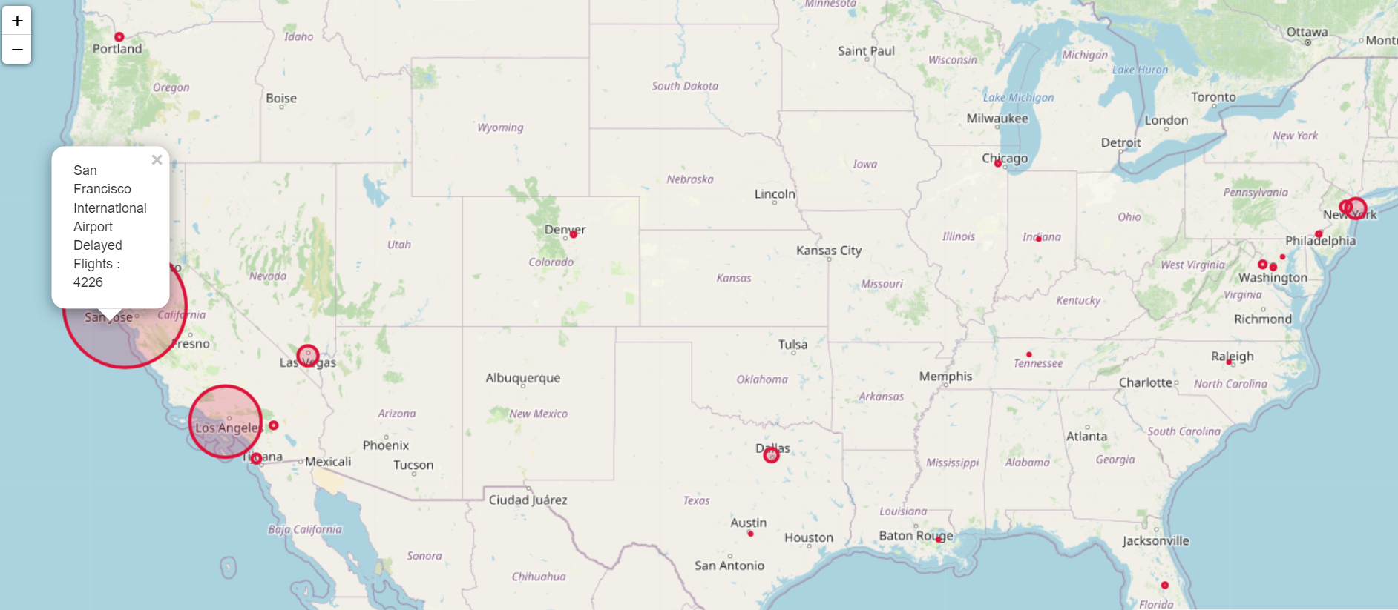
Exploratory Data Analysis:
After cleaning the data set, I did research on the new data set and tried to answer the following questions:
1 . At which airports were the most flight delays made?

Slide 5
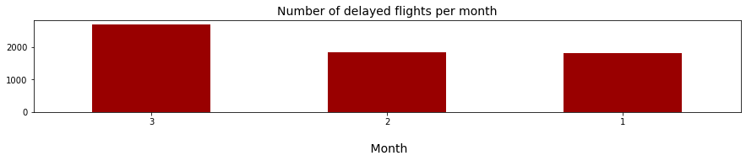
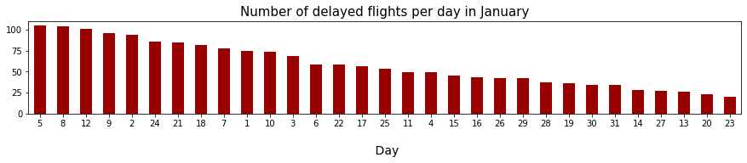
2 . In which months should fly?
For this question, I have ordered the data in such a way to describe to us which is the best month to fly,
that month will contain the lowest amount of late flights.
3 . On which day should fly?
Once we have found the month with the minimum number of delays in landings, it remains to be seen on which day it is
worthwhile to fly in that month.

Slide 6
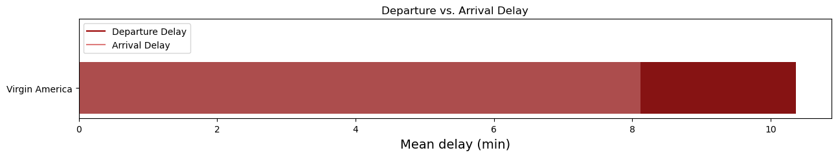
4 . Does a delay in departure effects on delay in Arrival?
For this question, I used a diagram that illustrates the differences between flight delays on departure and flight delays
on arrival according to Virgin America.
As can be seen from the diagram above, the number of delays in departure delay is much greater
then the number of delays in landings, it can be concluded that the airline reduces airtime for flights that have been delayed
on their departure to get on time.

Slide 7
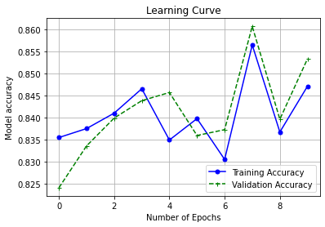
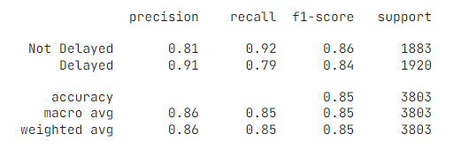
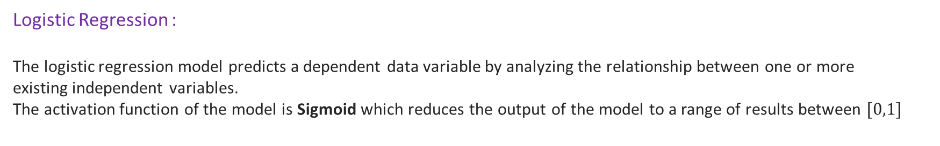
Modeling:
After performing pre-processing and exploratory analysis for the data set I used different models in machine learning that will predict whether a flight is delayed or not.
The data set was split into two groups, one is the training set which contains about 70 percent of the data set, and the other is the test set which contains about 30 percent of the data set.
Logistic Regression :
The logistic regression model predicts a dependent data variable by analyzing the relationship between one or more
existing independent variables.שמת
The activation function of the model is Sigmoid which reduces the output of the model to a range of results between $[0,1]$

Slide 8
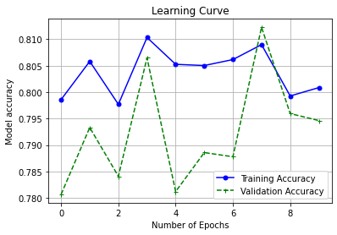
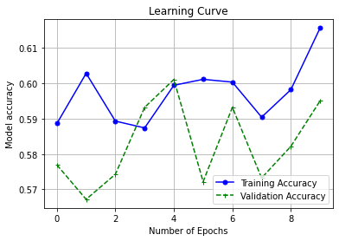
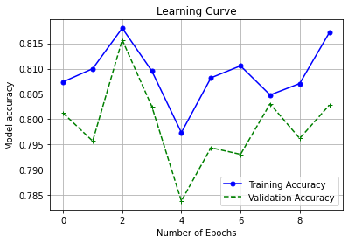
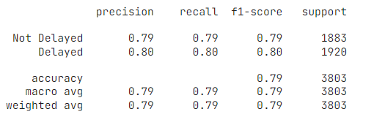
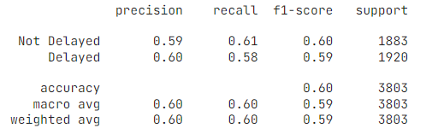
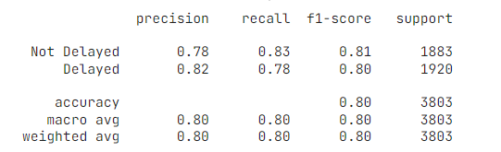
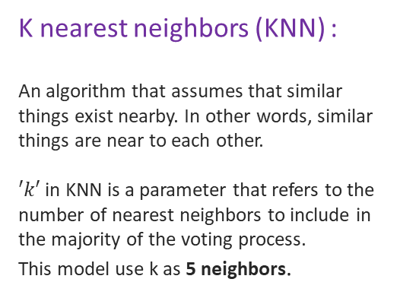
Neural Network (MLP) :
A feedforward artificial neural network generates a set of outputs from a set of inputs. An mlp is characterized by several layers of input nodes connected as a directed graph between the input and output layers.
The architecture of the network contains two hidden layers, one with the size of 128 neurons and the other with the size of 63 neurons, the activation function in all layers is the Relu function.
K nearest neighbors (KNN) :
An algorithm that assumes that similar things exist nearby. In other words, similar things are near to each other.
$′k′$in KNN is a parameter that refers to the number of nearest neighbors to include in the majority of the voting process.
This model use k as 5 neighbors.
Random Forrest :
A random forest is a meta estimator that fits a number of decision tree classifiers on various sub-samples of the dataset and uses averaging to improve the predictive accuracy and control over-fitting.

Slide 9
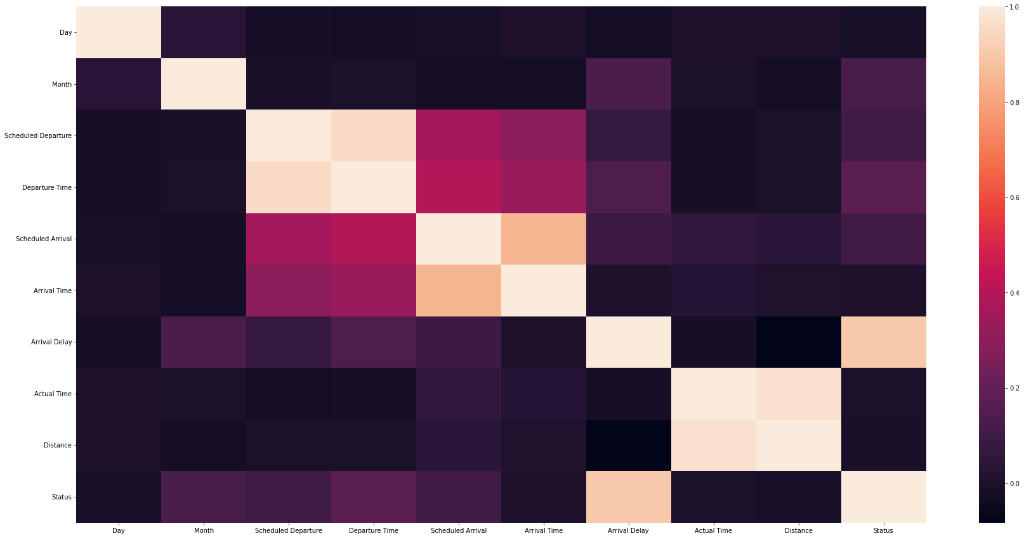
Predict Flight departure delay in minutes:
We will now present a new problem, a regression problem whereby we would like to predict the number of
minutes of flight delays during departure.
Thus our dependent variable becomes Departure Delay, and since we are dealing with a numerical value prediction problem we will use a linear regression model which looks for the different relationships between the independent variables and the dependent variable.
The model I chose to use is linear regression, in addition, I checked again whether there is a high correlation between the various features in the data set and I found that the feature Distance greatly affects the rest of the data, so I chose to remove it from the data set.

Slide 10
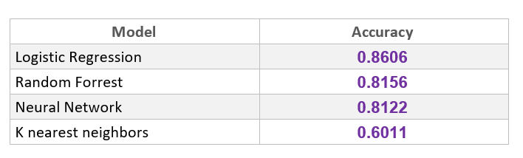
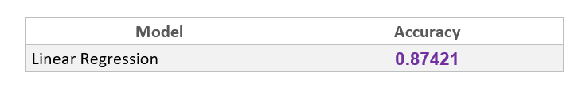
Conclusions and results :
Challenges :
The data set was very large and unbalanced, and in addition, there was a high correlation between the different features.
How can the airport and airline code names be adjusted to their original names?
How is a delayed flight defined based on the data set?
Final results for predicting flight delays :
Final results for predicting flight departure delay in minutes:

