Slide 1
Helcim Defender Transaction Fraud Detection + Merchant Fraud Detection

Slide 2
Merchant Fraud
What type of fraudsters are these?
Credit card thieves
They want to do card testing
They want to process fake cards and runaway with the deposit
Money Laundry
Transactions are ‘legitimate’, the cardholder doesn’t want to do a chargeback
Transactions are used to launder/transfer money
Illegal Transactions
Transactions are ‘legitimate’, the cardholder doesn’t want to do a chargeback
Merchant is not selling what he/she says he is (could be drugs/sex/etc)
We would implement ML right after merchant submits information ?

Slide 3
Transaction Fraud
What type of fraudsters are these?
Credit card thieves (stolen cards)
They want to test cards
They want to purchase something so that they can resell it.
7 current factors that we have – Taken From Helcim Defender
Main Focus of Presentation – Examples and concepts will be related to transaction fraud.

Slide 4
Types of Machine Learning
There are two types of Machine Learning Problems
Regression:
Predicting a real/Continuous value. For example predicting the Housing Pricing based on some set of data or predicting the percentage of getting a disease based on some feature set.
Classification:
Predicting a Category – 0 or 1;Yes or No;
Fraud? Yes? No?
Win? Yes? No?

Slide 5
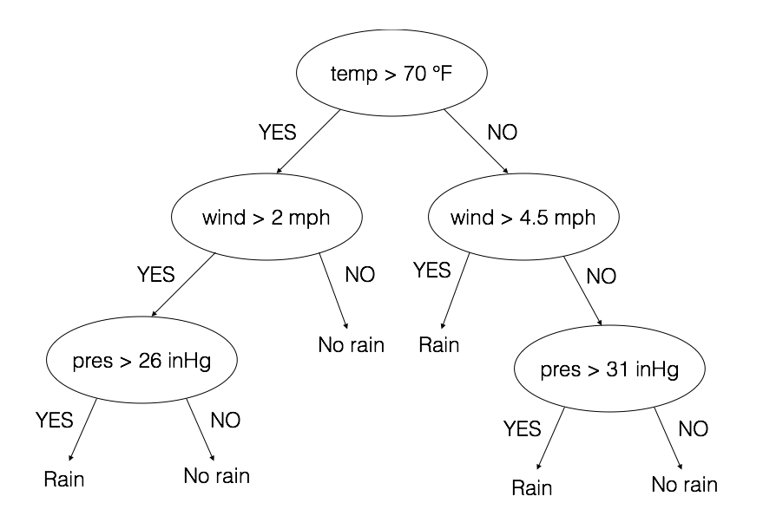
Decision Trees

Slide 6
Decision Trees + Random Forest
Random Forest Is just a collection of decision trees, hence the name forest.
Model builds multiple trees based on our features. Majority votes wins

Slide 7
Example – Kaggle Fraud Detection

Slide 8
Results:

Slide 9
Plan?
Collect Data – Get All Chargeback for all transaction – Charge Back means a fraudulent transaction?
Clean Data + Analyze all Features
Split Data into Dependent and Independent Data – For example in transaction all fields would be consider independent and the chargeback field would be the dependent.
Random Forest – Quick Analysis of number of trees to use in our RF model.
Build Initial Model:
Build Initial RF model on transactions – 80/20 Split.
Test our model on 20 split and then analyze the performance – Precision vs Recall – We want the Highest Recall
Eliminate useless data or data that has low impact on the outcome of the result.

