Slide 1
2024 Paris December
Discussion of:
Contract Completeness of Company Bylaws
and Entrepreneurial Success
By Paul Beaumont, Johan Hombert, and Adrien Matray
Discussant: Donghyun Kang (Erasmus School of Economics)

Slide 2
Direct evidence on adopting complete contracting
Key story: ‘flexible form leads to entrepreneurial success via by complete contracts’
We observe ‘new firms do choose the flexible form’
However, direct evidence is missing: do firms actually write more complete contracts?
Concern: flexible firms still stick to boilerplate bylaws
(The authors are already addressing it, fantastic!)
Why important? Helps rule out alternative explanations:
Other reform features (than bylaws) could also explain the result
Suggestion: textual analysis of bylaws
Simple Measures: Document length, Readability metrics, Word counts of contractual terms
Complex Measures: Similarity to boilerplate contracts, Classification of different types of provisions
Notes:
Compare differences between flexible & restricted

Slide 3
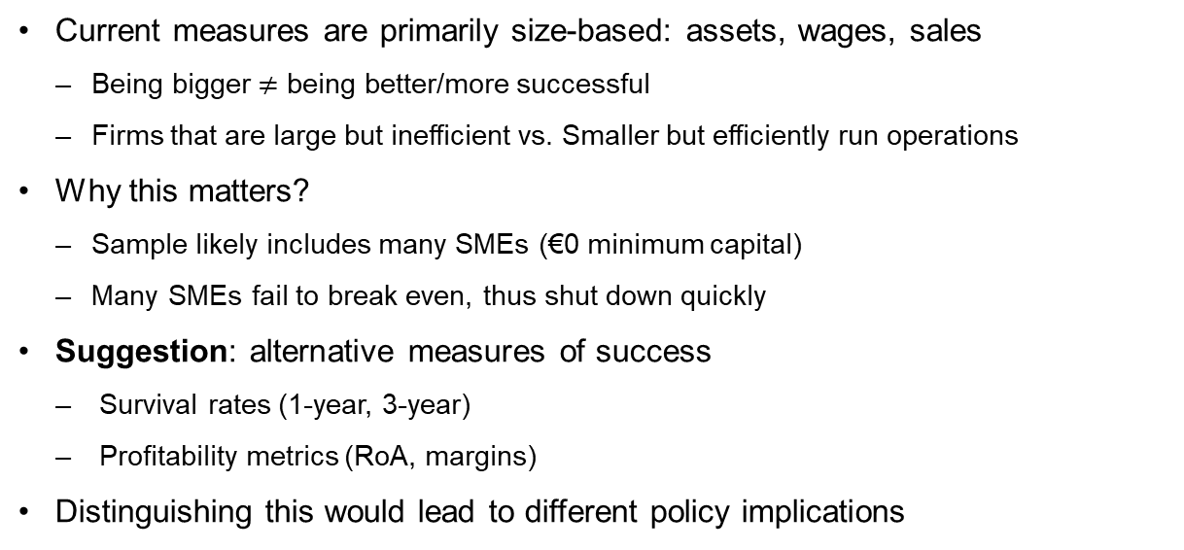
‘Success’ measures: Size vs. Performance
Current measures are primarily size-based: assets, wages, sales
Being bigger $≠$ being better/more successful
Firms that are large but inefficient vs. Smaller but efficiently run operations
Why this matters?
Sample likely includes many SMEs (€0 minimum capital)
Many SMEs fail to break even, thus shut down quickly
Suggestion: alternative measures of success
Survival rates (1-year, 3-year)
Profitability metrics (RoA, margins)
Distinguishing this would lead to different policy implications

Slide 4
Missing Channel: Debt Financing
Results show treated firms raise more equity (Table B.3)
What about debt?
SMEs primarily rely on bank financing (Nanda Philips 2023, Robb Robinson 2014)
Flexible bylaws may facilitate debt financing
If they reduce agency costs or improve creditworthiness
Alternatively, opposite effect: Partial substitution between debt and equity:
If flexible bylaws favor shareholders more than debtholders
May lead to financing riskier projects (can test with survival/profitability measures)
Suggestion: Examine changes in total debt, leverage ratios, textual analysis
Data should be available!
Notes:
If bank financing channel also works, richer implications:
As said, primary financing source for SMEs
Further support the large economic magnitude

Slide 5
Understanding Industry-Level Variation
The study exploits industry-level variation in flexible bylaws adoption
Tell us about which industries drive this variation
Suggestions
a) Descriptive Analysis: Show distribution of industry-level exposure to reform
E.g., Top/Bottom 10 industries with highest/lowest take-up
Test for concentration of effects in specific industries
b) Link to Economic Mechanisms: Test whether take-up varies with industry characteristics:
Innovation intensity, growth opportunities, business uncertainty
Hypothesis: Industries with higher uncertainty should show greater take-up than routine businesses
Tech startups vs. Restaurants
Why This Matters:
Helps understand whether effects are broad-based or concentrated
Provides evidence on mechanism
(contractual flexibility should matter more in certain industries)

Slide 6
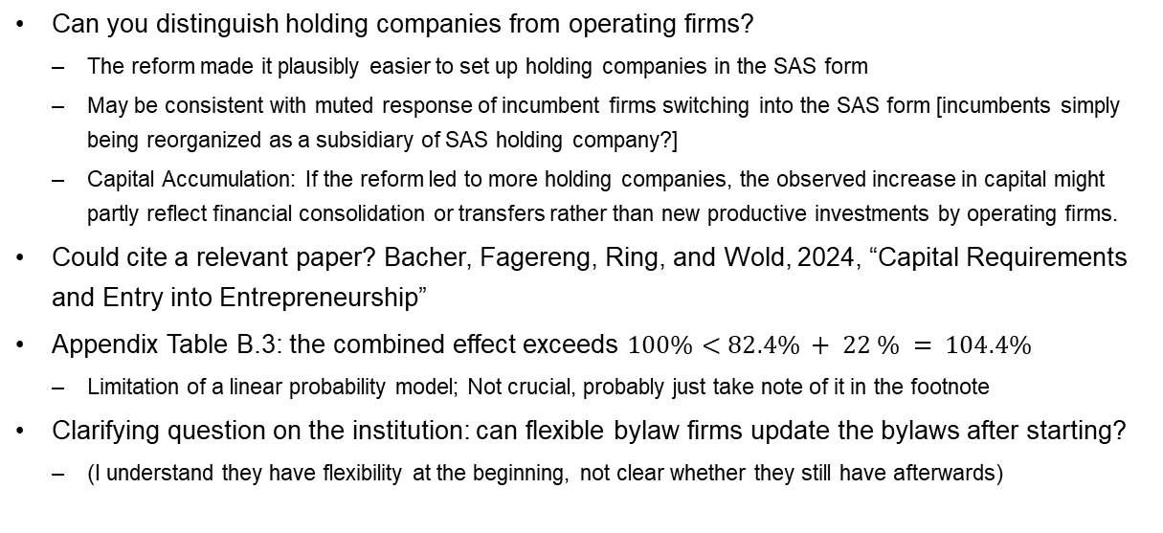
Miscellaneous comments
Can you distinguish holding companies from operating firms?
The reform made it plausibly easier to set up holding companies in the SAS form
May be consistent with muted response of incumbent firms switching into the SAS form [incumbents simply being reorganized as a subsidiary of SAS holding company?]
Capital Accumulation: If the reform led to more holding companies, the observed increase in capital might partly reflect financial consolidation or transfers rather than new productive investments by operating firms.
Could cite a relevant paper? Bacher, Fagereng, Ring, and Wold, 2024, “Capital Requirements and Entry into Entrepreneurship”
Appendix Table B.3: the combined effect exceeds $100\%<82.4\% + 22 \% = 104.4\%$
Limitation of a linear probability model; Not crucial, probably just take note of it in the footnote
Clarifying question on the institution: can flexible bylaw firms update the bylaws after starting?
(I understand they have flexibility at the beginning, not clear whether they still have afterwards)

Slide 7
Conclusion
Great paper with important policy implications
Nice empirical evidence on the real effect of company’s legal form
Clear writing + rich data + thorough discussion of institution + empirical analyses
‘Making easy for entrepreneurs to adopt complete contract improves their performance’
Few comments to strengthen the ‘contractual flexibility’ story
Direct evidence: Test how the new firms write more complete contracts
Measuring “success”: Measure performance, rather than size
Financing channel: Is it all via equity financing, or debt too?
Look forward to seeing the next version!
Thank you!

