Slide 1
2022 FMA European Conference
Discussion of:
Relationship Specific Investments with Customers and Suppliers and Credit Constraints
by Thomas David, Michael Troege, Hiep Manh Nguyen, and Hang Thu Nguyen
Discussant: Donghyun Kang (Copenhagen Business School)
July 12, 2022

Slide 2
Summary of findings
RQ: Do supplier- and customer-specific investments have different implications for the focal firm?
RSIs generate hold-up problems; supplier-RSI is riskier than customer-RSI
Model: two-stage bargaining between customer & supplier, with a chance of contract renegotiation
Mechanism: suppliers, relative to their customers, lose relatively little from a hold-up
Empirical identification: pooled OLS regression + matching approach
Supplier-RSI show negative (positive) correlation with leverage (difficulty to bank loans)
Customer-RSI show no (no) correlation with leverage (difficulty to bank loans)
Data: 2010, 2012, 2014 surveys on SMEs from Vietnam
Contribution
Investment policy in the presence of stakeholders (e.g., Banerjee, Dasgupta, and Kim (2008))
Notes:
Data: 2010,2012,2014 surveys on small and medium-sized enterprises (SMEs) from Vietnam
Average sales: 8,062 mil VND (0.34 mil USD)
Cf) Vietnam GDP per Capita in 2012: 36 mil VND (2,200 USD)

Slide 3
Institutional setting → incomplete contract
“Firms investing with their suppliers face higher risk of a hold-up”
Why can't the parties contract it out?
Small firms have limited financial resources to hedge against hold-ups
Vietnamese law allows renegotiation of contracts, under unforeseeable circumstances ➔ makes long-term contracts harder
But this is also a concern for external validity
If firms have enough financial resources (e.g., bigger size, well-developed financial markets), then hold-ups would be less worrying
Outside Vietnam, firms can more easily mitigate hold-ups by … entering into long-term contracts etc.

Slide 4
Identifying the equilibrium response
Corollary: ‘supplier RSI is ex post riskier (relative to customer RSI)’
Equilibrium response: firms will ex ante avoid supplier RSI
Those who still do it are likely to
Have weak bargaining power against the supplier (e.g., small size, and likely financially constrained)
Is the identification strategy suitable to test the model’s prediction?
In equilibrium, simple regressions capture the ex-ante response
Supplier RSI, a proxy for weak-power firms, positively correlates with financial constraints
Correlation doesn’t support ex-post prediction, ‘supplier RSI increases financial constraints’

Slide 5
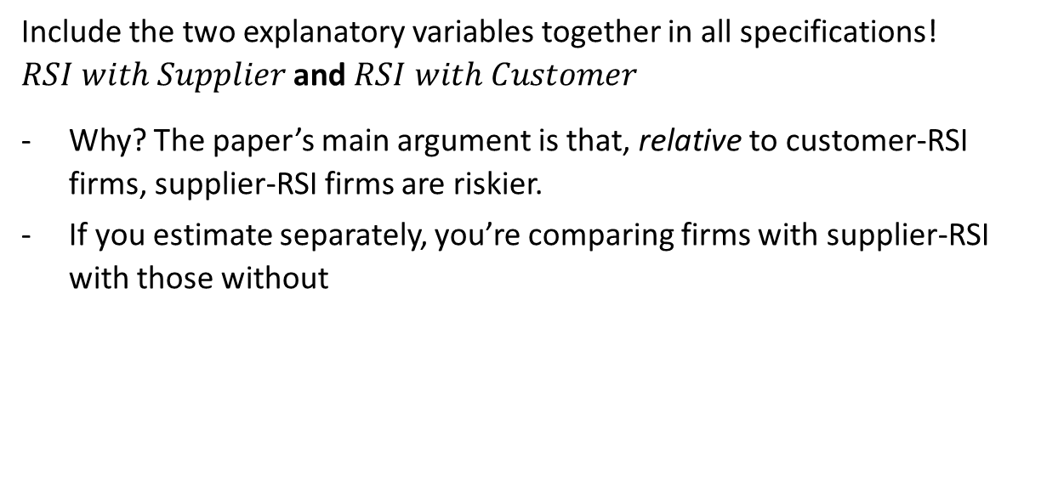
Empirical specification
Include the two explanatory variables together in all specifications! $RSI with Supplier$ and $RSI with Customer$
Why? The paper’s main argument is that, relative to customer-RSI firms, supplier-RSI firms are riskier.
If you estimate separately, you’re comparing firms with supplier-RSI with those without

Slide 6
External validity: Why Vietnam?
Does the survey data provide a better measure for RSI?
It seems so, emphasize it!
Other papers seem to use indirect/estimated proxies (e.g., Kale and Shahrur (2007), Costello 2013, Dass, Kale, and Nanda (2015))
Is it the best dataset to study RSI?
Only 6-8% firms in the sample do some form of RSI
Conditional on investment (50% of sample) → increases 2x
Provide other reasons why the level is relatively low
E.g., Vietnamese law and small firm size

Slide 7
Banks’ lending decision
Unclear to me whether and how banks can observe RSI of a borrowing firm
RSI is defined as: “investments in production and/or information technology and human capital upgrading” that are specific to a supplier or customer
Sounds difficult for banks to observe/verify
Also, firms have no incentive to reveal the level of RSI
If banks cannot, the observed difference in bank lending (Table 5) may not come from RSI intensity, but something else related, but more observable factors: supplier- and customer-concentration

Slide 8
Other comments
Data
Vietnam has 58 provinces + 5 municipalities (Ho Chi Minh, Hanoi Cities etc.). What are the chosen 9 ones, and why? Do they include developed regions?
What are the criteria to be included in the survey? Size, sales threshold? Need to know which firms are included/excluded
Empirics
Try include geographic region-fixed effects (9 provinces in the sample); don’t know how heterogeneous the provinces are, but better be conservative
Why matched sample analyses (e.g., Tables 7-10) have so few observations?
e.g., RSI only with supplier: 119 firm-year observations?
Other points
Customer RSI vs. Client RSI: stick to one wording
Provide baseline descriptives: Firms with RSIs vs. not

Slide 9
Conclusion
Great paper highlighting the diff between customer- and supplier-RSI on focal firms
Combines theory and empirics
Model is intuitive and the mechanism is clear
Exploits a novel measure of RSI, decomposed into customer- and supplier-specific investments
My comments are mainly about identification and external validity
Sharpen identification and motivate better why Vietnamese SMEs’ data
Look forward to seeing the next version!

