Slide 1

Super modern service
ykusnwp

Slide 2
Stages
Binder
Initialize
Server object, Filter object allocation
Prepare address-leak
Prepare .got overwrite
libc.so.6 address leak
.got overwrite

Slide 3
Binder https://elinux.org/Android_Binder
Binder is Android-specific inter-process communication mechanism, and remote method invocation system.
Simply, we can call it IPC/RPC

Slide 4
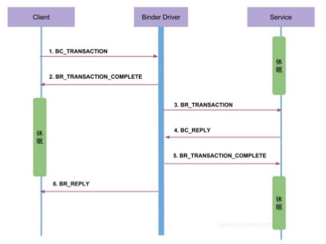
Binder - Protocol
Notes:
Binder protocol 설명.

Slide 5
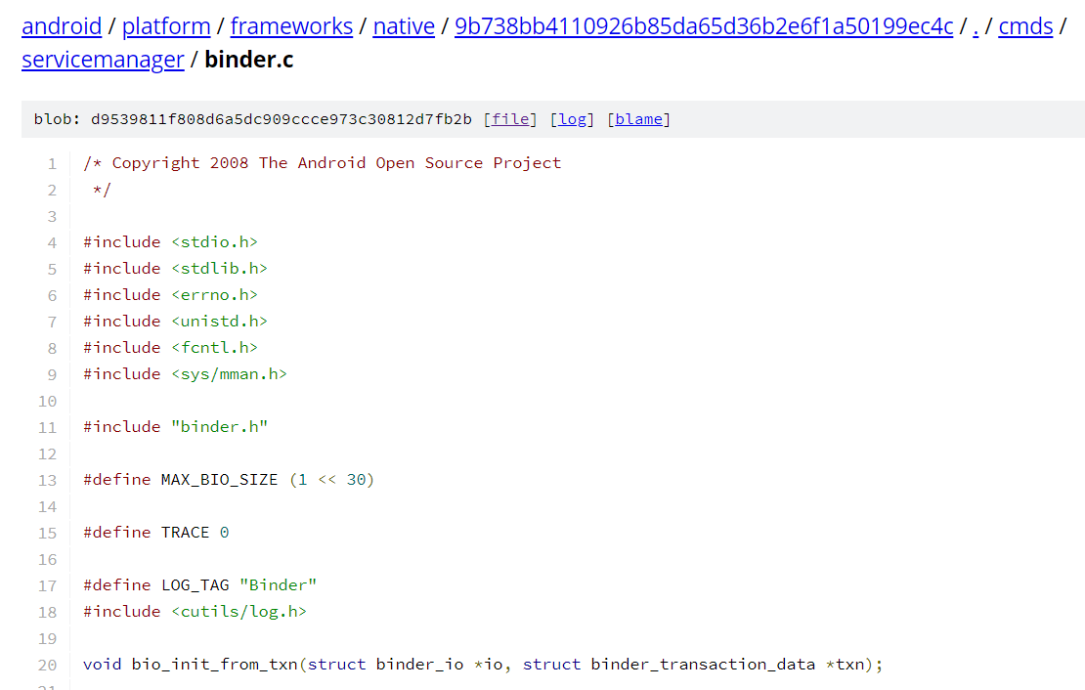
Binder - Protocol implementation
We already have protocol implementation code written by google.☺

Slide 6
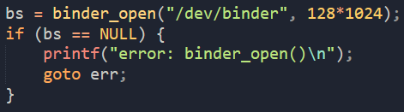
Initialize
open /dev/binder
Call mmap with fd.

Slide 7
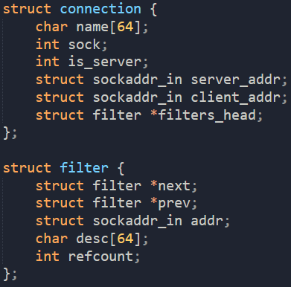
Server object, Filter object allocation

Slide 8
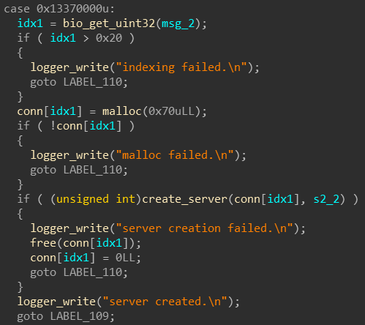
Server object, Filter object allocation
Binder shared mem
Low
uint32
uint32
uint32
string16
High

Slide 9
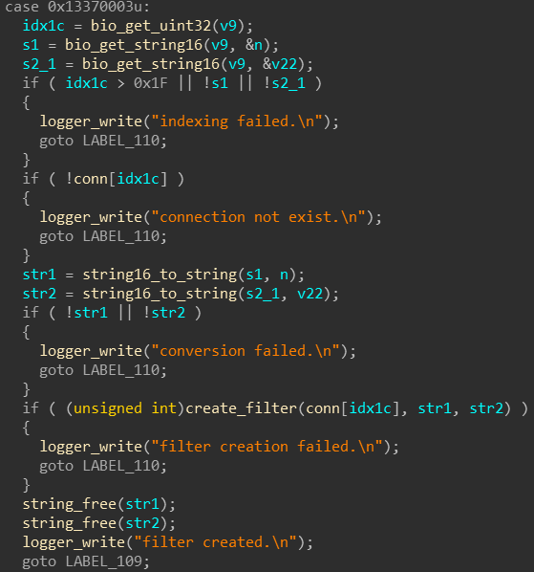
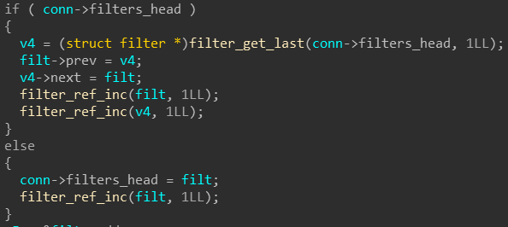
Server object, Filter object allocation

Slide 10

Server object, Filter object allocation

Slide 11
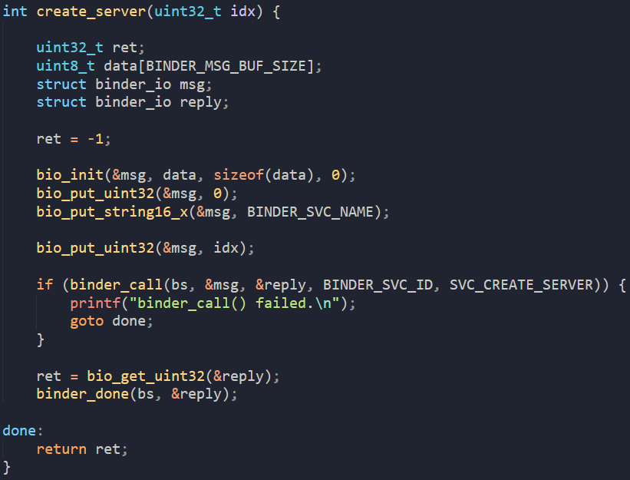
Server object, Filter object allocation

Slide 12
Server object, Filter object allocation

Slide 13
Server object, Filter object allocation

Slide 14
Server object, Filter object allocation

Slide 15
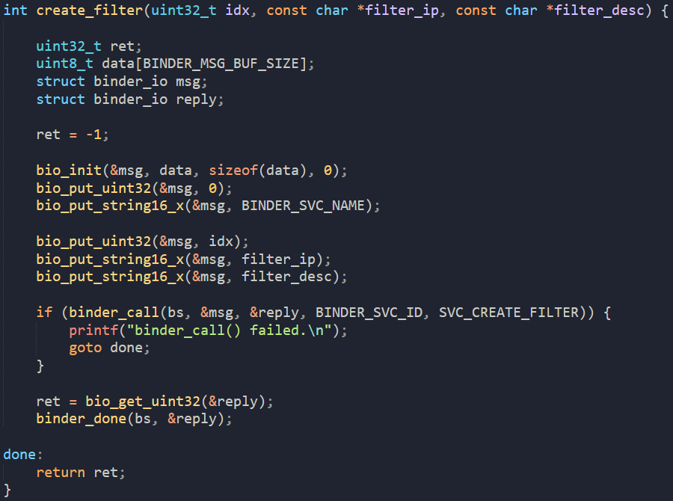
Server object, Filter object allocation

Slide 16
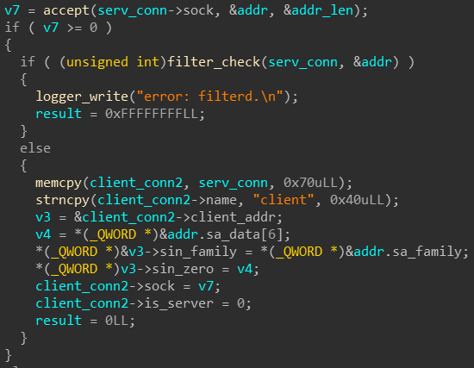
Prepare address-leak & .got overwrite
Notes:
Client_connect 함수

Slide 17
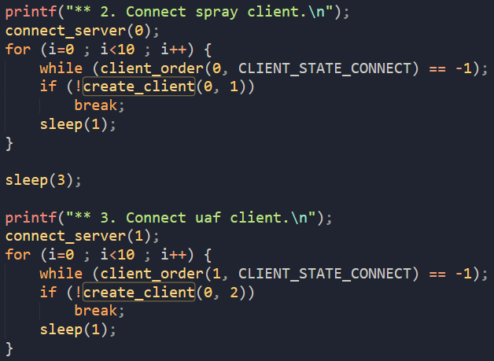
Prepare address-leak & .got overwrite

Slide 18
libc.so.6 address leak - use-after-free
Server Object 1
Filter Object
idx=0
Client Object 1
Client Object 2
Filter Object
Filter Object
idx=1
idx=2

Slide 19
libc.so.6 address leak - use-after-free
Server Object 1
Filter Object
Same heap buf
idx=0
Client Object 1
Client Object 2
Filter Object
Filter Object
idx=1
idx=2

Slide 20
libc.so.6 address leak - use-after-free
Server Object 1
Filter Object
Dangling
pointer
idx=0
Client Object 1
Client Object 2
Filter Object
Filter Object
idx=1
idx=2

Slide 21
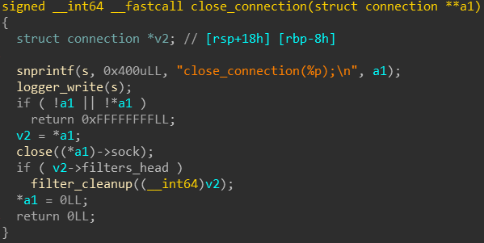
libc.so.6 address leak - use-after-free

Slide 22
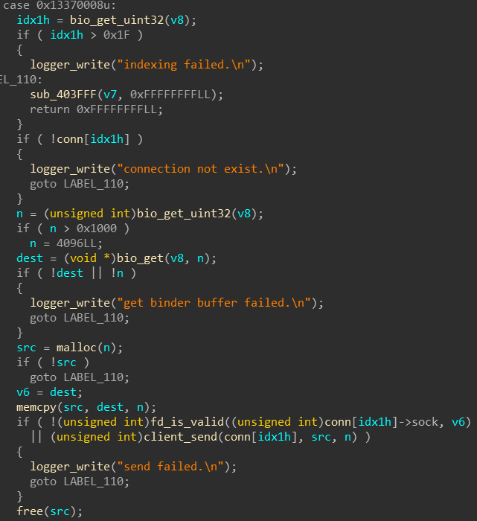
2.
1.
Notes:
Client_send -> 소켓으로 연결된 클라이언트로 데이터 전송.

Slide 23
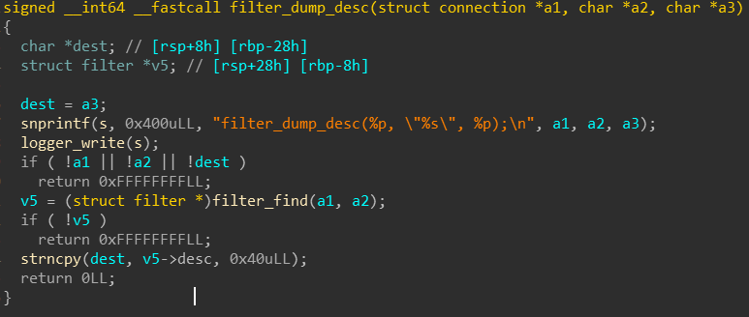
libc.so.6 address leak - use-after-free

Slide 24
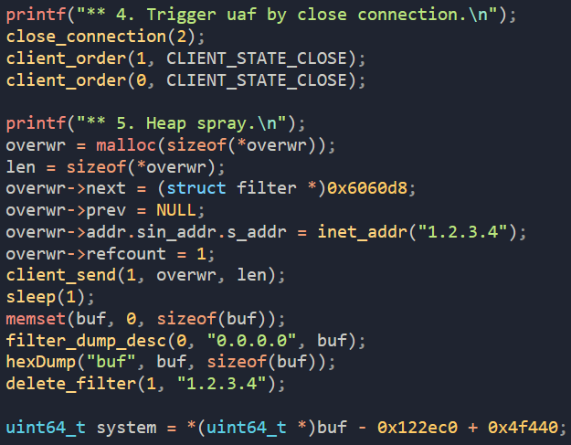
libc.so.6 address leak

Slide 25
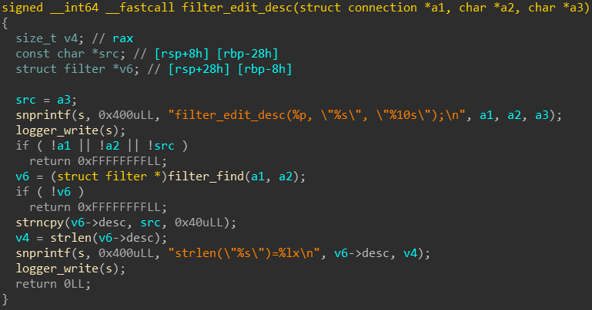
.got overwrite
`

Slide 26
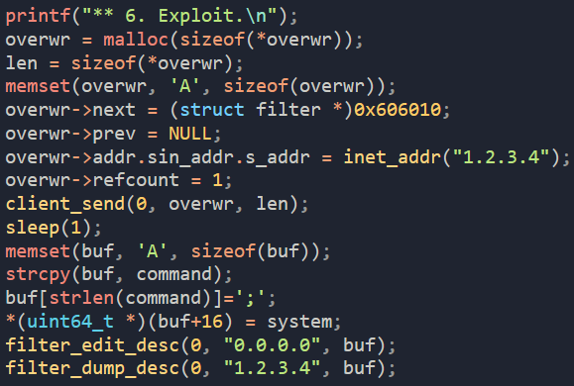
.got overwrite

Slide 27
Any questions? ykusnwp

