Slide 1
Talk About Java

Slide 2
Agenda
Why Java
Lombok
Spring Data JPA
Spring Boot
Conclusion
Q & A

Slide 3

Do you like Java ?

Slide 4
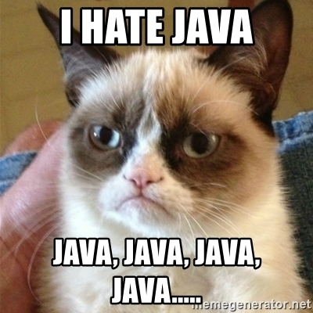
Why no Java ?
Getter / Setter
Heavy
Hard
Framework
Speed
No Reason

Slide 5
Lombok
No more Getter / Setter
No more log declare
Link
https://projectlombok.org/features/all
Demo
@Data
@Log
@Builder

Slide 6
Spring Data JPA
Generic DAO
Define interface function
Consistent Naming Convention
List<Person> findByEmailAddressAndLastname(EmailAddress emailAddress, String lastname);
List<Person> findDistinctPeopleByLastnameOrFirstname(String lastname, String firstname);
List<Person> findByLastnameOrderByFirstnameAsc(String lastname);
List<Person> findByLastnameAndFirstnameAllIgnoreCase(String lastname, String firstname);
Link
Query Keyword Doc
Demo

Slide 7
Spring Boot
No XML at all
Quick up
Embedded Tomact, Jetty or Undertow
HTTP endpoints to get detailed metrics
Link
https://start.spring.io/
http://springboot.fun/
Demo

Slide 8
Conclusion
In most cases：Java
Platform：React.js
Backend：Maybe some Golang
Next
Spring 5 Reactive Programming
RXJAVA
Spring Cloud

Slide 9
Q & A

