Slide 1
VLC下載
https://www.videolan.org/vlc/index.zh_TW.html

Slide 2
FFMPEG下載
https://www.ffmpeg.org/

Slide 3
VLC轉檔

Slide 4
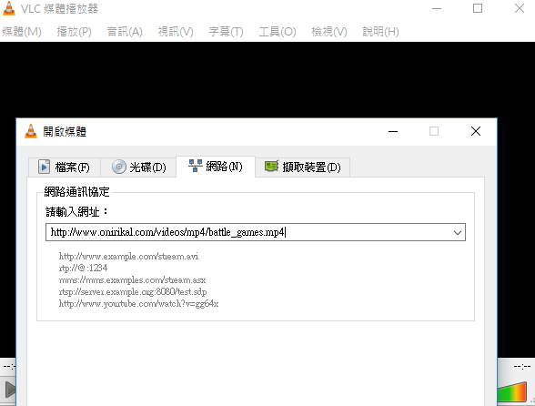
http://www.onirikal.com/videos/mp4/battle_games.mp4

Slide 5
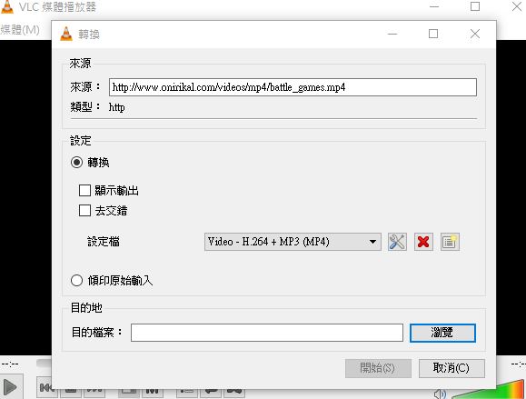

Slide 6
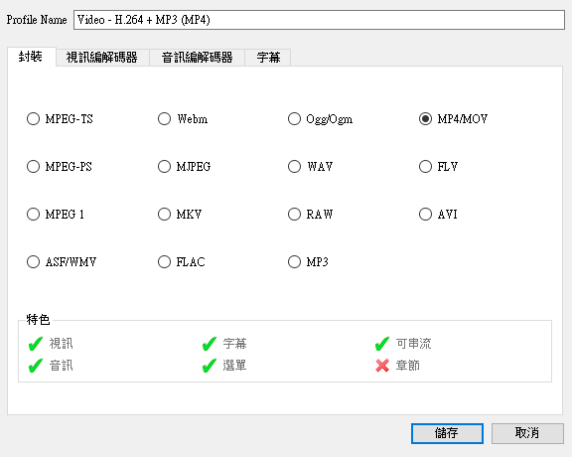

Slide 7
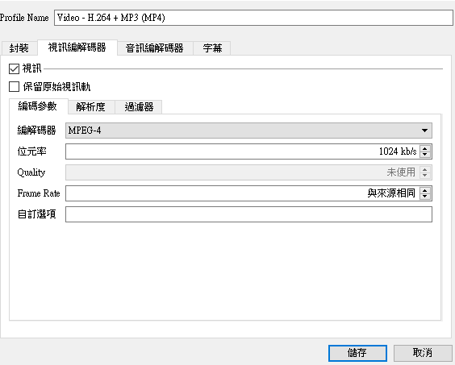

Slide 8


Slide 9
VLC串流

Slide 10
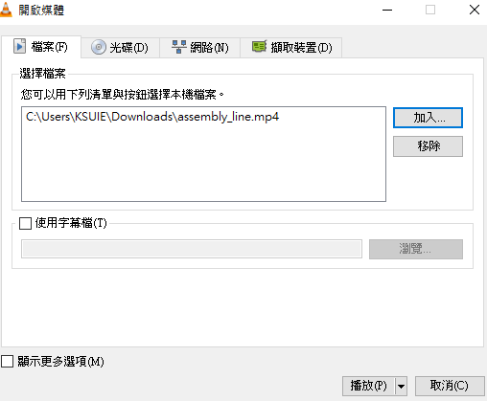

Slide 11
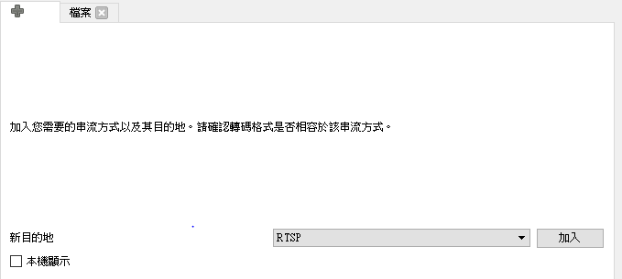

Slide 12
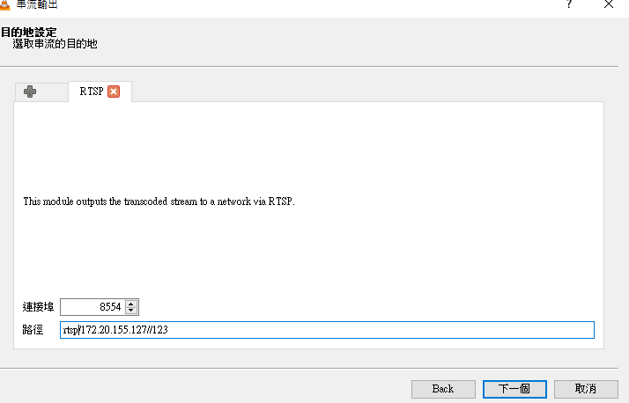

Slide 13
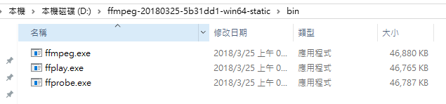

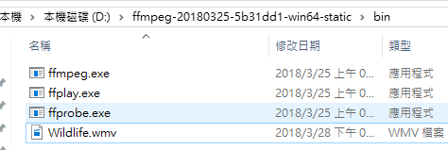

Slide 14
