Slide 1
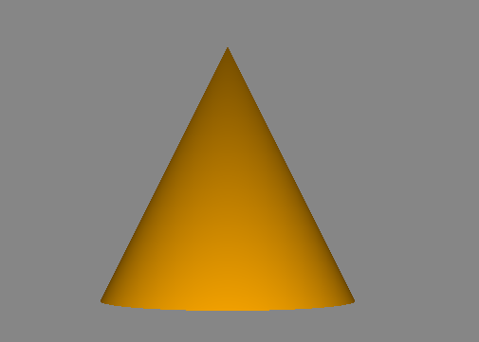
A simple voxelent scene
view
var view; function runVoxelentApp(){ view = vxl.api.setup('view-1');
vxl.api.loadAssets('cone2.json');
view.start();
}
<body onload='runVoxelentApp()'>
Scene
Actor (cone.json)
AssetManager
Model(cone.json)

Slide 2
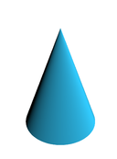
y
[2,3,4]
[10,3,4]
x
position
focal point
z

Slide 3
Orbiting rotation around the focal point
Tracking rotation around the camera position
position
focal point
position
focal point
var c = vxl.c.camera;
c.setType(vxl.def.camera.type.ORBITING)
c.setElevation(30)
var c = vxl.c.camera;
c.setType(vxl.def.camera.type.TRACKING)
c.setElevation(30)

