Slide 1
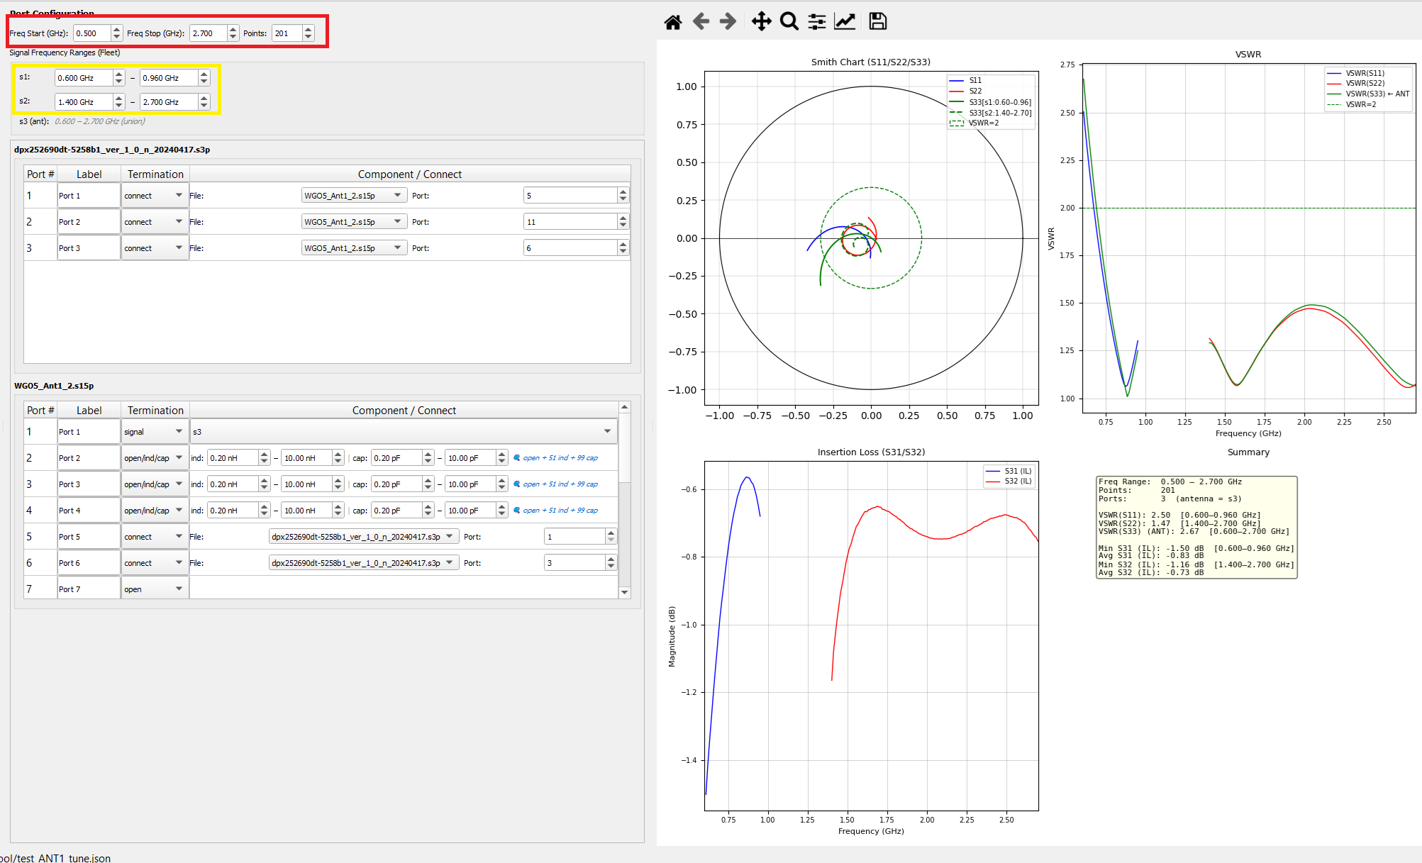
RF Network Cascade Tool
GUI operation guide for S-parameter cascade, BOM tuning, and Fleet optimization
- Audience: RF front-end engineers and tool users
- Goal: operate the tool confidently from file load to final report
- Visuals: local GUI/result images from the project workspace
RF Network Cascade Tool operation guide | Slide 1

Slide 2
1. Main GUI Layout
- Left: Loaded S-Parameter Files
- Center: Port Configuration and frequency controls
- Right: Smith Chart, VSWR, Insertion Loss, and Summary
- Toolbar: Run Cascade, Export SNP, Run Fleet, Save Config, Load Config
Loaded files
Port configuration
Results
Add/remove Touchstone files
Frequency, port roles, BOM parts
Smith, VSWR, IL, Summary
RF Network Cascade Tool operation guide | Slide 2

Slide 3
2. Load Touchstone Files
- Click Add Files... in the left panel
- Select one or more .snp files: .s2p, .s3p, .s4p, .s10p, .s12p, and similar
- Check that each file appears with the correct port count
- Select a file to configure its port rows in the center panel
Add Files...
Remove Selected
filename.sNp (N ports)
RF Network Cascade Tool operation guide | Slide 3

Slide 4
3. Configure Port Roles
- Edit Label if a port name helps the audience understand the topology
- Use Termination for open, short, capacitor, inductor, connect, signal, or Fleet sweep modes
- Keep unused ports as open or short based on the RF design
- Assign external I/O ports as s1, s2, s3, or s4
Port # | Label | Termination | Component / Connect
1 | TX | signal | s1
2 | Match | open/ind | 0.2-4.7 nH
3 | Link | connect | Filter_A port 1
RF Network Cascade Tool operation guide | Slide 4

Slide 5
4. Fixed Components vs Fleet Sweep
- capacitor / inductor: pick one fixed BOM component; Fleet treats it as locked
- open/ind, open/cap, open/ind/cap: sweep from an open baseline
- short/ind, short/cap, short/ind/cap: sweep from a short baseline
- Use nH and pF min/max fields to constrain the search space
Fixed
capacitor / inductor
Single locked BOM part
Open sweep
open/ind/cap
Try BOM values from open baseline
Short sweep
short/ind/cap
Try BOM values from short baseline
RF Network Cascade Tool operation guide | Slide 5

Slide 6
5. Connect Ports Between Files
- Choose connect when one port must be wired to another loaded network
- Select target File and target Port in the dynamic control area
- Configure the opposite port back to the original file and port
- Symmetric connections are required for a trustworthy cascade result
File A port 2
<---->
File B port 1
Both ends must point to each other
RF Network Cascade Tool operation guide | Slide 6

Slide 7
6. Signal Ranges and Antenna Rule
- At least s1 and s2 are required before Run Cascade and Run Fleet are enabled
- Signal indices must be consecutive: s1/s2, then s3, then s4
- The highest signal index is treated as the antenna port
- Set Start GHz and Stop GHz per non-antenna signal; antenna uses the union range
s1: 1.700 - 2.200 GHz
s2: 2.300 - 2.700 GHz
s3 (ant): 1.700 - 2.700 GHz union
RF Network Cascade Tool operation guide | Slide 7

Slide 8
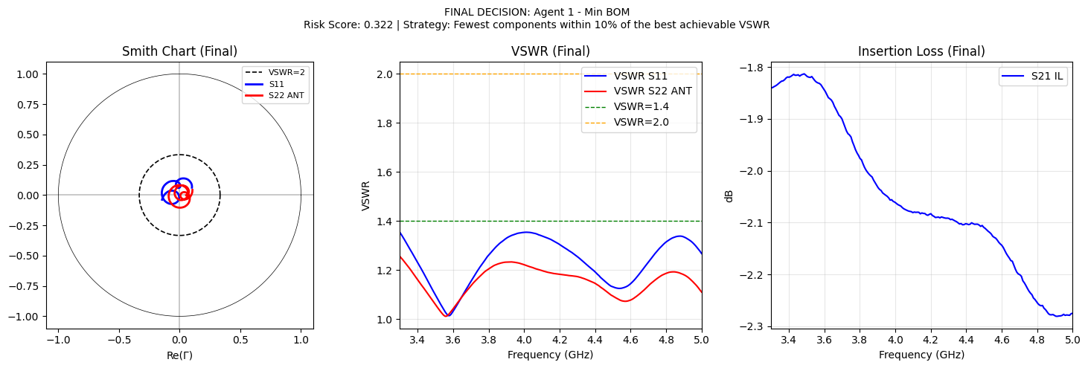
7. Run Cascade and Read Results
- Click Run Cascade after files, connections, and signal ports are valid
- Smith Chart shows reflection traces with a VSWR=2 reference circle
- VSWR plot confirms match quality across each signal band
- IL plot shows transmission from signal paths to the antenna port
RF Network Cascade Tool operation guide | Slide 8

Slide 9
8. Save, Load, and Export
- Save Config writes the full setup to JSON
- Load Config restores files, port roles, components, connections, and signal ranges
- Export SNP is enabled only after a successful cascade
- Saved .snp paths are absolute; update paths if the project is moved
Save Config -> setup.json
Load Config <- setup.json
Export SNP -> cascade_result.sNp
RF Network Cascade Tool operation guide | Slide 9

Slide 10
9. Run Fleet Optimization
- Click Run Fleet to open the Fleet Progress dialog
- Fleet only sweeps ports configured as open/* or short/* sweep modes
- Fixed capacitor and inductor selections stay locked during optimization
- The dialog shows tunable ports, sweep progress, agent summaries, risk scores, and final output path
- Close becomes available when the optimizer finishes or reports an error
Run Fleet
Open progress dialog
Tunable ports
List open/* and short/* rows
Progress log
Sweep, agents, scores
Close
Enabled after finish/error
RF Network Cascade Tool operation guide | Slide 10

Slide 11
10. Before Clicking Run Fleet
- Save Config first so the original setup can be restored after tuning
- Mark tunable ports with open/ind, open/cap, open/ind/cap, short/ind, short/cap, or short/ind/cap
- Limit each tunable port with realistic nH and pF ranges to reduce search time
- Confirm BOM folders are available and the live candidate counts are not zero
- Confirm at least s1 and s2 are defined, consecutive, and frequency ranges overlap the .snp data
1. Save Config
2. Set sweep modes
3. Constrain ranges
4. Check BOM counts
5. Check signal bands
RF Network Cascade Tool operation guide | Slide 11

Slide 12
11. What Fleet Does Internally
- Phase 1: build the base network and identify all tunable ports
- Phase 1: create candidate lists from BOM files, including the baseline open or short option
- Phase 1: sweep all component combinations and evaluate valid cascades
- Phase 2: run five strategy agents against the shared sweep results
- Phase 3: compute normalized production risk scores and choose the lowest-risk winner
- Phase 4: save JSON, plots, comparison chart, final decision plot, and Markdown report
Phase 1
Phase 2
Sweep BOM combinations
Run five strategy agents
Phase 3
Phase 4
Score production risk
Save plots and reports
RF Network Cascade Tool operation guide | Slide 12

Slide 13
12. Five Agent Strategies
- Agent 1 - Min BOM: choose the fewest components within 10 percent of the best achievable VSWR
- Agent 2 - Balance: trade off low VSWR and low insertion loss
- Agent 3 - Min VSWR: strictly minimize peak VSWR across signal ports
- Agent 4 - Smith Contour: prefer the tightest Smith-chart cluster near center
- Agent 5 - Min IL: maximize transmission by minimizing insertion loss
A1
Min BOM
fewest parts near best VSWR
A2
Balance
VSWR plus IL
A3
Min VSWR
lowest peak VSWR
A4
Smith
tightest contour
A5
Min IL
best transmission
RF Network Cascade Tool operation guide | Slide 13

Slide 14
13. How Risk Score Is Decided
- Lower Risk Score is better; the Principal agent selects the lowest value
- Score blends normalized metrics so no single raw unit dominates
- 30 percent: worst VSWR under +/-5 percent tolerance
- 25 percent: component count, because simpler BOMs are lower production risk
- 20 percent: VSWR sensitivity under tolerance
- 15 percent: insertion loss penalty, and 10 percent: VSWR spread between ports
Risk Score = weighted normalized sum
0.30
Worst VSWR under +/-5% tolerance
0.25
Component count
0.20
VSWR sensitivity
0.15
Insertion loss penalty
0.10
VSWR spread
RF Network Cascade Tool operation guide | Slide 14

Slide 15
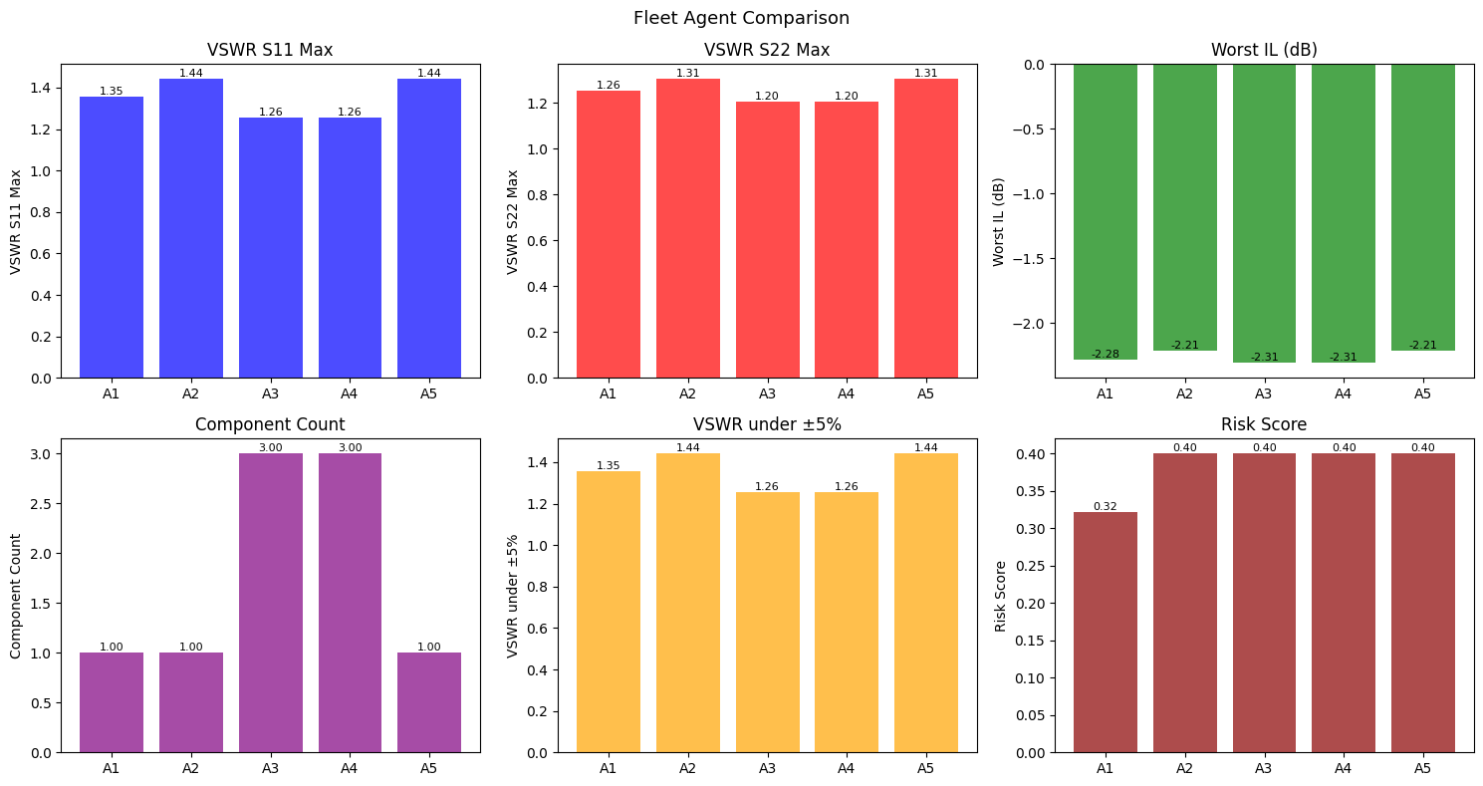
14. Read fleet_comparison.png
- Use this chart to compare all five agents side by side
- VSWR S11 Max: worst match across non-antenna signal ports; lower is better
- VSWR S22 Max: antenna/common-port VSWR across the union of signal bands; lower is better
- Worst IL (dB): most negative transmission value; closer to 0 dB is better
- Component Count: number of non-baseline assigned parts; lower is usually safer
- Risk Score: final combined ranking metric; lowest bar is the production recommendation
RF Network Cascade Tool operation guide | Slide 15

Slide 16
15. Read final_decision.png
- The title names the winning agent, risk score, and strategy
- Smith Chart shows the final reflection loci; traces closer to center indicate better match
- Dashed reference circles/lines help identify VSWR targets such as 1.4 and 2.0
- VSWR plot verifies pass/fail behavior across the selected frequency ranges
- IL plot shows each signal-to-antenna path; flatter and closer to 0 dB is better
RF Network Cascade Tool operation guide | Slide 16

Slide 17
16. Read JSON and fleet_report.md
- agent_N_result.json records each agent's selected assignments and metrics
- assignments show network_id, port_index, final term_type, component_name, and component_path
- fleet_report.md starts with the Winner, Strategy, Risk Score, and selection reason
- The comparison table is the fastest way to explain tradeoffs in a design review
- Final Component Assignments is the list to copy back into the GUI or BOM tuning record
agent_N_result.json: exact chosen assignments
agent_N_*.png: per-agent Smith/VSWR/IL
fleet_comparison.png: compare strategies
final_decision.png: winning plots
fleet_report.md: design-review summary
RF Network Cascade Tool operation guide | Slide 17

Slide 18
17. Run Fleet Troubleshooting
- Run Fleet disabled: define consecutive signal ports starting at s1 and s2
- No tunable ports: change at least one port to an open/* or short/* sweep mode
- Empty or slow sweep: tighten nH/pF ranges and confirm BOM folders are populated
- Empty plots or no valid configurations: check signal frequency ranges overlap all loaded .snp files
- Unexpected winner: compare risk score, component count, VSWR tolerance, and IL rather than one metric alone
Disabled
fix signal indices
No tunables
use open/* or short/*
Slow
tighten ranges
No data
check band overlap
Winner surprise
read risk tradeoff
RF Network Cascade Tool operation guide | Slide 18

Slide 19
18. Operator Checklist
- BOM folders must sit beside the source/project or packaged executable
- Signal indices must be unique and consecutive across all loaded files
- Frequency ranges must overlap the .snp simulation grid
- Save the starting config before Fleet because optimization can change active assignments
- Re-run Fleet when more confidence is needed in the random subset sweep
[ ] BOM folders found
[ ] Signals unique
[ ] Bands overlap data
[ ] Config saved
[ ] Fleet report reviewed
RF Network Cascade Tool operation guide | Slide 19

