Slide 1
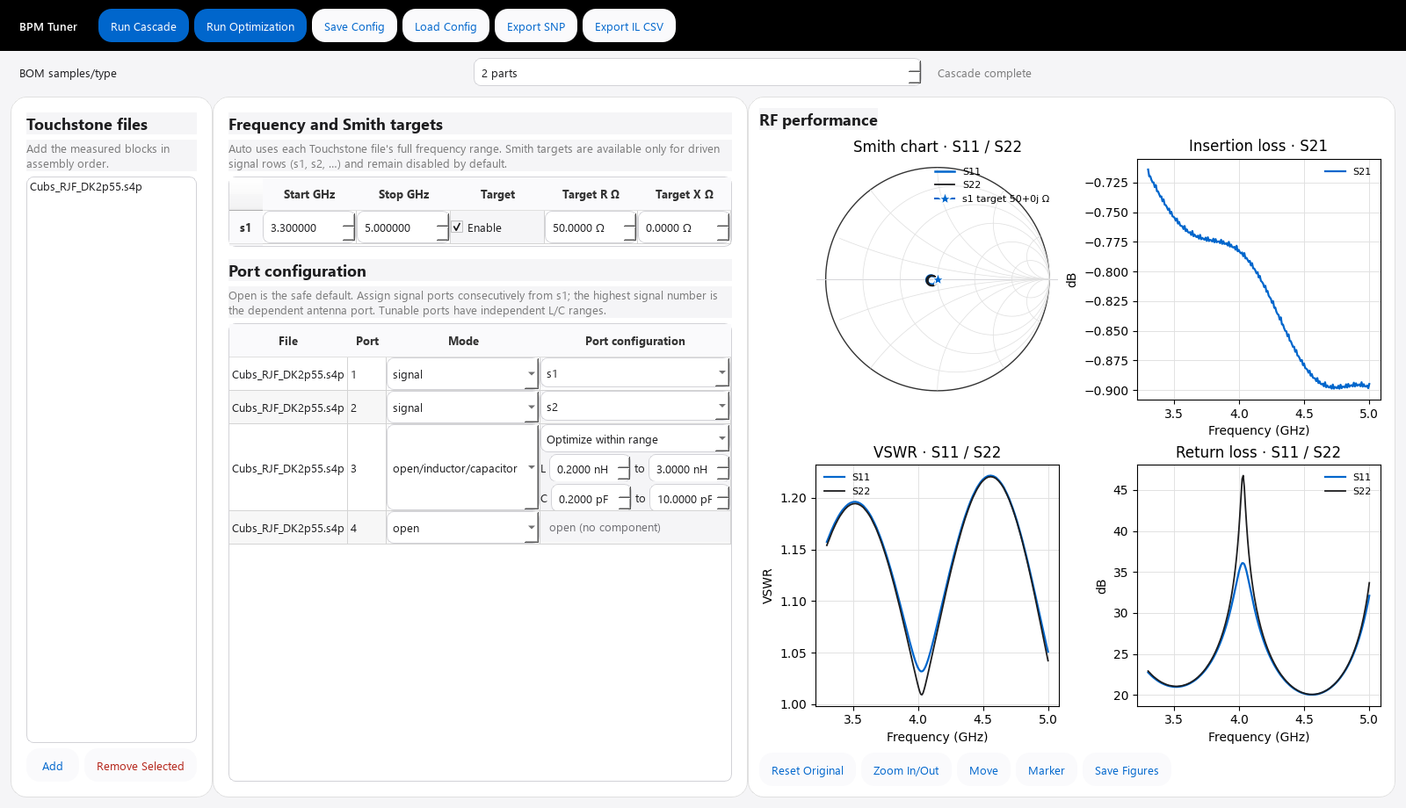
USER GUIDE
Real BPM
Tuning Tool
Configure multiport Touchstone networks, evaluate RF performance, and select measured BOM parts with production-aware optimization.
Python / PyQt interface • Rust exhaustive sweep
Example cascade view using a non-confidential demo file
Real BPM Tuning Tool • User guide
1

Slide 2
The six-step workflow
Use Cascade to validate the configured circuit before committing time to Optimization.
1
2
3
4
5
6
Add
Configure
Set
Cascade
Optimize
Export
Touchstone files
every active port
bands and targets
check the circuit
compare five strategies
config, SNP, CSV, plots
Fast feedback: Run Cascade after any connection, frequency, or component change. Export buttons become available only after a successful result.
Real BPM Tuning Tool • User guide
2

Slide 3
Launch the tool and keep its measured BOM beside it
The Windows EXE needs no Python or Rust installation on the target PC.
DEPLOYED EXE
DEVELOPER
Double-click BPMTuningTool.exe
Launch from PowerShell
dist\ BPMTuningTool.exe Capacitors_BOM\ Inductors_BOM\
bpm-tuner --gui
● Start in the project root.
● For a first optimization, set BOM samples/type to 2.
Keep both BOM folder names unchanged and move all three items together.
Build the deployable EXE with .\build_one_exe.bat
Real BPM Tuning Tool • User guide
3

Slide 4
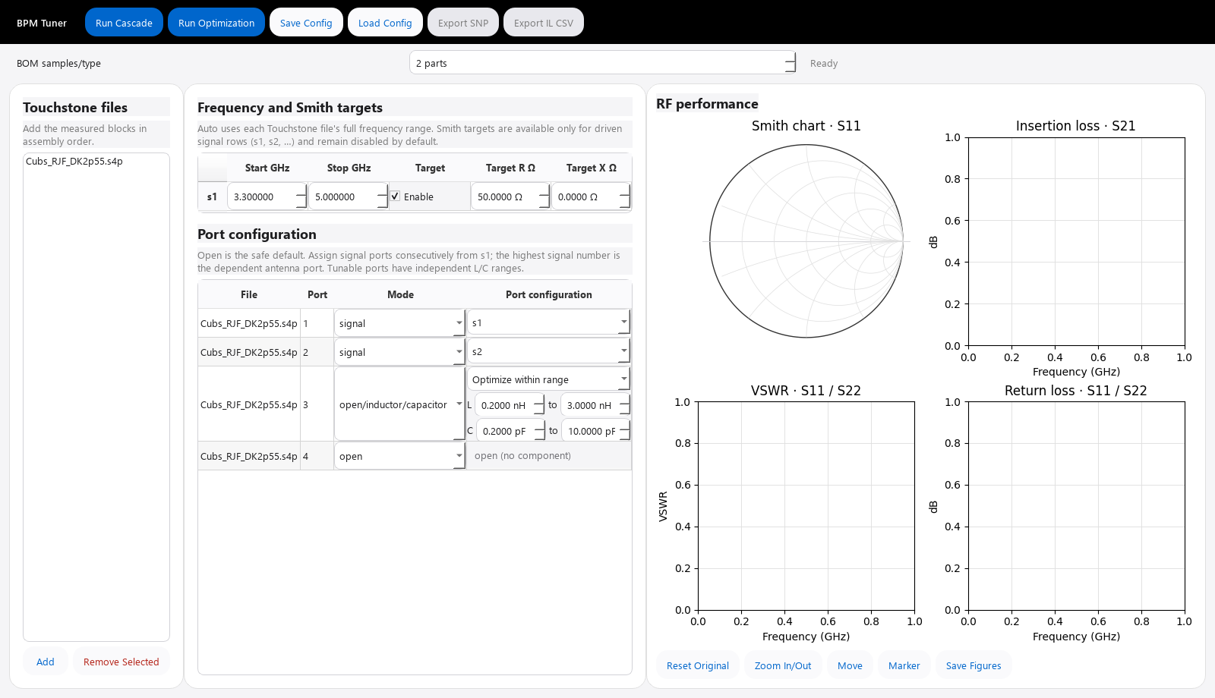
Interface tour
Work left to right: source files → port and target settings → RF plots.
4
1
2
3
1 Files
2 Configuration
3 Plots
4 Toolbar
Add or remove .sNp networks.
Assign modes, signals, bands, targets, and ranges.
Smith, S21, VSWR, and return loss.
Run, save/load, and export.
Real BPM Tuning Tool • User guide
4

Slide 5
Configure every active port
The selected Mode controls what appears in the Port configuration column.
signal
External driven/dependent port
connect
Reciprocal link to another file/port
open / short
Unused port or 0 Ω termination
inductor / capacitor
Measured part or optimized range
inductor/capacitor
Search both measured catalogs
open/inductor/capacitor
True open baseline + both catalogs
Preflight rules
Connections must be reciprocal. • Signals must be unique and consecutive from s1; use 2–4 total. • The highest-numbered signal is the dependent antenna/common port. • A file not used yet may remain loaded only when all of its ports are open.
Real BPM Tuning Tool • User guide
5

Slide 6
Set frequency bands and optional Smith targets
Only driven signals appear in the compact target table; the dependent final signal is intentionally hidden.
Signal
Start GHz
Stop GHz
Target
Target R Ω
Target X Ω
s1
3.3
5.0
☑ Enable
50.0000
0.0000
Frequency
Smith target
● Auto uses the full Touchstone overlap.
● Enter both limits or leave both Auto.
● Start must be lower than Stop.
● Disabled by default.
● Enter physical R + jX in ohms.
● 50 + j0 Ω is the 50 Ω Smith-chart center.
Tip: set different bands and targets for s1, s2, and s3 when they are driven ports; never assign an independent target to the dependent final signal.
Real BPM Tuning Tool • User guide
6

Slide 7
Control BOM coverage without exploding the search
BOM samples/type is global; each tunable port may have its own inclusive L and C range.
Choices per tunable port
Safe first run
inductor
N
Set BOM samples/type to 2
capacitor
N
Example: three flexible open/L/C ports
inductor/capacitor
2N
(2×2 + 1)³ = 5³ = 125
open/inductor/capacitor
2N + 1
Increase N only after the topology and bands are correct. The GUI warns above 100,000,000 combinations or an estimated 10-minute native sweep.
Total combinations = product of the choices at every tunable port
Real BPM Tuning Tool • User guide
7

Slide 8
Run Cascade first, then read all four views
A successful cascade enables SNP and insertion-loss CSV export.
1
Smith chart
S11/S22 location, contour, and target proximity
2
S21
Insertion loss versus frequency
3
VSWR
Mismatch severity; lower is better
4
Return loss
Reflection magnitude in dB; higher is better
Marker mode: click a trace to synchronize the readout across plots.
Real BPM Tuning Tool • User guide
8

Slide 9
Run Optimization to compare five engineering priorities
Rust evaluates the full sampled Cartesian sweep; every strategy selects from the same candidate set.
1
2
3
4
5
minimum bom
balanced
minimum target
smith contour
minimum insertion loss
Fewer selected components
Balanced RF and production metrics
Lowest Smith-target error
Compact impedance contour
Lowest worst S21 loss
While it runs
● Watch progress and status.
● Cancel if the search is too large.
When complete, the Principal Engineer selects the lowest normalized production-risk score.
Each winner is re-evaluated with independent 1.00 / 0.95 / 1.05 component-value factors before risk scoring.
Real BPM Tuning Tool • User guide
9

Slide 10
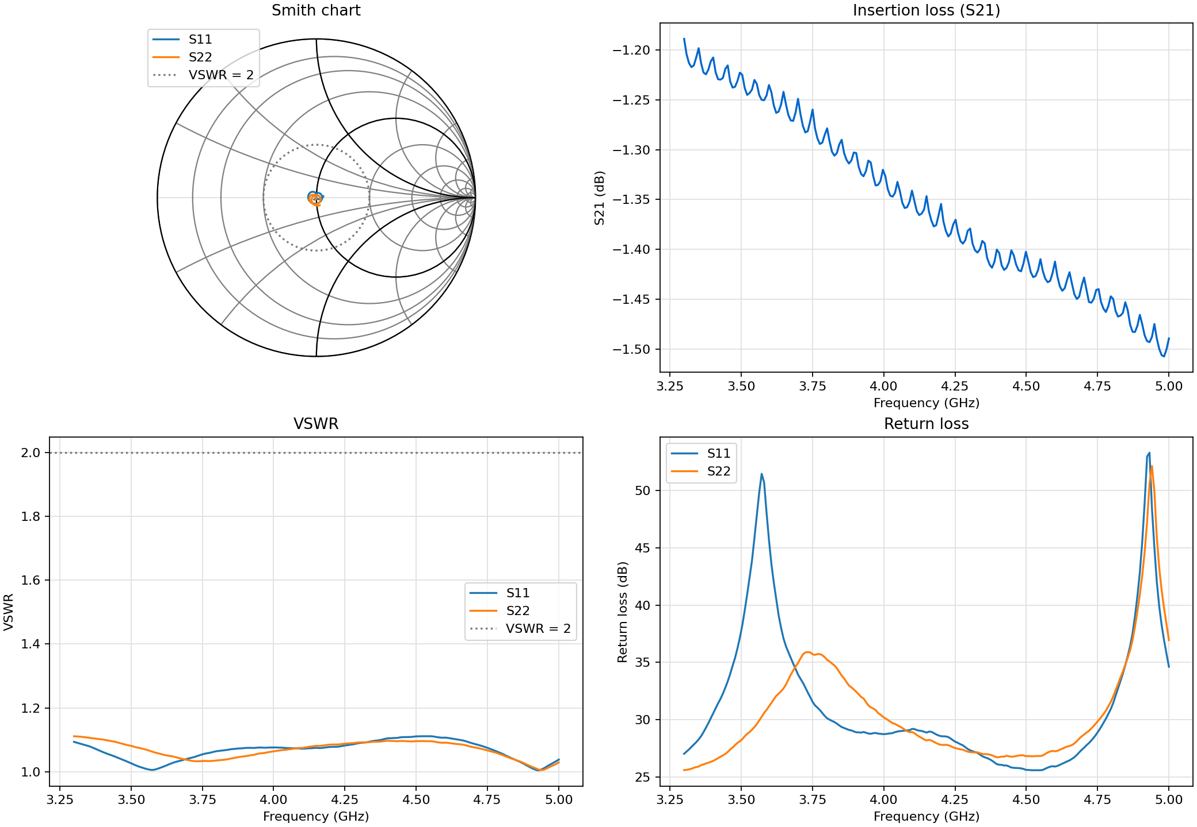
Review the fleet winner—and the trade-offs
Example output from a repo-local optimization run; values will differ with your circuit and settings.
Check these metrics
● VSWR S11 / S22
● Worst insertion loss
● Target error
● Component count
● ±5% sensitivity and risk
Production caveat
The ±5% study is an electrical sensitivity proxy—not measured yield, vendor tolerance, or process capability. Validate PCB, fixture, temperature, bias, and production variation before release.
Real BPM Tuning Tool • User guide
10

Slide 11
Save, share, and export
Save the project configuration separately from RF results so another user can reproduce the setup.
JSON
Save Config
JSON
Load Config
Store files, port modes, targets, and per-port L/C ranges.
Restore the configuration; confirm paths resolve on the new PC.
.sNp
Export SNP
.csv
Export IL CSV
Write the current cascaded or optimized Touchstone network.
Write the current insertion-loss trace for analysis or reporting.
Optimization result folder
Fleet_results_YYYYMMDD_HHMMSS → five agent JSON files + five PNGs + agent_comparison.png + final_decision.png + report.md
Real BPM Tuning Tool • User guide
11

Slide 12
Preflight checklist and common warnings
Most failures are actionable configuration issues; fix the named file and port, then run Cascade again.
!
No files
Add at least one valid .sNp file; two or more are typical for a cascade.
!
Connection target missing
Choose a destination and make the reverse port point back.
!
Signal assignment invalid
Use unique, consecutive names from s1 with 2–4 total signals.
!
Frequency range invalid
Enter both limits, keep Start < Stop, and stay inside the common data range.
!
Component range invalid
Use positive Min ≤ Max and include at least one measured BOM part.
!
Search too large
Reduce BOM samples/type or reduce the number of tunable ports.
Ready to optimize when Cascade succeeds, the plotted band is correct, targets are intentional, and the estimated search size is acceptable.
Real BPM Tuning Tool • User guide
12

