Slide 1
Predicting customer churn with Python
by Diego Trazzi

Slide 2
Today we’ll talk about:
Customer Churn
Analysis of large demo-dataset (telecom) using Python
A scientific approach to determine churn metrics
Machine learning algorithms to forecast churn
Not covered in this presentation:
Step-by-step analysis of machine learning algorithms
Deep AI
Strategies to reduce ‘churn’ once isolated

Slide 3
What is ‘churn’, and why we want to predicting it with Python?
What is customer churn ? Customer churn is when a company’s customers stop doing business with that company.
Why is churn important to Customer Success ? Customer relationship maximize customer retention, minimize customer churn and maximize customer lifetime value. If you think of farming your customers rather than hunting them, then what you know about farming takes on new meaning. Customer Success is about treating your customers like trees, nurturing them until they begin to yield a harvest, and then husbanding them for as many seasons as possible.
Why do we do this with Python ? The challenge in doing this is focus and prioritization. CS need to track customer status, health and various other key metrics to plan and execute an optimal plan to maximizes customer lifetime value across the entire portfolio of customers. Python enables CS to predict churn, identifying which “trees” need attention. If the goal is to make sure to maximize the value of the grove, Python allows CS to adopt a scientific approach to the challenge and utilize Big Data and Machine Learning to model prediction equations otherwise too complicated for a human to compute.

Slide 4
Leveraging on Digitization and Big Data
A big advantage of the digitization of products, especially SaaS vendors, is to provide insights of customers and offer an opportunity for a systematic approach to generate metrics and prediction from Big Data. These models can be used to improve the Customer Lifetime Value (CLV) and reduce churn.
Let’s take a look at an example dataset form a Telecommunication company…

Slide 5
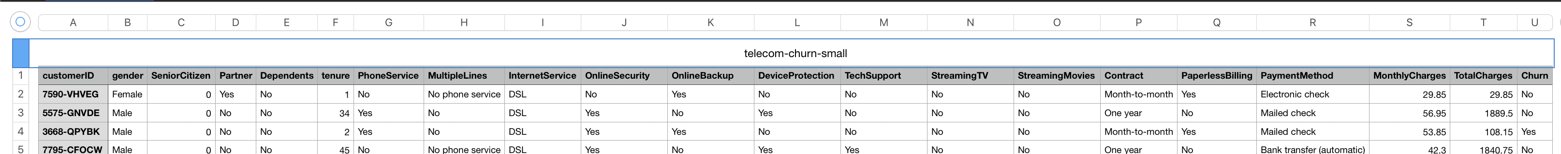
What does the data look like?
Each row gives details for more than 7,000 clients!
This dataset has 16 categorical features:
Six binary features (Yes/No)
Nine features with three unique values each (categories)
One feature with four unique values
The target for prediction is the ‘Churn’ column, indicating whether or not the customer cancelled their service.
To better represent the relationship amongst these feature we are going to build a visualization toolset with Pandas…

Slide 6
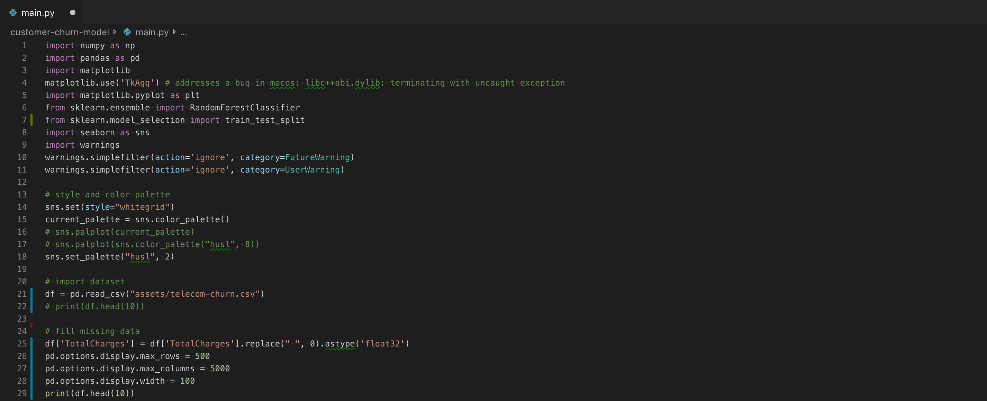
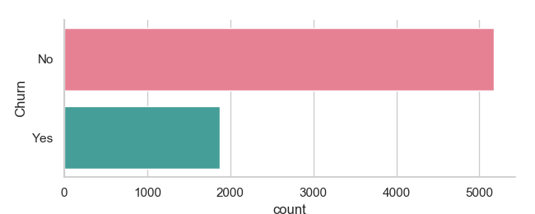
Python: data preparation with pandas
Pandas is an open source python library that is built on top of NumPy. It allows you do fast analysis as well as data cleaning and preparation. An easy way to think of Pandas is by simply looking at it as Python’s version of Microsoft’s Excel.
We want to track customer status and various other key metrics that are related in order to plan and execute an optimal plan that maximizes customer lifetime value across the entire portfolio of customers.

Slide 7
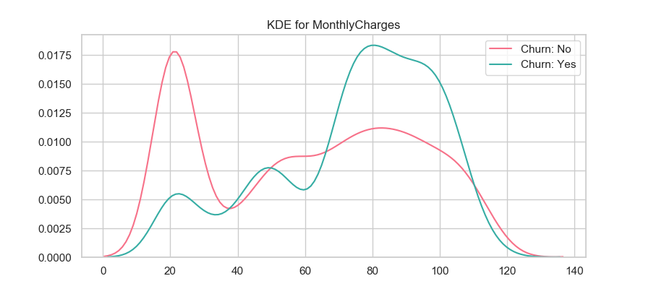
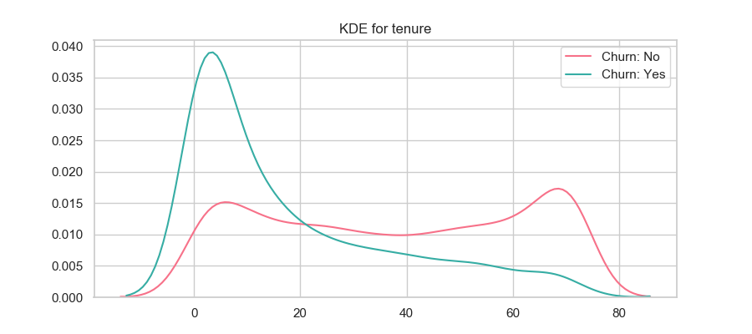
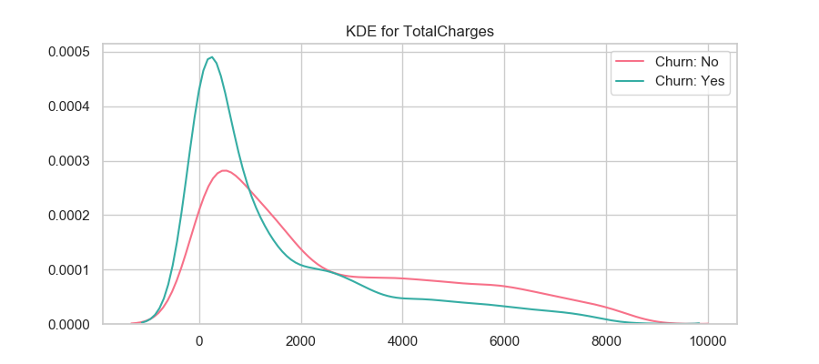
Numerical features
There are three numerical columns: tenure, monthly charges and total charges.
The probability density distribution can be estimated using display a KDE plot.
From the results we can observe that ‘churn’ is higher for those customers with small tenure, hight monthly charges and little total charges.

Slide 8
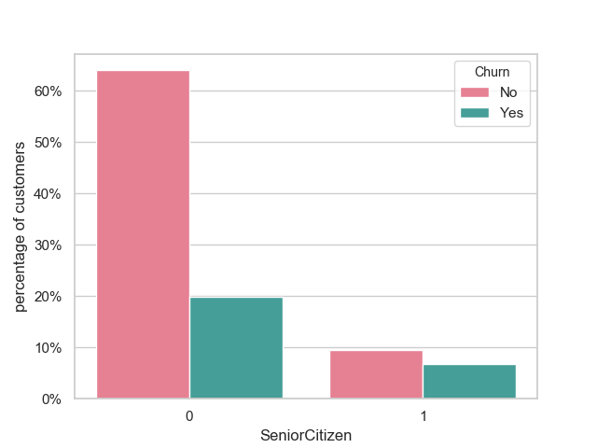
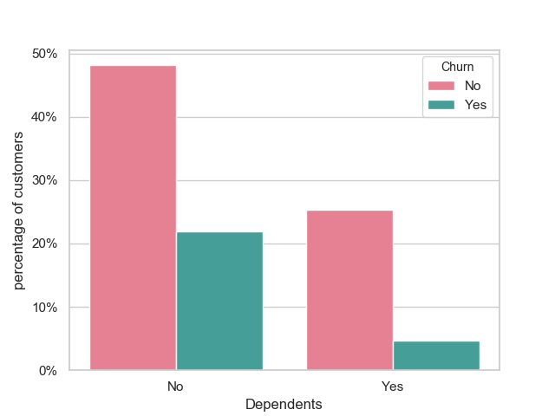
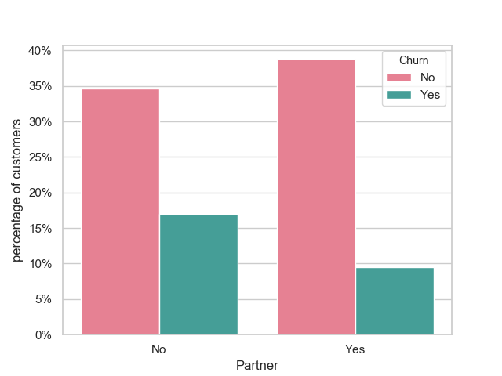
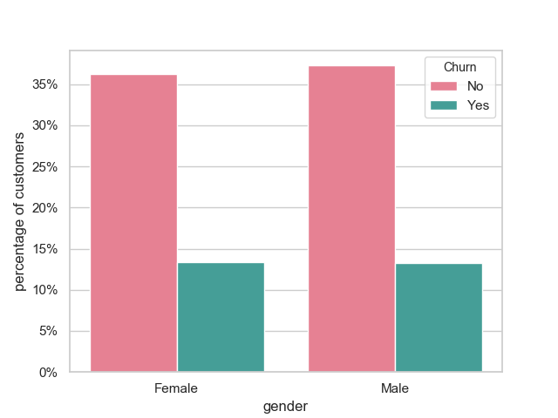
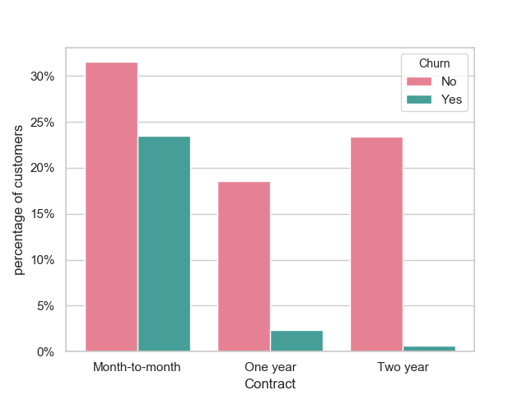
Categorical features
This dataset has 16 categorical features:
Six binary features (Yes/No)
Nine features with three unique values each (categories)
One feature with four unique values
From the bar-plot charts we observe that: gender is not an indicative of churn, whereas customers who don't have a partner are more likely to churn.
Also, customers without dependents are also more likely to churn.
Moreover, clients without yearly subscriptions are more likely to churn.

Slide 9

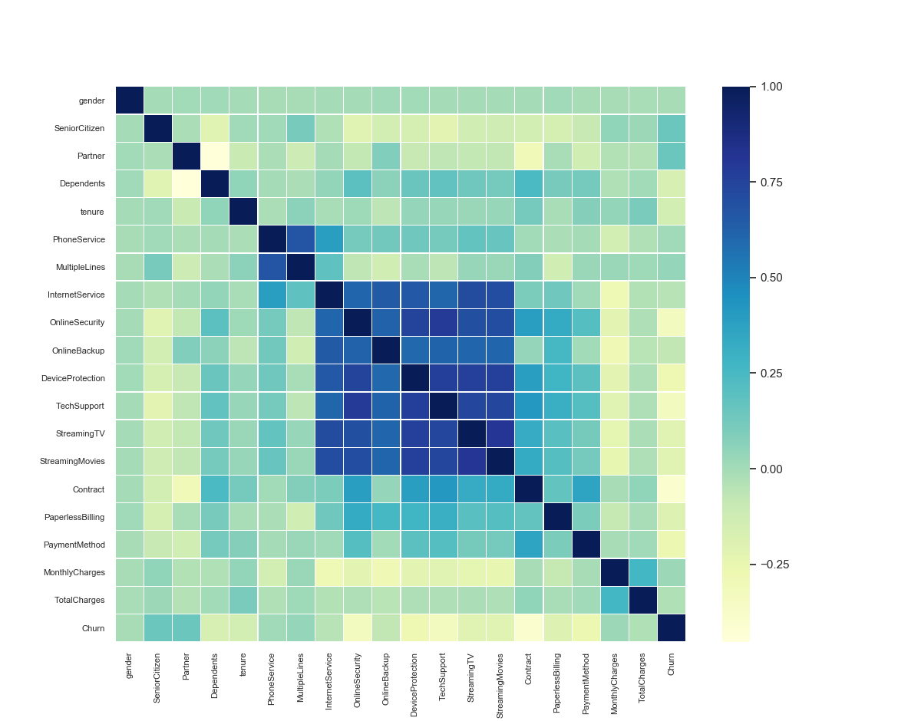
Correlation between features
Finally, to decide which features of the data to include in our machine-learning model, we’ll examine the correlation between churn and each customer feature.
We use a correlation heatmap, also known as Pearson method.
Although a heat-map helps us to identify key features, is too difficult for a human to determine an equation to describe the relationships. Instead, we can utilize a machine learning algorithm to model the solution. We’ll use Random Forest…

Slide 10
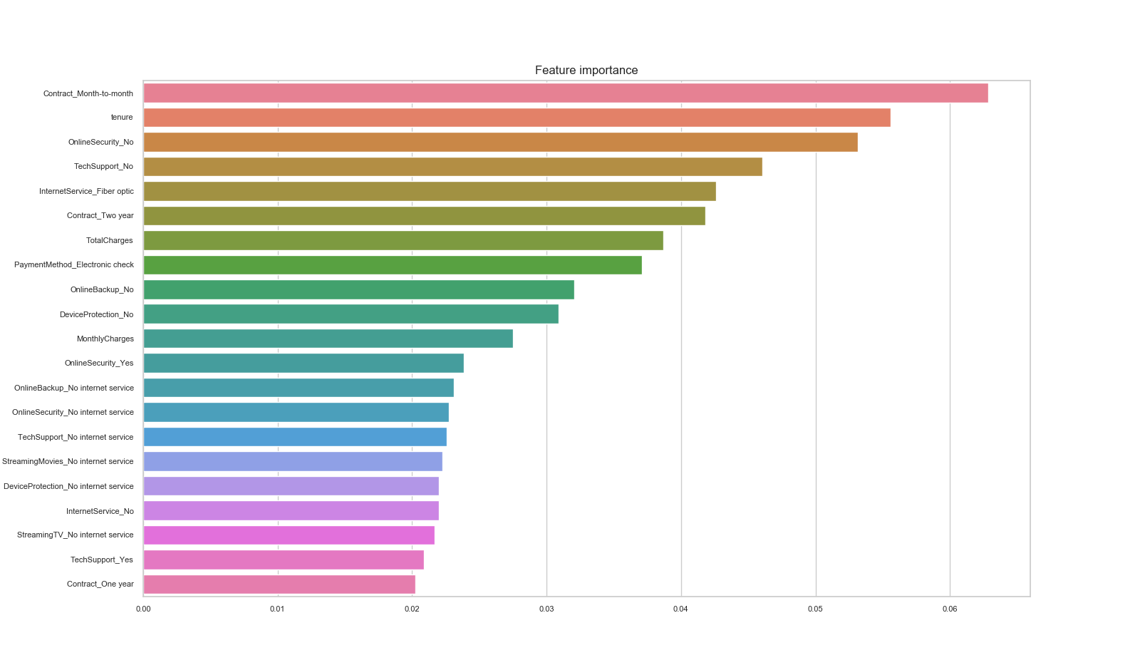
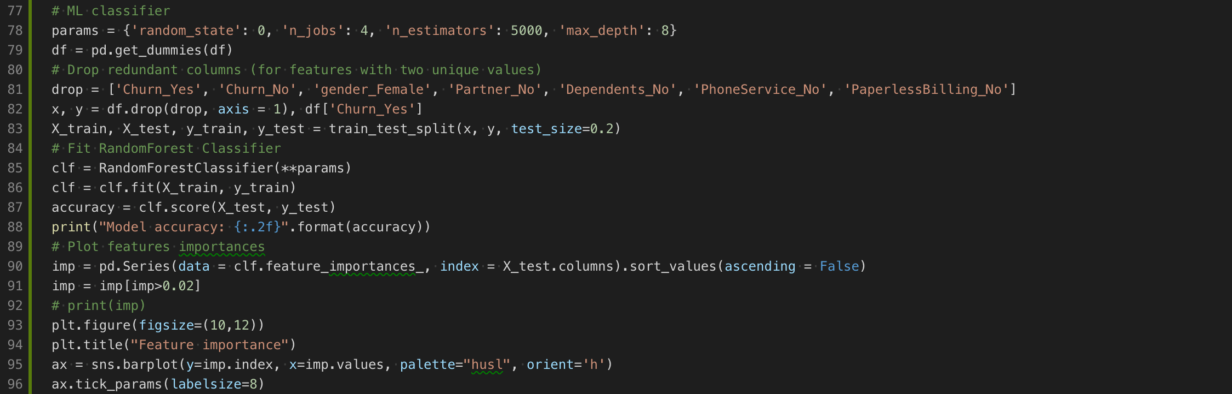
Machine Learning and Feature Importance
Random Forest is a machine-learning classifier, based on a decision-tree model.
The importances represent the weights of each feature on the final prediction.
Random forests are an ensemble learning method, where the results from multiple decision trees are combined to make a final prediction.
In order to measure the accuracy of the algorithm, we splitting the dataset into 2 subsets, a train subset and a test subset. Once the model is trained on the train-set we can then measure its precision by running it on the test set and comparing the result.

Slide 11
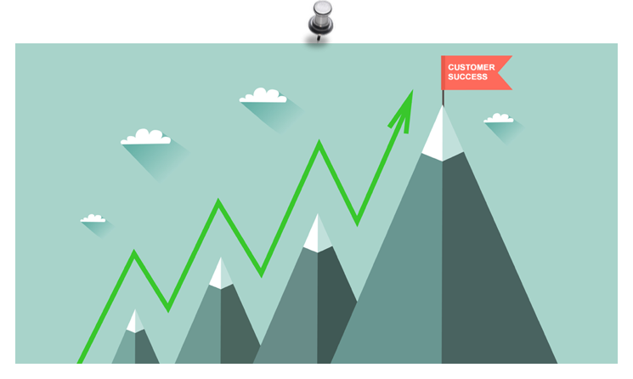
Conclusion: what’s next?
Using Python we established a graphical and scientific representation of a large dataset to visually identify key features
We then trained a machine-learning solution to determined the weight (influence) of each one of the 16 feature
Finally, we created a prediction model to identify customers who are more likely to ‘churn’.
In conclusion, we have created a set of metrics to determine where a “farmer” should focus his/her efforts.
“About early birds” … In many cases the renewal decision happens long before the renewal date. After all being a farmer is about cultivating your crop throughout the entire season.

Slide 12
Full CODE source
https://github.com/d1Ng0/customer-churn-model.git

