Slide 1

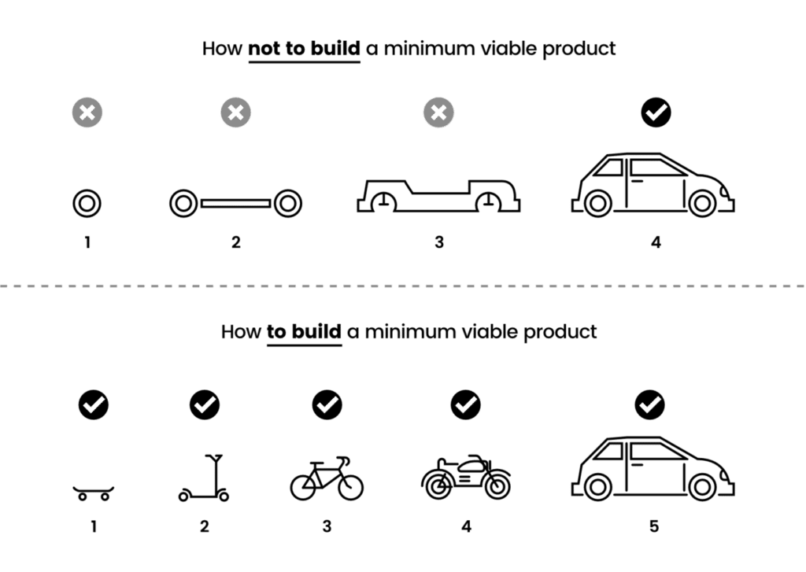
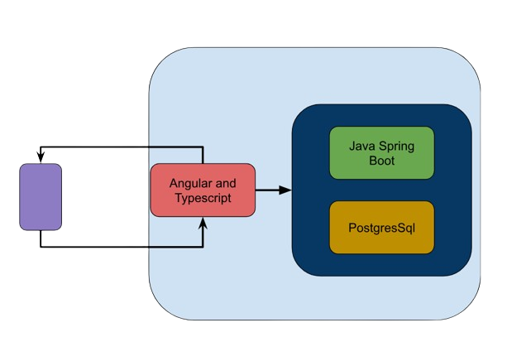
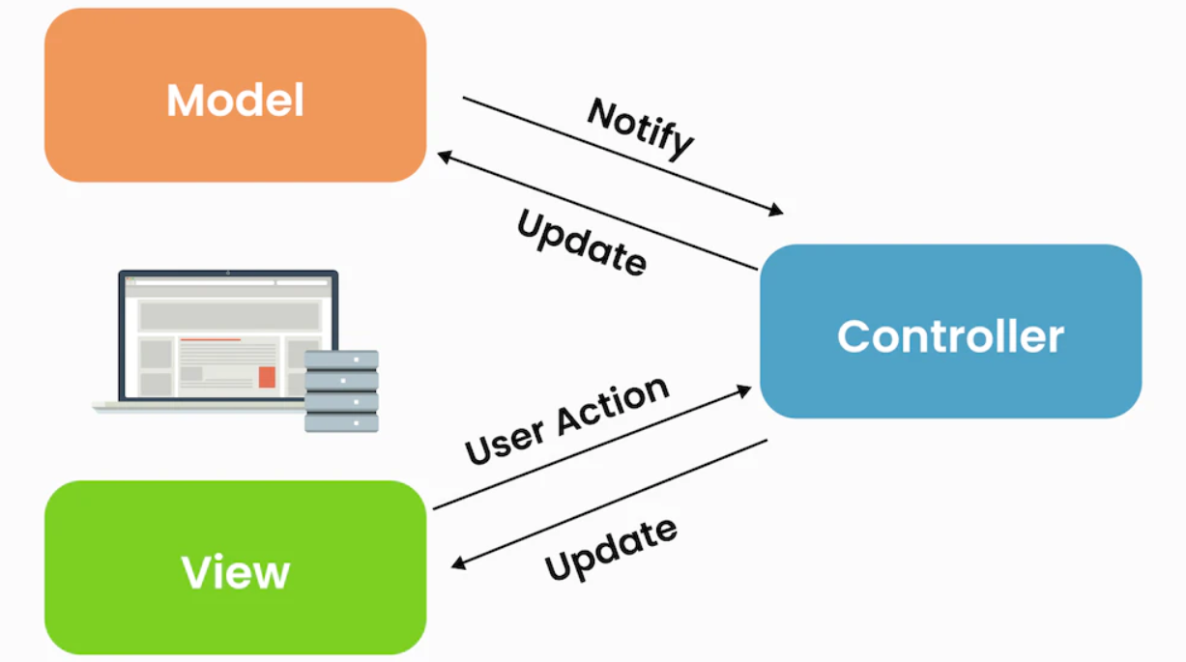

Secret Social Media 🤫
Brian Dell, David Tang, Jack Smolenski & Spencer Caramanna
Front End Design
About Us
Agile Software Dev. Process
Working with frameworks like Angular, Typescript, and Bulma allowed for us to make significant progress on the front end of our application. Using these frameworks along with the progress made with the previous year team, and with the assistance of TWC, the front end was developed enough for the application to enter the phase of deployment.
We are working for a private client tasked to develop a revolutionary social media platform! We have all signed a Non-Disclosure Agreement.
An iterative development process, where cycles of work are short term. The process is defined by Design, Develop, Test, Deploy, Review. Vertical slicing is an approach where stories are broken down into understandable, and deliverable increments.
Back End Design
Tech Stack
AWS: This is a web service offered by Amazon to host our website.
Java Spring Boot: Framework which allowed for us as developers to set up our application in a simpler / cleaner process.
PostgreSQL: This was used to set up the database side of our website, which held our data for the users of the site.
API
The API is how to client-side communicates with the back-end
REST: Architectural pattern used to design api’s
Uses CRUD operations (Create, Read Update, Delete)
Scrum
Scrum is a flexible agile framework that breaks down software development into cycles called Sprints. There are three primary roles the Scrum Master, Product Owner, and Development Team. Our duties include, standups, sprint planning, retrospectives and more.
This setup not only adapts to changes seamlessly but also encourages continuous improvement through regular feedback loops. Scrum ensures that our team can tackle complex projects efficiently and deliver high-quality results consistently.
Scrum Master: Brian Dell
Product Owner: David Tang
Dev Team: Jack Smolenski, Spencer Caramanna
MVC
Model-View-Controller (MVC) is a commonly used software development architectural pattern we used while programming.
Front End:
Angular
Typescript
Bulma
Back End:
AWS
Java Spring boot
PostgreSQL
Troy Web Consulting
We started collaborating with TWC after a pivot on the project’s focus leading us to concentrate our efforts on specific aspects of WEL. With bi-monthly meetings, our efforts helped us achieve our goals

