Slide 1
BUSINESS TRANSFORMATION AI · AI SOLUTION BUILDER · CHAOS2COMMIT 2026
Compile
Turn business chaos into a blueprint you can build from.
Team Blueprint AI
Dhruv Bhoi – D26CE154
Jiya Sheth – D26CE174
Kush Parekh – D26CE148
Heet Doshi – D26CE169
Team Leader
System Logic & System Architect
AI Integration & UI/UX
Frontend & Backend
Technical Documentation
Mentor: Prof. Rikita Chokshi , CE, CSPIT, CHARUSAT.
CHARUSAT × Futurrizon Technologies
Notes:
Welcome. We are Team Blueprint AI, and this is Compile. Every enterprise project starts with the same bottleneck: turning a vague business need into something engineers can build. Compile automates that step. Quick intro of the team and our mentor, Prof. Rikita Chokshi, then straight into the problem and a live demo.

Slide 2



The Problem
Projects don't fail at coding. They stall in the gap before it.
The alignment gap
Architecture guesswork
Documents that go stale
Business teams speak in goals and ROI. Engineers need schemas, API contracts and non-functional requirements. Translating takes weeks of meetings.
Stacks and topologies get picked by habit, not analysis. Unclear scope boundaries turn into scope creep on day one.
Requirements live in three or more disconnected docs, diagrams and sheets that never stay in sync, and obsolete fast.
2–4 weeks to a first solution blueprint, across 3+ disconnected tools — before a single line of code.
Compile · Blueprint AI · Chaos2Commit 2026
2
Notes:
Every enterprise initiative starts with enthusiasm and immediate friction. Business teams describe goals; developers need database relations, API contracts and NFRs. Translating between them takes weeks of alignment meetings and produces static documents that are outdated almost immediately. (Verify the 2–4 weeks and 3+ tools figures before presenting, or say 'typically'.)

Slide 3





Compile: Idea in, Blueprint out
One conversation replaces weeks of discovery.
01
02
03
04
Intake
Discovery
Synthesis
Blueprint
A one-line problem, a document, or an industry template. Domain and scale are classified automatically.
An AI business analyst asks five targeted questions: stakeholders, compliance, integrations, budget, scale.
Parallel AI agents compile every deliverable at once, with live progress telemetry.
Six linked deliverables in one hub, ready to export to PDF, Word or JSON.
Consults, not just summarizes
One shared source of truth
Implementation-ready output
Compile · Blueprint AI · Chaos2Commit 2026
3
Notes:
This is the user journey. Stage 1: intake, from a sentence, a file or a template. Stage 2: the discovery chat, where Compile asks what a real business analyst would ask before writing anything. Stage 3: parallel synthesis compiles all deliverables together so they stay consistent. Stage 4: the blueprint hub, with one-click export. Note the three principles: it consults rather than summarizes, everything shares one source of truth, and the output is concrete enough to hand to engineers.

Slide 4
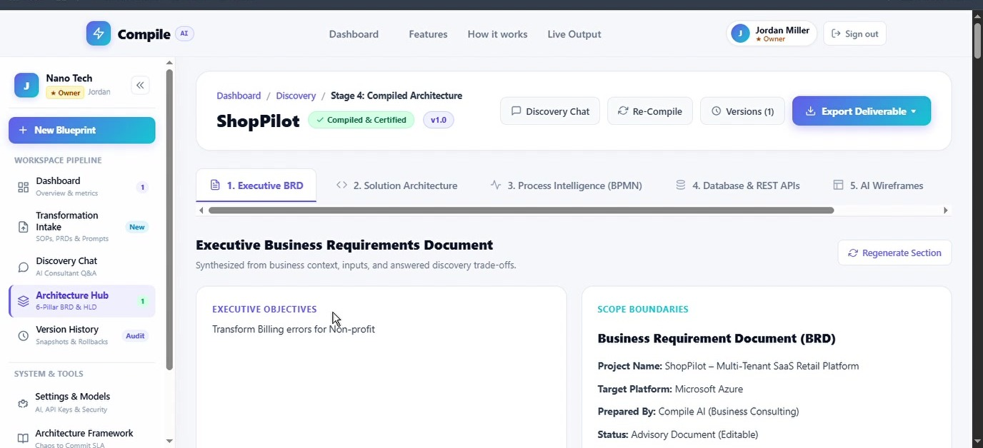
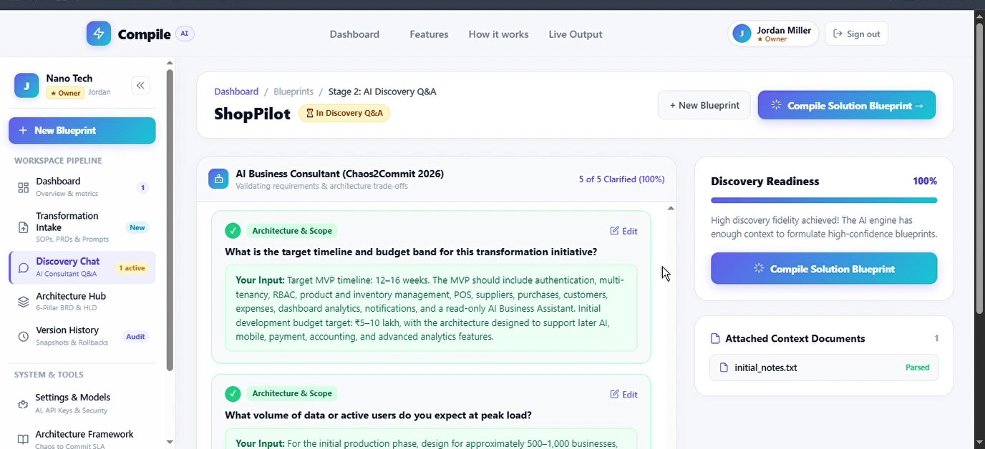
The Working Product
Real screens from the running app: a retail SaaS idea, compiled into a blueprint.
GitHub Link: https://github.com/dhruvbhoi2007-hub/BluePrint_AI
Blueprint hub: six tabbed deliverables
Discovery chat: 5 of 5 questions clarified
Demo case: ShopPilot, a multi-tenant SaaS app that helps small retail shops track sales and inventory. Five answers in, a build-ready blueprint out.
Compile · Blueprint AI · Chaos2Commit 2026
4
Notes:
Switch to the live demo here. Walk through: sign-in, the dashboard, and Transformation Intake for ShopPilot, a SaaS app for small retail shops. We paste the business context and attach a supporting document, then launch AI discovery. Compile comes back with five clarifying questions -- stakeholders, compliance, integrations, budget, expected load -- answered in chat until discovery readiness hits 100%. Compile then runs parallel multi-agent synthesis (sped up to about 18 seconds in the edit) and lands on the Architecture Hub. Walk the tabs: Executive BRD, Solution Architecture (note the structured fallback if the AI provider is unavailable, and Regenerate Section), Process Intelligence BPMN, Database and REST APIs, and Effort and Cost. Finish on Version History, saved as an immutable v1.0 snapshot. Keep a screen recording ready as a backup.

Slide 5





Six Deliverables, One Blueprint
From the boardroom BRD down to the database tables.
Executive BRD
Solution architecture
Process flow (BPMN)
Objectives, in/out of scope, and gap analysis with impact ratings.
Cloud topology, security model and tech stack matrix.
Step-by-step workflow, decision points and SLA escalations.
Database & REST APIs
UX wireframes
Effort & cost band
Normalized MySQL tables with keys and OpenAPI contracts.
Low-fidelity layouts that map the user hierarchy.
Three-tier budget estimates and phased sprint milestones.
Compile · Blueprint AI · Chaos2Commit 2026
5
Notes:
These are the six pillars generated for every project. Because they are compiled together, the BRD, the architecture, the schema and the cost bands stay consistent with each other. Developers can start scaffolding from the schema and API contracts immediately.

Slide 6
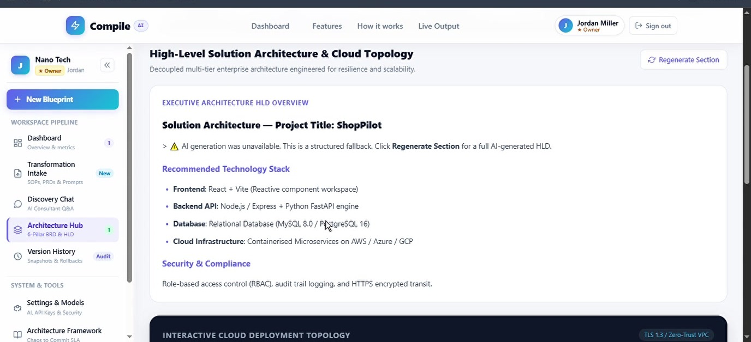
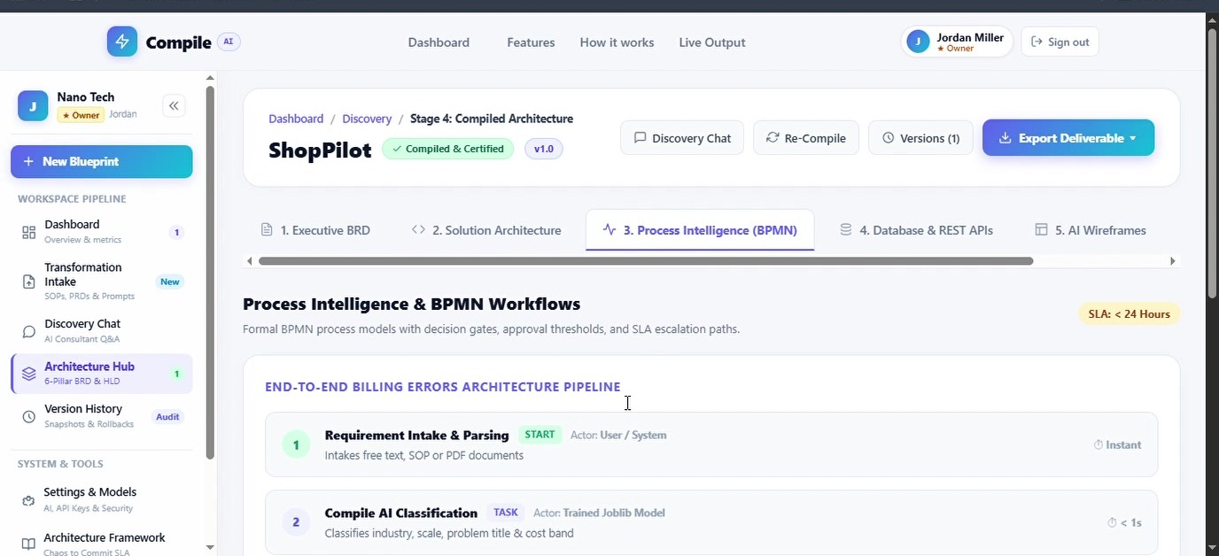
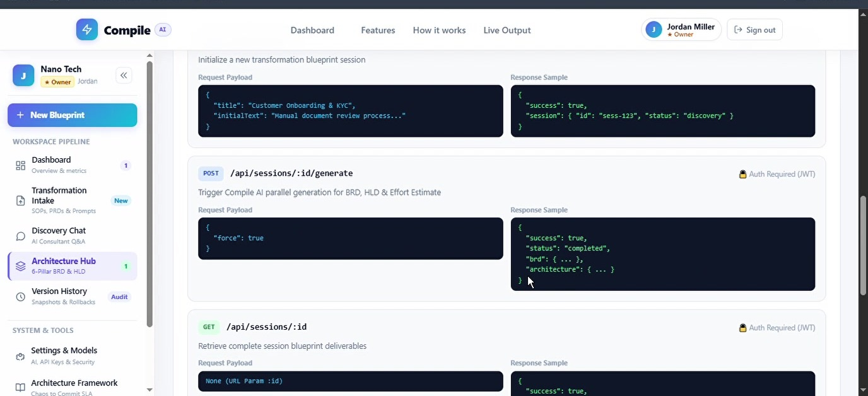
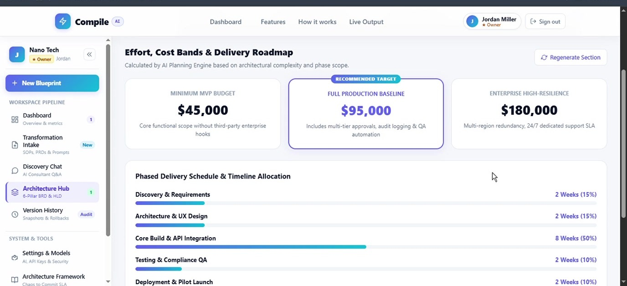
Inside the Blueprint
Every tab is generated from the same discovery answers.
1 Tech stack matrix
2 BPMN workflow with SLAs
3 REST API contracts
4 Phased delivery schedule
Compile · Blueprint AI · Chaos2Commit 2026
6
Notes:
Some real tabs from the hub. The stack matrix explains why each technology was chosen. The BPMN view shows workflow steps with actors, SLAs and escalation rules. The API tab gives developers the schema and endpoint contracts. The cost tab gives three budget tiers with a phased delivery schedule. All of it is derived from the same discovery answers, so the tabs agree with each other.

Slide 7




Under the Hood
Three decoupled tiers, so AI workloads never block the app.
React + Vite
Node.js + Express
Python FastAPI
Web client
API gateway
Compile AI engine
Workspace UI: intake, discovery, blueprint hub
Version history and compare view
PDF, Word and JSON export
JWT authentication, bcrypt-hashed passwords
MySQL 8.0: 13 tables, sessions and version snapshots
Bridge to the AI service
scikit-learn classifier: domain and budget
Gemini generation with OpenAI fallback
Dataset-grounded offline fallback
REST between client and gateway · HTTP/JSON between gateway and AI service
Compile · Blueprint AI · Chaos2Commit 2026
7
Notes:
Technically, Compile is three tiers. The React client talks to a Node and Express gateway that handles authentication and persistence in MySQL. The gateway offloads intelligence to a dedicated Python FastAPI service, so AI latency never blocks normal API traffic. That service pairs a custom scikit-learn classifier with Gemini for generation.

Slide 8
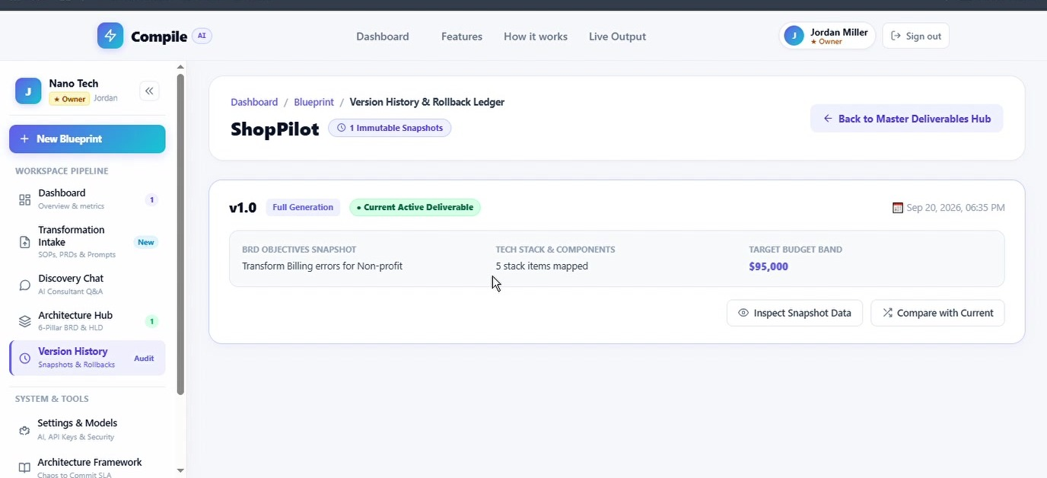
Built Like Software, Not a Chatbot
Version control and resilience are what make it usable in the real world.
Version ledger
Resilient AI engine
1
Classifier first
scikit-learn tags domain and budget before any LLM call
2
Primary model
Gemini generates each deliverable
3
Backup model
Automatic retry, then OpenAI as the fallback provider
Regenerate one section without touching the rest
Side-by-side compare against the live version
Rollback ledger of immutable snapshots
4
Offline fallback
Local dataset engine, so the user never sees a broken screen
Compile · Blueprint AI · Chaos2Commit 2026
8
Notes:
Two things set Compile apart from a basic LLM wrapper. First, architecture is iterative, so we treat it like source code: every generation is a versioned snapshot, you can regenerate a single section, diff two versions and roll back. Second, resilience: generative APIs hit load spikes, so we run a classifier first, retry with exponential backoff, fail over across models, and finally fall back to an offline dataset. Check that this matches what is actually implemented before presenting.

Slide 9



Business Model and Value
How it makes money
Business value
Subscription
Weeks → Minutes
Tiered by organization size, from small teams to consulting firms running discovery continuously.
From idea to first solution blueprint
Usage-based
6
Charged per blueprint or discovery session, scaling with delivered value.
Linked deliverables from one conversation
Enterprise license
1
White-label for firms like Futurrizon to speed up their own client discovery.
Shared source of truth for business and tech
Compile · Blueprint AI · Chaos2Commit 2026
9
Notes:
Monetization has three layers: subscriptions tiered by organization size, usage-based pricing per blueprint or discovery session, and white-label enterprise licences for consulting firms like Futurrizon. The value is speed and alignment: weeks to minutes, six deliverables from one conversation, and one shared source of truth. Replace 'Weeks to Minutes' with a measured number from your own demo runs if you have one.

Slide 10



From Documentation to Deployment
The blueprint becomes the starting point for building.
Shipped
Next
Later
Discovery chat and 6-pillar generation
Version history with snapshot compare
PDF, Word and JSON export
Team workspaces with sign-in and roles
Terraform and Kubernetes generation from the topology
Jira and GitHub sync: requirements become epics and stories
One-click provisioning to AWS, Azure and Google Cloud
Compile · Blueprint AI · Chaos2Commit 2026
10
Notes:
Today Compile turns requirements into a blueprint. Next, we close the loop into delivery: generate Terraform and Kubernetes manifests from the cloud topology, and push requirements into Jira and GitHub as epics and stories. Longer term, one-click provisioning to the major clouds. Adjust the 'Shipped' list to match exactly what is live.

Slide 11
The biggest unlock in enterprise AI isn't automating the build.
It's automating the thinking that happens
before anyone writes a line of code.
Thank You
Dhruv Bhoi – D26CE154
Jiya Sheth – D26CE174
Kush Parekh – D26CE148
Heet Doshi – D26CE169
Team Leader
System Logic & System Architect
AI Integration & UI/UX
Frontend & Backend
Technical Documentation
Mentor: Prof. Rikita Chokshi, CE, CSPIT, CHARUSAT
Team Blueprint AI · Compile · Chaos2Commit 2026
Notes:
Close on the idea: the real bottleneck in enterprise AI isn't writing code, it's the thinking before it. Compile automates that. Thank you to our mentor, Prof. Rikita Chokshi, for her guidance. We're happy to take questions or go deeper into the live demo.

