Slide 1

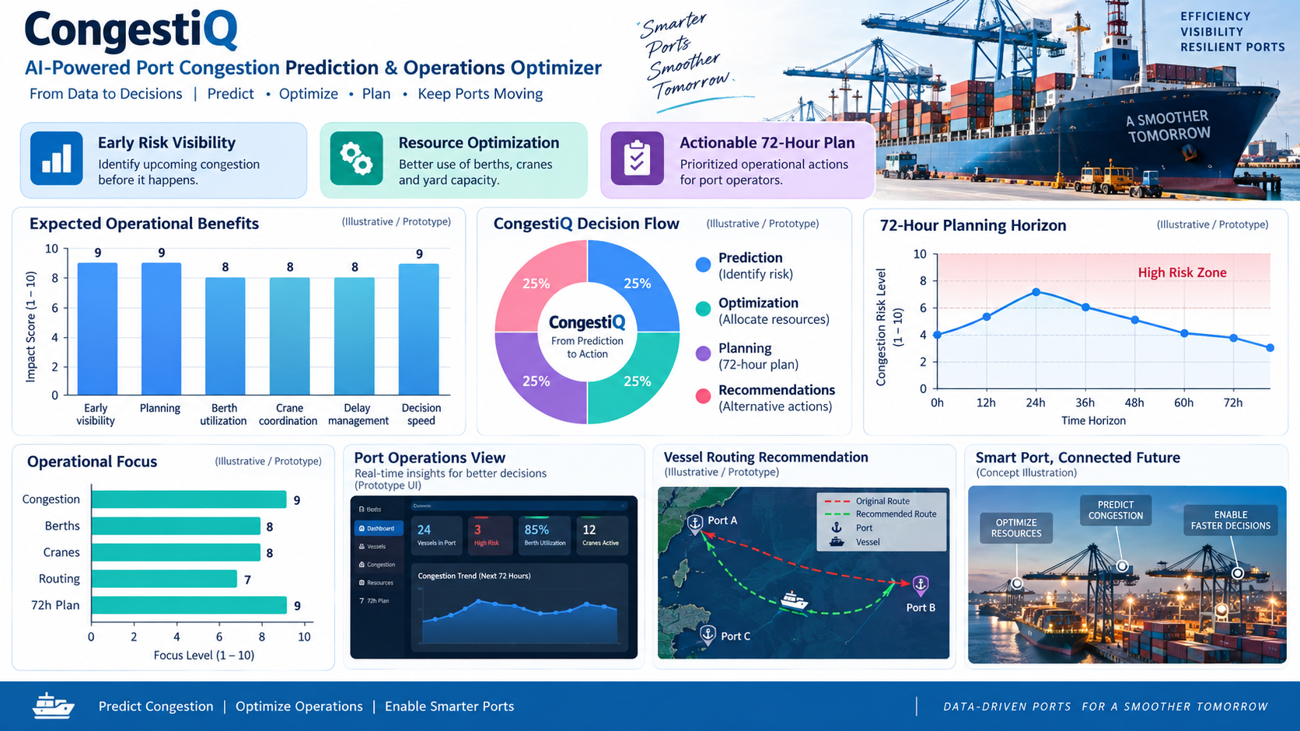
CongestiQ
AI-Powered Port Congestion Prediction & Operations Optimizer
IBM Bob AI Hackathon 2026
Predict congestion. Optimize operations. Keep cargo moving.

Slide 2

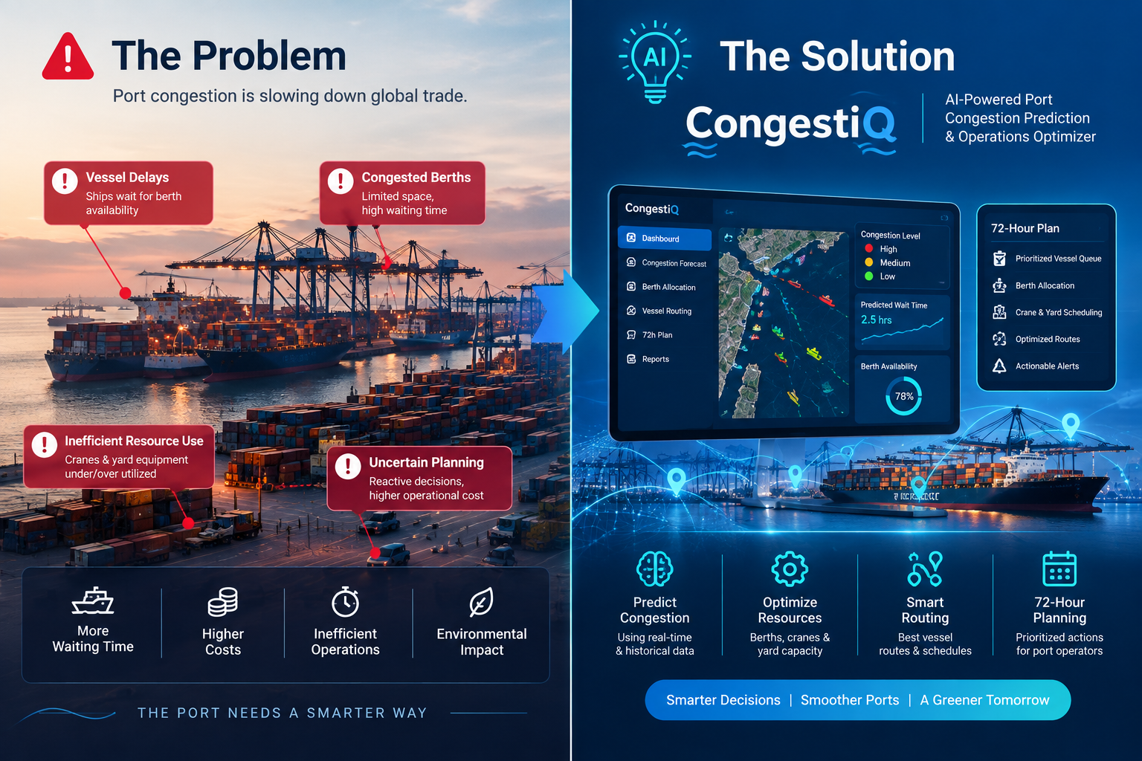
Problem
Port operators manage hundreds of vessels with limited berth and crane capacity.
Congestion is often identified only after vessel queues have already formed.
Manual allocation of berths, cranes, and yard space makes proactive planning difficult.
Delays can cause berth conflicts, inefficient resource utilization, and supply-chain disruption.
Alternative routing and operational decisions may come too late to reduce congestion effectively
Ports need a forward-looking system that predicts congestion and turns those predictions into actionable operational decisions.

Slide 3
Current Challenges
Unpredictable Port Congestion — Congestion can build rapidly and create long vessel queues.
Manual Resource Allocation — Berths, cranes, and yard space must be coordinated across many vessels.
Late Detection of Congestion — Operators may identify congestion only after queues have already formed.
Vessel Delays & Berth Conflicts — Poor coordination can increase waiting time and resource conflicts.
Difficult Alternative Routing — Late congestion detection makes alternative routing decisions harder.

Slide 4

Solution
Predict upcoming port congestion using vessel schedules and port capacity.
Identify high-risk vessels and congestion hotspots.
Optimize berth and crane assignments based on operational constraints.
Recommend alternative operational actions for high-risk vessels.
Plan a prioritized 72-hour operations plan for port supervisors.
Provide all insights through a single React dashboard.
CongestiQ transforms congestion prediction into proactive operational decision-making.

Slide 5
How it works
CongestiQ transforms vessel and port resource data into congestion predictions, operational optimization, and actionable 72-hour planning through a single integrated dashboard.
🚢 Vessel Schedules
⚓ Port Resources
↓
🧠 Congestion Prediction
↓
📊 Risk + Hotspots
↓
⚙️ Optimization
↓
📋 72-Hour Plan

Slide 6
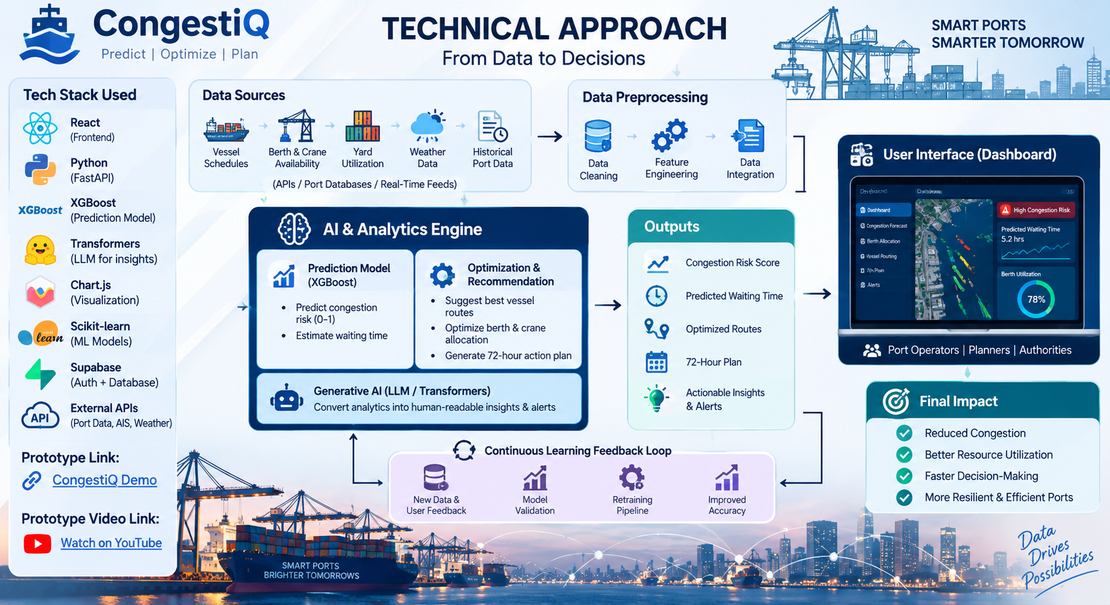
Technical Approach
Tech Stack Used
React + Vite
Python
FastAPI
SQLite / PostgreSQL
REST APIs
JavaScript
IBM Bob

Slide 7
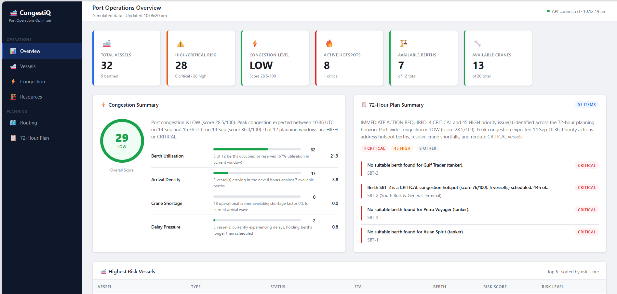
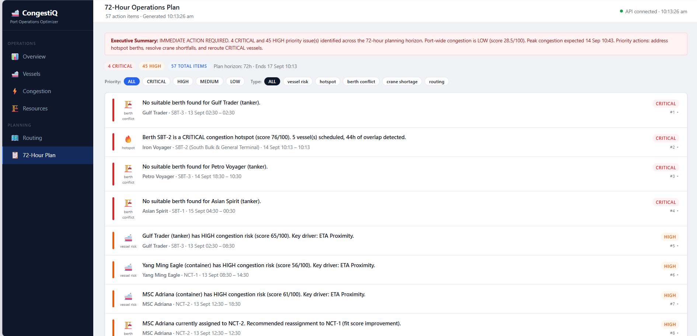
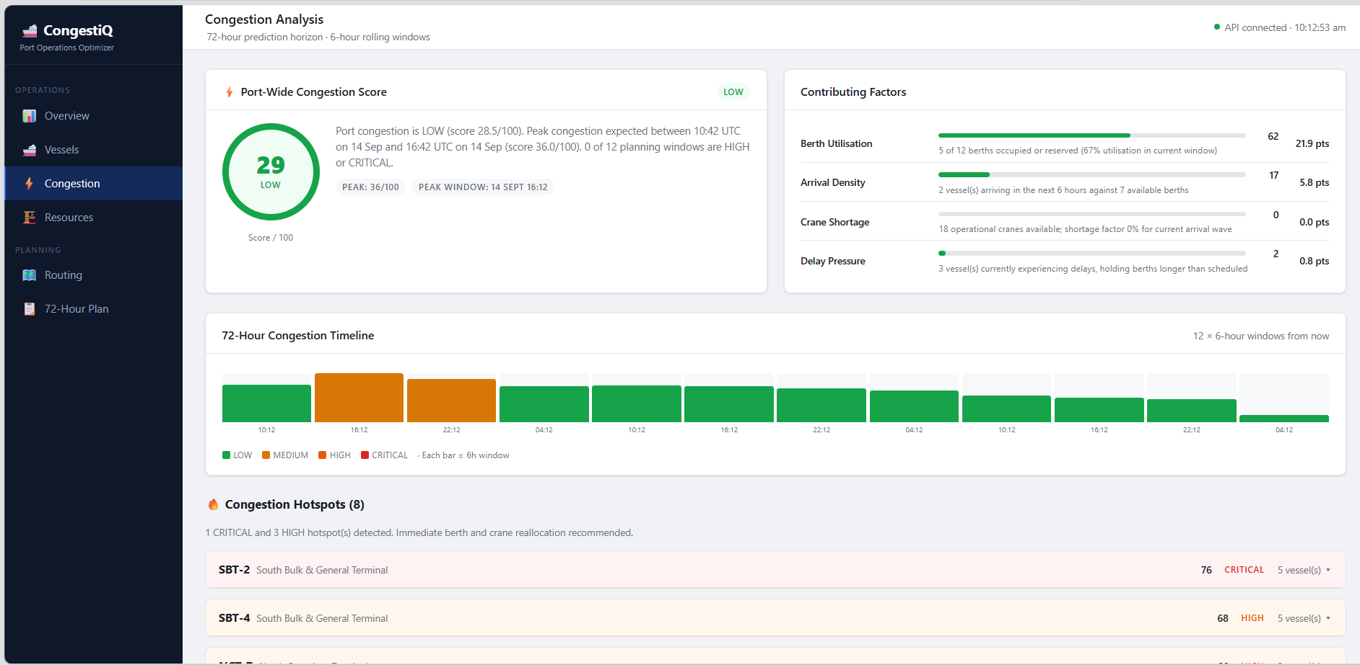
Live Application
Live Dashboard
Congestion Prediction
72-Hour Operations Plan

Slide 8
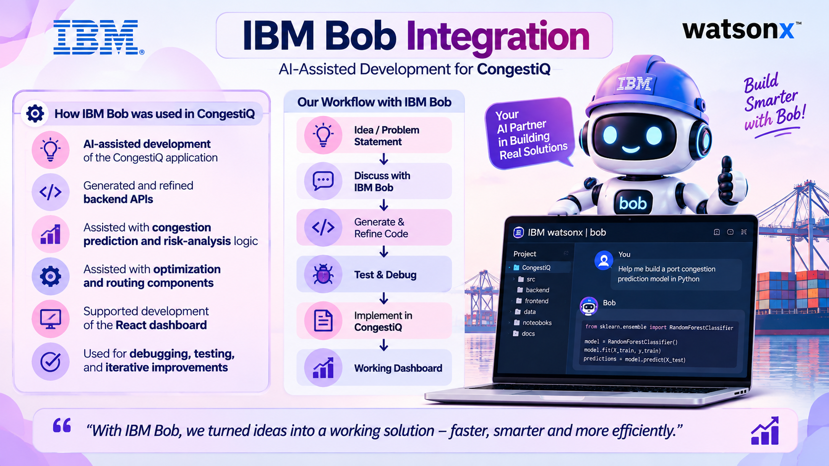
IBM Bob Integration
“With the help of IBM Bob, we turned our ideas into a working solution — faster, smarter, and more efficiently.”

Slide 9
Impact & Benefits
Expected Impact
Earlier identification of congestion risks
Better berth and crane utilization
Faster operational decision-making
Reduced vessel-delay risk
Clearer prioritization of near-term actions
Improved visibility into upcoming port congestion
Future Scope
Integrate live AIS and vessel schedule data
Connect to real-time berth and crane availability
Use historical port data for improved prediction
Add real-time operational alerts
Add authentication and role-based access
Extend to multi-port optimization

Slide 10
